Slide 1
PID
0:1440
Front
Sensor : RPLIDAR A3 laser scanner
Range for Right Edge Following
Sensor reading range : (250 – 290)
The constants to be set
Kp : 0.60 Ki : 0.20 Kd : 0.80
Additional stop condition ( To avoid accidental collision)
Sensor reading range : (0 – 80) + (1360 -1439)
0:80
1360:1439
1000:1160

Slide 2

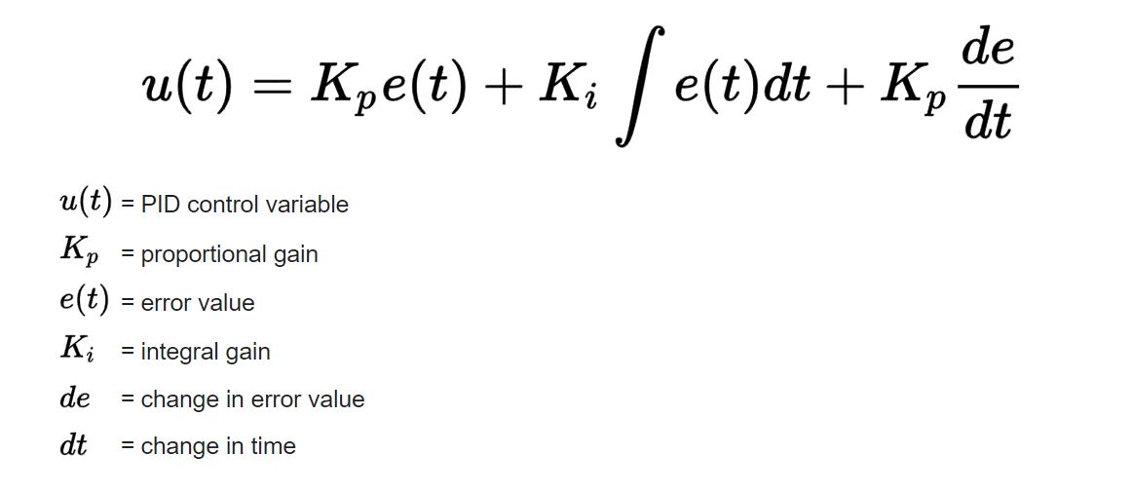

Slide 3
Fuzzy logic – Right edge following
RFS
1080:1360
Range for Right Edge Following
Right Front Sensor : 1080 - 1360
Right Back Sensor : 880 – 1079
Rising Edge :
Mf = b – x / b - a
Flat :
Mf = 1
Falling Edge :
Mf = x – a / b - a
RBS
880:1079

Slide 4
RULE BASE – RIGHT EDGE FOLLOWING
RFS | RBS | Linear X | Angular Z
Near | Near | Slow | Left
Near | Medium | Slow | Left
Near | Far | Slow | Left
Medium | Near | Slow | Left
Medium | Medium | Medium | Zero
Medium | Far | Slow | Right
Far | Near | Slow | Right
Far | Medium | Medium | Right
Far | Far | Fast | Right

Slide 5
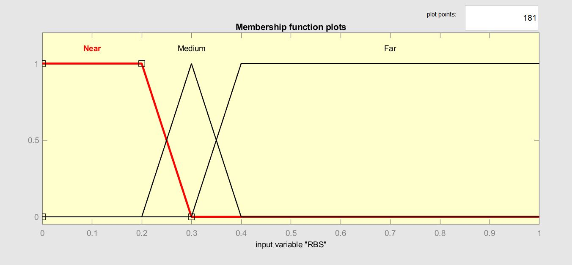
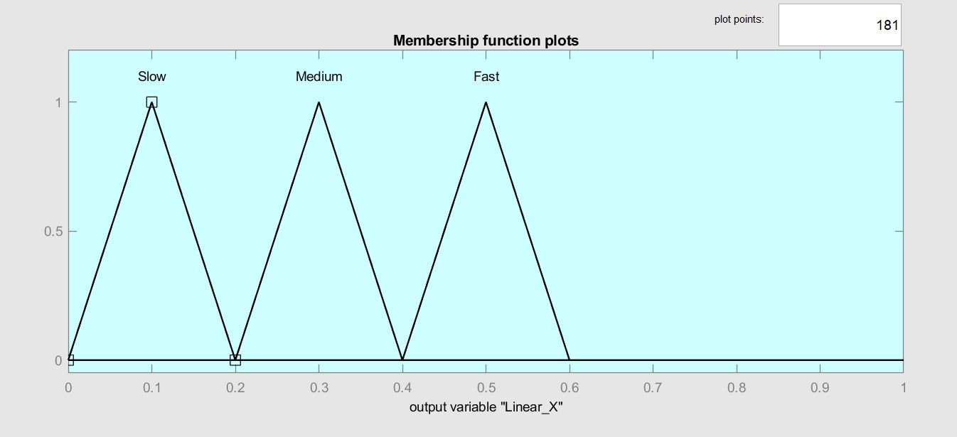
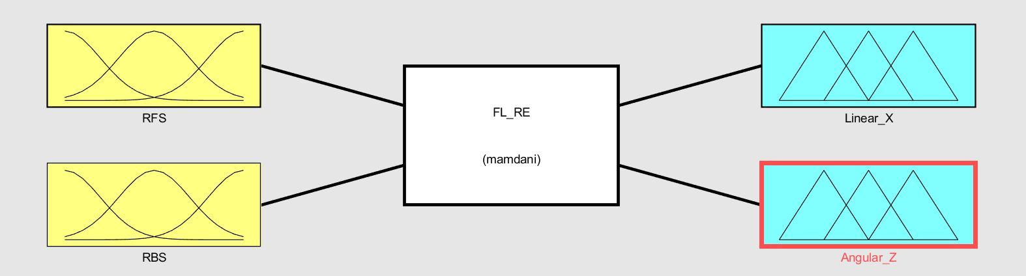
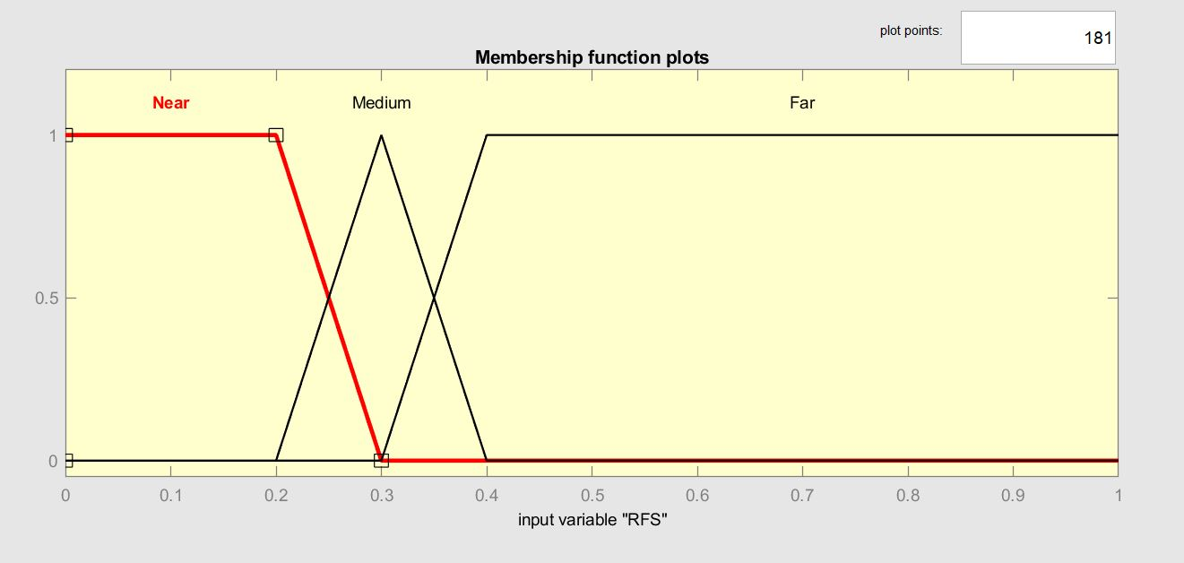
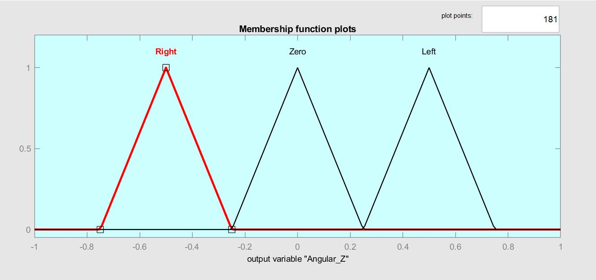
INPUT MEMBERSHIP FUNCTIONS
OUTPUT MEMBERSHIP FUNCTIONS

Slide 6
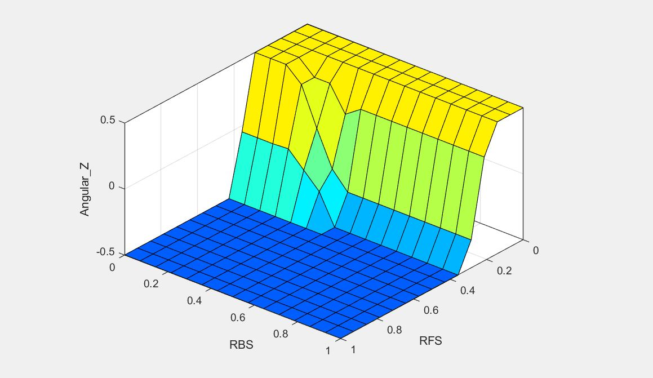
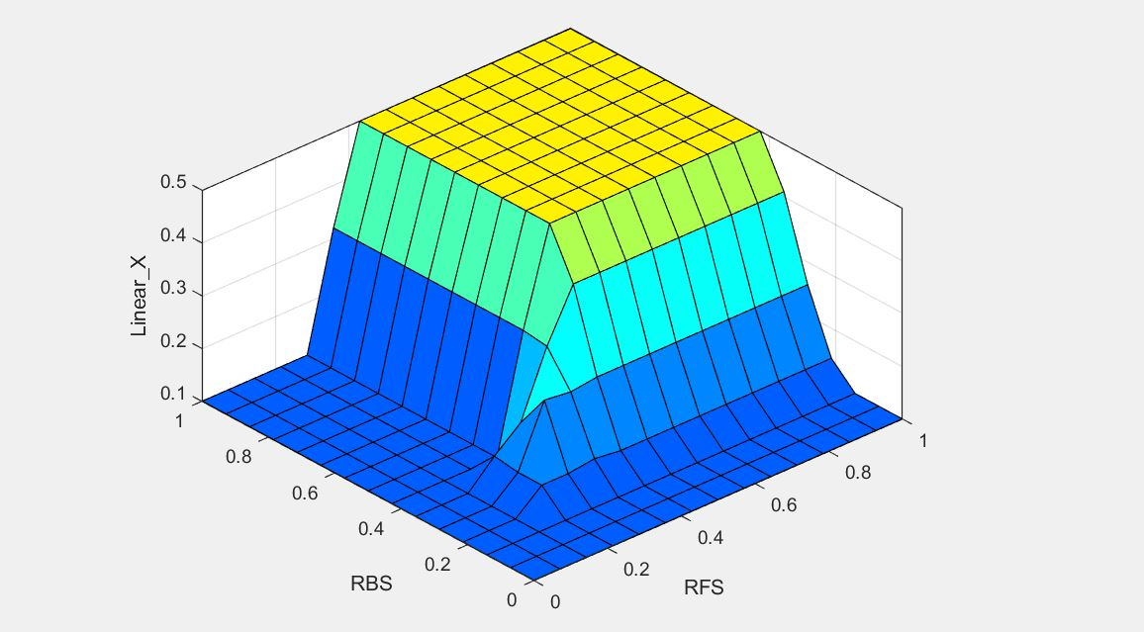
CONTROL SURFACE

Slide 7
Fuzzy logic – obstacle avoidance
FS
0:40
1400:1439
FLS
60:240
FRS
1200:1380
Range for Right Edge Following
Left Sensor : 60 – 240
Front Sensor : ( 0 – 40 ) + ( 1400 – 1439 )
Right Sensor : 1200 - 1380
Rising Edge :
Mf = b – x / b - a
Flat :
Mf = 1
Falling Edge :
Mf = x – a / b - a

Slide 8
RULE BASE – OBSTACLE AVOIDANCE
FLS | FS | FRS | Linear X | Angular Z
Near | Near | Near | Slow | Left
Near | Near | Medium | Slow | Right
Near | Near | Far | Medium | Right
Near | Medium | Near | Slow | Left
Near | Medium | Medium | Slow | Right
Near | Medium | Far | Slow | Right
Near | Far | Near | Medium | Zero
Near | Far | Medium | Slow | Right
Near | Far | Far | Medium | Left
Medium | Near | Near | Slow | Left
Medium | Near | Medium | Slow | Left
Medium | Near | Far | Slow | Right
Medium | Medium | Near | Slow | Left

Slide 9
RULE BASE – OBSTACLE AVOIDANCE
FLS | FS | FRS | Linear X | Angular Z
Medium | Medium | Medium | Slow | Right
Medium | Medium | Far | Medium | Right
Medium | Far | Near | Medium | Right
Medium | Far | Medium | Fast | Zero
Medium | Far | Far | Medium | Right
Far | Near | Near | Slow | Left
Far | Near | Medium | Slow | Left
Far | Near | Far | Slow | Right
Far | Medium | Near | Slow | Left
Far | Medium | Medium | Medium | Left
Far | Medium | Far | Medium | Right
Far | Far | Near | Fast | Left
Far | Far | Medium | Fast | Zero
Far | Far | Far | Fast | Zero

Slide 10
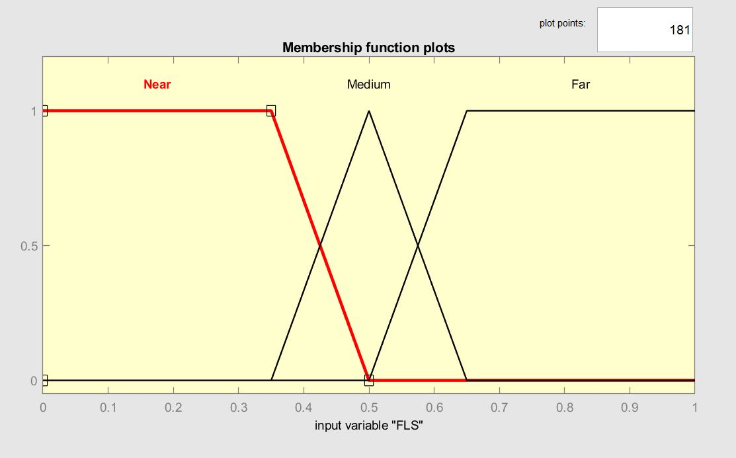
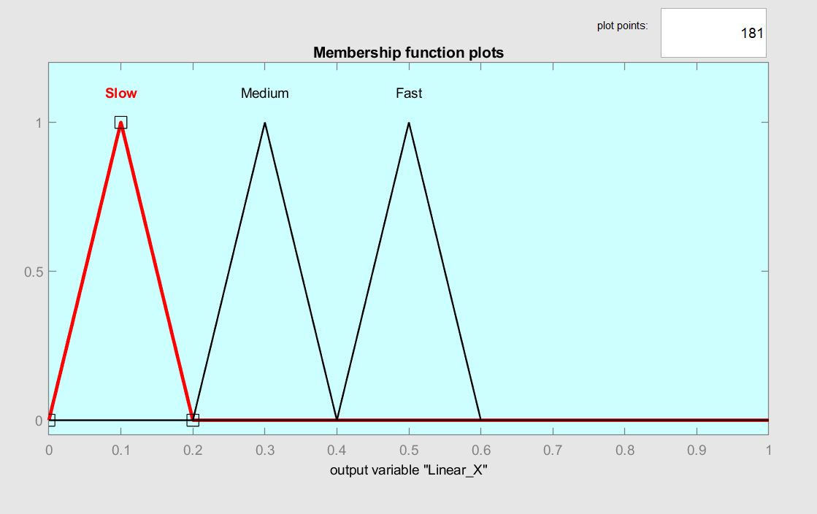
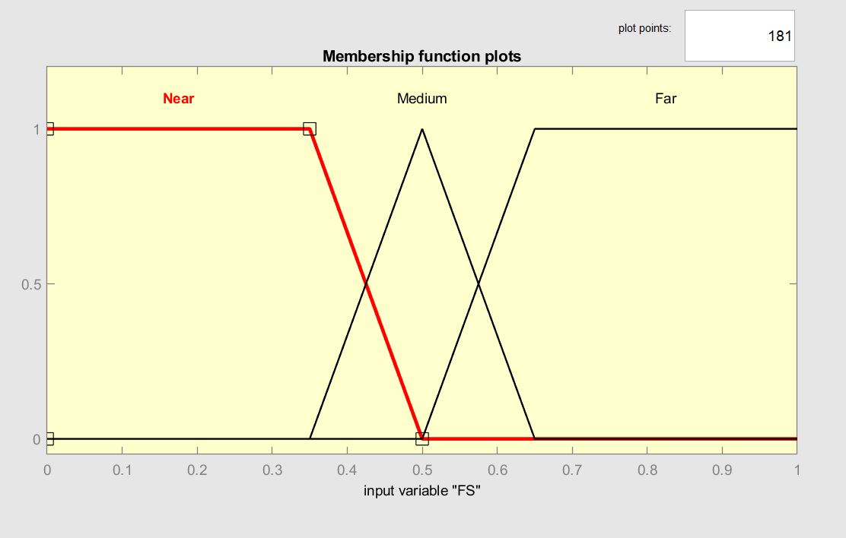
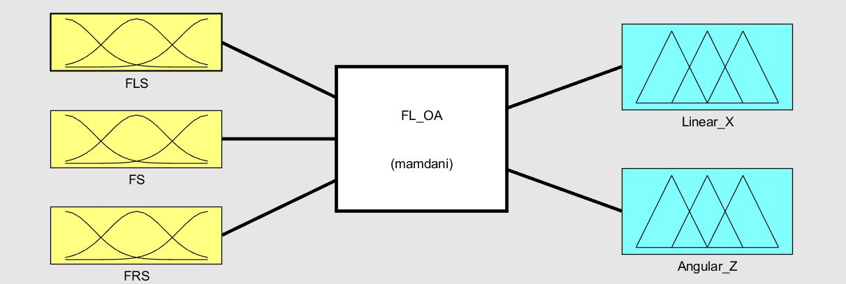
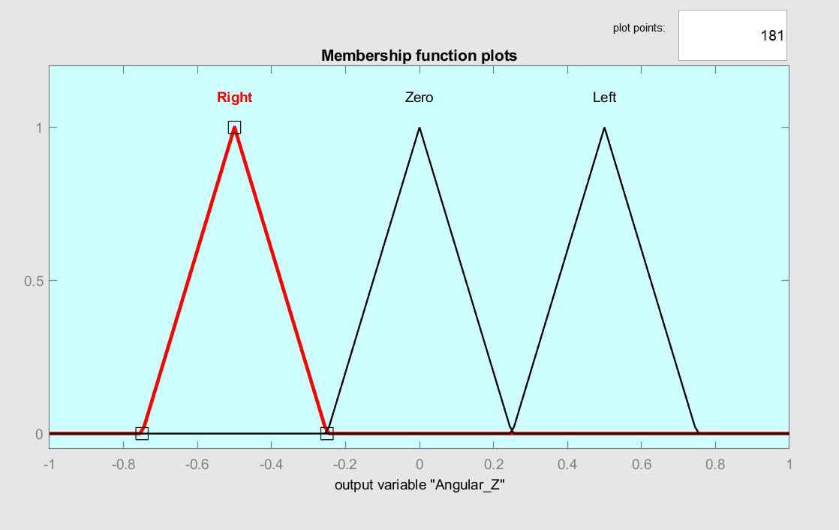
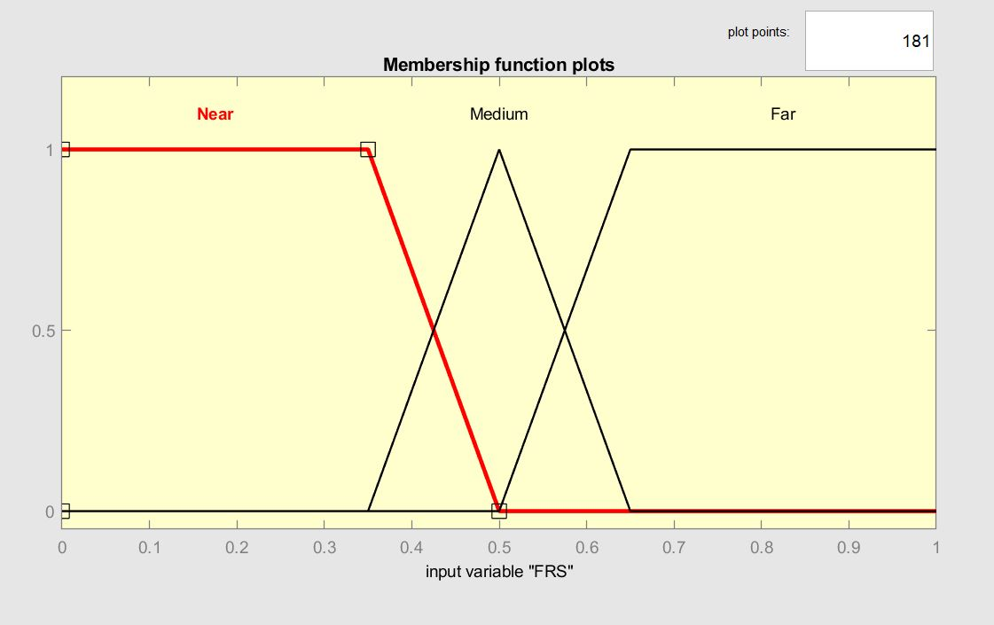
INPUT MEMBERSHIP FUNCTIONS
OUTPUT MEMBERSHIP FUNCTIONS

Slide 11
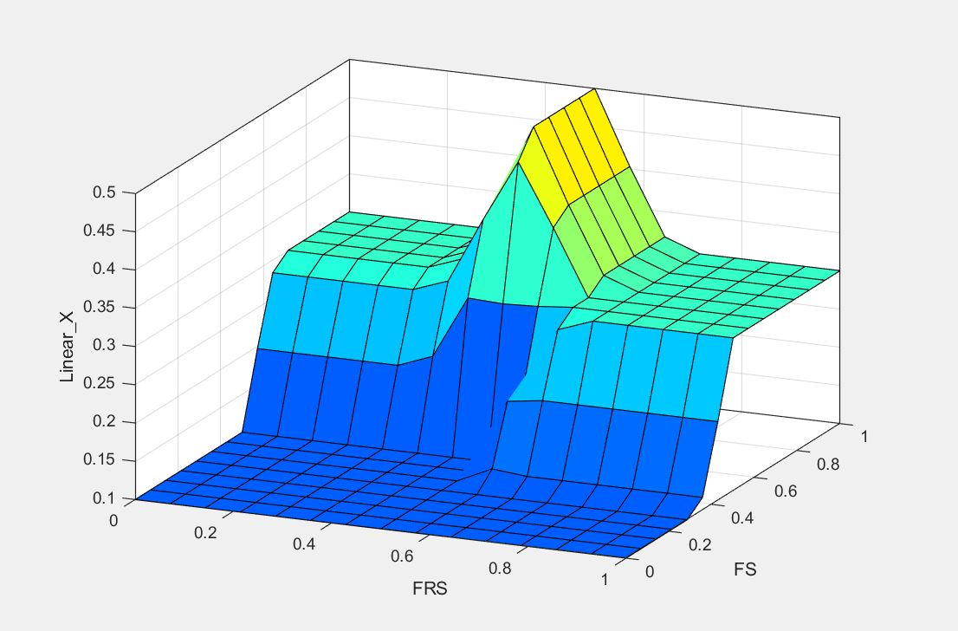
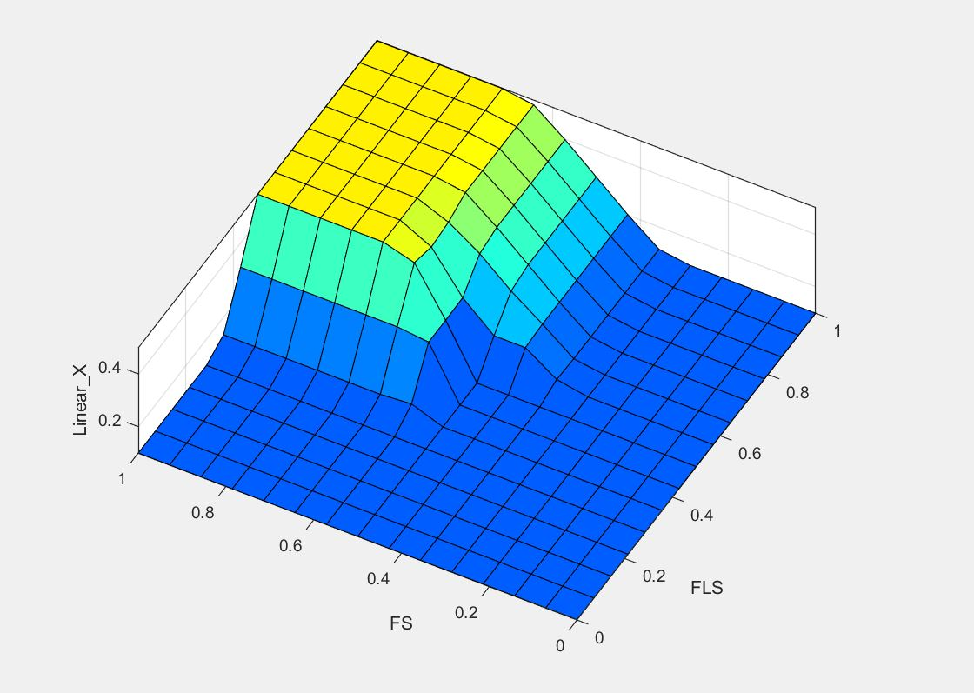
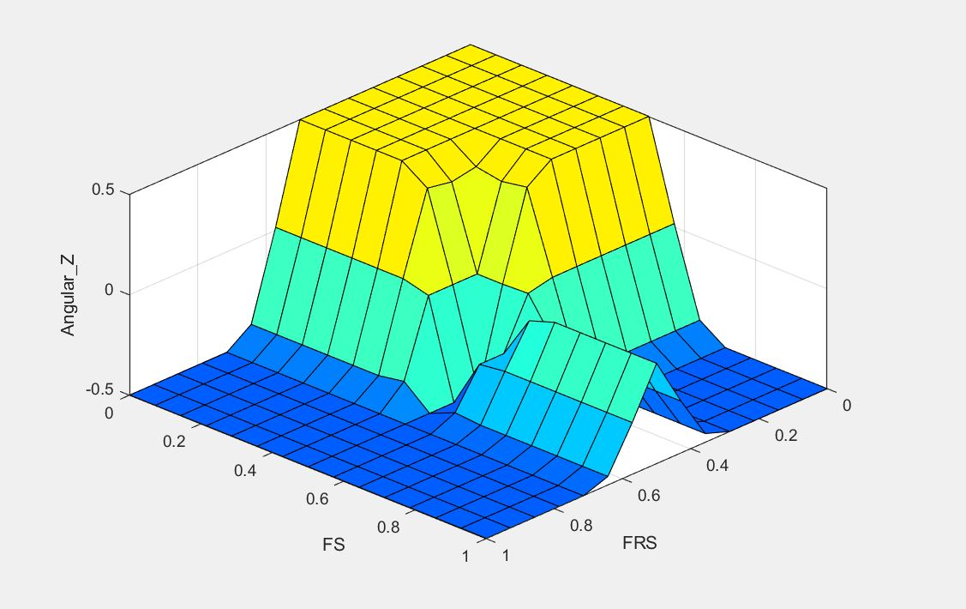
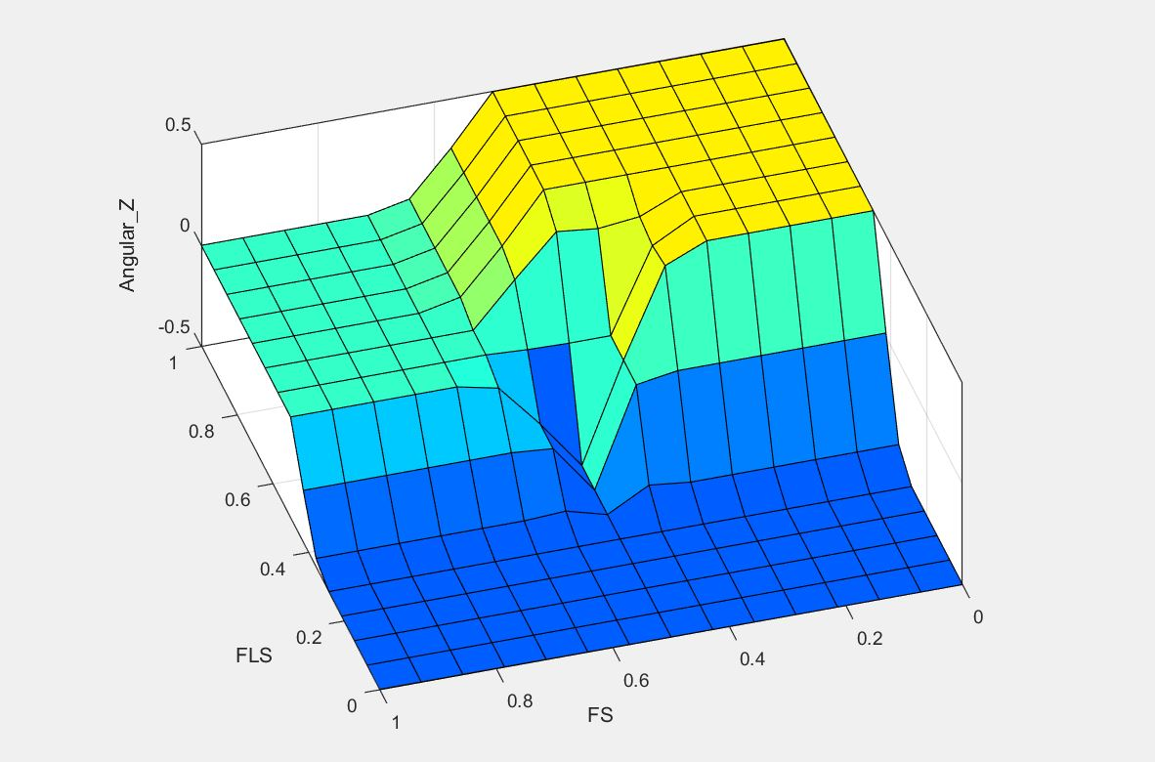
CONTROL SURFACE

Slide 12
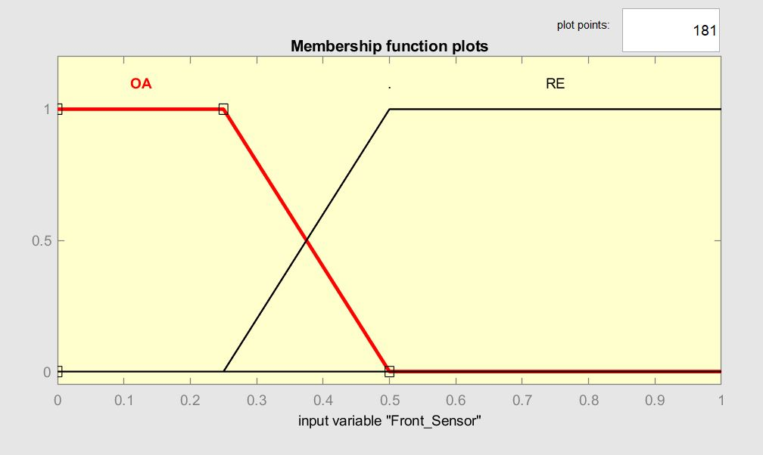
Fuzzy logic obstacle avoidance & RIGHT EDGE FOLLOWING
Front_Sensor
0/1440
180
1260
FS
0:40
1400:1439
FLS
60:240
FRS
1200:1380
RFS
1080:1360
RBS
880:1079

Slide 13
