Slide 1
Machine Learning 101
Doug Cha
©2018
http://github.com/dougfoo/machineLearning/

Slide 2
ToC
What is Machine Learning
History of AI / Machine Learning
Classes of Machine Learning
Example of “Machine Learning” – Decision Tree / Forests / Boosting (?)
Example of “Machine Learning” – Logistic Regression
Computers and the Brain (von Neuman)
Extended example of “Machine Learning” – Neural Network
Types of Neural Networks
Major ML Frameworks
Demo of Azure ML Studio
State of AI & Beware The Singularity ?
(Optional) – My ML Story

Slide 3
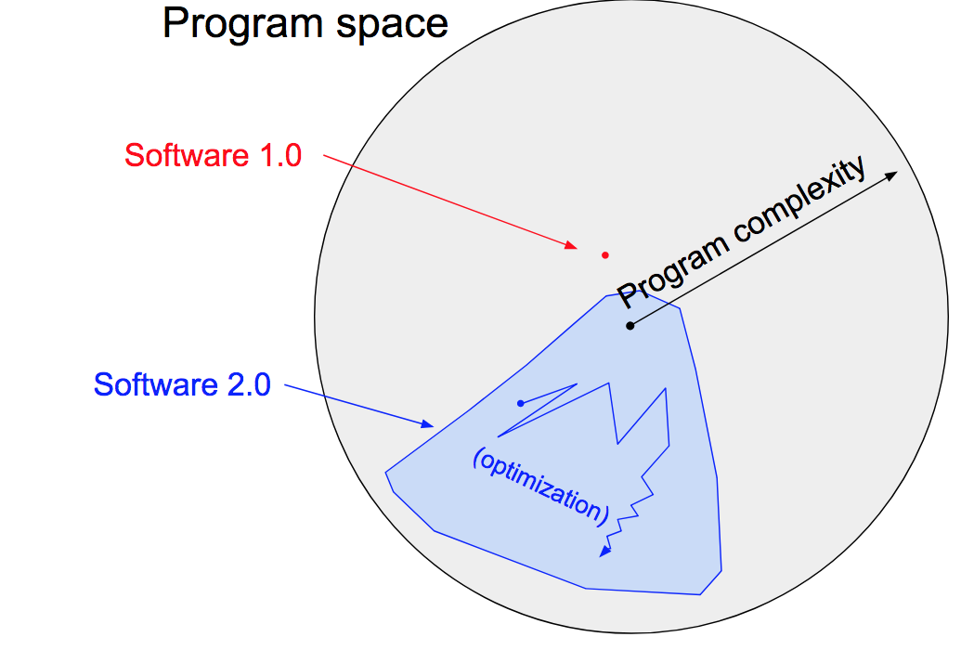
What is Machine Learning
Software 1.0
Software 2.0
Input
Input
Computer
Output
Computer
Program
Program
Output
Traditional & Current Programming Technique
Decompose problem
Design Algorithms
Compose into a system
Results in very specific
complex program solution
“Complexity Monster”
Fill in the blanks programming
https://machinelearningmastery.com/basic-concepts-in-machine-learning/
https://medium.com/@karpathy/software-2-0-a64152b37c35 - A.Karpathy – Tesla Direct of AI

Slide 4
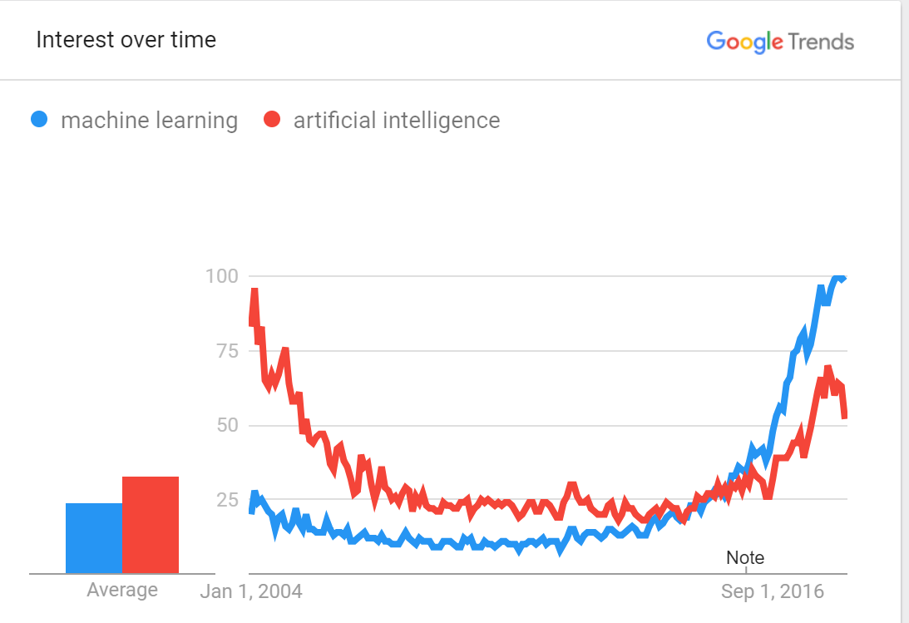
History and Evolution of AI/ML
1943 - Alan Turing (Imitation Game) & John Von Neumman - fathers of modern computing
1956 - AI conference “Minksy/McCarthy” — focus on top-down rules (golden years 56-74)
1970 - Minksy “ in 3-8 yrs we will have a machine w/ the general intelligence of an average human being” <- bad claims all around
1973 - “AI Winter” (1974-1980)
1980’s - “Expert Systems boom” - DEC RI ($40m annual saving success)
1987 (AI winter #2 - 1987-1993)
1997 - Deep blue (beat kasparov) ? (Brute force + heuristics), kasparov big on AI now
1999 - GPU invented (for games)
2007 - CUDA - GPU for non-games (finance/statistics)
2010 - First GPU for NN/Deep Learning - Goodfellow ch12.2
2011 - IBM Watson Jeopardy - some ML (NLP)
2016 - Alpha Go - Deep NN
2029 - Kurtweil Prediction!
Neumann’s book / Kurtzweil intro
+ (Perf) - 97 Deep Blue - 10,000,000 x faster than 1950’s
+ (GPU) - 10-100x faster than CPU, TPU/ASIC 5-10x faster than GPU
+ Neural Network and Training (Backprop)
- Richard Dawkins - natural selection w/ fitness function (similar to ML ?)
https://trends.google.com/trends/explore?date=all&q=machine%20learning,artificial%20intelligence
http://www.bbc.co.uk/timelines/zq376fr - “15 moments in story of AI”
http://en.wikipedia.org/wiki/History_of_artificial_intelligence
http://en.wikipedia.org/wiki/Infinite_monkey_theorem - Infinite Monkey Theorem

Slide 5
History and Evolution of AI/ML
1943 - Alan Turing (Imitation Game) & John Von Neumman - fathers of modern computing
1956 - AI conference “Minksy/McCarthy” — focus on top-down rules (golden years 56-74)
1970 - Minksy “ in 3-8 yrs we will have a machine w/ the general intelligence of an average human being” <- bad claims all around
1973 - “AI Winter” (1974-1980)
1980’s - “Expert Systems boom” - DEC RI ($40m annual saving success)
1987 (AI winter #2 - 1987-1993)
1997 - Deep blue (beat kasparov) ? (Brute force + heuristics), kasparov big on AI now
1999 - GPU invented (for games)
2007 - CUDA - GPU for non-games (finance/statistics)
2010 - First GPU for NN/Deep Learning - Goodfellow ch12.2
2011 - IBM Watson Jeopardy - some ML (NLP)
2016 - Alpha Go - Deep NN
2029 - Kurtweil Prediction!
Neumann’s book / Kurtzweil intro
+ (Perf) - 97 Deep Blue - 10,000,000 x faster than 1950’s
+ (GPU) - 10-100x faster than CPU, TPU/ASIC 5-10x faster than GPU
+ Neural Network and Training (Backprop)
- Richard Dawkins - natural selection w/ fitness function (similar to ML ?)
https://trends.google.com/trends/explore?date=all&q=machine%20learning,artificial%20intelligence
http://www.bbc.co.uk/timelines/zq376fr - “15 moments in story of AI”
http://en.wikipedia.org/wiki/History_of_artificial_intelligence
http://en.wikipedia.org/wiki/Infinite_monkey_theorem - Infinite Monkey Theorem

Slide 6
Major Classes of ML
Supervised Learning
Unsupervised Learning
Predictors
Classifiers
Traditional methods (Statistics/Data Science)
Linear and Logistic Regression
Decision Trees
Kmeans
Support Vector Machines
Cutting Edge Methods
Neural Networks / Deep Learning

Slide 7
Logistic Regression – Classification
How to train a machine to detect if any given song (text) is from “The Beatles” or not ?
Input 500 sample Beatles songs, 500 songs from the Clash, train a model
How to turn song into trainable “features” – occurrence of each word (Bag of Words) ?
<Insert table showing words, frequency>
Given n-top featured words, construct a model:
<insert 5 node Logistic Model>
Based on “score” +/-, convert to a probability 1 (true) or 0 (false)
Train/tune the “weights” of each word (← this machine learning/training)
Test the model vs real data (80% accuracy ?)

Slide 8
Logistic Regression – Trade Error Detector
Can we use the same approach to detect errors in manual inputs to say, booking derivatives ?
Derivative “features”
Type (IRS Swap, Future, FRA, Swaption, FX)
Notional ($1m – $100m)
Counterparty (ABN Amuro, General Electric, etc)
Reference Index (LIBOR3m+spread, LIBOR6m+spread, etc)
# Legs in trade
How do we map these to numeric features (0.0-1.0) ???
LR model may not work, luckily there are many other models.
<insert 5 note LR model>
Note # of weights to calculate /optimize

Slide 9
Decision Trees + Forests & Boosting
<insert Tree view of Booking problem>
More natural fit since Trees allow multiple data classes (text, strings, etc)
Random Forests & Boosting – ways to combine additional trees to improve accuracy
Decision Trees with Boosting win 70% of Kraggle competitions^{[1]}

Slide 10
Neural Networks & the Brain
<insert comparison of brain neurons & synapses to transisitors today>
Von Neumann book – not so much similarity (quote Andrew Ng ?)
Neural Networks & Deep Learning big hype today (Deep Blue, Deep Mind, etc)
Deep Learning == type of Neural Networks with many layers
Example of NN next

Slide 11
Neural Network – Trade Error Detector (v2)
Recap Derivative “features”
Type (IRS Swap, Future, FRA, Swaption, FX)
Notional ($1m – $100m)
Counterparty (ABN Amuro, General Electric, etc)
Reference Index (LIBOR3m+spread, LIBOR6m+spread, etc)
# Legs in trade
<insert 5x5x5x1 NN>
Show relationships can be modelled (XOR for example) and hierarchies
Training the NN is much harder (GPU / ASIC required) – show # of weights to calculate

Slide 12
Major ML Frameworks
<insert pic of the state of AI>
Add top cloud offerings
Add independent offerings (Data Robot, h2o etc)

Slide 13
Azure Demo
Wizard Cloud approach

Slide 14
Current State of AI & the Singularity
Where we are, where we want to get to
The danger of SkyNet
The Singularity (Kurtzweil & Von Neumann)

Slide 15
Why I care about AI / ML
?

Slide 16
References
History of ML
http://www.psych.utoronto.ca/users/reingold/courses/ai/cache/neural4.html
https://cs.stanford.edu/people/eroberts/courses/soco/projects/neural-networks/History/history1.html
https://www.import.io/post/history-of-deep-learning/
https://en.wikipedia.org/wik/Timeline_of_machine_learning
Singularity
Ray Kurzweil – Singularity - https://en.wikipedia.org/wiki/The_Singularity_Is_Near
John Von Neumann - https://en.wikipedia.org/wiki/The_Computer_and_the_Brain
Hardware
TPU diagram (scalar, vector, matrix) and perf chart: https://cloud.google.com/blog/big-data/2017/05/an-in-depth-look-at-googles-first-tensor-processing-unit-tpu#closeImag
Other
Kaggle – Boosting 70% wins (article: https://medium.com/syncedreview/tree-boosting-with-xgboost-why-does-xgboost-win-every-machine-learning-competition-ca8034c0b283)

