Slide 1
Machine Learning 101
Doug Cha
©2018
http://github.com/dougfoo/machineLearning/

Slide 2
ToC
AI 101
What is Machine Learning
History of AI / Machine Learning
Why ML So Hot Today ?
Classes of Machine Learning
Machine learning workflow
Example of “Machine Learning” – Linear Regression ? (the basics)
Example of “Machine Learning” – pt2
Example of “Machine Learning” – Logistic Regression
Computers and the Brain (von Neuman)
Extended example of “Machine Learning” – Neural Network
Types of Neural Networks, FF, CNN, RNN,
ML Landscape
State of AI & Beware The Singularity ?

Slide 3
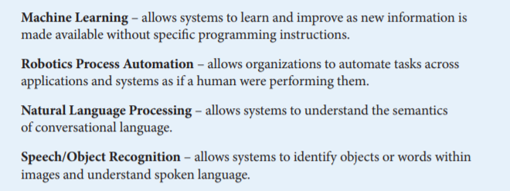
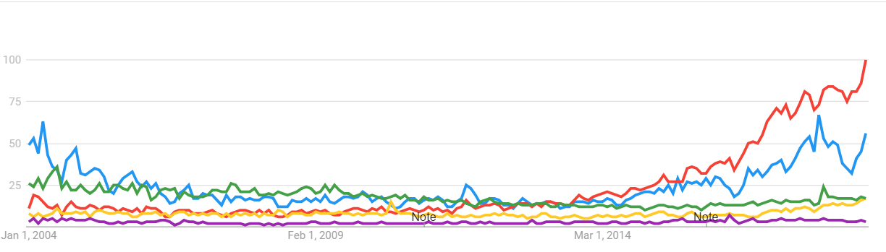
Artificial Intelligence 101
Google Trends 2004-Present AI vs ML vs NLP vs RPA vs Image Recognition
https://www.aba.com/Tools/Function/Technology/Documents/understanding-artificial-intelligence.pdf

Slide 4
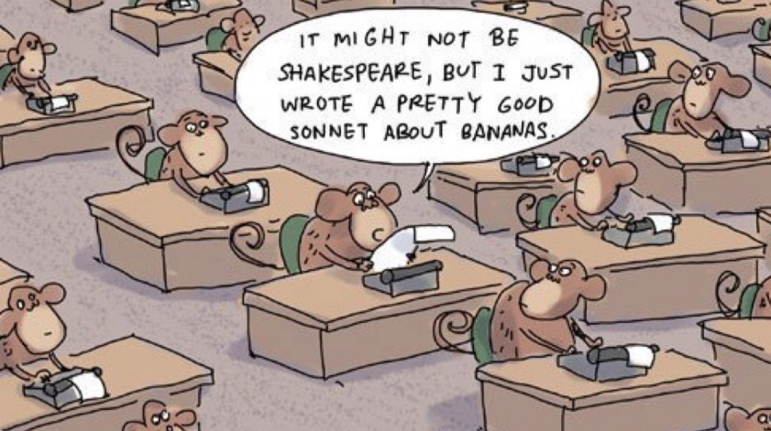
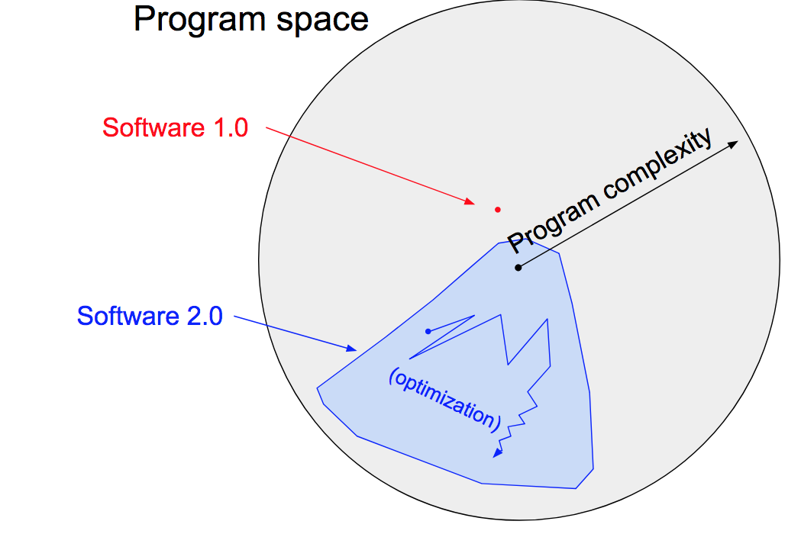
What is Machine Learning
Software Today (1.0):
Transformed to (2.0):
Input
Output
Machine
Output
Machine
Rules
Rules
Input
https://machinelearningmastery.com/basic-concepts-in-machine-learning/
https://medium.com/@karpathy/software-2-0-a64152b37c35 - A.Karpathy – Tesla Direct of AI

Slide 5
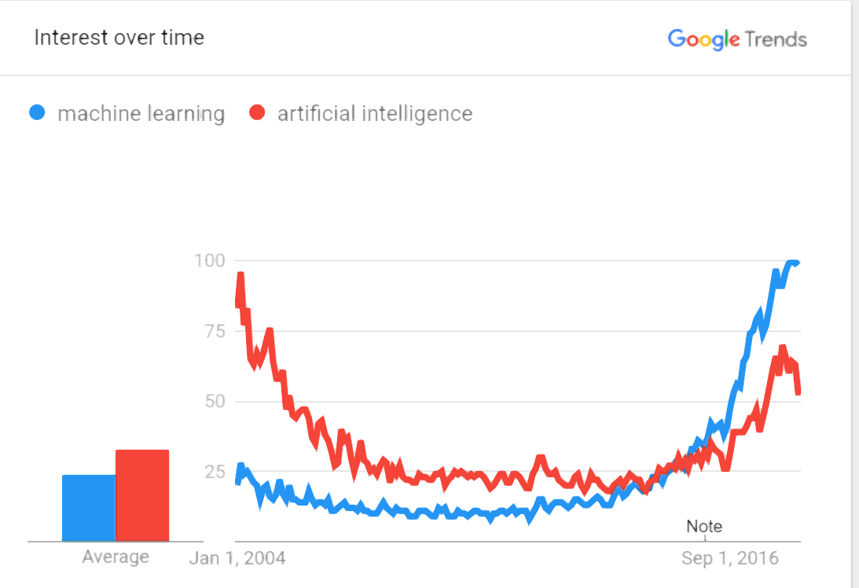
History and Evolution of AI/ML
Other key factors:
+ (Perf) - 97 Deep Blue - 10,000,000 x faster than 1950’s
+ (GPU) - 10-100x faster than CPU, TPU/ASIC 5-10x faster than GPU
+ Neural Network and Training (Backprop)
- Richard Dawkins - natural selection w/ fitness function (similar to ML ?)
1943 - Alan Turing (Imitation Game) & John Von Neumman - fathers of modern computing
1956 - AI conference “Minksy/McCarthy” — focus on top-down rules (golden years 56-74)
1970 - Minksy “ in 3-8 yrs we will have a machine w/ the general intelligence of an average human being” <- bad claims all around
1973 - “AI Winter” (1974-1980)
1980’s - “Expert Systems boom” - DEC RI ($40m annual saving success)
1987 (AI winter #2 - 1987-1993)
1997 - Deep blue (beat kasparov) ? (Brute force + heuristics), kasparov big on AI now
1999 - GPU invented (for games)
2007 - CUDA - GPU for non-games (finance/statistics)
2010 - First GPU for NN/Deep Learning - Goodfellow ch12.2
2011 - IBM Watson Jeopardy - some ML (NLP)
2016 - Alpha Go - Deep NN
2029 - Kurtweil Prediction!
https://trends.google.com/trends/explore?date=all&q=machine%20learning,artificial%20intelligence
http://www.bbc.co.uk/timelines/zq376fr - “15 moments in story of AI”
http://en.wikipedia.org/wiki/History_of_artificial_intelligence
http://en.wikipedia.org/wiki/Infinite_monkey_theorem - Infinite Monkey Theorem

Slide 6
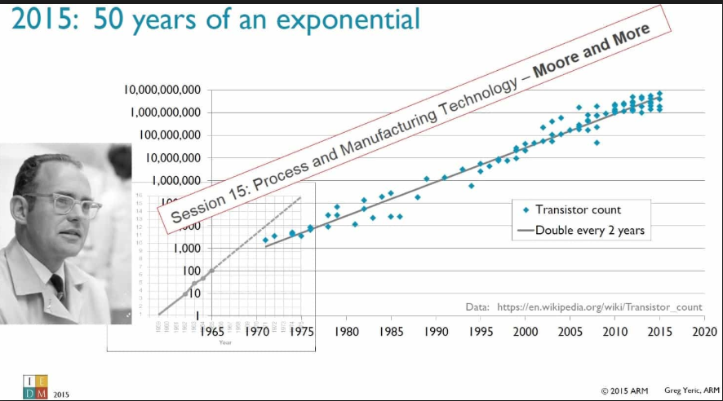
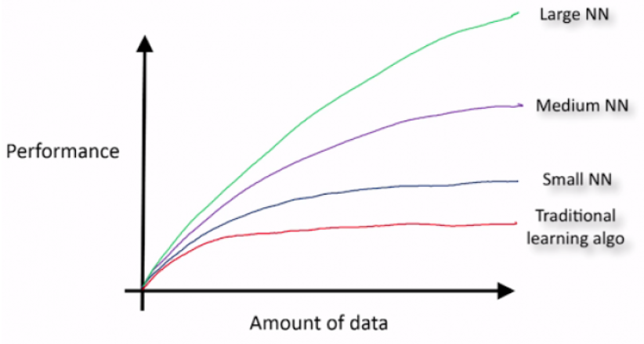
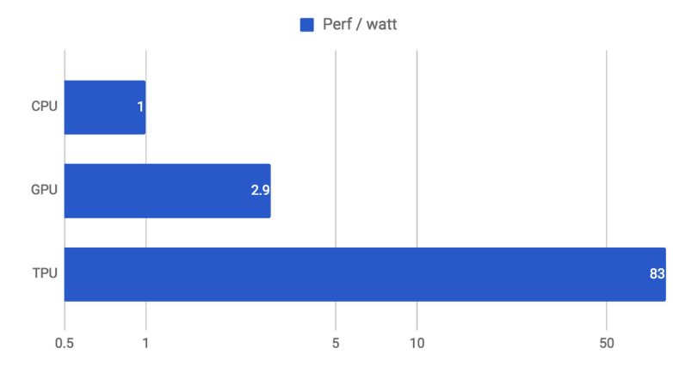
Why ML So Hot Today?
Hardware Leaps
Big Data
Algorithm Improvements (Less)
https://static.googleusercontent.com/media/research.google.com/en//pubs/archive/35179.pdf
https://cloud.google.com/blog/products/gcp/an-in-depth-look-at-googles-first-tensor-processing-unit-tpu

Slide 7
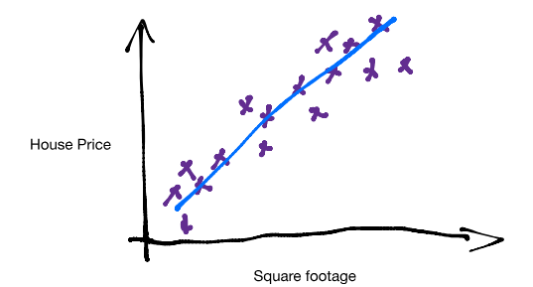
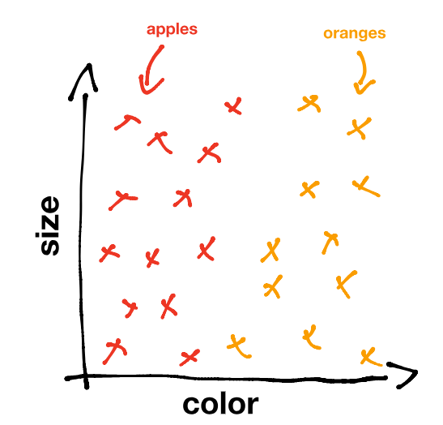
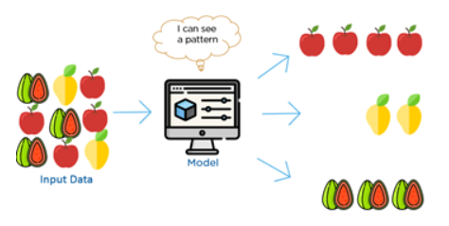
Machine Learning Types
Prediction
Labelled Classification
Un-Labelled / Clustering (patterns in data)
https://www.kdnuggets.com/2017/05/machine-learning-crash-course-part-1.html
https://www.youtube.com/watch?time_continue=6&v=G7fPB4OHkys

Slide 8
Machine Learning Pipeline
Data Sourcing
ETL / ELT
Normalize
Data Store
RDBMS
KDB
Feature Engineer
Cleanse
Data Warehouse
Hadoop Data Lake
Load
Model Selection
Encode
Normalize
Kmeans
SVM
Neural Nets
Train
Param tuning
Cross Validate
Deploy
Monitor
Refine and iterate
Refine and iterate
Evaluate Results
Select
Release
End to End Flow
End to end a long, iterative process

Slide 9
How it really works - Linear Regression example (1)
100’s $
Linear price model:
h(x) = W₀ + W₁*SqM + W₂*Loc + W₃*BR + …
General form:
h(x) = W₀ + W₁*X₁ + W₂*X₂ + W₃*X₃ + ….
Use X^{n} samples to learn “weights” W_{n}
10 SqM
Simplified Model example using just 1 variable/feature.
h(x) = W₀ + W₁*SqM
ie, y = mx+ b (solve for the regression line)
Solve for W₀,W₁ given x samples {5,10,15,20]; y labels=[3,4,3,5]
Algorithm:
Choose random W₀,W₁
Calculate Error (MSE - Mean Square Error)
Adjust W to minimize MSE (Gradient Descent)
Iterate until minimum error
Adapted from Andrew Ng’s Machine Learning course: https://www.coursera.org/learn/machine-learning )

Slide 10

How it really works - Linear Regression example (2)
100’s $
x samples {5,10,15,20]; y labels=[3,4,3,5]
Algorithm:
Choose random W₀,W₁
Calculate Error (MSE - Mean Square Error)
Adjust W to minimize MSE (Gradient Descent)
Iterate until minimum error
10 SqM
Iteration:
Set W₀,W₁ = 1,1 ie, y = x + 1
Calculate Error(E) - MSE = $Σ$(y^{i} – f(x^{i}))
Calculate Gradients - $\frac{∂E}{∂\text{W}\text{0}}$ and $\frac{∂E}{∂\text{W}\text{1}}$
Adjust W₀,W₁ by Gradients
Iterate until Error is mimimized

Slide 11
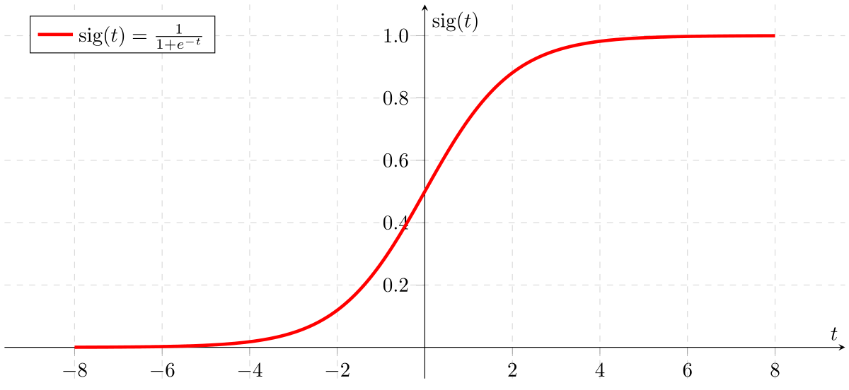

Logistic Regression – Classification
Using X_{n} - feature inputs, calculate a probability of Y or N (1 or 0)
Example E-mail Spam Detector – 4 feature “scores” generates a +/- result
X₁“Urgent”
W₁
X₂“Help”
Logistic F
Sigmoid, Relu, TanH Function
Spam?
1 or 0 (Y/N)
W₂
X₃“Audit”
W₃
W₄
X₄“Hello”
…
…
Training model sets W₁₋₄ values -1 to 1, eg:
“Urgent” – likely spam, W₁ ~ +0.9
“Help” – maybe spam, W₂ ~ +0.4
“Audit” – not likely, W₃ ~ -0.9
“Hello” – not sure, W₄ ~ +0.1
Given new email, evaluate likelihood of spam:
h(x) = W₀ + W₁*X₁ + W₂*X₂ + W₃*X₃ + ….
Heavy spam mail results in h(x) = 15
Wrap in sigmoid function ($\frac{1}{1−ⅇ^{h(x)}})$ generates 1 to 0 range
(4 features * 1,000 examples = 4,000 partial derivatives to calculate. Typical email may have ~500 words/features. Full corpus 50k)

Slide 12
Logistic Regression – Trade Error Detector
Can we use the same approach to detect errors in manual inputs to say, booking derivatives ?
Derivative “features”
Type (IRS Swap, Future, FRA, Swaption, FX)
Notional ($1m – $100m)
Counterparty (ABN Amuro, General Electric, etc)
Reference Index (LIBOR3m+spread, LIBOR6m+spread, etc)
# Legs in trade
How do we map these to numeric features (0.0-1.0) ???
LR model may not work, luckily there are many other models.

Slide 13
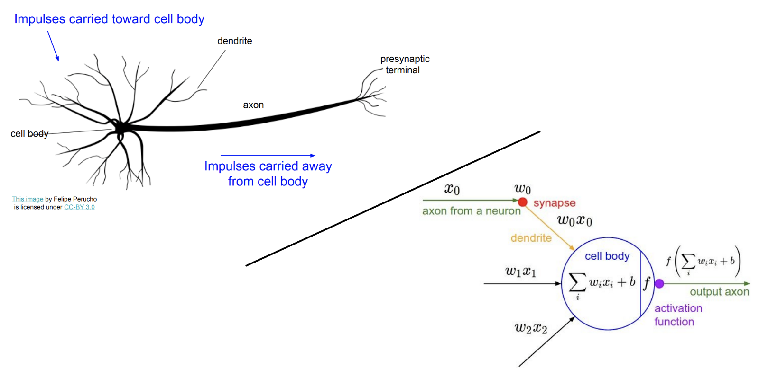
Neural Networks & the Brain
<insert comparison of brain neurons & synapses to transisitors today>
Von Neumann book – not so much similarity (quote Andrew Ng ?)
Neural Networks & Deep Learning big hype today (Deep Blue, Deep Mind, etc)
Deep Learning == type of Neural Networks with many layers
Example of NN next
Side-by-side illustrations of biological and artificial neurons, via Stanford’s CS231n. This analogy can’t be taken too literally — biological neurons can do things that artificial neurons can’t, and vice versa — but it’s useful to understand the biological inspiration. See Wikipedia’s description of biological vs. artificial neurons for more detail.

Slide 14
Neural Network – Trade Error Detector (v2)
Recap Derivative “features”
Type (IRS Swap, Future, FRA, Swaption, FX)
Notional ($1m – $100m)
Counterparty (ABN Amuro, General Electric, etc)
Reference Index (LIBOR3m+spread, LIBOR6m+spread, etc)
# Legs in trade
<insert 5x5x5x1 NN>
Show relationships can be modelled (XOR for example) and hierarchies
Training the NN is much harder (GPU / ASIC required) – show # of weights to calculate
<Insert std NN diagram>

Slide 15
Current State of AI/ML - Showdown
Big Data &
Database Vendors
API/Analytic Toolkits
Full Stack Vendors
Cloud
Providers
Scikit Learn
TensorFlow
MXNET
PyTorch
Apache Spark & Hadoop
KDB
Oracle
Alteryx
H2o
Tableau
Google GCP
Amazon AWS
MSFT Azure
Oracle
Data Robot
Note on the danger of SkyNet & “The Singularity” (Ray Kurtzweil & Von Neumann)

Slide 16
Machine Learning Pipeline
Data Sourcing
ETL
Normalize
Data Store
RDBMS
KDB
Feature Engineer
Cleanse
Data Warehouse
Hadoop Data Lake
Load
Model Selection
Encode
Normalize
Kmeans
SVM
Neural Nets
Train
Param tuning
Cross Validate
Deploy
Monitor
Refine and iterate
Refine and iterate
Evaluate Results
Select
Release
Big Data &
Database Vendors
Cloud
Providers
API/Analytic Toolkits
Full Stack Vendors

Slide 17
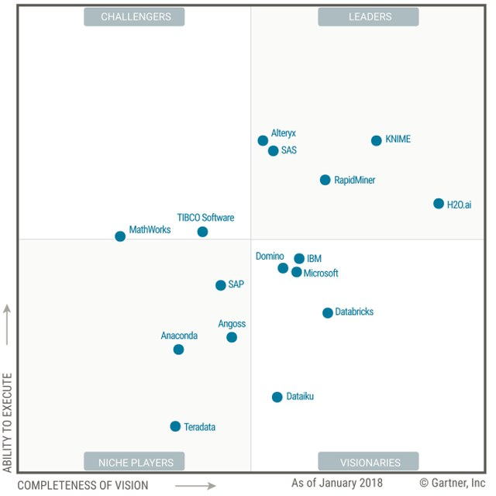
Full Stack Vendors
<insert pic of the state of AI>
Add top cloud offerings
Add independent offerings (Data Robot, h2o etc)

Slide 18
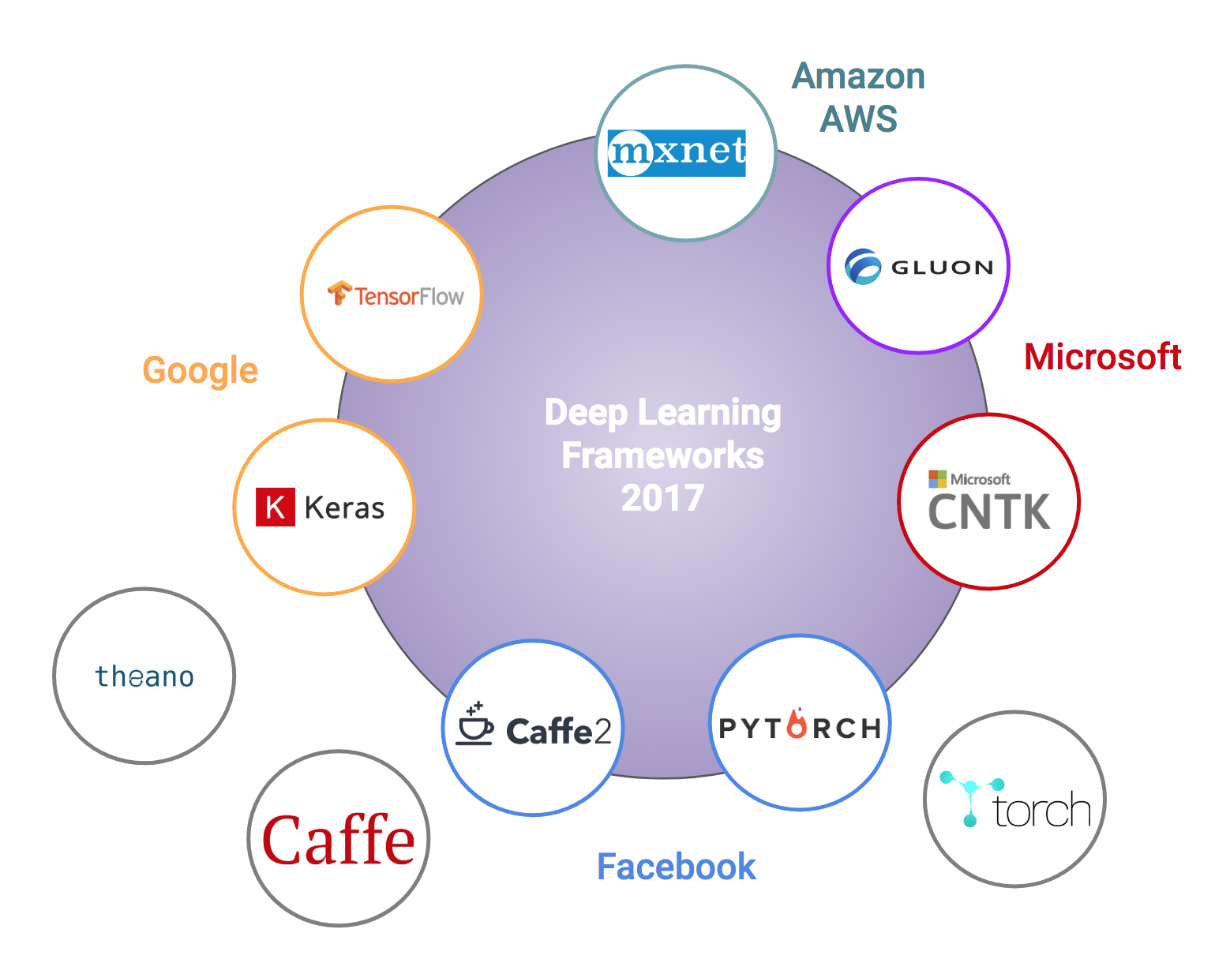
Major ML Frameworks 2
API and Analytic Libraries

Slide 19
Cloud Offerings
Amazon AWS
Azure ML Studio
Google GCP & Tensorflow
Oracle Cloud
Sony Cloud (??) (http://dl.sony.com)

Slide 20
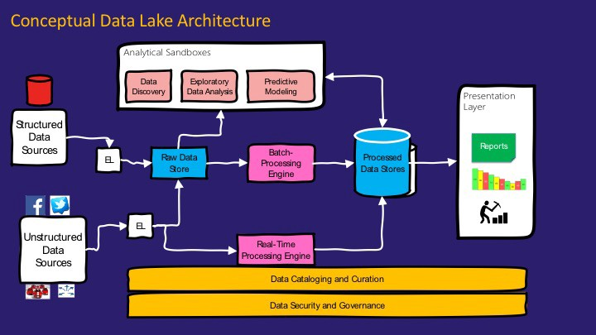
Big Data – Apache Spark/Hadoop
https://medium.com/@rpradeepmenon/demystifying-data-lake-architecture-30cf4ac8aa07
https://www.jamesserra.com/archive/2015/04/what-is-a-data-lake/

Slide 21
Why I care about AI / ML
?

Slide 22
References
History of ML
http://www.psych.utoronto.ca/users/reingold/courses/ai/cache/neural4.html
https://cs.stanford.edu/people/eroberts/courses/soco/projects/neural-networks/History/history1.html
https://www.import.io/post/history-of-deep-learning/
https://en.wikipedia.org/wik/Timeline_of_machine_learning
Singularity
Ray Kurzweil – Singularity - https://en.wikipedia.org/wiki/The_Singularity_Is_Near
John Von Neumann - https://en.wikipedia.org/wiki/The_Computer_and_the_Brain
Hardware
TPU diagram (scalar, vector, matrix) and perf chart: https://cloud.google.com/blog/big-data/2017/05/an-in-depth-look-at-googles-first-tensor-processing-unit-tpu#closeImag
Other
Kaggle – Boosting 70% wins (article: https://medium.com/syncedreview/tree-boosting-with-xgboost-why-does-xgboost-win-every-machine-learning-competition-ca8034c0b283)

