Slide 1
Machine Learning 101
Doug Cha
©2018
http://github.com/dougfoo/machineLearning/

Slide 2
ToC
AI 101
What is Machine Learning
History of AI / Machine Learning
Why ML So Hot Today ?
Classes of Machine Learning
Machine learning workflow
Example of “Machine Learning” – Linear Regression ? (the basics)
Example of “Machine Learning” – pt2
Example of “Machine Learning” – Logistic Regression
Computers and the Brain (von Neuman)
Extended example of “Machine Learning” – Neural Network
Types of Neural Networks, FF, CNN, RNN,
ML Landscape
State of AI & Beware The Singularity ?

Slide 3
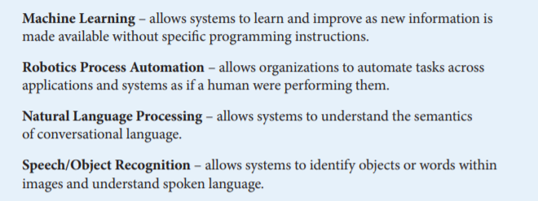
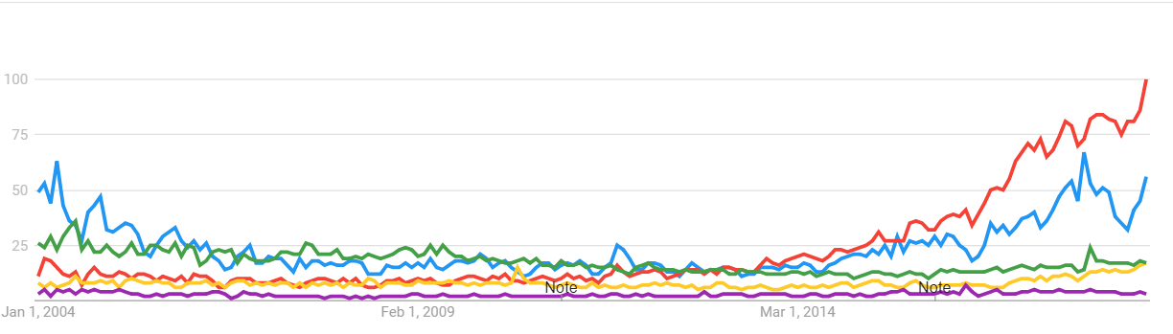
What is Artificial Intelligence ?
Google Trends 2004-Present AI vs ML vs NLP vs RPA vs Image Recognition
https://www.aba.com/Tools/Function/Technology/Documents/understanding-artificial-intelligence.pdf

Slide 4
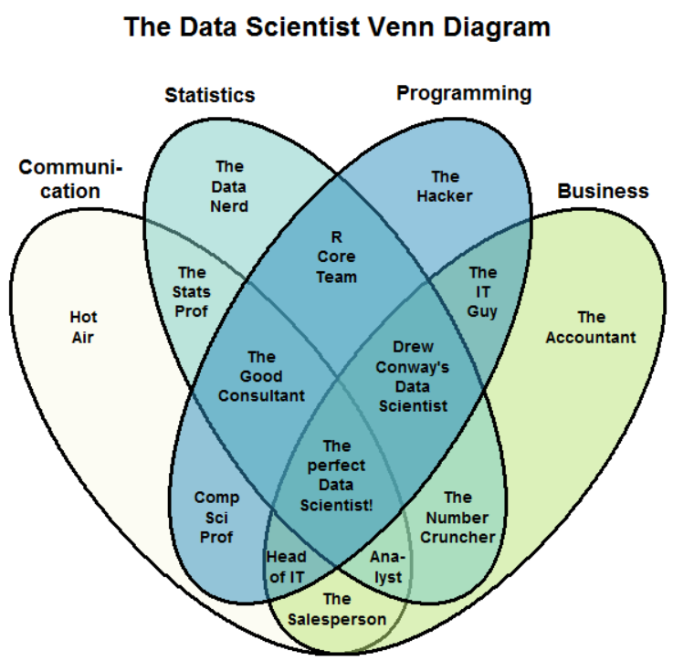
What is Data Science ?
https://www.kdnuggets.com/2016/10/battle-data-science-venn-diagrams.html

Slide 5
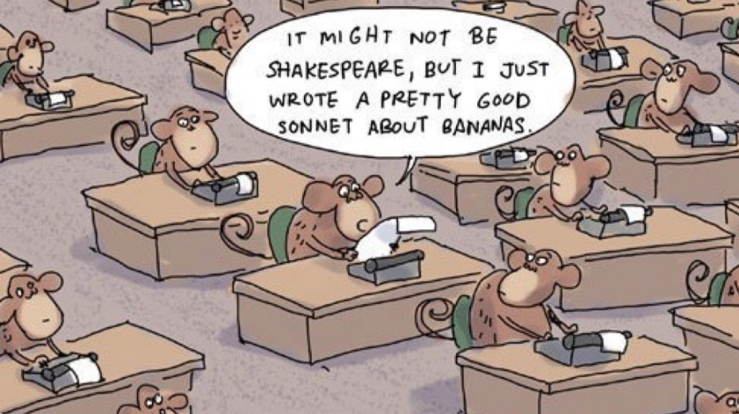
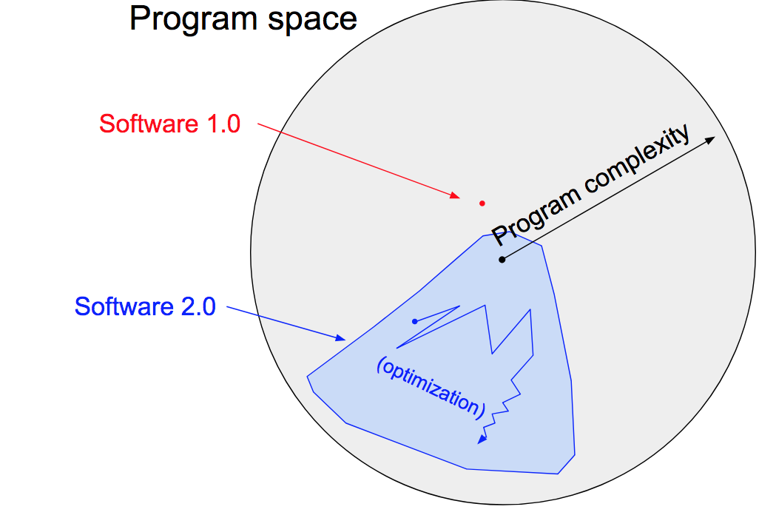
What is Machine Learning
Software Today (1.0):
Transformed to (2.0):
Input
Output
Machine
Output
Machine
Rules
Rules
Input
https://machinelearningmastery.com/basic-concepts-in-machine-learning/
https://medium.com/@karpathy/software-2-0-a64152b37c35 - A.Karpathy – Tesla Director of AI

Slide 6
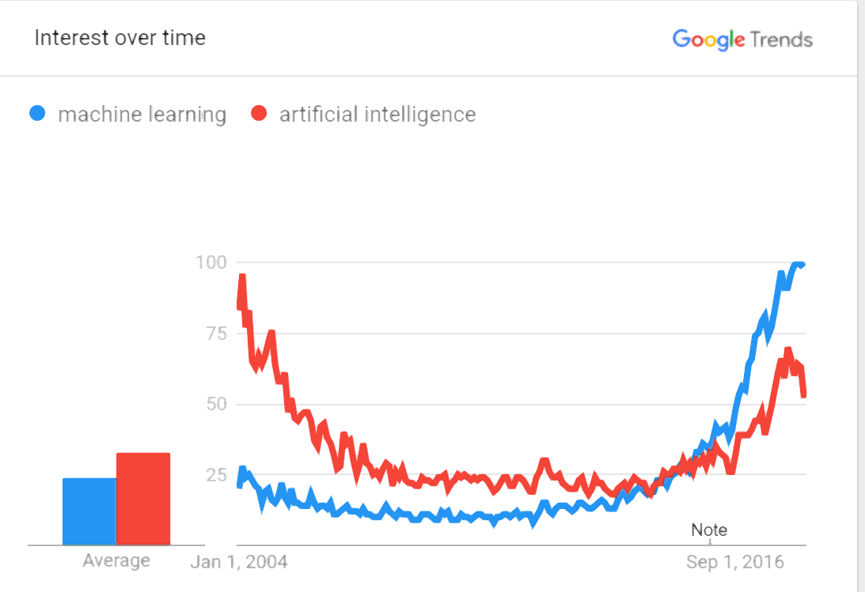
History and Evolution of AI/ML
1943 - Alan Turing (Imitation Game) & John Von Neumman - fathers of modern computing
1956 - AI conference “Minksy/McCarthy” — focus on top-down rules (golden years 56-74)
1970 - Minksy “ in 3-8 yrs we will have a machine w/ the general intelligence of an average human being” <- bad claims all around
1973 - “AI Winter” (1974-1980)
1980’s - “Expert Systems boom” - DEC RI ($40m annual saving success)
1986 – Hinton Backprop
1987 (AI winter #2 - 1987-1993)
1997 - Deep blue (beat kasparov) ? (Brute force + heuristics), kasparov big on AI now
1999 - GPU invented (for games)
2007 - CUDA - GPU for non-games (finance/statistics)
2010 - First GPU for NN/Deep Learning - Goodfellow ch12.2
2010 SciKit initial release
2011 - IBM Watson Jeopardy .
– h20 & alteryx foundedt
2012 – DataRobot founded
2015 MSFT Azure ML
2016 PyTorch released
2017 - TensorFloww 1.0
2018 AWS Sagemaker
2045 - Kurtweil Prediction!
https://trends.google.com/trends/explore?date=all&q=machine%20learning,artificial%20intelligence
http://www.bbc.co.uk/timelines/zq376fr - “15 moments in story of AI”
http://en.wikipedia.org/wiki/History_of_artificial_intelligence
http://en.wikipedia.org/wiki/Infinite_monkey_theorem - Infinite Monkey Theorem

Slide 7
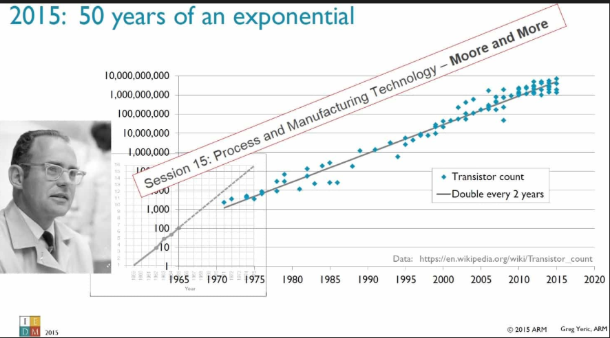
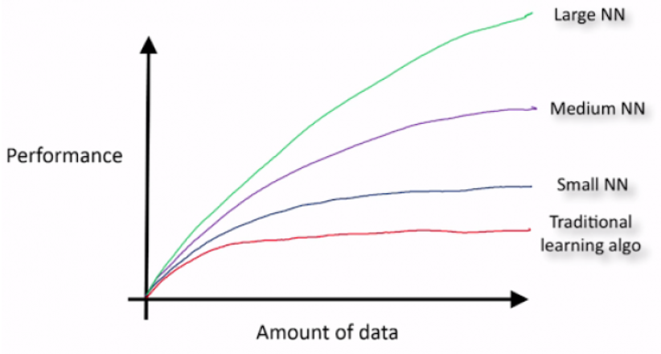
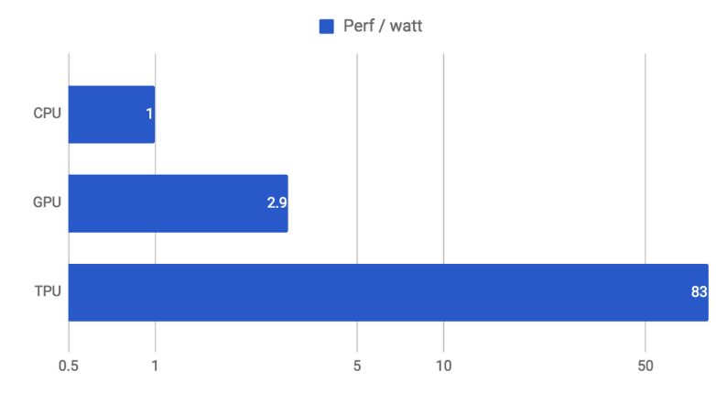
Why ML So Hot Today?
Hardware Leaps
Big Data
Algorithm Improvements (Less)
https://static.googleusercontent.com/media/research.google.com/en//pubs/archive/35179.pdf
https://cloud.google.com/blog/products/gcp/an-in-depth-look-at-googles-first-tensor-processing-unit-tpu
https://www.kdnuggets.com/2015/06/machine-learning-more-data-better-algorithms.html

Slide 8
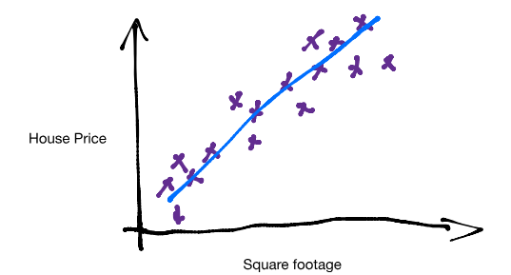
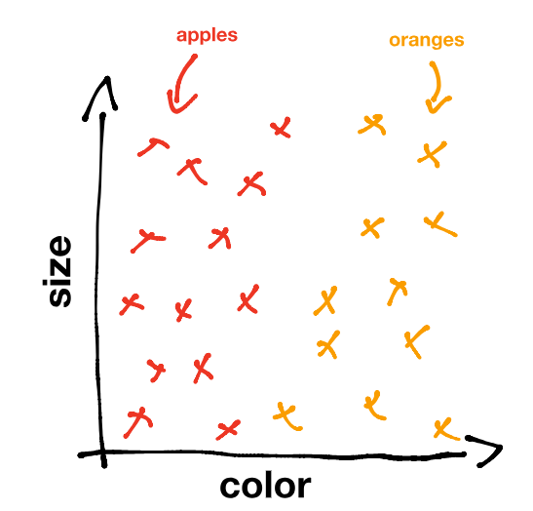
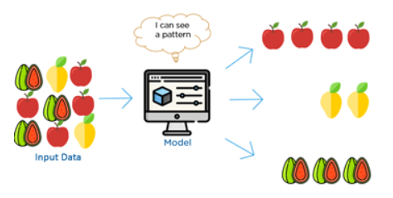
Machine Learning Types
Prediction
Labelled Classification
Un-Labelled / Clustering (patterns in data)
https://www.kdnuggets.com/2017/05/machine-learning-crash-course-part-1.html
https://www.youtube.com/watch?time_continue=6&v=G7fPB4OHkys

Slide 9
Machine Learning Workflow
Data Sourcing
ETL / ELT
Normalize
Data Store
RDBMS
KDB
Feature Engineer
Cleanse
Data Warehouse
Hadoop Data Lake
Load
Model Selection
Encoding
Normalize
L-Regress
SVM
NN, CNN, RNN
Train
Param tuning
Cross Validate
Deploy
Monitor
Refine and iterate
Refine and iterate
Evaluate Results
Selection
Release
Typical Workflow
II. Refine Features & Model
I. Load/Cleanup Data
Durations ?
12 month project
9 months+ – 80%
2-3 months+ – 15%
1-2 months+ – 5%
https://www.kaggle.com/willkoehrsen/start-here-a-gentle-introduction

Slide 10
Training a Simple Linear Model - example (0)
Example:
How to build a house price predictor?
Using inputs (features)…
X₁ – SqFt Building
X₂ – SqFt Land
X₃ – # Bedrooms
X₄ – Local School Rating
Try a Linear price model:
p(X) = A*X₁ (SqFt Building) + B*X₂ (SqFt Land) + C*X₃ (# Bedrooms) + D*X₄ (School Rating)
Where A,B,C,D are some “weights” on each input
General form:
p(X) = W₀ + W₁*X₁ + W₂*X₂ + W₃*X₃ + ….
How do we set Weights?
(Remember the Monkeys writing Shakepeare? -- we can keep guessing until we find optimal one ?)
Or – use real examples to learn “weights” W_{n} – ie, based on actual data !!
This process is called Training the model !!!
Eventually solve the optimization problem, p(X) = 155 + 0.22*X₁ + -0.08*X₂ + 0.87*X₃ + ….

Slide 11
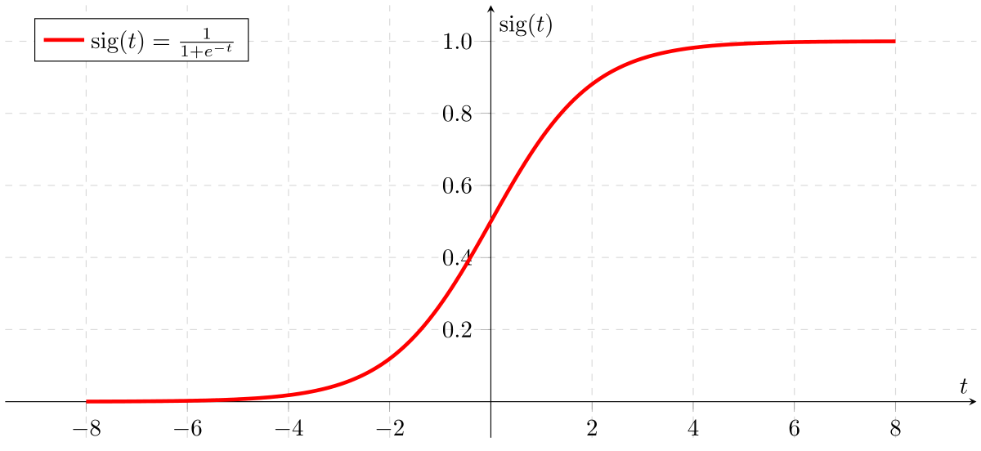

Logistic Regression – Classification
Using X_{n} - feature inputs, calculate a probability of Y or N (1 or 0)
Example E-mail Spam Detector – 4 feature “scores” generates a +/- result
X₁“Urgent”
W₁
X₂“Help”
Logistic F
Sigmoid, Relu, TanH Function
Spam?
1 or 0 (Y/N)
W₂
X₃“Audit”
W₃
W₄
X₄“Hello”
…
…
Training model sets W₁₋₄ values -1 to 1, eg:
“Urgent” – likely spam, W₁ ~ +0.9
“Help” – maybe spam, W₂ ~ +0.4
“Audit” – not likely, W₃ ~ -0.9
“Hello” – not sure, W₄ ~ +0.1
Given new email, evaluate likelihood of spam:
h(x) = W₀ + W₁*X₁ + W₂*X₂ + W₃*X₃ + ….
Heavy spam mail results in h(x) = 15
Wrap in sigmoid function ($\frac{1}{1−ⅇ^{h(x)}})$ generates 1 to 0 range
(4 features * 1,000 examples = 4,000 partial derivatives to calculate. Typical email may have ~500 words/features. Full corpus 50k)

Slide 12
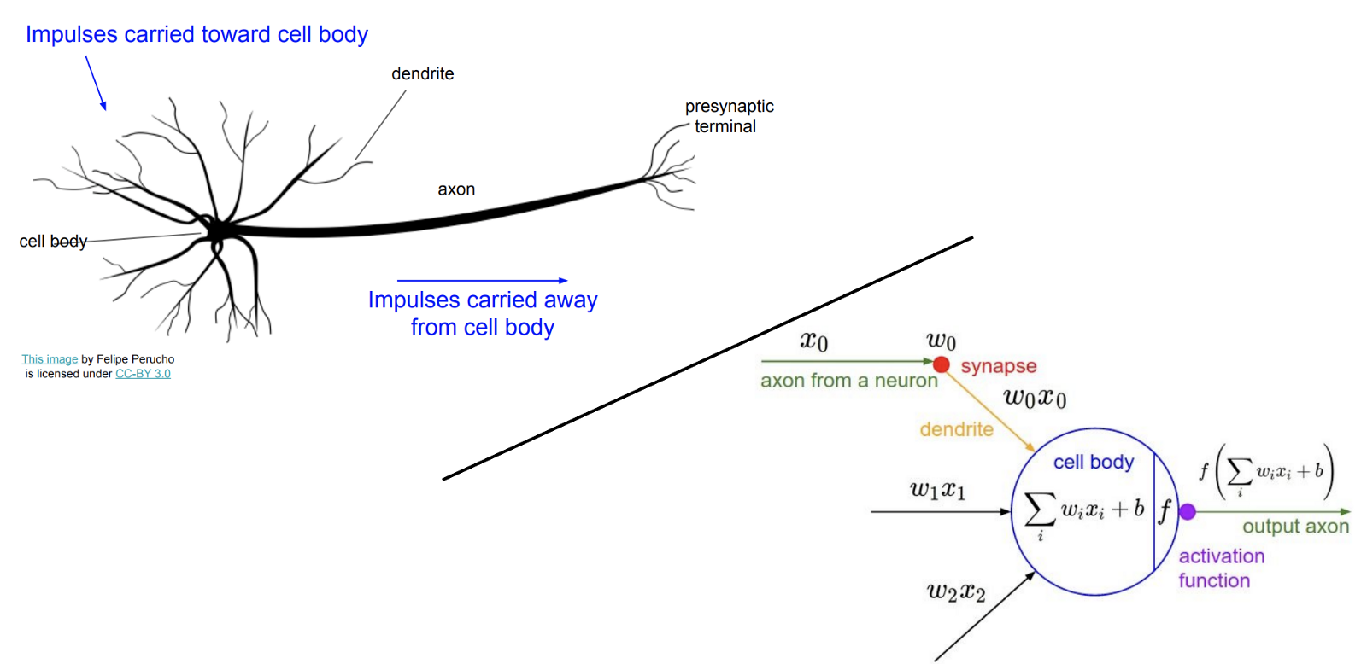
Neural Networks & the Brain
The Computer and the Brain – John Von Neumann 1958
First concept of an Artificial Neural Network (Human Brain) was 1943 – Pitts & McCullough
Biology doesn’t really match, but it sounds great “Deep Learning” (hype)
Interesting facts:
Worm C Elegans – 300 Neurons
Fruit Fly – 135k Neurons
Human – 80B-100B Neurons
Modelling AI / ANN this way is
not going to work… !!
https://en.wikipedia.org/wiki/Artificial_neural_network
http://cs231n.stanford.edu/slides/2017/cs231n_2017_lecture4.pdf

Slide 13
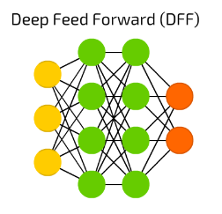
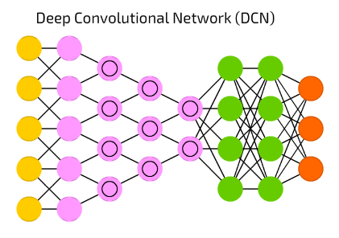
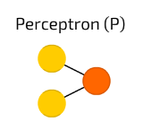
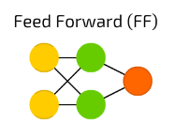
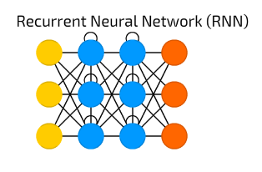
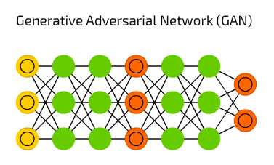
Neural Network Types
https://towardsdatascience.com/the-mostly-complete-chart-of-neural-networks-explained-3fb6f2367464

Slide 14
Digression– Challenges to think about
Feature Growth – (Imagine 1 for every word in the dictionary ???)
Slow to train
Hard to determine valuable features vs junk
Non-Numeric Features
How to encode Trade Type = “Swap, Bond, Future” into digits ?
How to normalize across numbers of various ranges (Notional $100m’s vs Gender M/F)
Which model to use – there are so many ….
Training takes time (can take days/weeks on hundreds of CPU to train an AI)
Game AI Dota2 (open.ai 2017) Months w/ 256 GPUs and 128,000 CPU cores !!
Alpha Go (Google 2015) – 40 days w/ 176 GPU
Alpha Go Zero (2017) – 3 days w/ just 4 TPU !!
https://blog.openai.com/openai-five/
https://en.wikipedia.org/wiki/AlphaGo
https://deepmind.com/blog/alphago-zero-learning-scratch/

Slide 15
State of AI/ML – Platform Showdown
Big Data &
Database Vendors
API/Analytic Toolkits
Full Stack Vendors
Cloud
Providers
Scikit Learn
TensorFlow
MXNET
PyTorch
Apache Spark & Hadoop
KDB
Oracle
Alteryx
H2o
Tableau
Google GCP
Amazon AWS
MSFT Azure
Oracle
Data Robot
Note on the danger of SkyNet & “The Singularity” (Ray Kurtzweil & Von Neumann)

Slide 16
Machine Learning Workflow
Typical Workflow
Data Sourcing
Data Store
Feature Engineer
Model Selection
Train
Deploy
II. Refine Features & Model
I. Load/Cleanup Data
Durations
12 month project
9 months+ – 80%
2-3 months+ – 15%
1-2 months+ – 5%
Platform Strengths
Big Data Vendors
Full Stack Vendors
Cloud Vendors
API Vendors

Slide 17
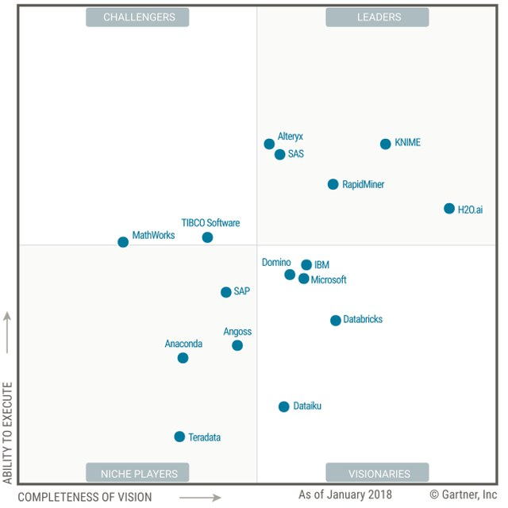
Full Stack Vendors
Summary of Gartner Magic Quadrant Analysis
“Full Stack Vendors” offer a E2E solution –
Some Data Loading ETL tools
Some Data Storage
Feature Selection Tools
Strong DS Test Env & Auto-ML
Deployment tools
Visualization/Dashboards
Where is Data Robot??
https://www.gartner.com/doc/3860063/magic-quadrant-data-science-machinelearning

Slide 18
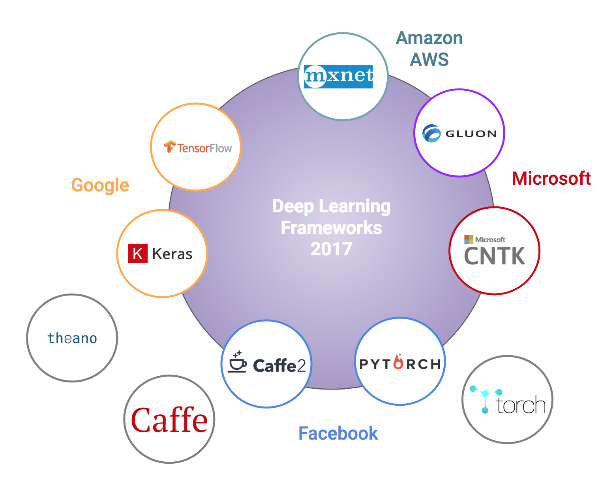
API/Analytic Toolkits
API and Analytic Libraries
Low level Libraries
All do the same thing (diff GPU/OS support)
Good for highly technical teams just needing an API library
They are all similar.. And seem to be converging (TensorFlow, PyTorch, Keras are winning ?)..
https://towardsdatascience.com/battle-of-the-deep-learning-frameworks-part-i-cff0e3841750

Slide 19
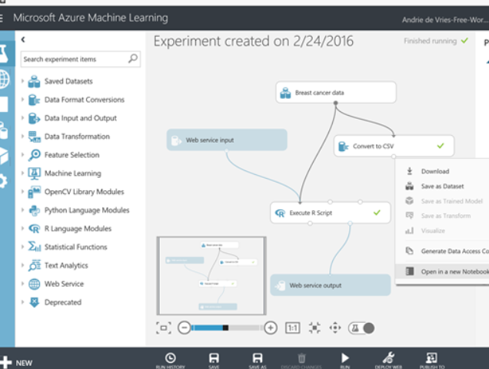
Cloud Offerings
Amazon AWS
Azure ML Studio
Google GCP & Tensorflow
Oracle Cloud Platform (GCP)
Sony Cloud
Features:
CPU/GPU/TPU on demand
Some have GUI’s
Good Data backend integration
Strong deployment tools

Slide 20
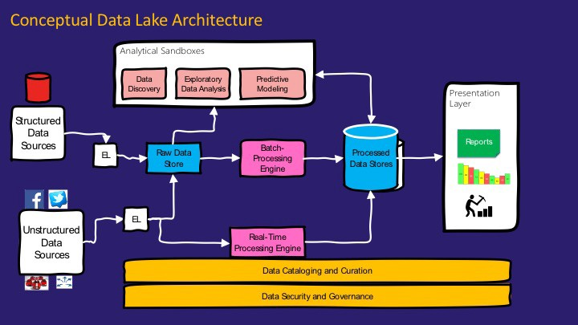
Big Data – Apache Spark/Hadoop
Apache Spark & Hadoop
KDB
Oracle
Bring ML to the data
(Data being the hardest part ?)
https://medium.com/@rpradeepmenon/demystifying-data-lake-architecture-30cf4ac8aa07
https://www.jamesserra.com/archive/2015/04/what-is-a-data-lake/

Slide 21
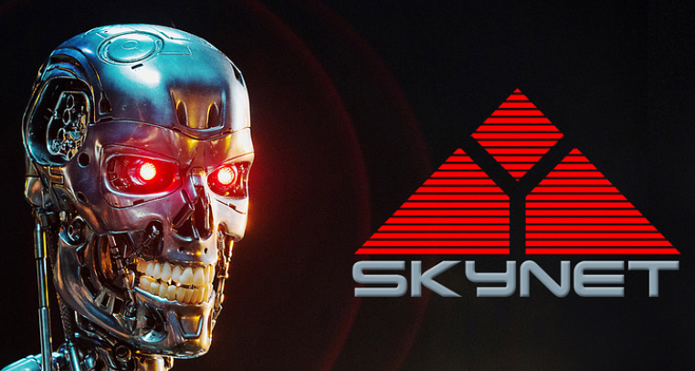
Final Words
“Stephen Hawking warns artificial intelligence could end mankind ...”
“Beware the singularity, says Skype founder | Stuff.co.nz”
The "Father of Artificial Intelligence" Says Singularity Is 30 Years Away ...
The Singularity..
Theory/Logic
If we can train a machine to be “smarter” than us (the creators) – “the singularity”
Then the machine can train another machine to be smarter than itself
Recursively – it can evolve into a super-intelligence
What this sometime for fun: https://www.youtube.com/watch?v=ye5C-zlCAyM&t=211s
In Practice.. we are nowhere near this for “Artificial General Intelligence” – all applications so far are “Narrow Intelligence”… Kurtzweil thought we are < 30yr away (See: AI Winter)
https://en.wikipedia.org/wiki/Technological_singularity
“Singularity” term comes from Ray Kurtzweil, who says he came up with this from reading works by John Von Neumann
https://www.technologyreview.com/s/608911/is-ai-riding-a-one-trick-pony/

Slide 22
References
History of ML
http://www.psych.utoronto.ca/users/reingold/courses/ai/cache/neural4.html
https://cs.stanford.edu/people/eroberts/courses/soco/projects/neural-networks/History/history1.html
https://www.import.io/post/history-of-deep-learning/
https://en.wikipedia.org/wik/Timeline_of_machine_learning
Singularity
Ray Kurzweil – Singularity - https://en.wikipedia.org/wiki/The_Singularity_Is_Near
John Von Neumann - https://en.wikipedia.org/wiki/The_Computer_and_the_Brain
Hardware
TPU diagram (scalar, vector, matrix) and perf chart: https://cloud.google.com/blog/big-data/2017/05/an-in-depth-look-at-googles-first-tensor-processing-unit-tpu#closeImag
Other
Kaggle – Boosting 70% wins (article: https://medium.com/syncedreview/tree-boosting-with-xgboost-why-does-xgboost-win-every-machine-learning-competition-ca8034c0b283)

Slide 23
Appendix

Slide 24
How it really works - Linear Regression example (1)
100’s $
Linear price model:
h(x) = W₀ + W₁*SqM + W₂*Loc + W₃*BR + …
General form:
h(x) = W₀ + W₁*X₁ + W₂*X₂ + W₃*X₃ + ….
Use X^{n} samples to learn “weights” W_{n}
10 SqM
Simplified Model example using just 1 variable/feature.
h(x) = W₀ + W₁*SqM
ie, y = mx+ b (solve for the regression line)
Solve for W₀,W₁ given x samples {5,10,15,20]; y labels=[3,4,3,5]
Algorithm:
Choose random W₀,W₁
Calculate Error (MSE - Mean Square Error)
Adjust W to minimize MSE (Gradient Descent)
Iterate until minimum error
Adapted from Andrew Ng’s Machine Learning course: https://www.coursera.org/learn/machine-learning )

Slide 25

How it really works - Linear Regression example (2)
100’s $
x samples {5,10,15,20]; y labels=[3,4,3,5]
Algorithm:
Choose random W₀,W₁
Calculate Error (MSE - Mean Square Error)
Adjust W to minimize MSE (Gradient Descent)
Iterate until minimum error
10 SqM
Iteration:
Set W₀,W₁ = 1,1 ie, y = x + 1
Calculate Error(E) - MSE = $Σ$(y^{i} – f(x^{i}))
Calculate Gradients - $\frac{∂E}{∂\text{W}\text{0}}$ and $\frac{∂E}{∂\text{W}\text{1}}$
Adjust W₀,W₁ by Gradients
Iterate until Error is mimimized

