Slide 1
HEMA Simulator
Eric Reesor & Conlan LaFreniere
Supervisor: Dr. Samuel Ajila

Slide 2

Presentation Outline
Project Overview
Background Concepts
Software System Design Process
Hardware Input Design Process
Conclusion

Slide 3

Project Objective
Provide reliable HEMA training to novices without the need for a trainer

Slide 4

Breaking it down
What is Historical European Martial Arts (HEMA)?
What is a simulator?
Who is this for?

Slide 5

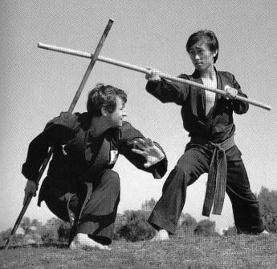
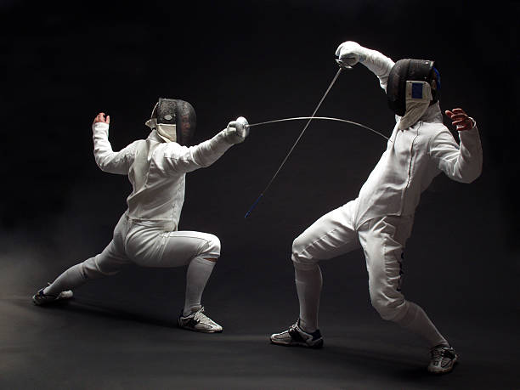
What are Martial Arts?
Self-defense or combat theory utilizing physical skill and coordination

Slide 6
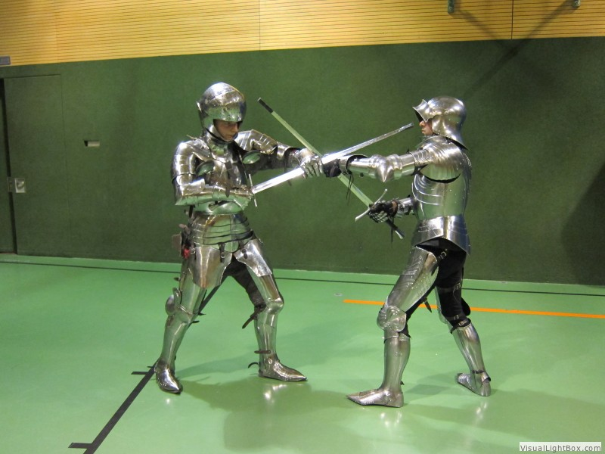
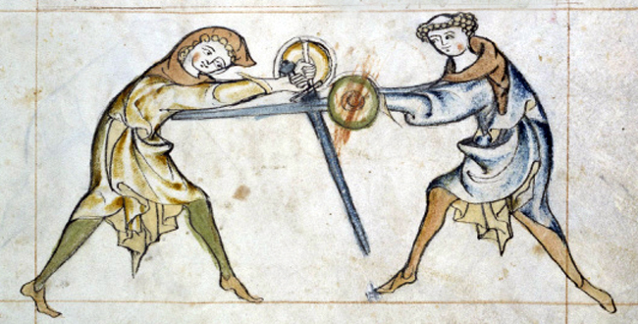
Historical European Martial Arts
Martial arts of European origin, based on historical texts

Slide 7
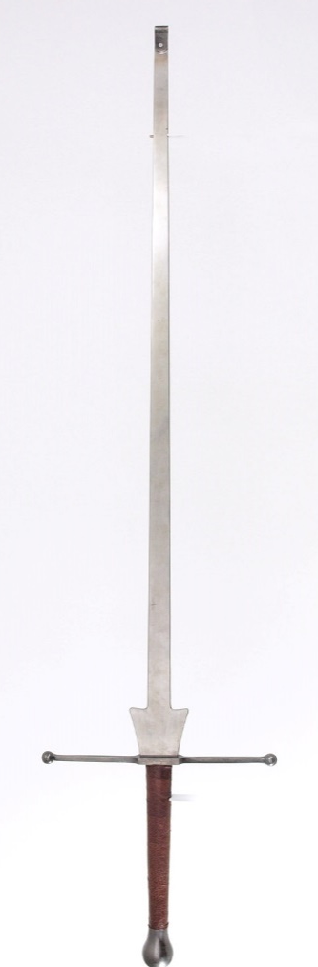
Liechtenauer Fencing School
Based upon teachings of Johannes Liechtenauer
Evolved into modern German fencing
Utilizes the Federschwert (feather sword)

Slide 8
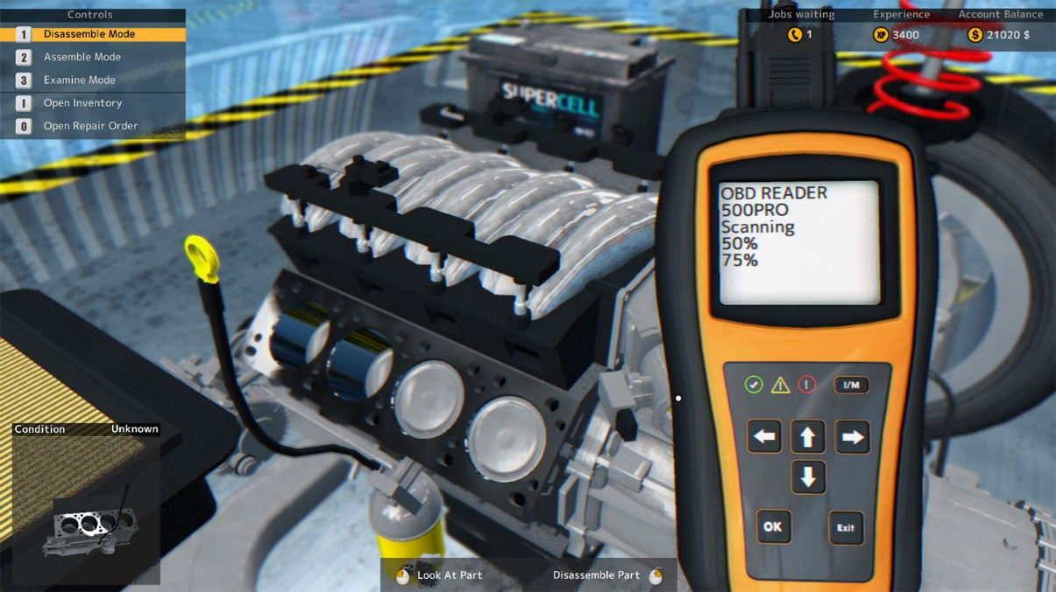
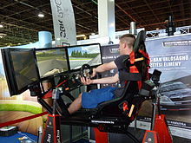
What is a Simulator
A set of controls designed to provide a realistic imitation of a complex system; used for training purposes

Slide 9

Why Use Simulation?
Minimize financial overhead
Simplified distribution of knowledge
Expand potential client base
Hardware standards are increasing
Allows practical training without the physical risks

Slide 10
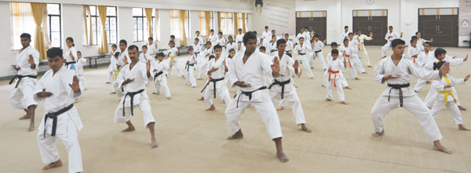
Who is this for?

Slide 11
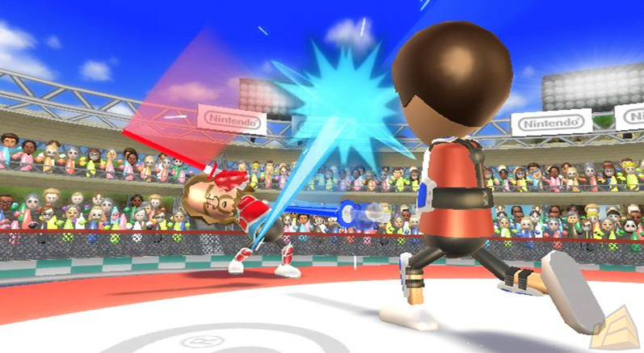
Our Application
Influenced by Wii design
Built on pose estimation
Train user in Liechtenauer fencing
Replaces need for an opponent
Heavily focused on martial form

Slide 12
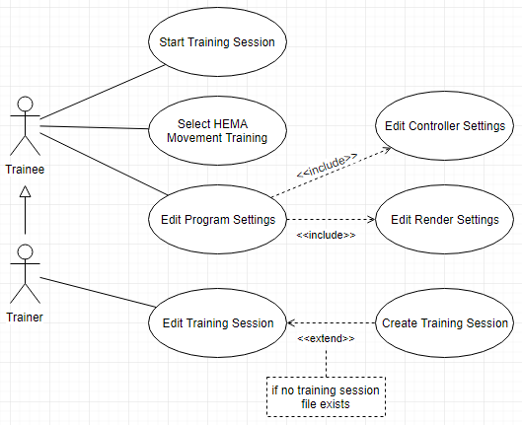
Requirements Analysis
Eric’s HEMA knowledge + Conlan’s design knowledge
Design goals elicitation
Application structure

Slide 13



Design Goals
Responsiveness, Extensibility, Transmission Integrity

Slide 14
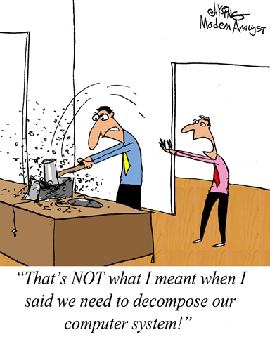
System Decomposition
Maximize cohesion, minimize coupling
Open for extension, closed for modification
Service based design

Slide 15
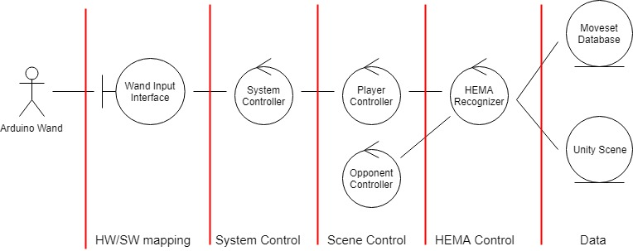
Control Flow

Slide 16
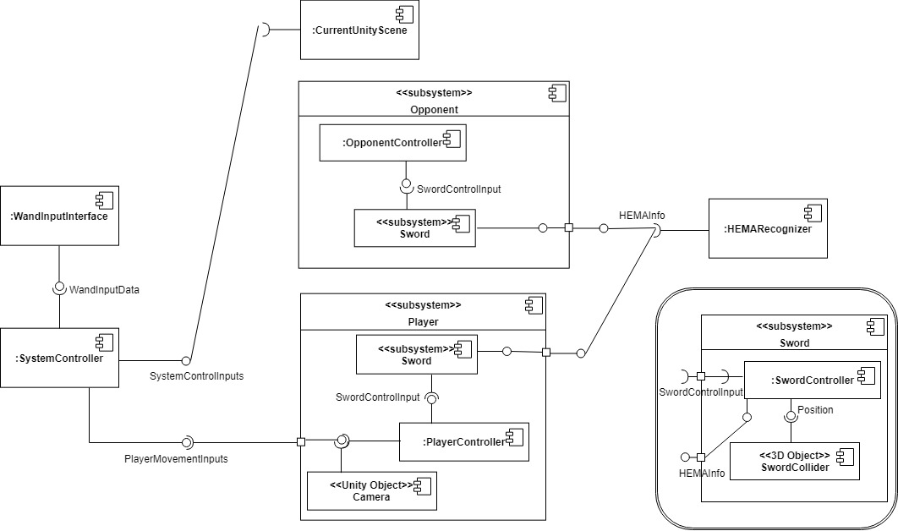
System Decomposition (Con’t)

Slide 17
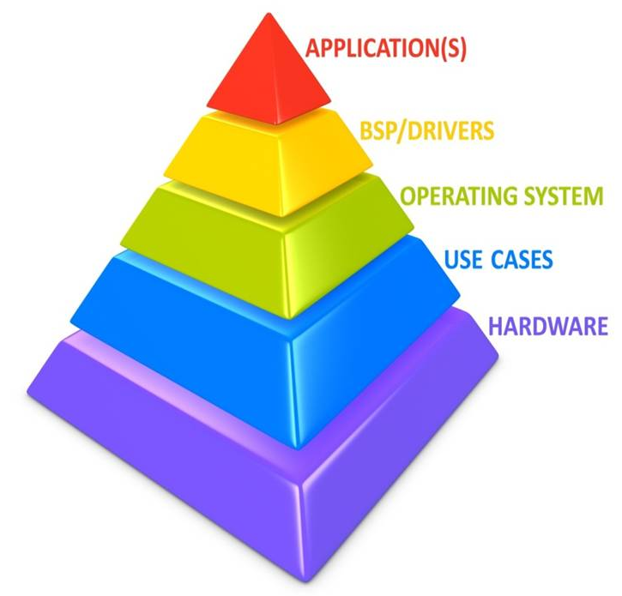
Abstract System Design
High Level: ???
Application Level: Unity3d
Low Level: Wand Control Inputs

Slide 18
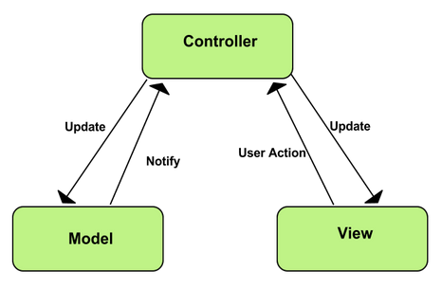
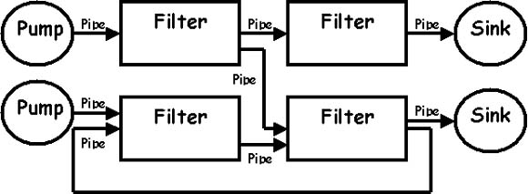
Software Architecture Design Patterns
A generalized software solution applicable to multiple contexts

Slide 19
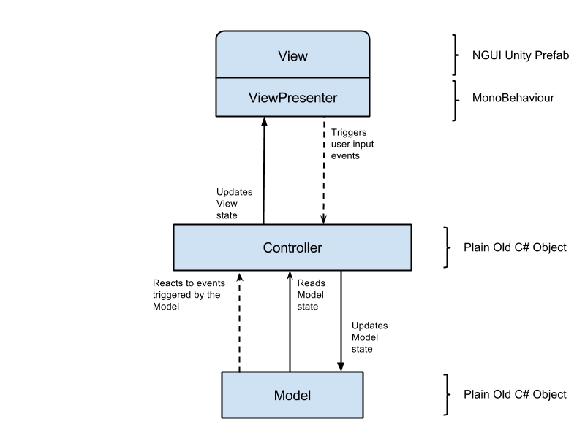
Model View Controller
Easily modifiable and extensible
Common practice in industry
Built around reactions to user input

Slide 20
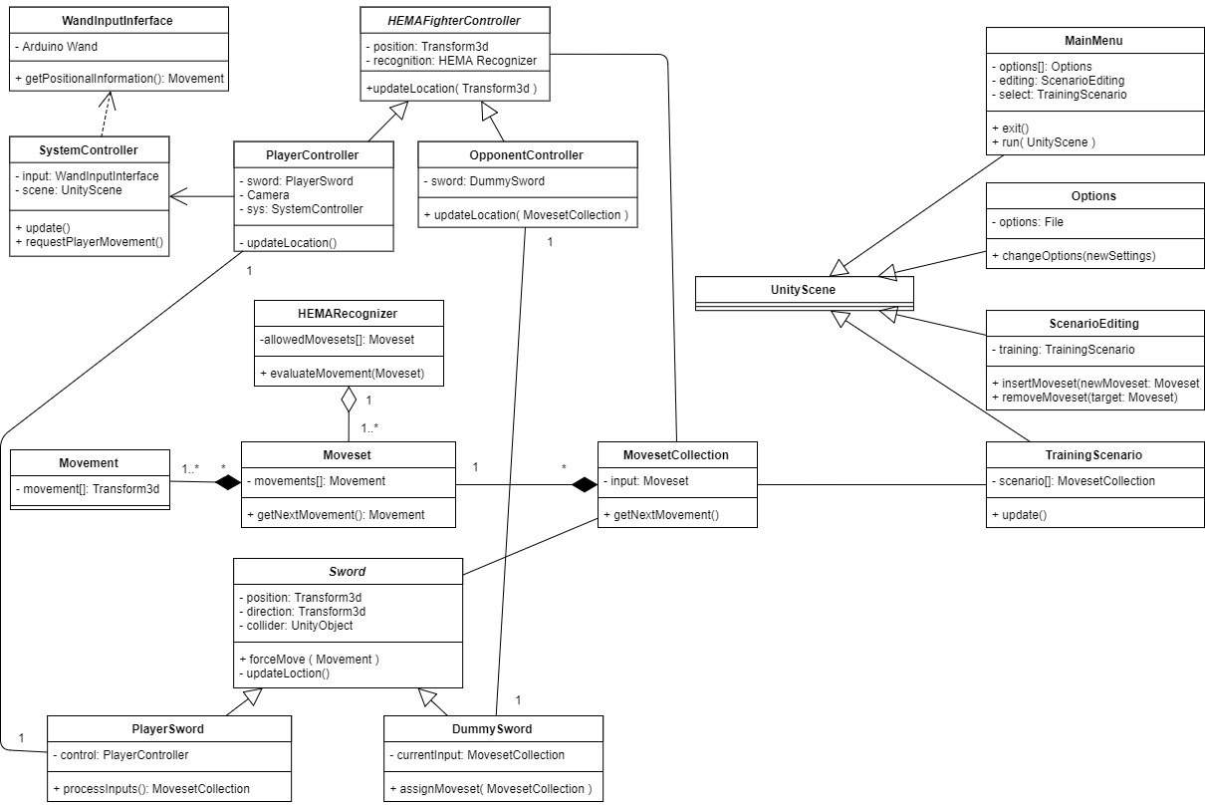
Domain Model

Slide 21
Motion Controls
System input is taken from a 3 axis Inertial Measurement Unit (IMU)
Connected via an I2C interface to an Arduino Uno
IMU data transmitted to simulation system via Bluetooth
Simulation model
Strapdown Inertial Navigation
Uses IMU data to estimate orientation and position

Slide 22
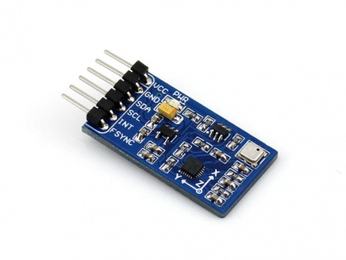
THE IMU
Gyroscope
Measure rotation of unit in degrees/second
Accelerometer
Measures forces acting upon the unit including gravity
Units of G (9.81m/s²)

Slide 23
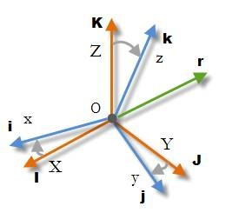
Strapdown Inertial Navigation
Step 1
Estimate orientation using a known starting orientation and dynamically adding rotations read by the IMU.
Uses Directional Cosine Matrix (DCM)
For Unity3D, this is converted to a quaternion

Slide 24
Strapdown Inertial Navigation
Step 2
Use the DCM to transform the accelerations read by the IMU to a global frame of reference.
Removing gravitation acceleration from the transformed acceleration gives the unit’s actual acceleration.
Using a known starting position and speed, a position estimation is given by relating acceleration to change in position over time

Slide 25
Strapdown Inertial Navigation
All calculation listed in these steps is handled by the simulation system. This results in having an estimate of the orientation and position of the IMU which can be used by the Unity3D game engine. Mounting this on a mock sword will allow realistic input to the simulation. This configuration is dubbed the Federuino (Federschwert + Arduino)

Slide 26
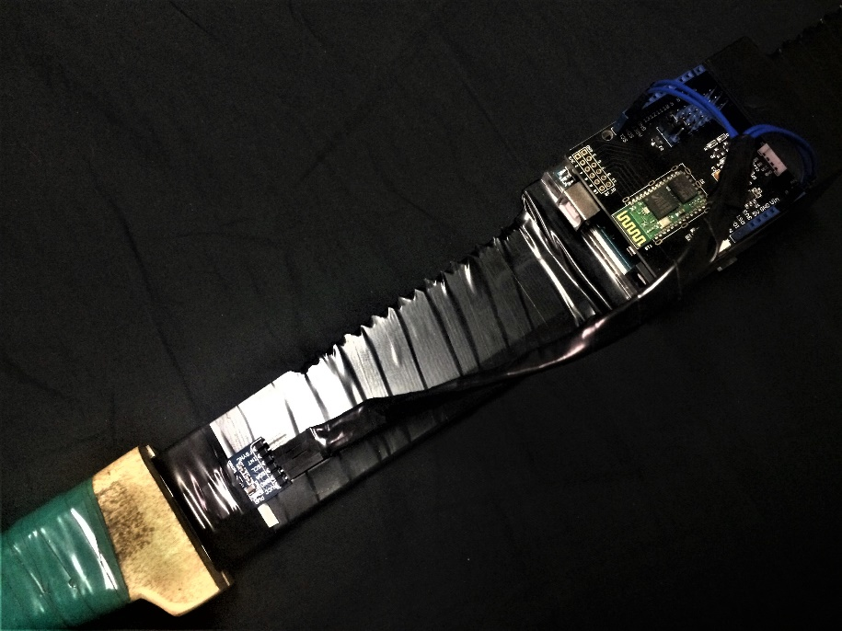
FeDEruino
Arduino Uno
Waveshare 10DOF IMU
Seeed Studio Bluetooth Shield v2.0

Slide 27
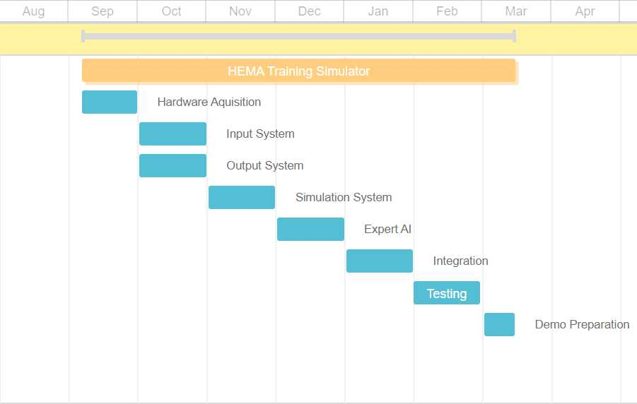
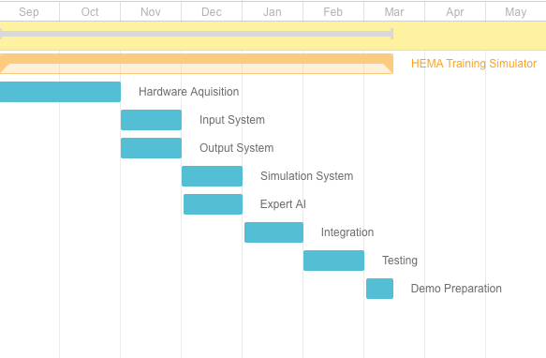
Progress So Far
September 2017 January 2018

Slide 28
Project Roadblocks
Wiimote Plus – the original input system
It was insufficient when trying to estimate orientation and position
Replaced with the Federuino system
Original Bluetooth module
Scarce documentation for the original module delayed progress and after, the module ceased functioning
Replaced with the SEEED Bluetooth Shield

Slide 29
References
Woodman, Oliver J. (2007) An introduction to inertial navigation. Cambridge: University of Cambridge, p. 21-23. Available at: https://www.cl.cam.ac.uk/techreports/UCAM-CL-TR-696.pdf (Accessed 20 Jan,2018)
The Open Group. (2006). Architectural Patterns. Retrieved January 22, 2018, from http://pubs.opengroup.org/architecture/togaf8-doc/arch/chap28.html
Mallawaarachchi, V. (2017, September 04). 10 Common Software Architectural Patterns. Retrieved January 23, 2018, from https://towardsdatascience.com/10-common-software-architectural-patterns-in-a-nutshell-a0b47a1e9013
Unity Technologies. (n.d.). Scenes Documentation. Retrieved January 24, 2018, from https://docs.unity3d.com/Manual/CreatingScenes.html

Slide 30

In Conclusion
HEMA training simulator progresses, if slowly
Next steps are input recording and standardizing
On track for March 2018 completion

Slide 31

Thanks for Listening! Questions?

