Slide 1
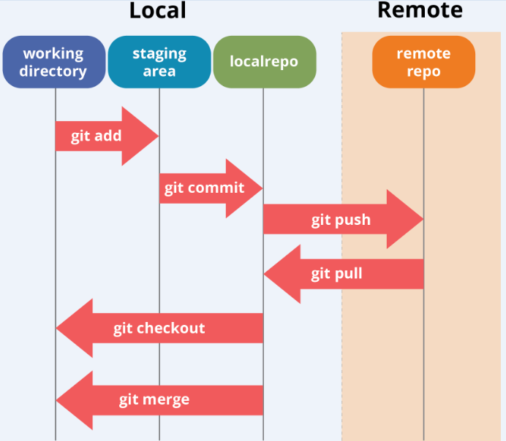

Slide 2
Following are the repo providers:
GitHub, GitHub Enterprise
GitLab, GitLab self-hosted
Bitbucket, Bitbucket Server

Slide 3
git clone url : it copy the remote repository content to local machine directory.
git pull : it is used to fetch and download content from a remote repository and immediately update the local repository to match that content
git pull origin branch_name : pull the code of particular branch
git checkout branch_name : to move to existing branch
git checkout -b branch_name : creation of new branch
git add filename or git add –a : kept the file in staging area
git commit -m “message name” : save file in local repository i.e in local machine
git checkout --filename
git merge branch_name
git push origin branch_name : save file in remote repostiory i.e github

Slide 4
STASH
Feature111
Feature112
git stash temporarily shelves (or stashes) changes you've made to your working copy so you can work on something else, and then come back and re-apply them later on.
git stash save “save message”
git stash list
git stash show
git stash pop stash_name or git stash apply stash_name
git stash drop stash_name
git stash clear
git reset --hard

Slide 5
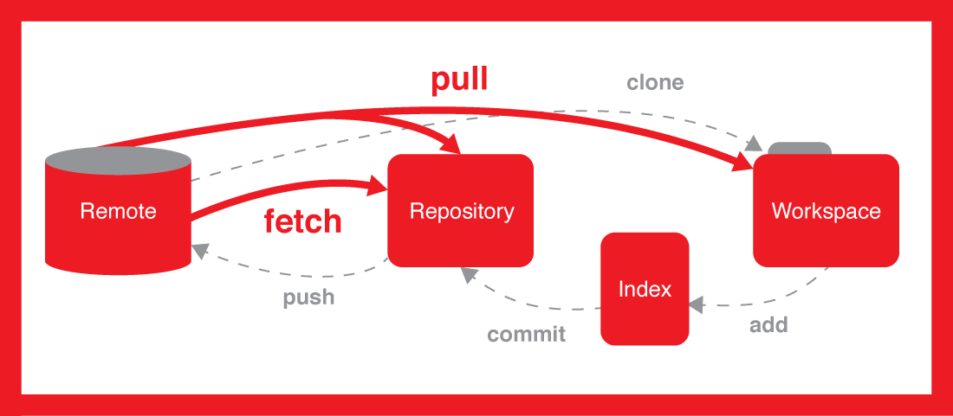
git fetch is the command that tells your local git to retrieve only the latest meta-data info from remote repository but no file/data gets transferred to local repository. git pull on the other hand does that AND brings (copy) those changes from the remote repository

