Slide 1

ROOMAN TECHNOLOGIES
Cybersecurity Internship Program
Phase 2 — Build
Establish an IPSec VPN Tunnel
Between Head Office & Datacenter
Name
Tool
Domain
Phase
Nithin Nayaka V N
Cisco Packet Tracer 9.0
Cybersecurity
02 — Build

Slide 2
Phase 2 Roadmap — 5-Day Build Plan
Day 1
Day 2
Day 3
Day 4
Day 5
Topology
IP Config
Routing
IPSec VPN
Testing
Place 15 devices
Connect cables
Assign IPs to all
routers & PCs
Static routes for
end-to-end reach
IKE + Transform
+ Crypto Map
Ping + verify
crypto SA
✔ Deliverable: IPSec VPN tunnel QM_IDLE ACTIVE with 0% packet loss across 15 devices
Rooman Technologies | Cybersecurity Internship | Phase 2 — Build

Slide 3
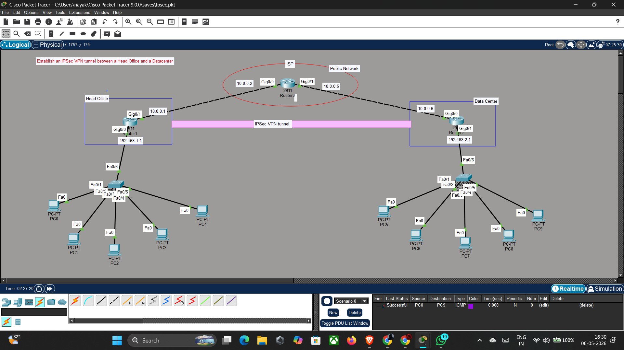
Day 1 — Network Topology (15 Devices)
Rooman Technologies | Cybersecurity Internship | Phase 2 — Build | Day 1: Topology Design

Slide 4
Day 2 — IP Address Configuration
Device | Interface | IP Address | Role
HO-Router | Gi0/0 | 192.168.1.1 /24 | HO LAN Gateway
HO-Router | Gi0/1 | 10.0.0.1 /30 | WAN to ISP
ISP-Router | Gi0/0 | 10.0.0.2 /30 | WAN facing HO
ISP-Router | Gi0/1 | 10.0.0.5 /30 | WAN facing DC
DC-Router | Gi0/0 | 10.0.0.6 /30 | WAN to ISP
DC-Router | Gi0/1 | 192.168.2.1 /24 | DC LAN Gateway
PC0–PC4 (HO) | Fa0 | 192.168.1.x /24 | GW: 192.168.1.1
PC5–PC9 (DC) | Fa0 | 192.168.2.x /24 | GW: 192.168.2.1
Rooman Technologies | Cybersecurity Internship | Phase 2 — Build | Day 2: IP Configuration

Slide 5
Day 3 — Static Routing Configuration
HO-Router
ISP-Router
DC-Router
ip route 192.168.2.0 255.255.255.0 10.0.0.2
ip route 192.168.1.0 255.255.255.0 10.0.0.1
ip route 192.168.1.0 255.255.255.0 10.0.0.5
ip route 10.0.0.4 255.255.255.252 10.0.0.2
ip route 192.168.2.0 255.255.255.0 10.0.0.6
ip route 10.0.0.0 255.255.255.252 10.0.0.5
✓ Routes applied & saved
✓ Routes applied & saved
✓ Routes applied & saved
Baseline Test (before VPN): PC0 → ping 192.168.2.2 — SUCCESS ✓ (unencrypted baseline confirmed)
Rooman Technologies | Cybersecurity Internship | Phase 2 — Build | Day 3: Static Routing

Slide 6
Day 4 — IPSec VPN: IKE Phase 1 (ISAKMP Policy)
Encryption
HO-Router & DC-Router:
AES-128
crypto isakmp policy 10
encryption aes 128
Hash
hash sha
SHA-1
authentication pre-share
group 2
Auth
lifetime 86400
Pre-Shared Key
exit
DH Group
! HO-Router PSK:
Group 2 (1024-bit)
crypto isakmp key ROOMAN@VPN
address 10.0.0.6
Lifetime
! DC-Router PSK:
86400 sec (24 hrs)
crypto isakmp key ROOMAN@VPN
address 10.0.0.1
Rooman Technologies | Cybersecurity Internship | Phase 2 — Build | Day 4: IPSec Configuration

Slide 7
Day 4 — IKE Phase 2, ACL & Crypto Map
Transform Set
ACL (Interesting Traffic)
Crypto Map (VPNMAP)
crypto ipsec transform-set
! HO-Router:
crypto map VPNMAP 10
TSET esp-aes
access-list 101 permit ip
ipsec-isakmp
esp-sha-hmac
192.168.1.0 0.0.0.255
set peer 10.0.0.6
192.168.2.0 0.0.0.255
set transform-set TSET
ESP-AES: Encrypts data
match address 101
ESP-SHA-HMAC: Integrity
! DC-Router:
Mode: Tunnel
access-list 101 permit ip
int Gi0/1
192.168.2.0 0.0.0.255
crypto map VPNMAP
192.168.1.0 0.0.0.255
Applied to WAN interfaces: HO-Router → Gi0/1 | DC-Router → Gi0/0
Rooman Technologies | Cybersecurity Internship | Phase 2 — Build | Day 4: IPSec Configuration

Slide 8
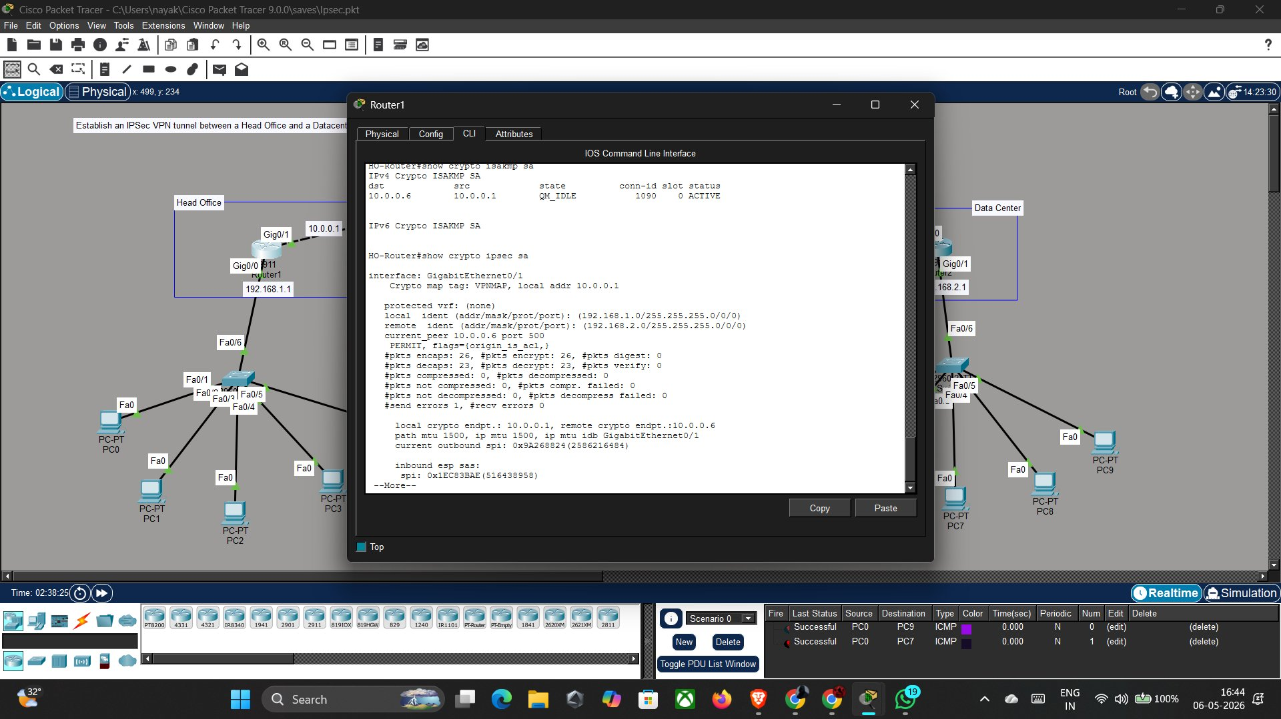
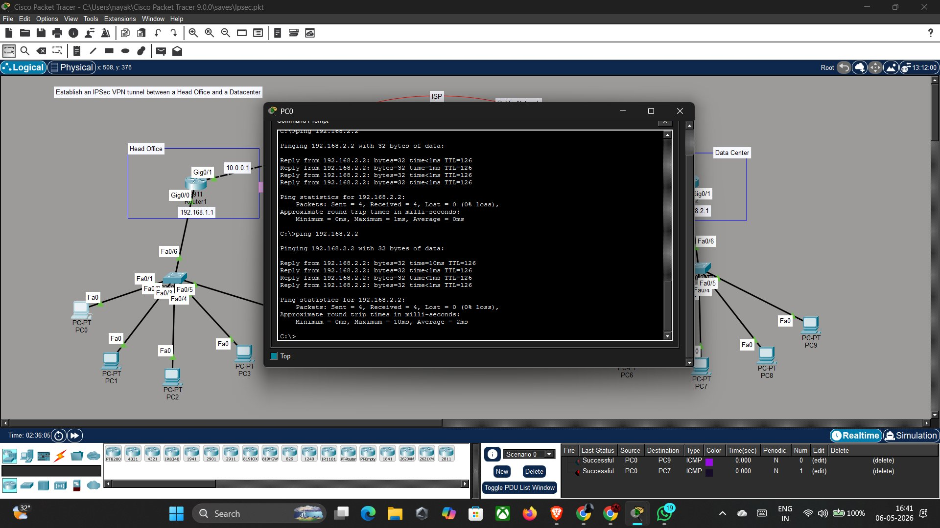
Day 5 — Testing & Verification
show crypto isakmp sa → QM_IDLE ACTIVE ✓
PC0 → ping 192.168.2.2 → 0% loss ✓
26
23
QM_IDLE
0%
pkts encrypt
pkts decrypt
Tunnel State
Packet Loss
Rooman Technologies | Cybersecurity Internship | Phase 2 — Build | Day 5: Testing & Verification

Slide 9
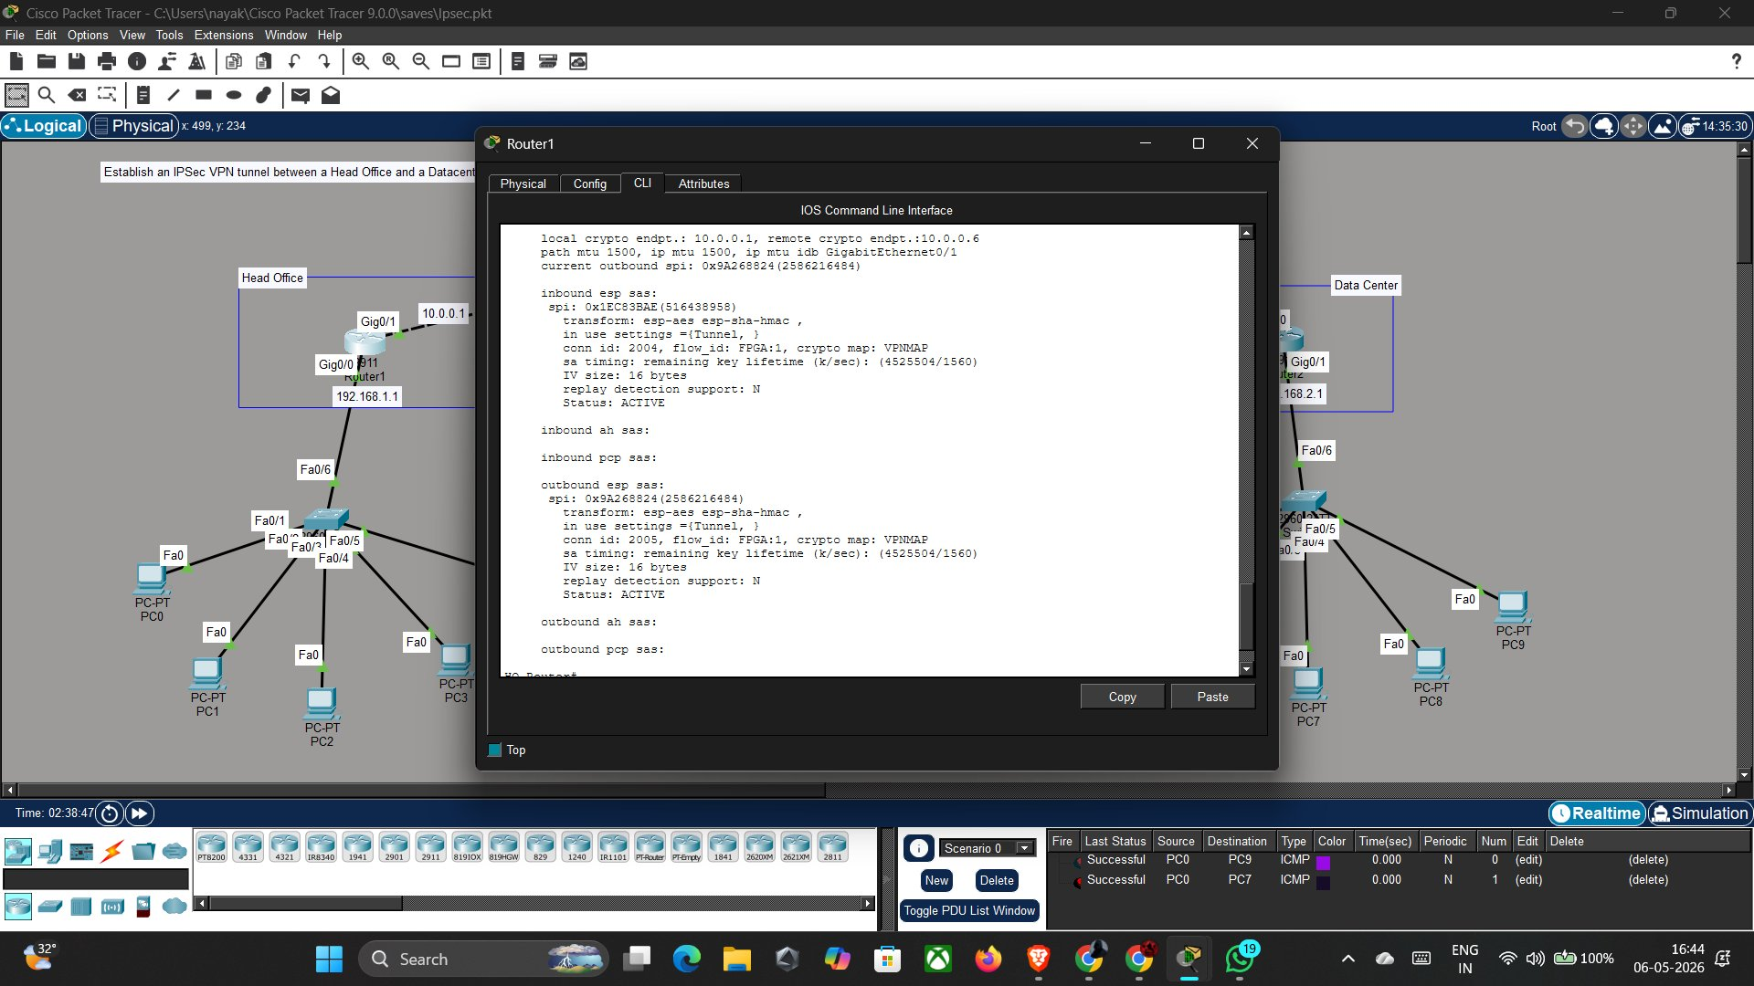
Day 5 — show crypto ipsec sa Output
Rooman Technologies | Cybersecurity Internship | Phase 2 — Build | Verification: IPSec SA Details

Slide 10
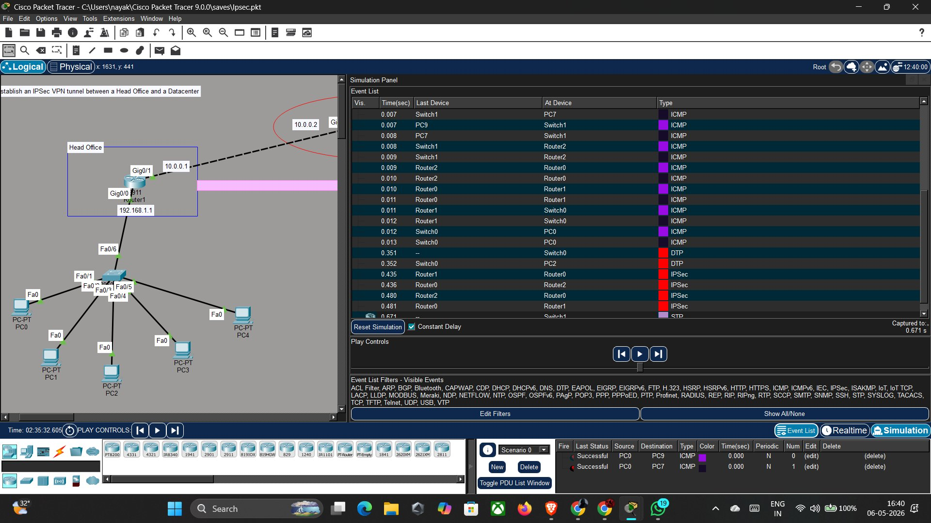
Simulation Mode — Packet Flow Visualization
IPSec packets (red) visible between routers — confirms traffic is encrypted through the tunnel
Rooman Technologies | Cybersecurity Internship | Phase 2 — Build | Simulation Verification

Slide 11
Phase 2 Summary — All Deliverables Met
✓
15-device topology built in Packet Tracer
✓
IKE Phase 2: Transform set TSET (ESP-AES + SHA-HMAC)
✓
IP addresses configured on all 3 routers & 10 PCs
✓
Crypto map VPNMAP applied to WAN interfaces
✓
Static routing verified (end-to-end pre-VPN ping)
✓
Tunnel status: QM_IDLE ACTIVE (conn-id 1090)
✓
Security license activated (securityk9 package)
✓
Encrypted packets: 26 encaps / 23 decaps confirmed
✓
IKE Phase 1 policy: AES-128, SHA-1, PSK, Group 2
✓
PC0 → PC9 ping: 4/4 packets, 0% loss
🎉 Phase 2 Complete — IPSec VPN Tunnel Successfully Established!

