Slide 1

ROOMAN TECHNOLOGIES
Cybersecurity Internship Program
Phase 3 — Present
Establish an IPSec VPN Tunnel
Between Head Office & Datacenter
Name
Tool
Domain
Phase
Nithin Nayaka V N
Cisco Packet Tracer 9.0
Cybersecurity
03 — Present

Slide 2



Problem Statement
Why Does This Project Matter?
Organizations transmit sensitive data — employee records, financial data, internal communications — over public networks. Without encryption, this data is exposed to interception, tampering, and unauthorized access.
Packet Sniffing
MITM Attack
Unauthorized Access
Capturing unencrypted
packets in transit
Intercepting &
modifying data
Exploiting unprotected
communication channels
Rooman Technologies | Cybersecurity Internship | Phase 3 — Present

Slide 3
Our Solution — IPSec Site-to-Site VPN
IKE Phase 1 — Key Exchange
IKE Phase 2 — Data Encryption
Encryption:
AES-128
Transform Set:
TSET
Hash:
SHA-1
Encryption:
ESP-AES
Auth:
Pre-Shared Key
↔
Integrity:
ESP-SHA-HMAC
DH Group:
Group 2
Mode:
Tunnel
Lifetime:
86400 sec
Crypto Map:
VPNMAP
Rooman Technologies | Cybersecurity Internship | Phase 3 — Present

Slide 4
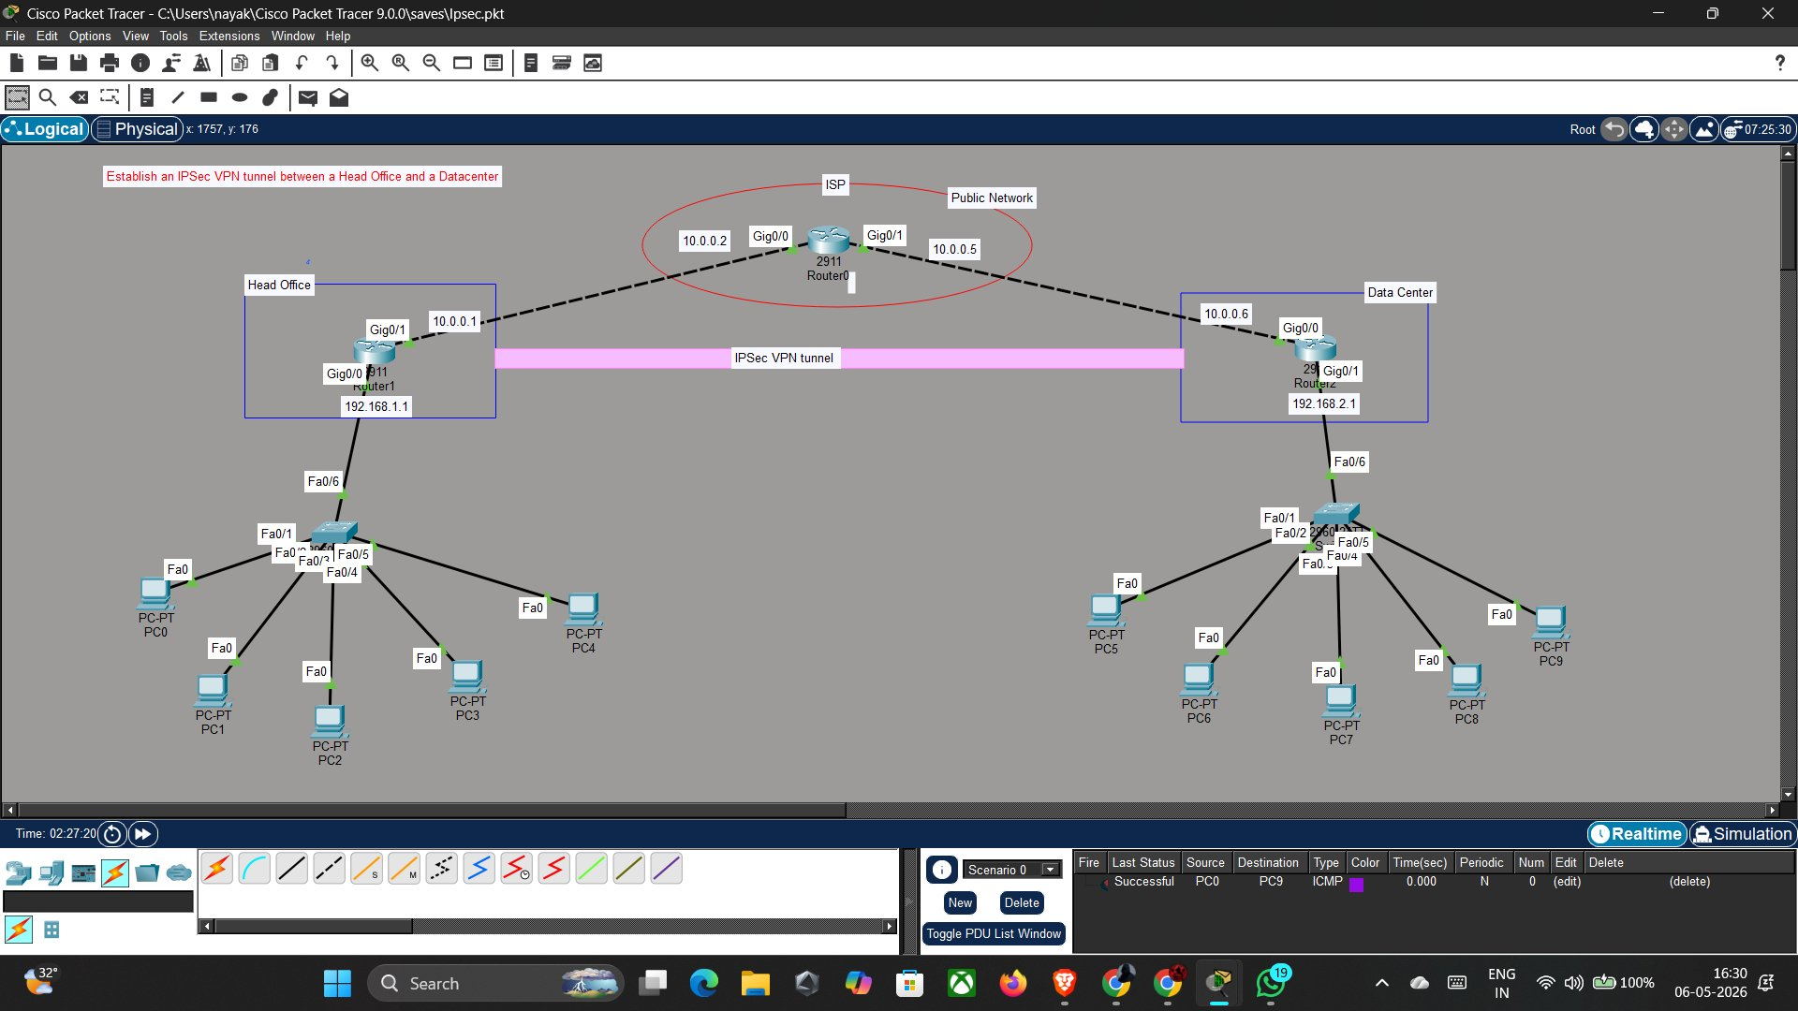
Network Topology — 15 Devices
• 3 Cisco 2911 Routers
• 2 Cisco 2960 Switches
• 10 PCs (5 per site)
• Simulated ISP/Internet
Rooman Technologies | Cybersecurity Internship | Phase 3 — Present | Network Design

Slide 5
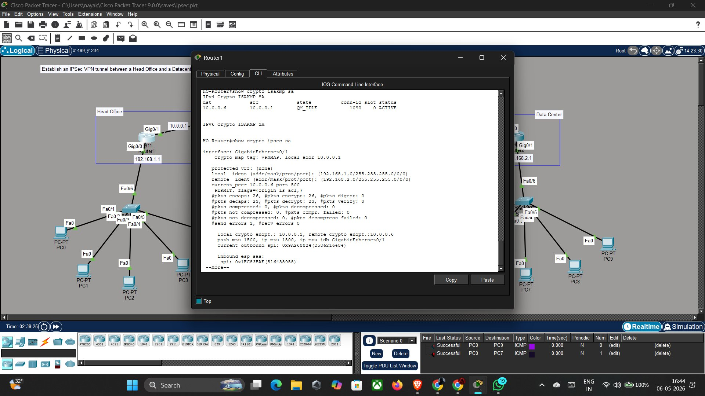
Live Demo — VPN Tunnel Verification
QM_IDLE = IKE Phase 1 ACTIVE | conn-id: 1090 | Peer: 10.0.0.1 ↔ 10.0.0.6
Rooman Technologies | Cybersecurity Internship | Phase 3 — Present | Demo: Tunnel Status

Slide 6
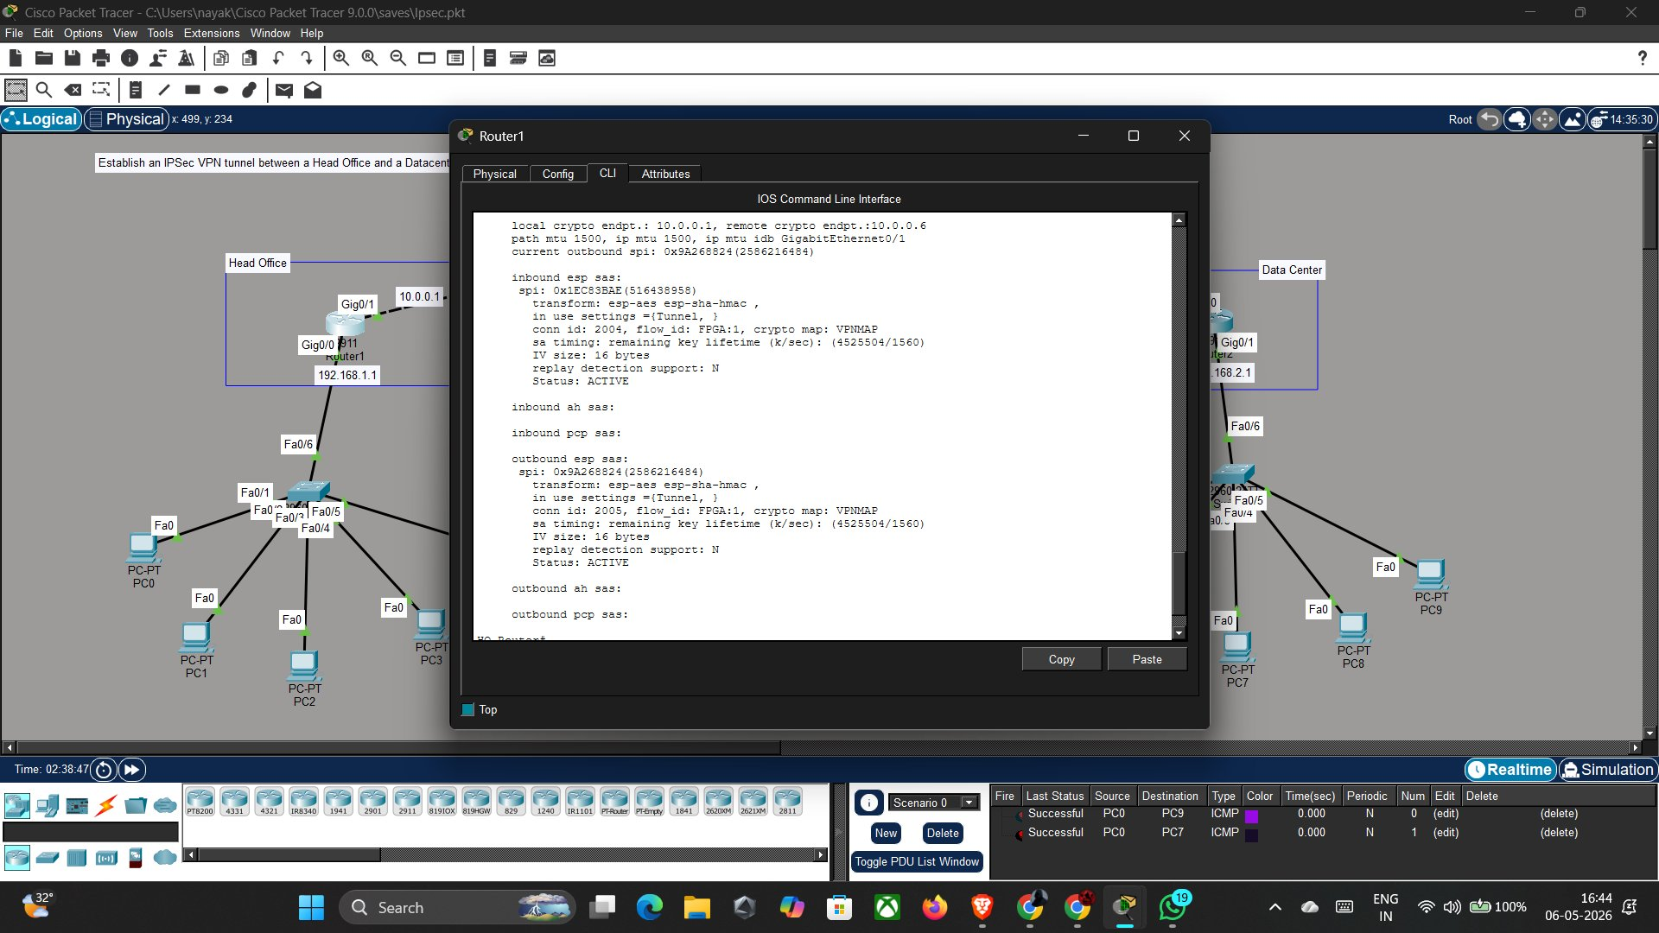
Live Demo — IPSec SA & Encrypted Packets
26
26
23
23
pkts encaps
pkts encrypt
pkts decaps
pkts decrypt
Rooman Technologies | Cybersecurity Internship | Phase 3 — Present | Demo: IPSec SA

Slide 7
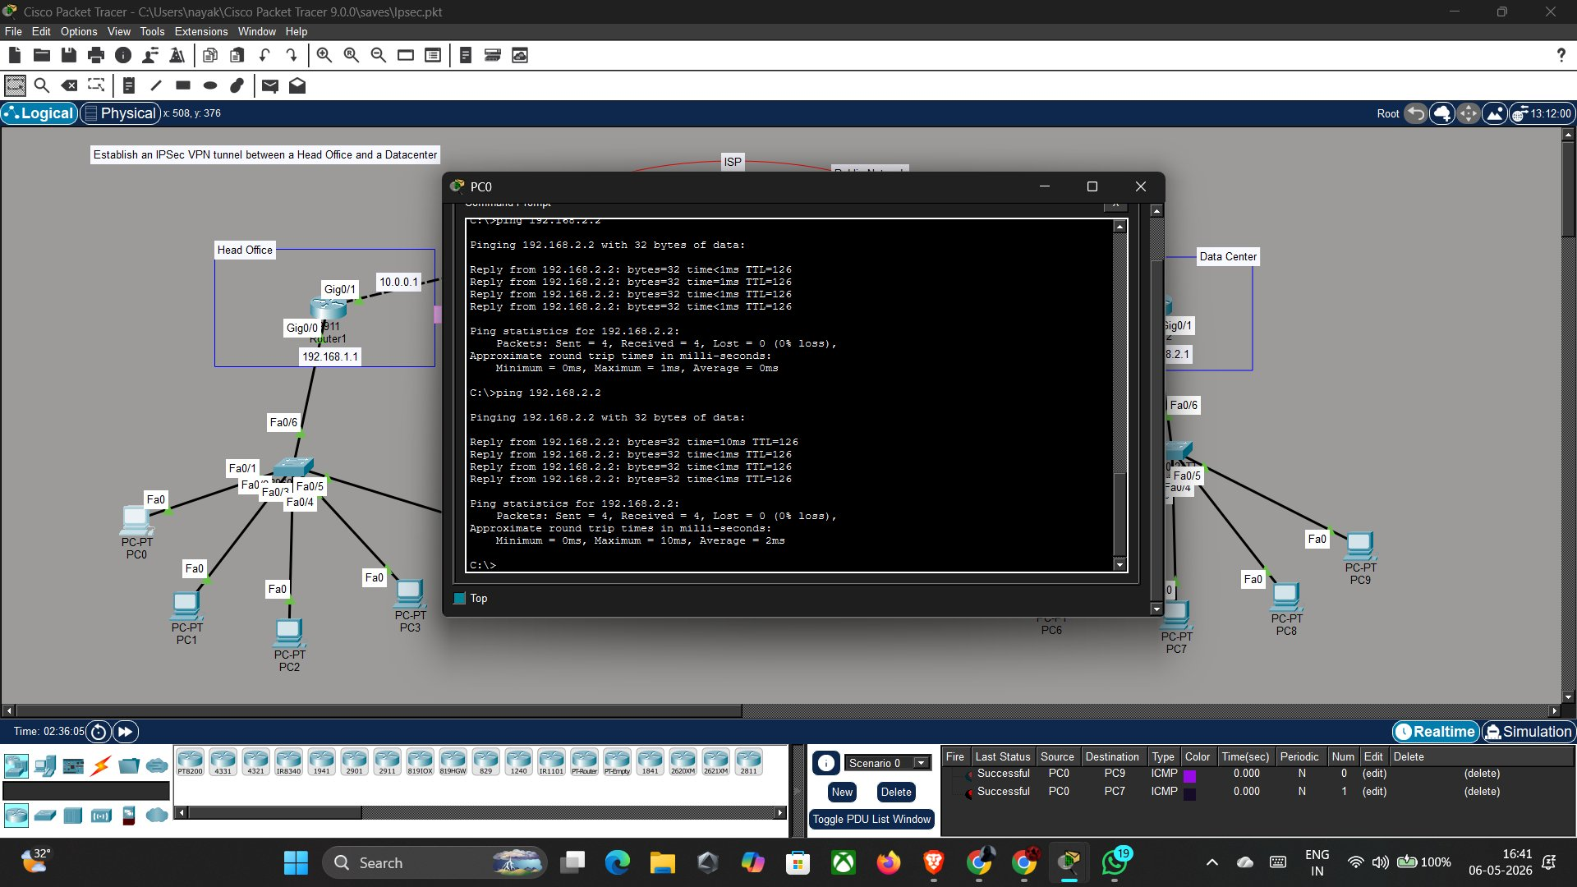
Live Demo — End-to-End Connectivity (PC0 → DC)
PC0 (192.168.1.x) → ping 192.168.2.2 (Datacenter) | Sent = 4, Received = 4, Lost = 0 (0% loss) ✓
Rooman Technologies | Cybersecurity Internship | Phase 3 — Present | Demo: PC-to-PC Ping

Slide 8
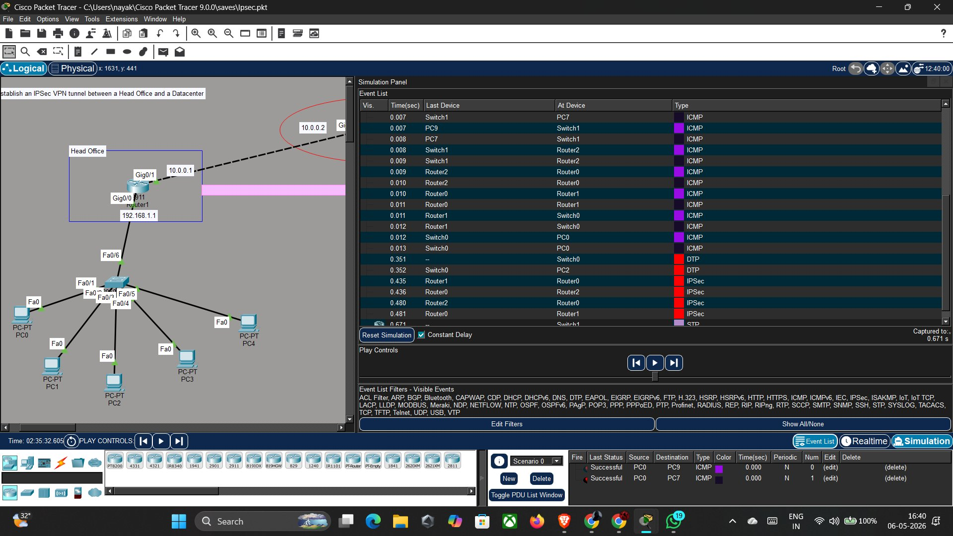
Simulation Mode — IPSec Packet Visualization
IPSec (red) and ICMP (purple) packets visible — routers encrypt traffic before forwarding through the public network
Rooman Technologies | Cybersecurity Internship | Phase 3 — Present | Demo: Simulation

Slide 9
Results — All Success Criteria Met
IKE Phase 1 Tunnel
IKE Phase 2 SA
Encryption Applied
QM_IDLE ACTIVE
Status: ACTIVE
26 pkts encrypt
conn-id 1090
Both inbound & outbound
ESP-AES Tunnel mode
Decryption Verified
PC-to-PC Ping
Router-to-Router
23 pkts decrypt
0% Packet Loss
100% (5/5)
ESP-SHA-HMAC verified
4/4 replies from DC
HO-Router → 192.168.2.2
Rooman Technologies | Cybersecurity Internship | Phase 3 — Present | Results

Slide 10
Lessons Learned — Key Takeaways
Security Licensing
Two-Phase Negotiation
01
Cisco IOS requires the securityk9 package before crypto commands are available — real-world routers need proper licensing.
02
IKE Phase 1 secures the key exchange channel; Phase 2 protects the data. Both must succeed for the tunnel to work.
Routing Before VPN
PSK Must Match Exactly
03
Static routing must be fully working before VPN is applied — troubleshooting the VPN with broken routing wastes time.
04
MM_NO_STATE error occurs when pre-shared keys don't match. Case-sensitive — ROOMAN@VPN must be identical on both ends.
Crypto Map Interface
Interesting Traffic ACL
05
The crypto map must be applied to the WAN (outgoing) interface — HO Gi0/1 and DC Gi0/0. Wrong interface = no tunnel.
06
The ACL defines what goes through the VPN. HO→DC and DC→HO must both be defined as mirror images of each other.
Rooman Technologies | Cybersecurity Internship | Phase 3 — Present | Lessons Learned

Slide 11






Future Enhancements & Next Steps
Upgrade to IKEv2
PKI Certificates
GRE over IPSec
More efficient, built-in NAT traversal, EAP auth
Replace PSK with CA-signed certs for scalability
Enable OSPF/EIGRP routing protocols over the VPN
Zone-Based Firewall
HA / Redundancy
SIEM Integration
Granular ACLs to restrict intra-VPN traffic
Dual ISP links + HSRP for zero downtime VPN
Forward IPSec logs to security monitoring platform
Rooman Technologies | Cybersecurity Internship | Phase 3 — Present | Future Scope

Slide 12

Thank You
Project Successfully Completed
QM_IDLE ACTIVE
26 pkts
23 pkts
0%
✓ Tunnel State
✓ Encrypted
✓ Decrypted
✓ Packet Loss
Nithin Nayaka V N | Cybersecurity Internship | Rooman Technologies | May 2026

