Slide 1
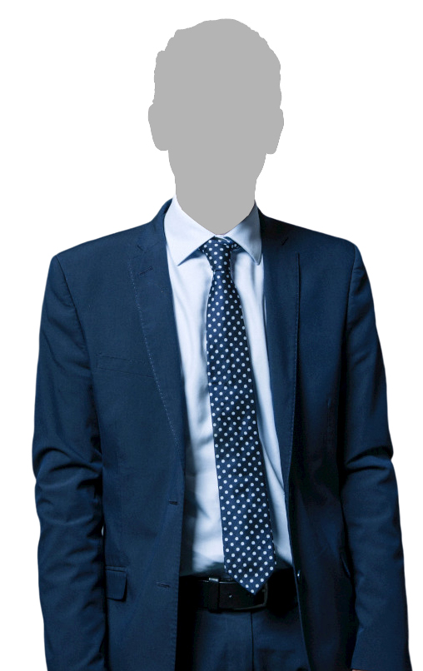

Your MP’s Name & Photo MP for Your Constituency
HEY MY MP
LET US VOTE!
MP portrait image is used under Creative Commons Attribution 3.0 Unported (CC BY 3.0) license, retrieved from beta.parliament.gov.uk and modified by removal of image background. Promoted by Eloise Todd on behalf of Best for Britain, the campaign name of UK-EU OPEN POLICY LIMITED registered at International House, 24 Holborn Viaduct, London, EC1A 2BN.

