Slide 1
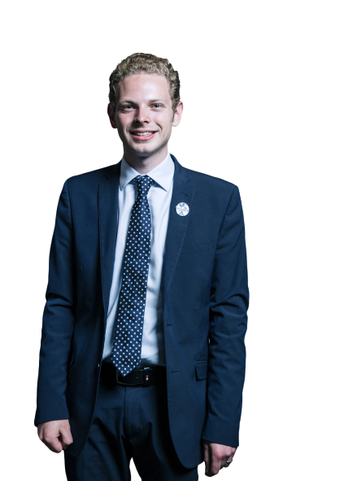

Jack Brereton MP for Stoke on Trent South
HEY JACK
LET US VOTE!
MP portrait image is used under Creative Commons Attribution 3.0 Unported (CC BY 3.0) license, taken from beta.parliament.gov.uk with original image background removed by algorithm. Promoted by Eloise Todd on behalf of Best for Britain, the campaign name of UK-EU OPEN POLICY LIMITED registered at International House, 24 Holborn Viaduct, London, EC1A 2BN.

