Slide 1

A History of Linux
Damian Gordon

Slide 2
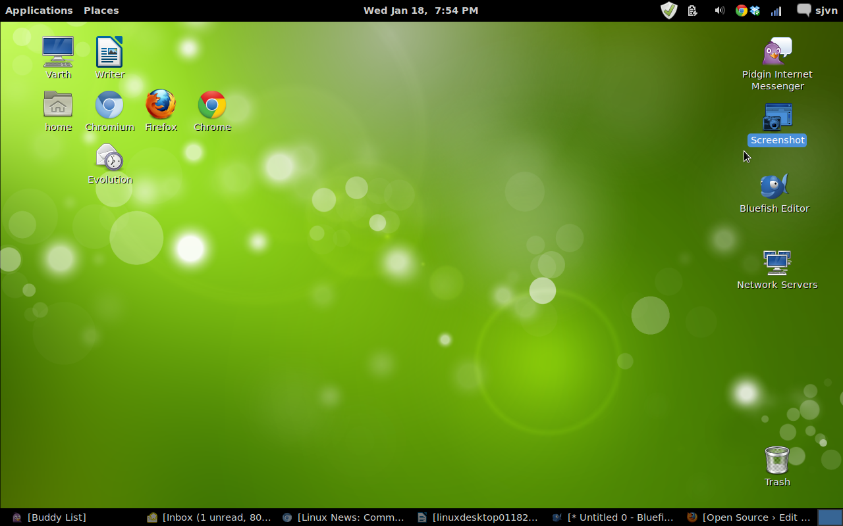

Slide 3
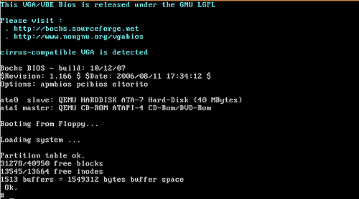

Slide 4
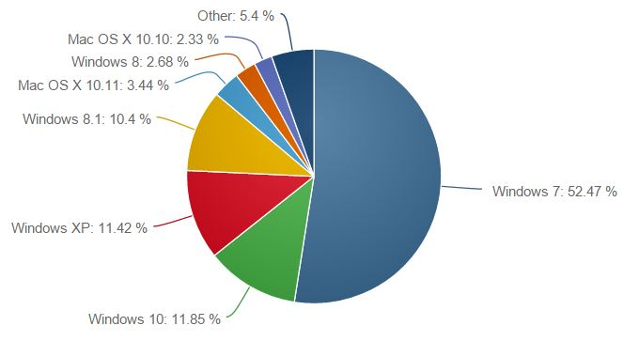
Desktop market share (8/2/2016)
1.47%

Slide 5
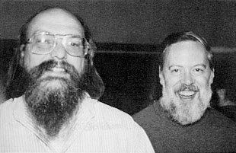
Prehistory of Linux
The Unix operating system was developed by Ken Thompson and Dennis Ritchie of AT&T Bell Laboratories in 1969 and first released in 1970.

Slide 6
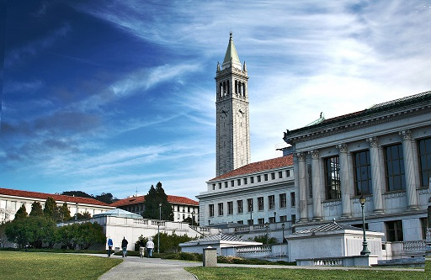
Prehistory of Linux
In 1977 the University of California, Berkeley released a free UNIX-like system, Berkeley Software Distribution (BSD). But BSD contained Unix code, so AT&T sued.

Slide 7
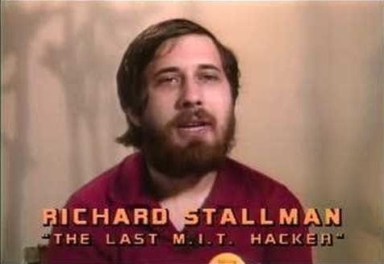
Prehistory of Linux
In 1983, Richard Stallman started the GNU project to create a free UNIX-like operating system. Hurd (the GNU kernel) failed to attract enough developers, leaving GNU incomplete.

Slide 8

Prehistory of Linux
In 1987 Andrew S. Tanenbaum released MINIX, a Unix-like system intended for academic use. While source code for the system was available, modification and redistribution were restricted.

Slide 9

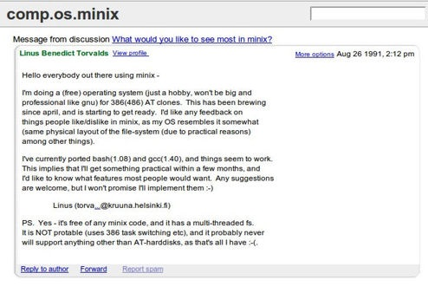

Slide 10

Linus Benedict Torvalds
Born: December 28, 1969 (age 45)
Born in Helsinki, Finland
Chief developer on the Linux kernel
Created the revision control system Git
2014 IEEE Computer Society Computer Pioneer Award

Slide 11
Linux
Torvalds made the code of Linux freely available to everyone on the internet, and therefore lots of people created their own versions of Linux.

Slide 12
Linux
Linux is therefore an example of Open-source software, in which the copyright holder provides the rights to study, change and distribute the software to anyone and for any purpose. Open-source software is often developed in a public, collaborative manner.

Slide 13
Timeline of Linux
1992
V0.01
1996
V2
1994
V1
2011
V3
2015
V4

Slide 14
Timeline of Linux
1992
V0.01
1993
Slackware
1994
SUSE
1996
V2
2000
Knoppix
2002
Gentoo
2004
Ubuntu
2006
Alpine
2008
Musix
2011
Mageia
1993
Debian
1994
V1
1995
Red Hat
2002
Arch
2003
Fedora
2004
CentOS
2006
Oracle
2008
Android
2011
V3
2015
V4

Slide 15
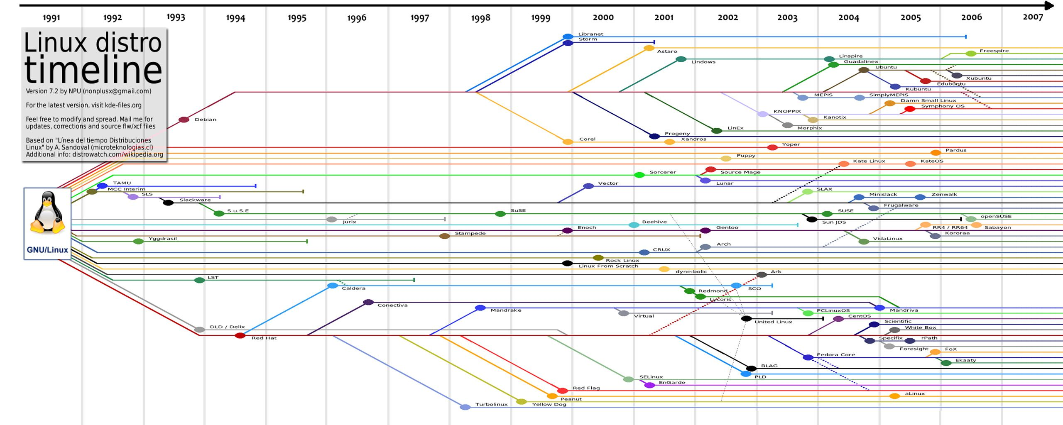
Timeline of Linux

Slide 16
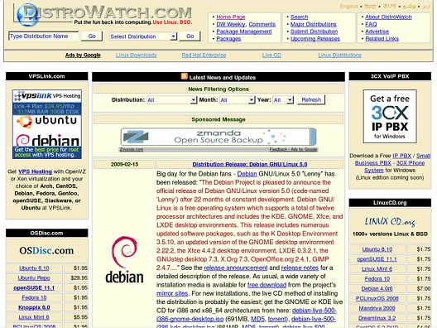
Timeline of Linux

Slide 17


Slide 18
Kernel

Slide 19
Kernel
Shell

Slide 20
Shell
Kernel

Slide 21
Commands
Shell
Kernel
Hardware

Slide 22
V0.01
September
1991
Not a mature product at the time
Minix-like kernel for i386(+) based AT-machines
Efficiently using the 386 chip, use of system calls rather than message passing, a fully multi-threaded FS, minimal task switching, and visible interrupts

Slide 23
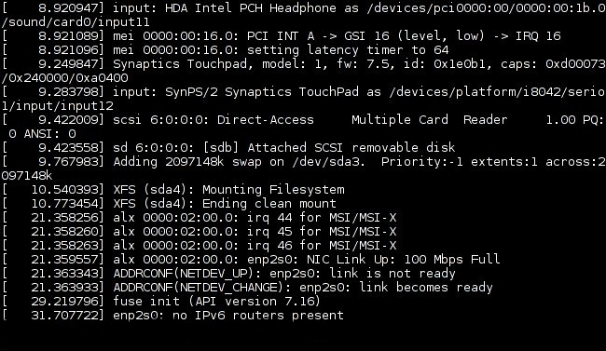
V1.0
March
1994
Allowed Multi-programming – multiple programs run at the same time.
Virtual Memory management supported
Linux is highly backwards compatible, so if a program worked in any version of Linux it will work on all versions of Linux.

Slide 24
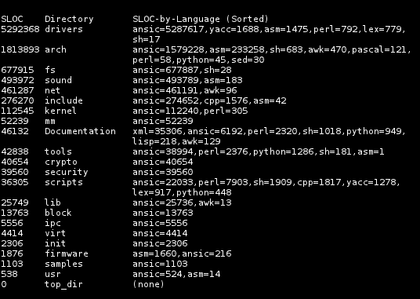
V2.0
June
1996
Restructured memory management and improvements in task scheduling
Improved SCSI support
Increased networking protocols. Filesystem support for NCP (Novell) and SMB (MS Lan Manager, etc.) network filesystems added.

Slide 25
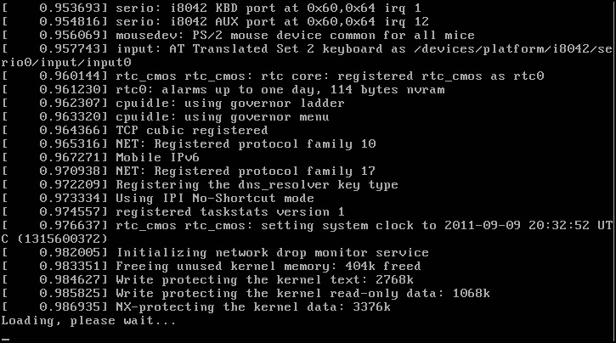
V3.0
July
2011
Better handling of virtualization systems
Btrfs data scrubbing and automatic defragmentation
Not a major change in kernel concept, but started a new version number to mark the 20th anniversary of Linux

Slide 26
V4.0
12th April
2015
A *fairly* small release, some VM clean-ups
The unification of the PROTNONE and NUMA handling for page tables.
Some people advocated the 4.0 version number, to eventually see 4.1.15 - because "that was the version of Linux SkyNet used for the T-800 Terminator".

Slide 27
V4.10
15th January, 2017
A small release by Linus Torvalds, on device drivers, some architecture work, some file systems fixes and some network issues.

Slide 28
V4.0
Version | Original release date | Current Version | Support Model
4.0 | 12 April 2015 | 4.0.9 | Maintained from April 2015 to July 2015
4.1 | 22 June 2015 | 4.1.38 | Maintained from July 2015 to September 2017
4.2 | 30 August 2015 | 4.2.8 | Maintained from August 2015 to December 2015
4.3 | 1 November 2015 | 4.3.6 | Maintained from November 2015 to February 2016
4.4 | 10 January 2016 | 4.4.44 | Maintained from January 2016 to February 2018
4.5 | 13 March 2016 | 4.5.7 | Maintained from March 2016 to June 2016
Notes:
https://en.wikipedia.org/wiki/Linux_kernel

Slide 29
V4.0
Version | Original release date | Current Version | Support Model
4.6 | 15 May 2016 | 4.6.7 | Maintained from May 2016 to August 2016
4.7 | 24 July 2016 | 4.7.10 | Maintained from July 2016 to October 2016
4.8 | 25 September 2016 | 4.8.17 | Maintained from September 2016 to January 2017
4.9 | 11 December 2016 | 4.9.5 | Latest mainline release
4.10 | 15 January 2017 | 4.10-rc4 | Latest unstable release
Notes:
https://en.wikipedia.org/wiki/Linux_kernel

Slide 30
Some Other Linux Versions

Slide 31

Slackware
July
1993
Slackware is oriented toward simplicity and software purity
Provides no graphical installation procedure
Developed by:
Patrick Volkerding

Slide 32

Debian
September
1993
The Debian Project's policies focus on collaborative software development and testing processes
New release every two years.
Developed by:
Ian Murdock and the Debian Project

Slide 33

SUSE
1994
"Software und System-Entwicklung", meaning "Software and systems development".
Often includes YaST setup and configuration tool
Developed by:
Roland Dyroff, Thomas Fehr, Burchard Steinbild, and Hubert Mantel

Slide 34

Red Hat
May
1995
In 2003 Red Hat Linux merged with the community-based Fedora Project
Introduced a graphical installer called Anaconda and Lokkit for configuring the firewall capabilities.
Developed by:
Bob Young, Marc Ewing and Red Hat Inc.

Slide 35
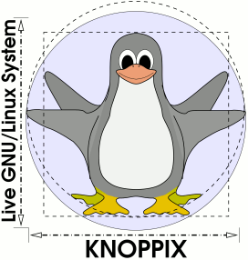
Knoppix
September
2000
Can be used to copy files easily from hard drives with inaccessible operating systems.
Designed to be booted straight from CD, DVD or USB.
Developed by:
Klaus Knopper

Slide 36

Gentoo
March
2002
Gentoo package management is designed to be modular, portable, and easy to maintain.
Not a binary software distribution, source code is compiled locally and optimized for the specific type of computer.
Developed by:
Daniel Robbins and Gentoo Foundation

Slide 37

Arch
March
2002
The development team focused on elegance, code correctness, and minimalism.
The user is expected to make significant effort to understand the systems function.
Developed by:
Judd Vinet, Aaron Griffin and the Arch Linux team

Slide 38

Fedora
November
2003
Focuses on innovation, integrating new technologies early on and working closely with Linux communities.
Linus Torvalds uses Fedora on all of his computers.
Developed by:
Fedora Project (owned by Red Hat)

Slide 39
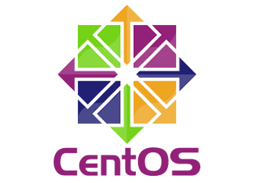
CentOS
2004
The project is affiliated with Red Hat but aspires to be more public, open, and inclusive.
Provides a free, enterprise-class, community-supported computing platform.
Developed by:
David Parsley, Lance Davis and the CentOS Project

Slide 40

Ubuntu
October
2004
Committed to open source development; encouraged to use free software, study how it works, improve upon it, and distribute it.
Named after the Southern African philosophy of ubuntu (literally, "human-ness").
Developed by:
Mark Shuttleworth and Canonical Ltd.

Slide 41

Alpine
2006
Lightweight and secure by default while still being useful for general-purpose tasks.
Compiles all packages with stack-smashing protection.
Developed by:
Alpine Linux development team

Slide 42

Oracle
October
2006
Based on Red Hat Enterprise Linux (RHEL), repackaged and freely distributed by Oracle.
Oracle Linux supports KVM and Xen.
Developed by:
Oracle Corporation

Slide 43

Musix
December
2006
Collection of software for audio production, graphic design, video editing and general purpose applications.
Documentation is in Spanish.
Developed by:
Marcos Germán Guglielmetti. And teams from Argentina, Spain, Mexico and Brazil.

Slide 44

Android
September
2008
Android is designed primarily for touchscreen mobile devices such as smartphones and tablet computers.
The most widely used mobile OS.
Developed by:
Google, and Open Handset Alliance

Slide 45

Mageia
June
2011
A secure, and sustainable operating system, designed to set up a stable and trustable governance to direct collaborative projects.
Uses all major desktop environments
Developed by:
Former employees of Mandriva

Slide 46
Some Linux Desktop Environments

Slide 47
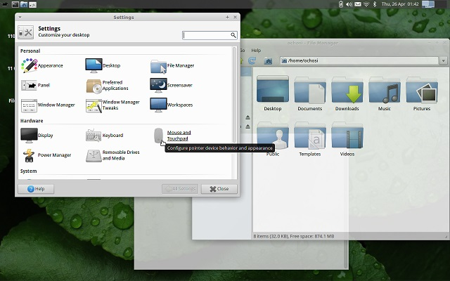
Xfce
1996
It aims to be fast and lightweight, while still being visually appealing and easy to use.
Does not feature any desktop animations, but translucency effect is supported.
Developed by:
Olivier Fourdan

Slide 48
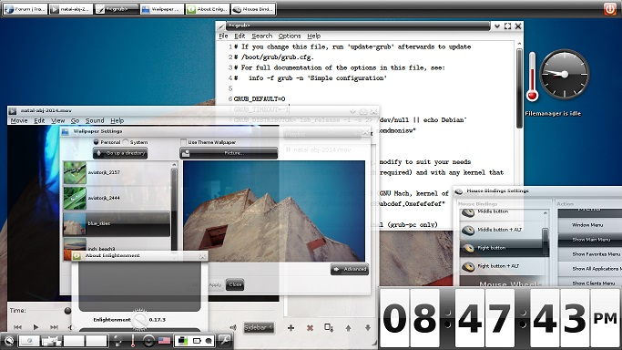
Enlightenment
1997
Enlightenment developers have referred to it as "the original eye-candy window manager“
Supports virtual desktops
Developed by:
Carsten Haitzler (aka Raster or Rasterman)

Slide 49
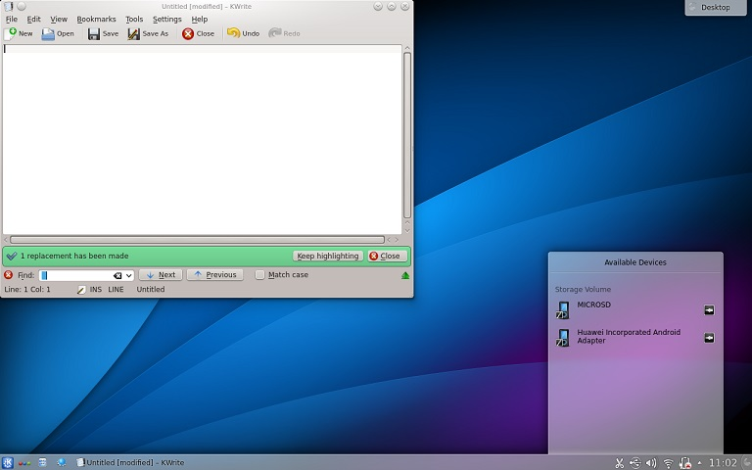
KDE
July
1998
Developed as an easy-to-use environment
Works well with multimedia devices and applications and mobile devices.
Developed by:
Matthias Ettrich and KDE

Slide 50
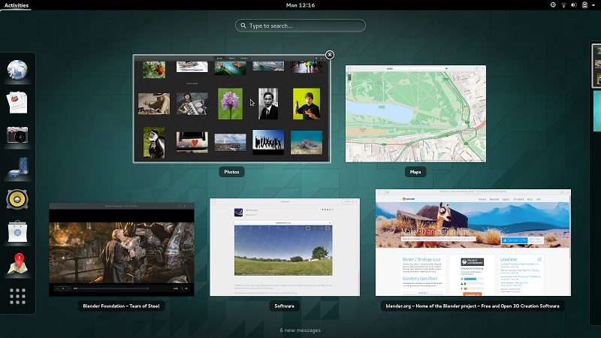
GNOME
March
1999
Focuses on internationalization and localization and accessibility of software.
Incorporates freedesktop.org standards and programs to better interoperate with other desktops.
Developed by:
Miguel de Icaza, Federico Mena, and the GNOME project

Slide 51
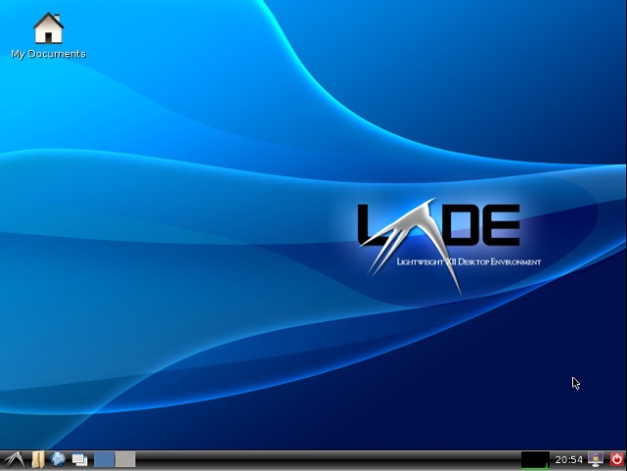
LXDE
2006
Suitable for resource-constrained computers, e.g., netbooks or System on a chip computers.
A desktop environment that is fast and energy efficient
Developed by:
Hong Jen Yee ( aka PCMan)

Slide 52
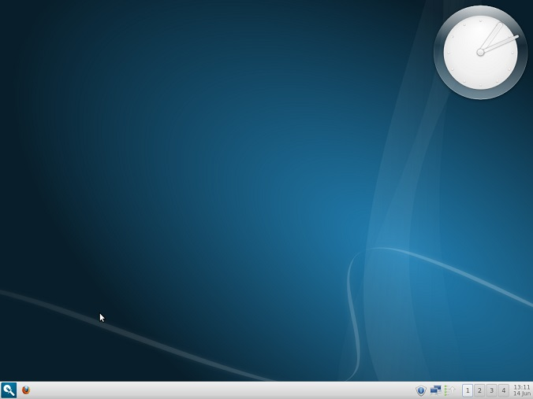
Razor-qt
2010
Tailored for users who value simplicity, speed, and an intuitive interface
Merged with LXDE in 2013 to become LXQt
Developed by:
The Razor-qt Team

Slide 53
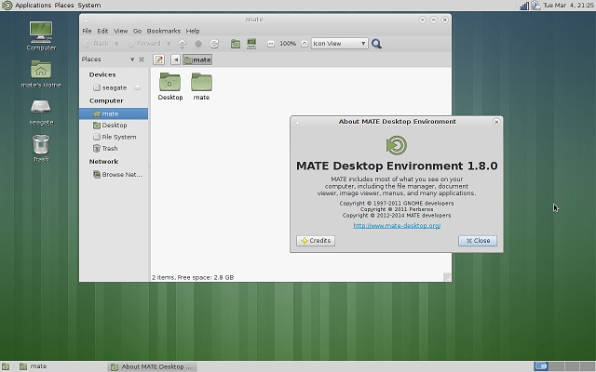
MATE
August
2011
Forked from GNOME 2, to maintain the simple and clean interface that was controversially removed in GNOME 3.
Developed by:
Perberos and MATE Developers

Slide 54
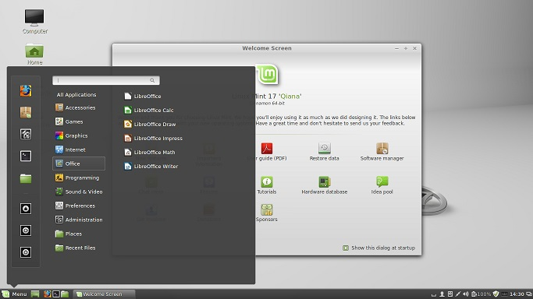
Cinnamon
December
2011
Another fork of GNOME 2, which provides a range of user configurable interface components.
Better performance.
Developed by:
Linux Mint development team

