Slide 1
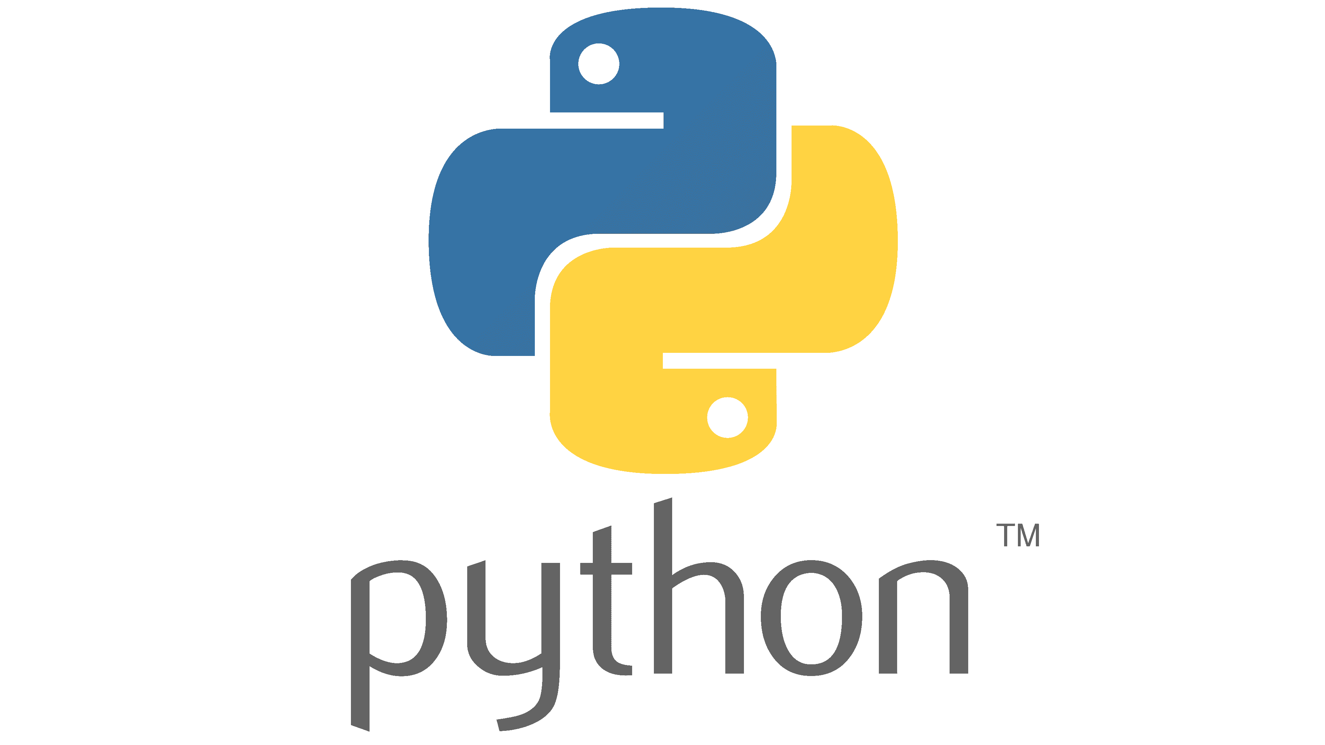
Part 1: Introduction

Slide 2
What is Python?
Python is the most popular high-level programming language.

Slide 3
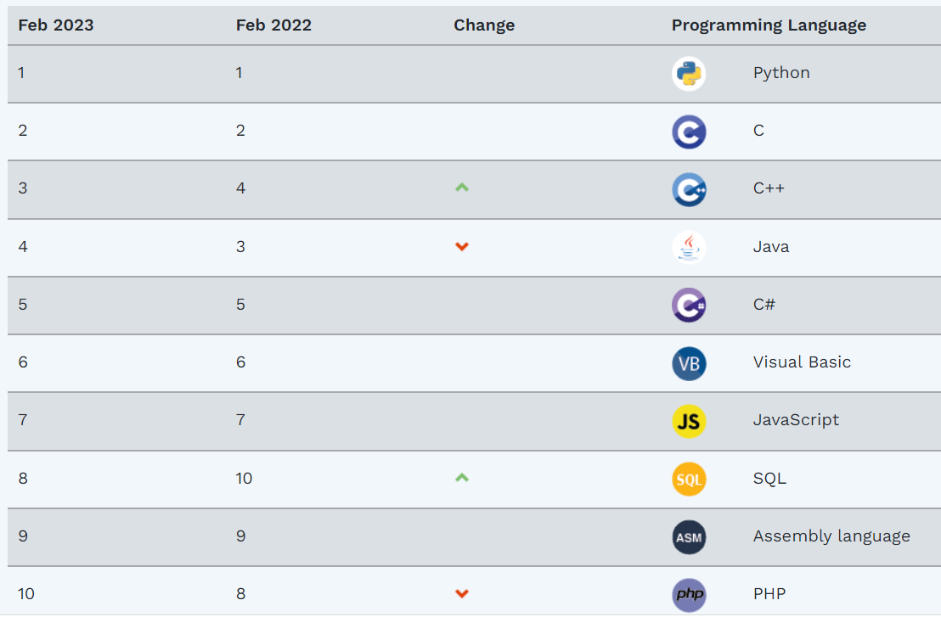
What is Python?

Slide 4
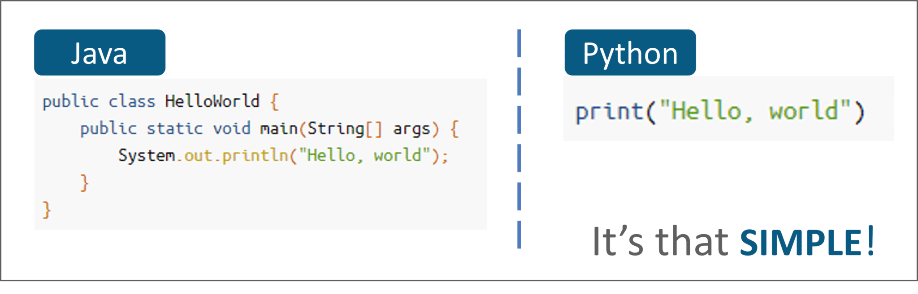
Why Python?
Python Is Beginner-Friendly

Slide 5
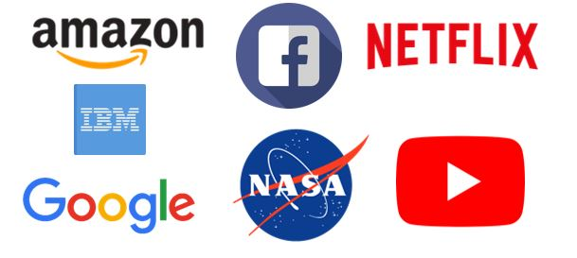
Why Python?
2. Career Opportunities and Salary

Slide 6
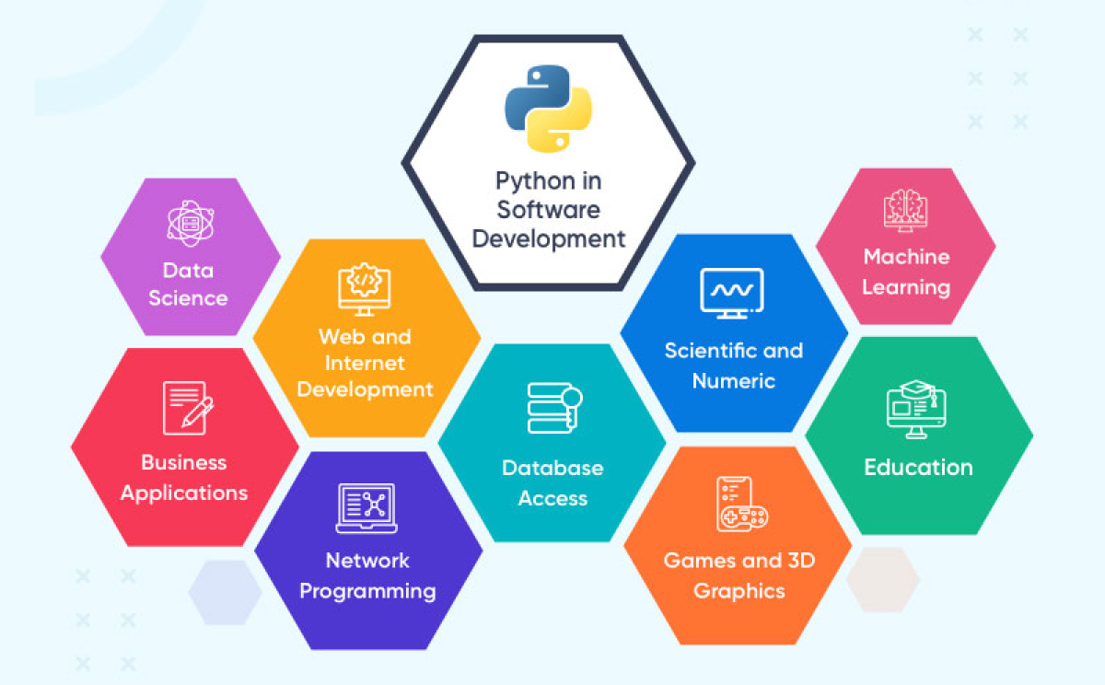
Why Python?
3. Python Is Versatile

Slide 7
Why Python?
4. Active Community

Slide 8

