Slide 1
E- Commerce
Participants-
Piyush Varshney -2115000710
Prakhar Mittal -2115000732
Shantanu Singh -211500934
Harsh Sharma -2115000445
GLA University , Mathura
Computer Engineering And Application
29 Nov. 2023

Slide 2
Introduction
This e-commerce project aims to create an online platform that offers a seamless shopping experience for users, providing a wide array of products across various categories. The platform aims to revolutionize the way people shop by leveraging technology to enhance convenience, choice, and overall customer satisfaction.
The motivation behind this project stems from the need to address several challenges in traditional shopping methods. These challenges include limited accessibility to diverse products, geographical constraints, time limitations, and the lack of personalized shopping experiences.
For users engaging with this e-commerce platform, they can expect a user-friendly interface that offers a vast selection of products from different vendors or brands. The platform will prioritize ease of navigation, secure transactions, and a personalized shopping journey.

Slide 3
Objective
Develop a user-friendly and intuitive e-commerce platform . Create a robust backend system for inventory management, order processing, and customer data . Implement secure payment gateways for safe transactions . Integrate personalized recommendation algorithms based on user behaviour
Enhance the user shopping experience by providing a wide range of products with easy navigation . Offer a secure and reliable platform for online transactions, building trust among users . Personalize the shopping journey to increase user engagement and satisfaction . Enable vendors to efficiently manage their inventories and orders

Slide 4
Problem Statement
The problem revolves around the limitations and challenges faced in traditional shopping methods: Limited Accessibility to Diverse Products: Brick-and-mortar stores often have finite space, restricting the variety of products available for consumers, especially niche or specialized items.
Lack of Personalized Shopping Experience: Traditional shopping fails to provide tailored recommendations or personalized experiences based on individual preferences and buying behavior.
Addressing these problems in the e-commerce domain is crucial for several reasons: Personalization for Improved User Experience: Tailoring recommendations and providing a personalized shopping journey enhances user satisfaction and increases the likelihood of repeat purchases, fostering customer loyalty.

Slide 5
Methodology
Platform Development Strategy: Detail the steps taken to develop the e-commerce platform, including initial planning, design, development, and testing phases.
User-Centric Approach: Emphasize the focus on user experience and satisfaction throughout the platform's development, ensuring it meets the needs and preferences of the target audience.
Iterative Development: Discuss an iterative approach to development, where feedback loops from users and stakeholders were integrated to refine and improve the platform continuously .
Agile Methodology: If applicable, mention the use of Agile methodologies like Scrum or Kanban, highlighting how they facilitated efficient development, faster iterations, and adaptability to changing requirements.

Slide 6
Algorithms, techniques, tools, languages used
Frontend Development: Frontend technologies are used, such as HTML, CSS, JavaScript, and frameworks like bootstrap .
Backend Development: Backend technologies and frameworks are utilized such as Node.js ,express, mongoose , ejs, passport along with database like MongoDB.

Slide 7
System Architecture
Client-Side (Frontend): The user interacts with the system through a web or mobile interface developed using HTML, CSS, and JavaScript. This layer focuses on presenting the catalog, facilitating searches, and enabling user interactions.
Server-Side (Backend): The backend comprises various components responsible for handling requests, processing data, and managing the system's logic.
Web Server: Manages incoming HTTP requests and responses, often utilizing technologies like Node.js.
Application Layer: Includes modules for user authentication, product management, cart functionality, and order processing. It interacts with the database and external services.
Database: Stores product information, user profiles, order details, and other relevant data using databases like MongoDB, or similar.

Slide 8
Implementation
Planning and Design Phase: Initially, the team outlined the project requirements, defined user stories, and created wireframes/mockups to visualize the user interface and functionalities.
Frontend Development: The frontend team began implementing the UI using HTML, CSS, and JavaScript . This phase involved creating product display pages, cart functionality, user authentication forms, and integrating responsive design principles for various devices.
Backend Development: Simultaneously, the backend team worked on developing the server-side logic using Node.js, Express.js, or other backend frameworks. They implemented APIs for user authentication, product retrieval, cart management, and order processing, ensuring scalability and security measures were in place.
Database Setup: The database team designed the database schema and set up database like MongoDB, ensuring efficient data storage, retrieval, and management. They focused on establishing relationships between entities for seamless data flow.

Slide 9
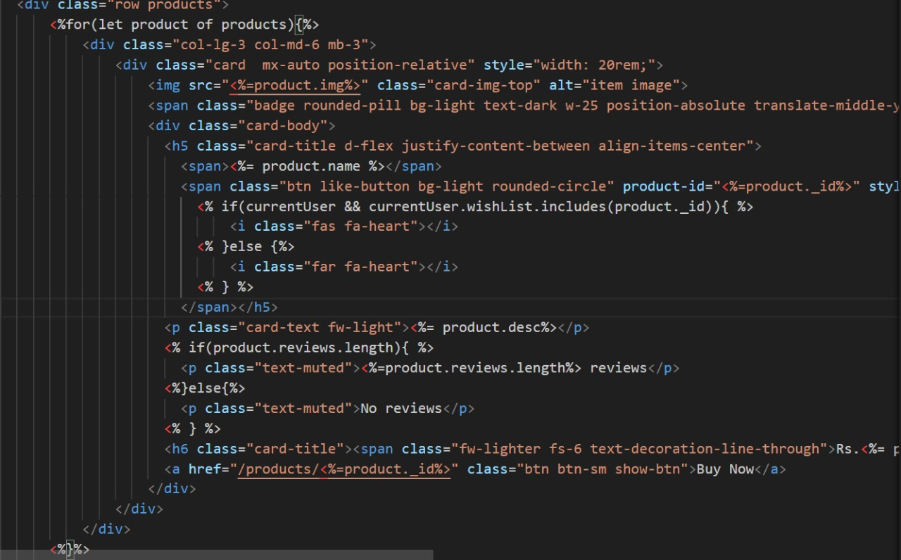
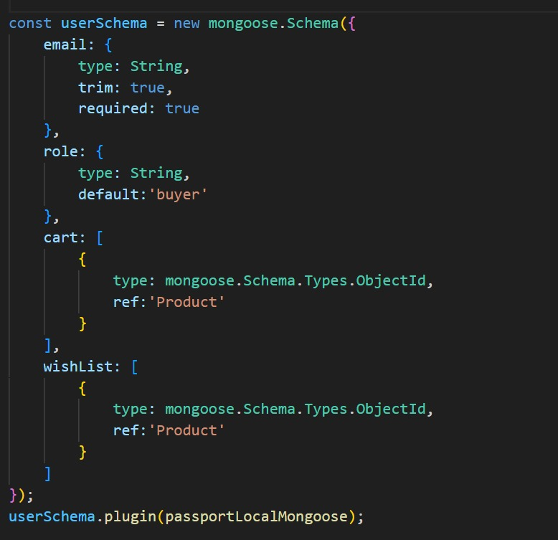
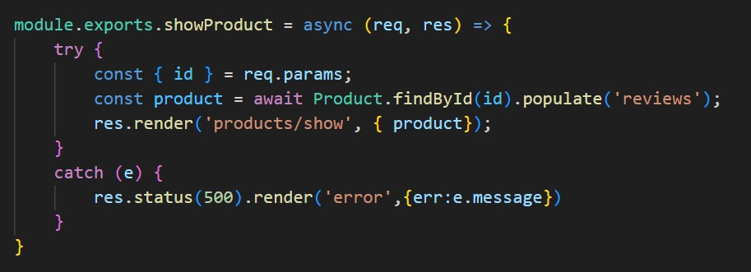
Some source codes-

Slide 10
Features
User Authentication and Profiles: Enable users to create accounts, log in securely, and manage their profiles, including order history, saved addresses, and payment information.
Shopping Cart and Checkout: Allow users to add/remove items to/from their cart, review their cart contents, and proceed to a secure checkout process with multiple payment options.
Product Catalog: Display a comprehensive catalog of products with categories, filters, and search functionalities for easy navigation and exploration.

Slide 11
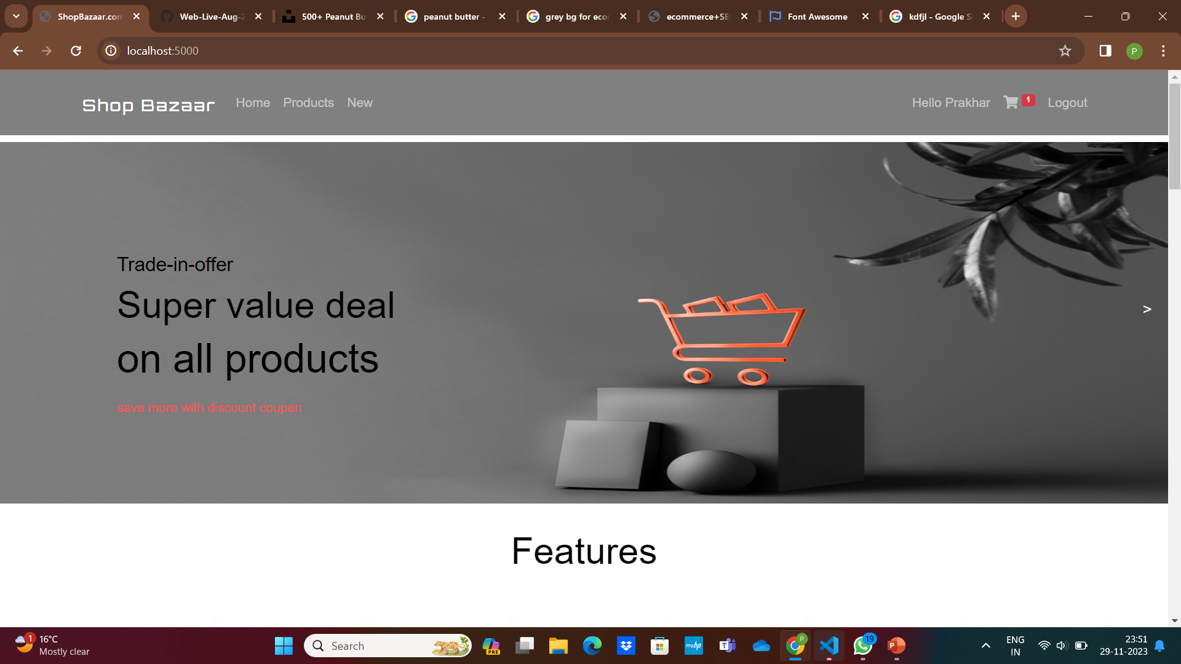
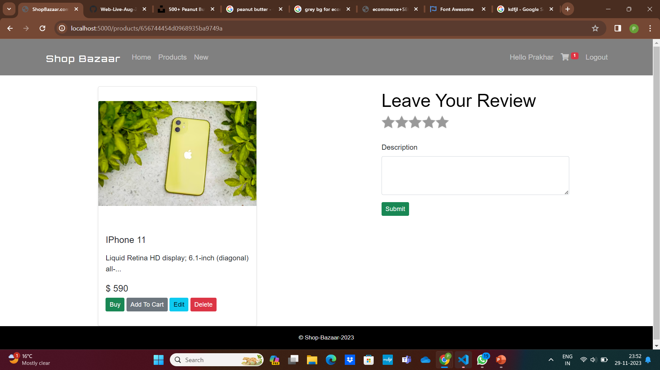
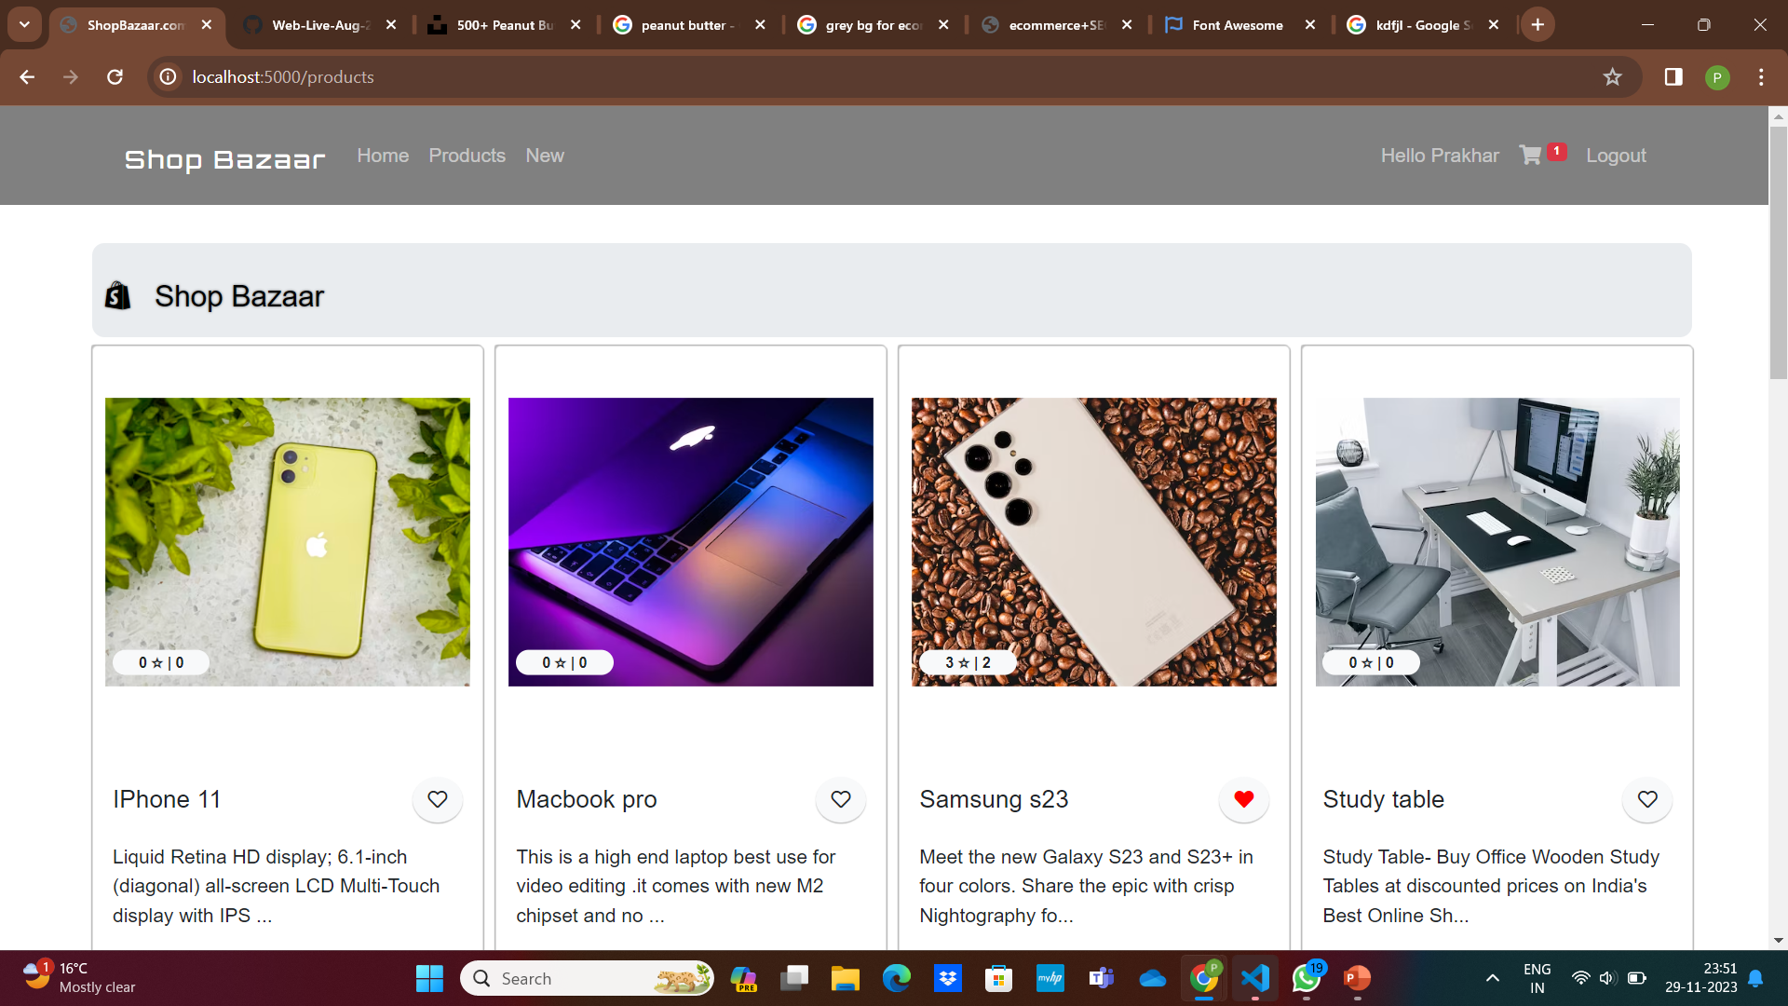
Results

Slide 12
Challenges Faced
User Experience Optimization: Balancing a visually appealing interface with fast load times and intuitive navigation to enhance user experience.
Solutions
User Experience Improvement: Conducted usability tests, gathered user feedback, and iteratively improved the UI/UX design based on user preferences and behavior.

Slide 13
Future Work
Enhanced Personalization: Implement more advanced recommendation algorithms based on machine learning to offer even more accurate and personalized product suggestions.
Expansion of Product Range: Continuously onboard new vendors or expand product categories to provide a wider range of choices to users.
Localization and Global Expansion: Offer multi-language support and consider expanding operations to reach international markets, addressing diverse customer needs.
Mobile App Development: Develop dedicated mobile applications for iOS and Android platforms to provide a seamless shopping experience on mobile devices.

Slide 14
Conclusions
In summary, our e-commerce project aimed to revolutionize online shopping by offering a comprehensive platform that addressed several challenges:
We identified limitations in traditional shopping experiences: limited product accessibility, time constraints, and a lack of personalization.
The project focused on delivering key features like a user-friendly interface, personalized recommendations, and secure payment gateways.
Challenges such as user experience optimization were encountered and overcome through strategic solutions.
Results showcased remarkable growth in user engagement, and positive customer satisfaction.

Slide 15
Acknowledgement
We extend our heartfelt gratitude to several individuals and groups whose support and expertise were instrumental in the successful completion of this e-commerce project.
Academic Advisors and Professors: We are immensely grateful for the guidance, wisdom, and encouragement provided by Mr. Sanjay Madaan. His mentorship and valuable insights were invaluable throughout the project's development.

