Slide 1
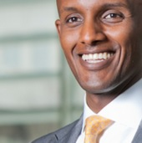
Persona: 3
“I constantly look for talents to benefit my company’s growth.”
Jacob
I got my eyes on you. Do a good job in your final project that my
company sponsored and the reward will be great.
I reach out to local universities each year and work with your
faculty to coordinate senior projects with my company’s theme.
each university portal is different, but your university portal is
one of the most user unfriendly one.
Therefore, I am looking forward to a better user experience this
year when I revisit your university portal.
I will leave my feedback and suggestion on possible improvements.
Age: 38
Occupation: Technical Recruiter
Income: > $195,500
Marital Status: Married
Interests: Investment, jogging, dancing
Technical Profile: Comfortable with Linux laptops
only, Blackberry smartphone user.
Alternate Mobile Device User: Yes

