Slide 1
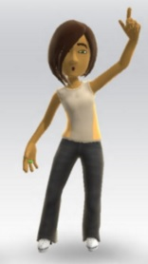
Persona: 2
“Helping students success is my enjoyment.”
Srividya
Being a Professor at ASU exposes me to a whole new world of
bright and productive people whom I truly enjoy working with.
Guiding students to enable them to reach their academic goals
is my true enjoyment. Their success is mine, too.
I love using computer aided selection tools to assist me in building
compatible senior capstone project teams such that the teams will
work well together.
But current tools I used weren’t straight forward. Their user
interface design did not yield a user good experience since there
was no feedback loop to inform or instruct me how to use them
properly.
Age: 36
Occupation: University SE Professor
Income: > $195,000
Marital Status: Single
Interests: Social networking, Theater, Culinary arts
Technical Profile: Comfortable with Macbook laptops
only, iPhone6 smartphone user.
Alternate Mobile Device User: Yes

