Slide 1
CST 250
Final Project
Hieu Pham

Slide 2
Project Requirement
Reference Information
Implementation
Results
Challenges

Slide 3

Project Requirement
Review the information for Gnome Sorting algorithm.
Implement the Gnome Sorting function.
This sorting function needs to perform an in-place sort on an array in memory (only memory within the array is modified while sorting).

Slide 4
Reference Information
There are common places in the Internet where Gnome Sorting algorithm information can be found. I visited the following sites during this project:
https://en.wikipedia.org/wiki/Gnome_sort
http://buffered.io/posts/sorting-algorithms-the-gnome-sort/
https://en.wikibooks.org/wiki/Algorithm_Implementation/Sorting/Gnome_sort
From a high-level perspective, the gnome sort involves comparison and exchange
mechanism similar to the bubble sort.

Slide 5
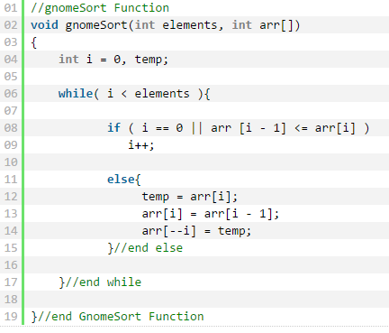
Implementation
PSEUDO_CODE

Slide 6
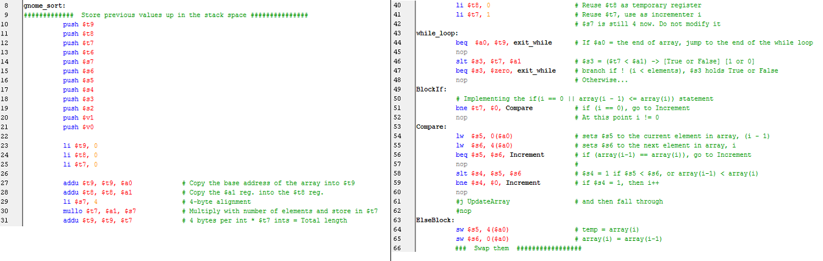
Implementation
PLP CODE

Slide 7
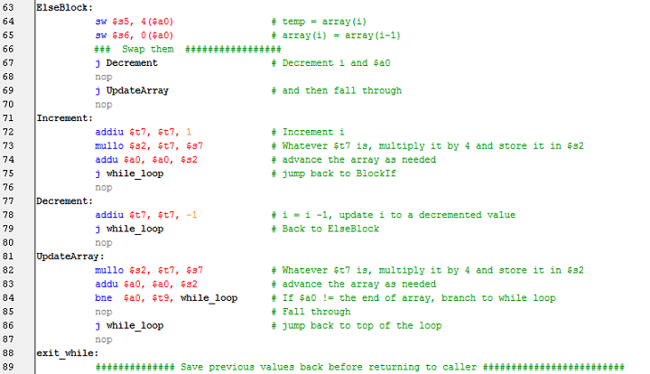
Implementation

Slide 8
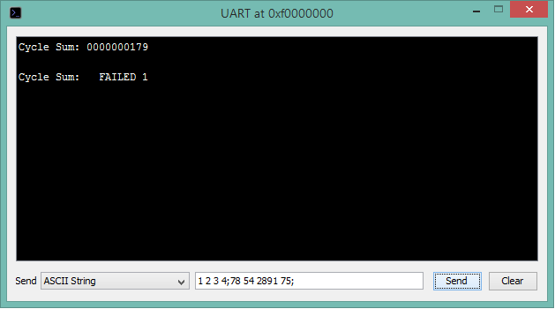
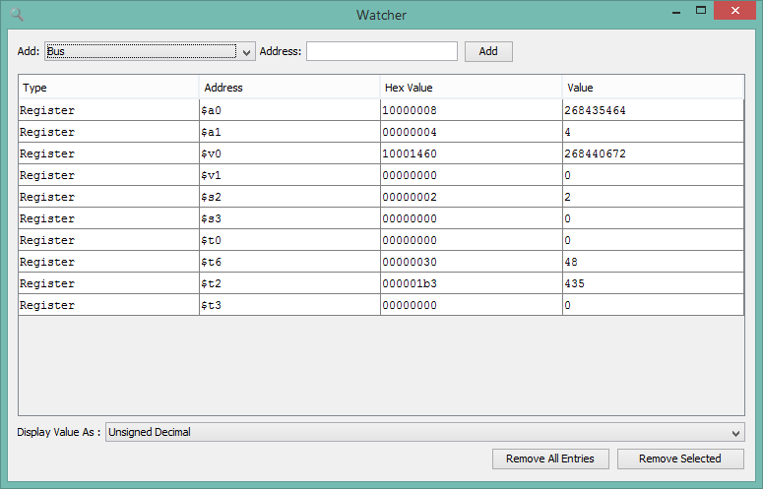
Results

Slide 9
Challenges
The only challenge I encountered during this exercise was converting the pseudo-code to the
PLP MIPS assembly instruction flow. For example, converting the while loop statement such as follows:
while(I < elements) {
[loop body]
}
required a new thought process in MIPS assembly instruction arrangement to break the mechanics of
while loop into blocks represented by labels for jumping back and forth to mimic the actual while loop
logic. Those who come from a high-level programming language domain will find how cumbersome the
translation process is. However, it can be done. It took a little effort to think at low-level to get pass
the challenges.
I can conclude that assembly language is very honest in its self-respecting place where it, too, obeys its
Programmer’s instruction one mnemonic at a time.

