Slide 1
AdaBoost
from Weak to Strong

Slide 2
Key Points of AdaBoost
Linear ensemble of many weak classifiers with different weights.
Adjust weights of training samples according to the prediction results in each iteration.
Notes:
There are two key points that make AdaBoost work.
For classification problem, it is easier to find some weak classifiers which may not have enough good performance. However, AdaBoost is able to combine many weak classifiers to strong one. Linear ensemble is performed over all classifiers by assigning them different weights.
Also, in each iteration, the weight of each training sample will be changed according to its prediction by the classifier. In this way, the method pays more attention on samples that cannot be correctly classified.

Slide 3
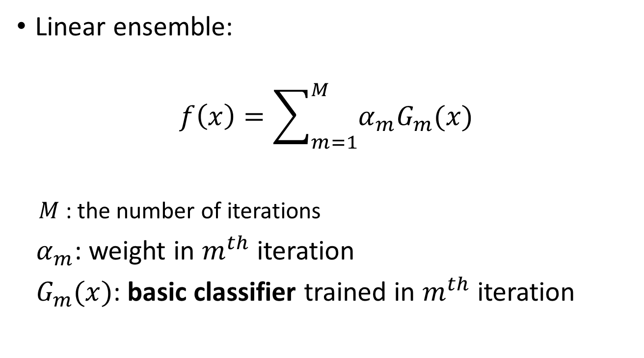
Linear ensemble
Linear ensemble:
$$f\left(x\right)=\sum_{m=1}^{M}{α_{m}G_{m}(x)}$$
$M$: the number of iterations
$α_{m}$: weight in $m^{th}$ iteration
$G_{m}(x)$: basic classifier trained in $m^{th}$ iteration
Notes:
Here is a requirement for basic classifier, it should be abled to trained by weighted samples. For example, decision tree can be used as basic classifier, but not SVM.

Slide 4
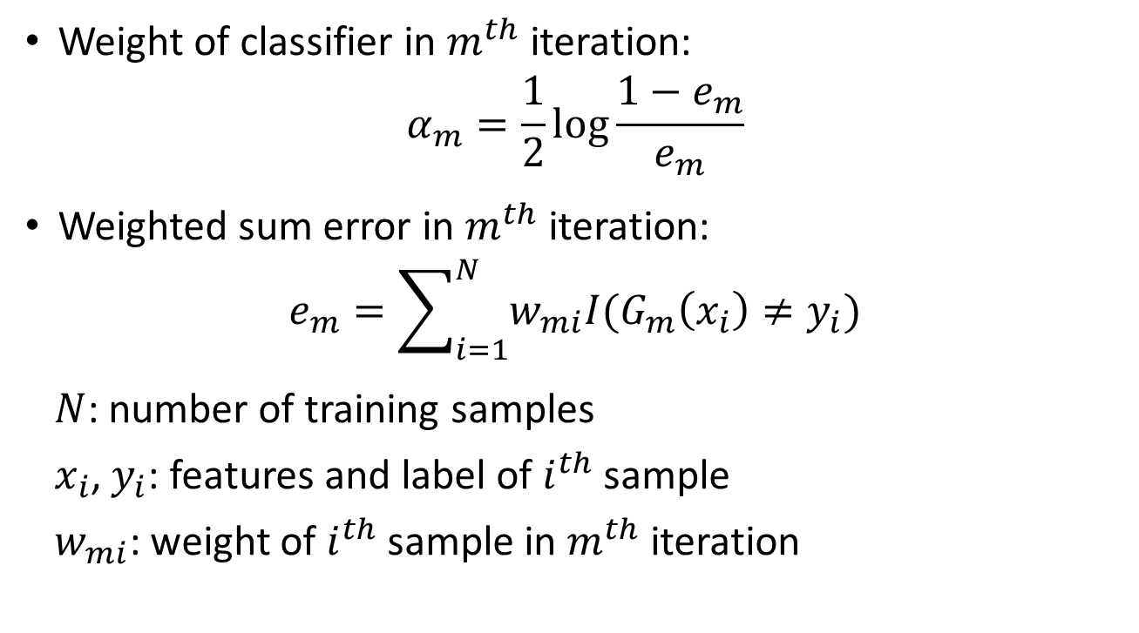
Linear ensemble
Weight of classifier in $m^{th}$ iteration:
$$α_{m}=\frac{1}{2}\log{\frac{1−e_{m}}{e_{m}}}$$
Weighted sum error in $m^{th}$ iteration:
$$e_{m}=\sum_{i=1}^{N}{w_{mi}I(G_{m}\left(x_{i}\right)≠y_{i})}$$
$N$: number of training samples
$x_{i}$, $y_{i}$: features and label of $i^{th}$ sample
$w_{mi}$: weight of $i^{th}$ sample in $m^{th}$ iteration
Notes:
If you are curious about why the alpha is calculated as this equation, you can look at the Wikipedia page of AdaBoost for a detailed explanation.

Slide 5
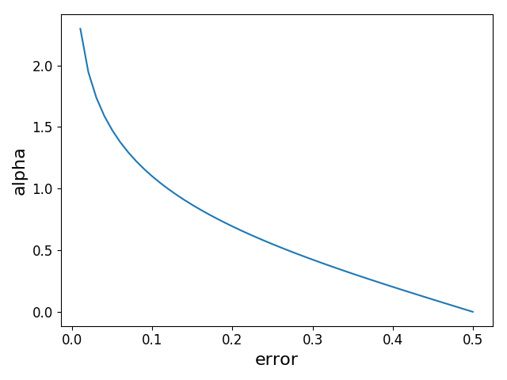
Linear ensemble
Notes:
This plot shows that the weight of classifier is decreasing as the error going up.

Slide 6
Linear ensemble
If weak classifiers give similar classification results on training samples, similar weights will be assigned, performance limitedly improved after ensemble.
To obtain different classifiers, change input by updating weight of each sample.

Slide 7
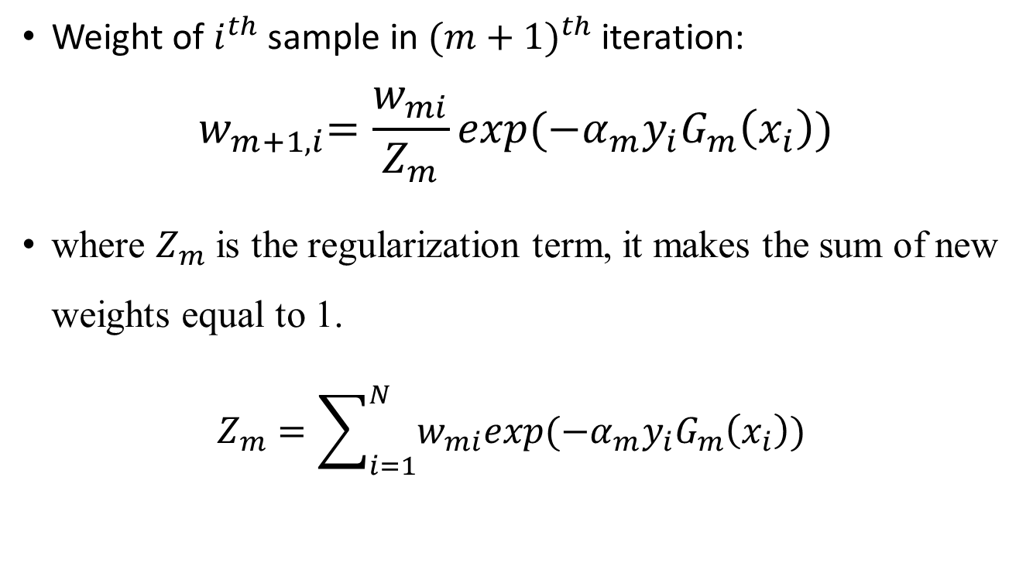
Weights Updating
Weight of $i^{th}$ sample in ${(m+1)}^{th}$ iteration:
$${ w}_{m+1,i}=\frac{w_{mi}}{Z_{m}}exp⁡(−α_{m}y_{i}G_{m}\left(x_{i}\right))$$
where $Z_{m}$ is the regularization term, it makes the sum of new weights equal to 1.
$$Z_{m}=\sum_{i=1}^{N}{w_{mi}exp⁡(−α_{m}y_{i}G_{m}\left(x_{i}\right))}$$

Slide 8

Weights Updating
Weight of $i^{th}$ sample in ${(m+1)}^{th}$ iteration:
$${ w}_{m+1,i}=\frac{w_{mi}}{Z_{m}}exp⁡(−α_{m}y_{i}G_{m}\left(x_{i}\right))$$
where $Z_{m}$ is the regularization term, it makes the sum of new weights equal to 1.
$$Z_{m}=\sum_{i=1}^{N}{w_{mi}exp⁡(−α_{m}y_{i}G_{m}\left(x_{i}\right))}$$
$$y_{i}==G_{m}\left(x_{i}\right)$$

Slide 9

Weights Updating
Weight of $i^{th}$ sample in ${(m+1)}^{th}$ iteration:
$${ w}_{m+1,i}=\frac{w_{mi}}{Z_{m}}exp⁡(−α_{m}y_{i}G_{m}\left(x_{i}\right))$$
where $Z_{m}$ is the regularization term, it makes the sum of new weights equal to 1.
$$Z_{m}=\sum_{i=1}^{N}{w_{mi}exp⁡(−α_{m}y_{i}G_{m}\left(x_{i}\right))}$$
$$negative$$

Slide 10

Weights Updating
Weight of $i^{th}$ sample in ${(m+1)}^{th}$ iteration:
$${ w}_{m+1,i}=\frac{w_{mi}}{Z_{m}}exp⁡(−α_{m}y_{i}G_{m}\left(x_{i}\right))$$
where $Z_{m}$ is the regularization term, it makes the sum of new weights equal to 1.
$$Z_{m}=\sum_{i=1}^{N}{w_{mi}exp⁡(−α_{m}y_{i}G_{m}\left(x_{i}\right))}$$
$$smaller than 1$$

Slide 11

Weights Updating
Weight of $i^{th}$ sample in ${(m+1)}^{th}$ iteration:
$${ w}_{m+1,i}=\frac{w_{mi}}{Z_{m}}exp⁡(−α_{m}y_{i}G_{m}\left(x_{i}\right))$$
where $Z_{m}$ is the regularization term, it makes the sum of new weights equal to 1.
$$Z_{m}=\sum_{i=1}^{N}{w_{mi}exp⁡(−α_{m}y_{i}G_{m}\left(x_{i}\right))}$$
$$smaller than the previous weight$$

Slide 12
Weights Updating
Weight of $i^{th}$ sample in ${(m+1)}^{th}$ iteration:
$${ w}_{m+1,i}=\frac{w_{mi}}{Z_{m}}exp⁡(−α_{m}y_{i}G_{m}\left(x_{i}\right))$$
where $Z_{m}$ is the regularization term, it makes the sum of new weights equal to 1.
$$Z_{m}=\sum_{i=1}^{N}{w_{mi}exp⁡(−α_{m}y_{i}G_{m}\left(x_{i}\right))}$$
$$y_{i} ≠ G_{m}\left(x_{i}\right) → larger than the previous weight$$

Slide 13
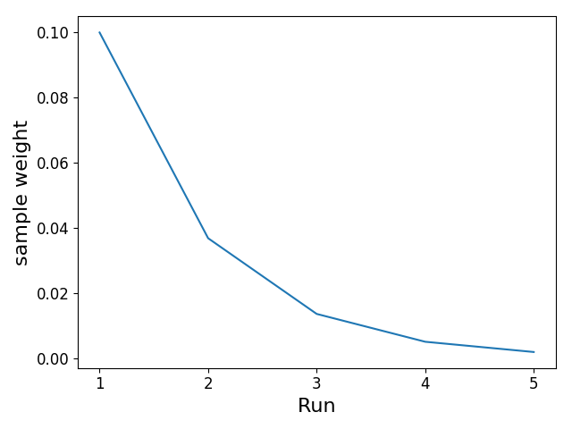

Weights Updating
Assum $w_{1}$ = 0.1, $α=1$, the sample is correctly classified in each run. After 4 runs:

Slide 14
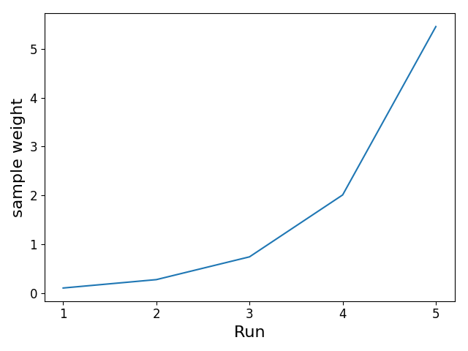

Weights Updating
Assum $w_{1}$ = 0.1, $α=1$, the sample is falsely classified in each run. After 4 runs:

Slide 15

Final Classifier
Linear ensemble:
$$f\left(x\right)=\sum_{m=1}^{M}{α_{m}G_{m}(x)}$$
Final classifier:
$$G\left(x\right)=sign\left(f\left(x\right)\right)$$

Slide 16
Pros and Cons
Advantages:
Simple and elegant.
Fairly good generalization.
Disadvantage:
Sensitive to noise and outliers.
Notes:
Since the AdaBoost can assign a higher weight to the sample which is hard to classify. Normally, the noisy data or outliers are more easily to be mistakenly classified. Thus, the method will take these samples into more account, causing the overfitting.

Slide 17
Tests of AdaBoost
Implement AdaBoost algorithm using Python.
Apply decision tree as basic classifier which is generated from scikit-learn library.
Tests on two datasets:
Simulated Dataset – Hastie_10_2
Real Dataset – Wisconsin Diagnostic
Breast Cancer
20% samples in test set.

Slide 18
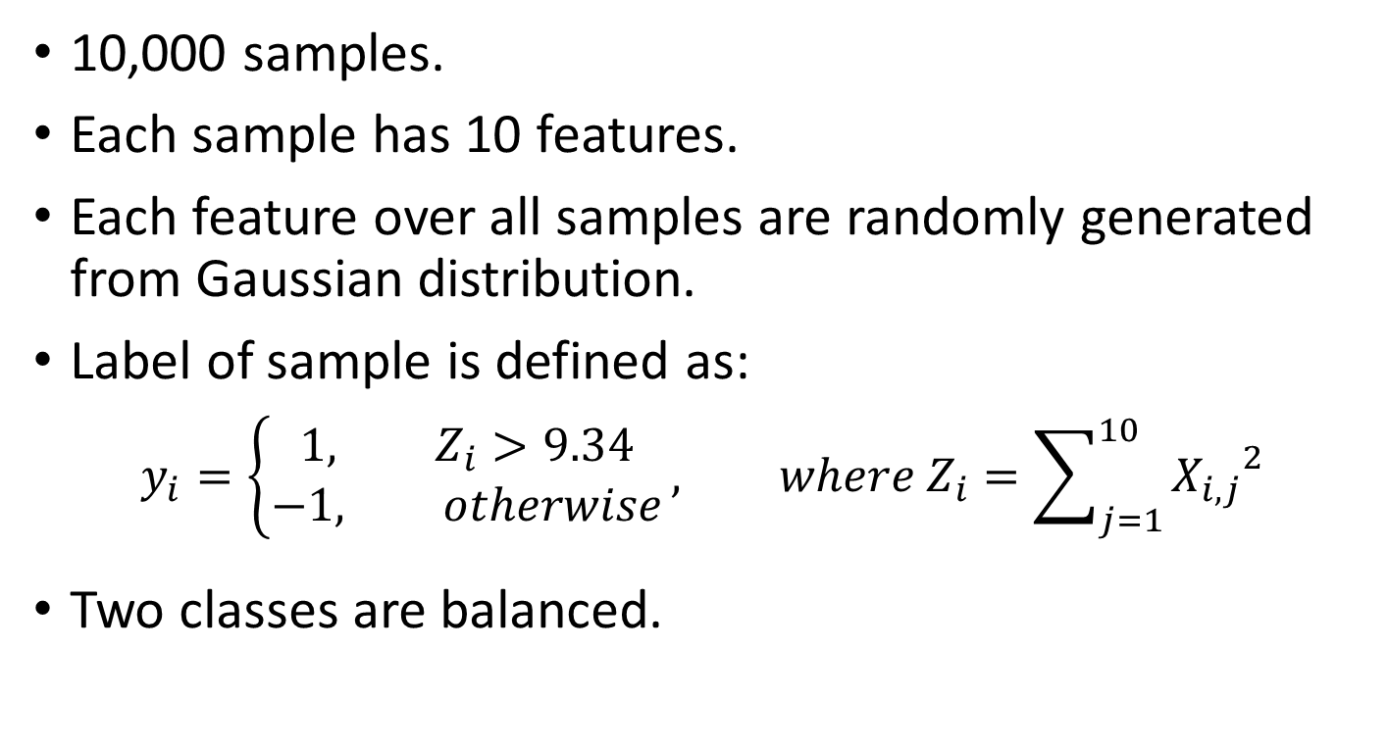
Simulated Dataset
10,000 samples.
Each sample has 10 features.
Each feature over all samples are randomly generated from Gaussian distribution.
Label of sample is defined as:
$$y_{i}=\left\{\begin{aligned}1, Z_{i}>9.34 \\ &−1, otherwise\end{aligned}\right., where Z_{i}=\sum_{j=1}^{10}{{X_{i, j}}^{2}}$$
Two classes are balanced.

Slide 19
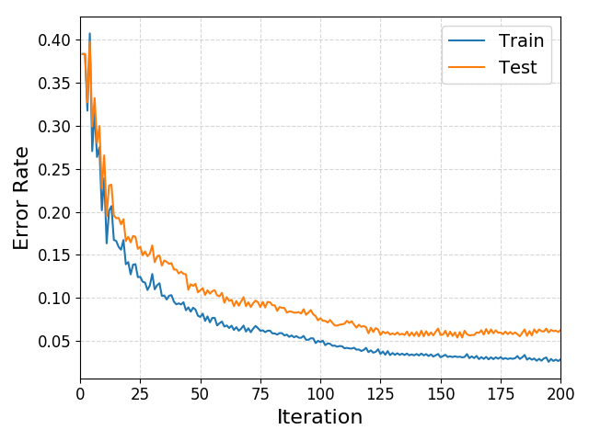
Simulated Dataset – learning curves
Test Acc:
0.9435

Slide 20
Wisconsin Diagnostic Breast Cancer (WDBC)
569 samples.
Each sample has 30 features extracted from images of cell nuclei of breast mass.
Number of “Benign”: 357
Number of “Malignant”: 212
See UCI Data Repo for more information.

Slide 21
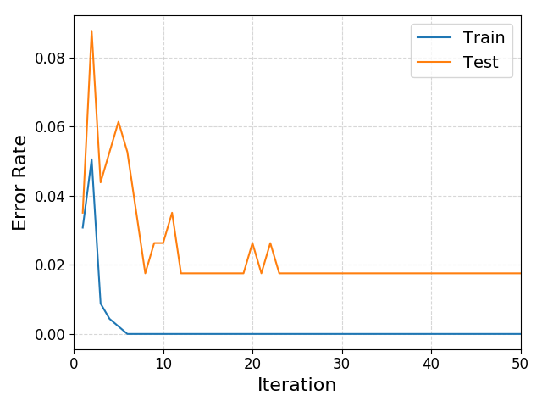
Wisconsin Diagnostic Breast Cancer(WDBC) – learning curves
Test Acc:
0.9825

Slide 22
Implementation (If you want to know)
The GitHub repo:
https://github.com/quqixun/MLAlgorithms
See here to create virtual python environment and install all required libraries.
Follow instructions in folder “AdaBoost” to run code in command line.

Slide 23
More ensemble methods
See the “ensemble” module of scikit-learn.
eXtreme Gradient Boosting (XGBoost).
Light Gradient Boosting Machine (LightGBM).

Slide 24
References
Freund, Y. and Schapire, R.E., 1997. A decision-theoretic generalization of on-line learning and an application to boosting. Journal of computer and system sciences, 55(1), pp.119-139.
Schapire, R.E. and Singer, Y., 1999. Improved boosting algorithms using confidence-rated predictions. Machine learning, 37(3), pp.297-336.
Simulated data for binary classification.

