Slide 1
Business Contract Validation
ADIT, CVM University
102000801 – Industrial Internship
Semester - 8
Prepared By: Ms. Kanan P Patel(12102080601054)
Guided By: Prof Hemanshu Patel

Slide 2
Student Details
No. | Enrollment No. | Student Name | Role In Project
1 | 12102080601054 | Kanan Patel | Data Science Intern

Slide 3
Index
Introduction
Company Overview
Task Completed During Training Period
Project Overview
Technologies Used
Key Responsibilities
Challenges and Solutions
Conclusion and Learnings

Slide 4
Introduction
Internship Role: Data Science Intern
Company: TECH ELECON PVT LTD
Project: Business Contract Validation Project
Goal: The Business Contract Validation project aims to automate the verification of the contract documents using data science techniques. It ensures contract compliance by identifying inconsistencies, missing clauses and potential risks. The project enhances accuracy, reduces manual effort, and improves decision-making in contract management.

Slide 5
Company Overview
Company Name: TECH ELECON PVT LTD
Contact Person: Mr. Satyam Raval
Email: ssraval1@techelecon.com
Contact no: +91 7066207670
Introduction:
Tech Elecon Private Limited (TEPL), established in 2012, is the Information Technology division of the Elecon Group, headquartered in Vallabh Vidyanagar, Gujarat, India. With over 25 years of experience in hardware, software, and networking, TEPL offers a comprehensive range of connectivity system integration solutions and services, including high-speed internet, bandwidth on demand, IP VPN, and data storage. The company is committed to delivering innovative IT solutions to meet the evolving needs of its clients.

Slide 6
Project Overview
Project –> Business Contract Validation
The Business Contract Validation project aims to automate the verification of contract documents using data science techniques. It ensures contract compliance by detecting inconsistencies, missing clauses, and potential risks. By leveraging Natural Language Processing (NLP) and machine learning, the system enhances accuracy, reduces manual effort, and speeds up contract review. This project provides a scalable solution for efficient contract management, improving decision-making and reducing legal risks.

Slide 7
Project Overview
Characteristics of Business Contract Validation Project:
Automated Contract Analysis – Uses NLP and machine learning to scan and validate contract documents efficiently.
Error & Inconsistency Detection – Identifies missing clauses, ambiguous terms, and potential compliance risks.
Risk Assessment – Flags legal risks and non-compliance issues to ensure contract integrity.
Scalability – Can be adapted to analyze various contract types across different industries.
User-Friendly Interface – Provides easy-to-understand insights for legal and business teams.
Time & Cost Efficiency – Reduces manual contract review time, lowering operational costs and improving decision-making speed.

Slide 8
Project Overview
Workflow & Technologies Used
1. Converting PDFs to Grayscale Images
• Input: Dataset of contract PDFs
•Process: Convert PDF pages into grayscale images
•Technology Used: OpenCV, OS
•Output: Grayscale contract images
2. Extracting Text from Images
Process: Use Optical Character Recognition (OCR) to extract text from grayscale images
Technology Used: Tesseract OCR (Pytesseract), Python
Output: Extracted text saved in .txt files
3. Segmenting Contract by Headings
Process: Identify and extract contract sections based on headings
Technology Used: Regular Expressions (re library)
Output: Segmented contract stored in a .json file
Example Sections:
•Scope of Work
•Payment Terms
•Liability

Slide 9
Project Overview
Workflow & Technologies Used
4. Identifying & Extracting Risk Clauses
Process: Detect specific risk-related clauses from the contract
Technology Used: NLP techniques (Regex, Text Analysis)
5. AI Model for Contract Validation
Process: Use an AI model to validate contract clauses
Output: AI-generated paragraph summarizing contract validity
6. Visualization of Results
Process: Display insights using graphs or structured outputs
Technology Used: HTML, CSS, Javascript

Slide 10
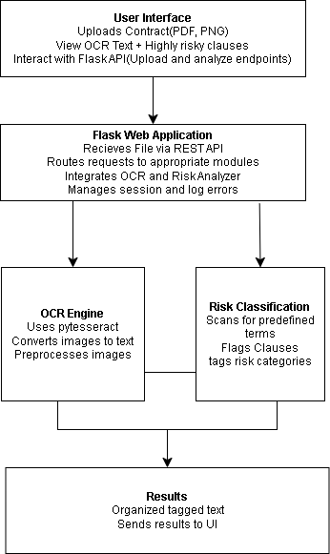
System Architecture Overview

Slide 11
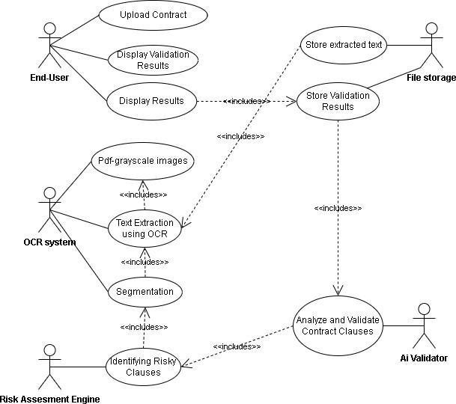
Use-Case diagram

Slide 12
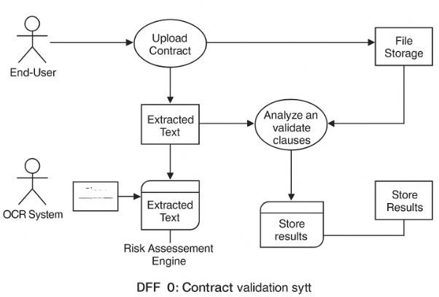
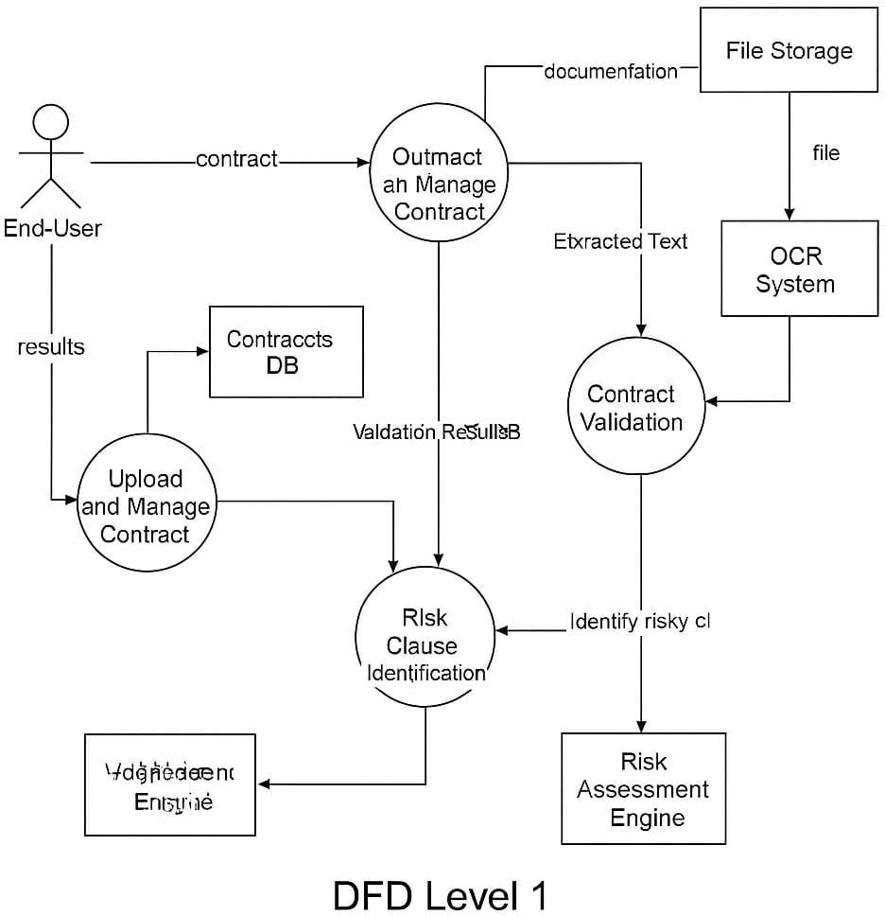
Data Flow Diagrams
DFD Level – 0 DFD Level – 1

Slide 13
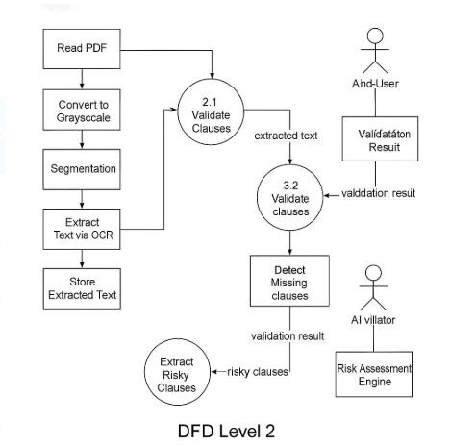
Data Flow Diagrams
DFD Level – 2

Slide 14
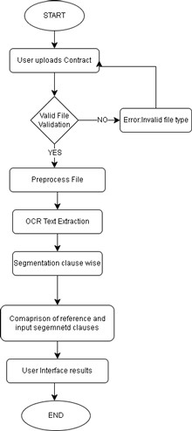
Flowchart

Slide 15
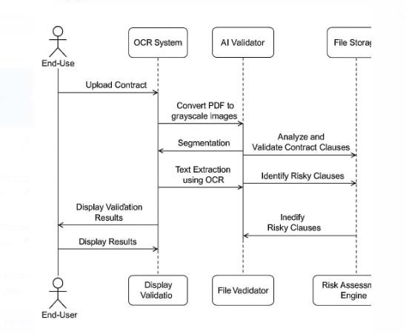
Sequence Diagram

Slide 16
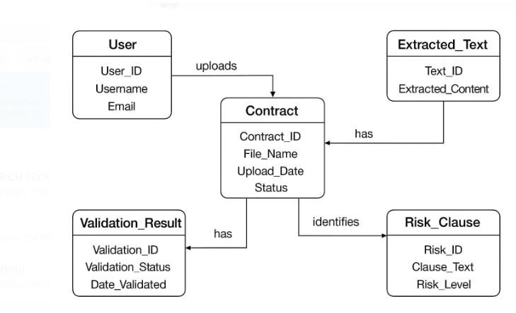
ER Diagram

Slide 17
Technologies Used
Programming Languages: Python, SQL(for database management)
Code Editor: Jupyter Notebook, VS Code
Technology Used in Business Contract Validation Project:
Frontend: HTML, CSS, JavaScript
Backend: Flask (API & Integration)
Backend Processing: Jupyter Notebook
Database: Microsoft SQL Server
Libraries Used: OpenCV, Pytesseract, Regular Expressions (re), NLP

Slide 18
Key Responsibilities
Key Responsibilities in Business Contract Validation Project
Data Collection & Preprocessing – Gather contract documents, clean text data, and prepare it for analysis.
Natural Language Processing (NLP) Implementation – Use NLP techniques to extract key contract terms and clauses.
Error & Risk Detection – Identify inconsistencies, missing clauses, and potential legal risks.
Machine Learning Model Development – Train models to classify contracts and detect anomalies.
Testing & Validation – Ensure the system provides accurate and reliable contract analysis results.
Reporting & Visualization – Present findings using dashboards or reports for easy interpretation.

Slide 19
Challenges and Solutions
Challenge | Solution
Understanding complex contract language | Used basic NLP techniques to extract key terms and clauses
Different formats (PDF, scanned, text) | Applied OCR (Tesseract) to extract text from images
Identifying missing or incorrect clauses | Compared with a predefined clause checklist
Ensuring accurate results | Started with rule-based logic, then introduced ML for accuracy
Handling large data | Used Python and Pandas for efficient data processing

Slide 20
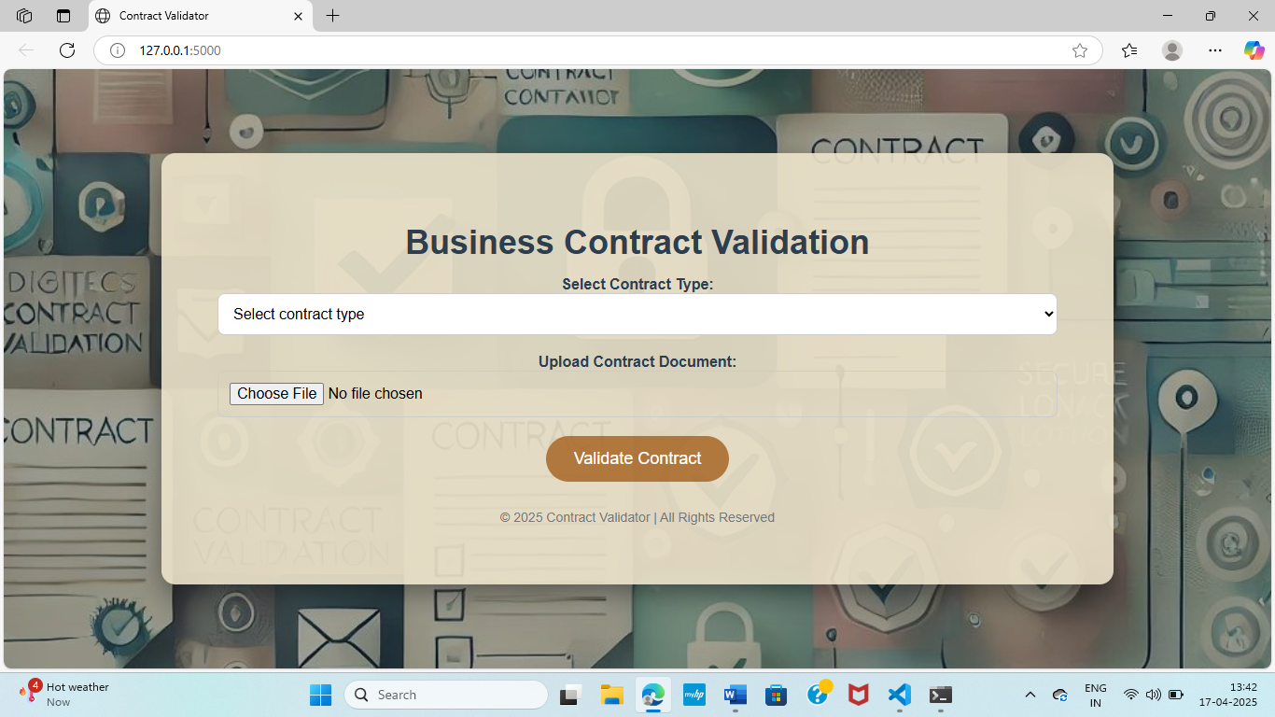
Diagrams

Slide 21
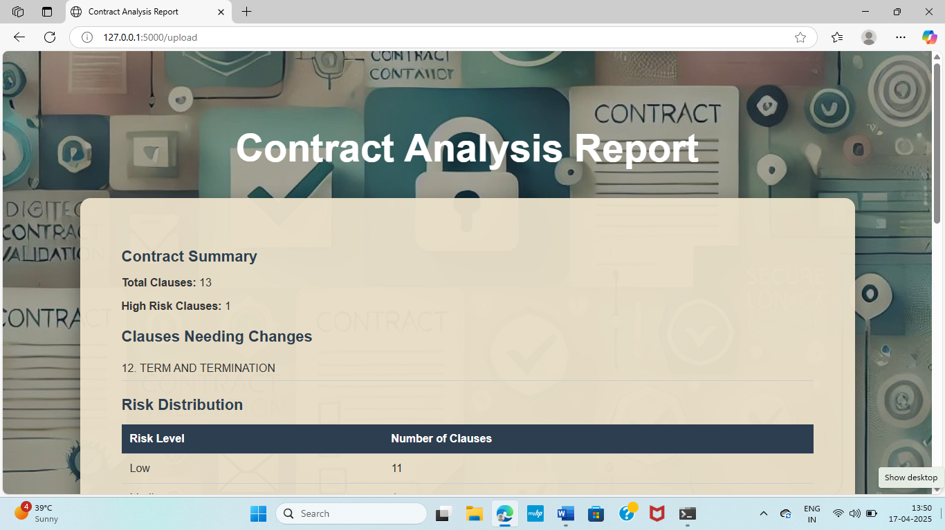
Diagrams

Slide 22
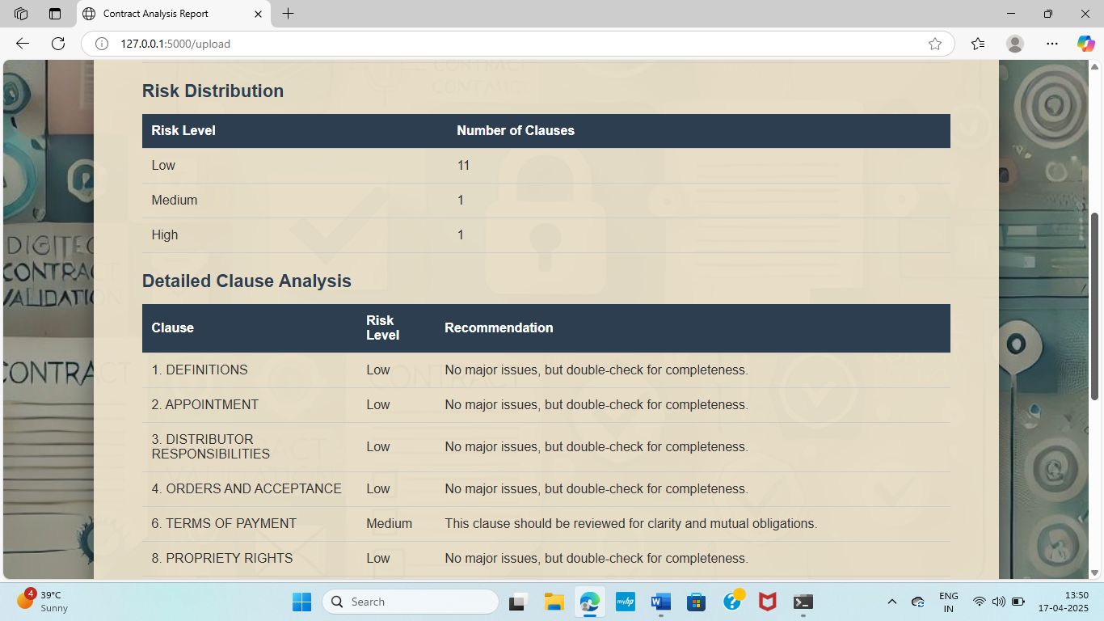
Diagrams

Slide 23
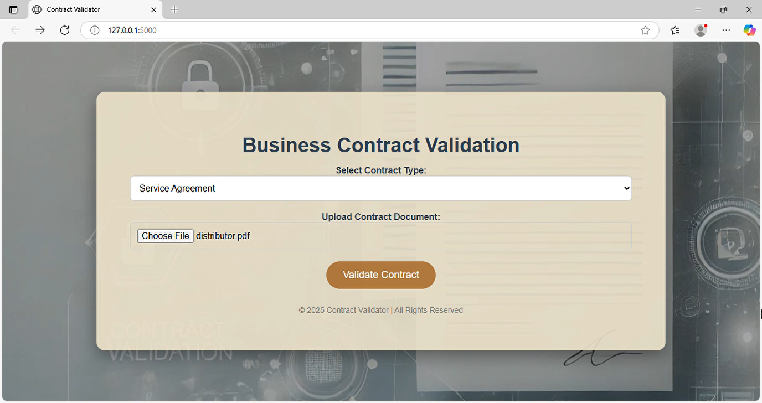
Project Demonstration

Slide 24
Conclusion and Learnings
Automated contract validation improves accuracy, reduces manual effort, and enhances decision-making.
NLP and machine learning help detect inconsistencies, missing clauses, and legal risks in contracts.
OCR and text processing are essential for handling scanned and unstructured legal documents.
AI-driven techniques address challenges like format variability and improve contract validation efficiency.
Balancing automation with human oversight ensures higher accuracy and reliability in contract analysis.

Slide 25
