Slide 1
ECE: IP DESIGN · GRADUATE PROJECT
Custom IP Module for Tiled GEMM
An 8×8 Weight-Stationary Systolic Array on Xilinx Zynq-7020
Jo Choi
NYU Tandon · ECE9463 Spring 2026
Notes:
Good morning. I'm YoungJo Choi, and I want to walk you through my custom intellectual property module — a hardware accelerator for tiled general matrix multiplication, built from scratch in SystemVerilog on the Zynq-7020 FPGA. Over the next five minutes, I'll show you what I built, why I made the design choices I made, and the results.

Slide 2
What I Built
A reusable Vivado IP that computes one tile of a GEMM
Operation: C[8][8] = A[8][8] × B[8][8]
Numerics: int16 inputs, int32 accumulator output
Interface: AXI-Lite slave (CTRL, STATUS, C-tile readback)
Deliverable: Packaged Vivado IP — drop-in to any block design
A
8×8
×
B
8×8
=
C
8×8
15 cycles / tile
3.4 GMAC / s
150 ns at 100 MHz
64 PEs × 8 MACs / 150 ns
Notes:
My IP computes one tile of a general matrix multiplication — C equals A times B for eight-by-eight tiles, with 16-bit signed integer inputs and a 32-bit accumulator output. The interface is AXI-Lite: the host writes to a CTRL register to start, polls a STATUS register for done, and reads the result tile from 64 memory-mapped registers. From start to finish, a single tile takes 15 clock cycles — about 150 nanoseconds at 100 megahertz — which works out to 3.4 giga-multiply-accumulates per second. The deliverable is a packaged Vivado IP that can be dropped into any block design like a standard Xilinx component.

Slide 3
Architecture
Modular hierarchy — controller, buffers, compute core, AXI wrapper
Host (Zynq PS)
gemm_top.sv
Top-level IP
axi_lite_ctrl.sv
AXI-Lite slave
AXI-Lite + tile loads
a_tile_buffer
b_tile_buffer
FSM
tile_ctrl.sv
FSM controller
a_tile_buffer.sv
A operand (8 banks)
b_tile_buffer.sv
B operand (64 reg)
Systolic Array · 8×8 PE grid
systolic_array.sv
8×8 PE grid
64 multiply-accumulates per cycle
Key parallelism: 64 PEs operate concurrently · 8-bank A buffer · 64-element B register array · skew/drain chains for alignment
Notes:
The architecture has five major blocks. At the top is a custom AXI-Lite slave that handles all host communication. Underneath is a finite state machine controller that sequences the compute phases. Two tile buffers stage the A and B operand tiles — the A buffer is partitioned into 8 banks so all 8 rows can be read in parallel each cycle, and the B buffer is a 64-element register array that exposes all weights simultaneously for single-cycle loading. The compute core is an 8-by-8 grid of 64 processing elements, each containing a multiplier, accumulator, and weight register. The grid uses per-row input skew chains and per-column output drain chains to keep the dataflow correct. Every cycle in the stream phase, 8 multiplies and 8 adds execute simultaneously.

Slide 4
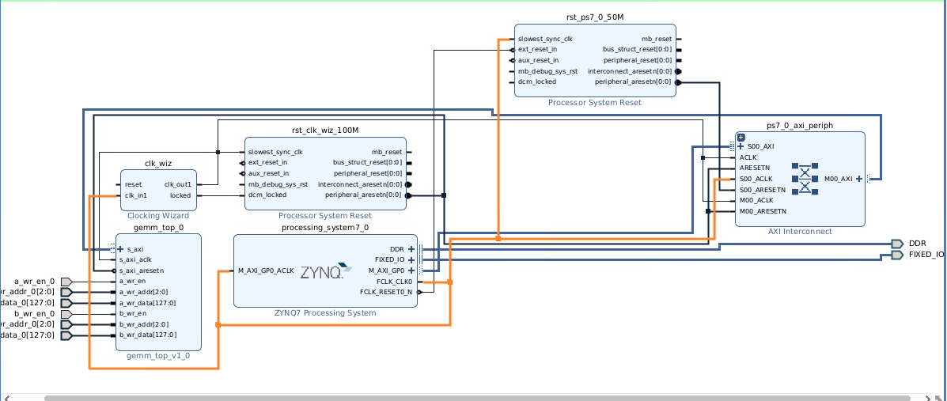
Architecture
Modular hierarchy — controller, buffers, compute core, AXI wrapper
Notes:
The architecture has five major blocks. At the top is a custom AXI-Lite slave that handles all host communication. Underneath is a finite state machine controller that sequences the compute phases. Two tile buffers stage the A and B operand tiles — the A buffer is partitioned into 8 banks so all 8 rows can be read in parallel each cycle, and the B buffer is a 64-element register array that exposes all weights simultaneously for single-cycle loading. The compute core is an 8-by-8 grid of 64 processing elements, each containing a multiplier, accumulator, and weight register. The grid uses per-row input skew chains and per-column output drain chains to keep the dataflow correct. Every cycle in the stream phase, 8 multiplies and 8 adds execute simultaneously.

Slide 5
Why These Choices?
Each choice driven by concrete tradeoffs, not intuition
01
02
03
SystemVerilog over HLS
8×8 array size
Weight-stationary dataflow
RTL is 1.5–3× more area-efficient than HLS for structured datapaths like systolic arrays. Course also emphasizes register-transfer-level understanding.
64 DSP = 29% of 220 budget. 4×4 underutilizes; 16×16 needs 256 DSP — exceeds budget. 8×8 hits the sweet spot.
B loaded once (1 cycle) then never touched. Simplest buffer interface of the three stationary choices.
Notes:
Three key choices defined this design. First — I wrote it in raw SystemVerilog instead of using Vitis HLS. The course emphasizes register-transfer-level understanding, and hand-tuned RTL is typically 1.5 to 3 times more area-efficient than HLS output for structured datapaths like systolic arrays. Second — why 8 by 8 specifically? Four by four would underutilize the chip. Sixteen by sixteen would need 256 DSP slices, but the Zynq-7020 only has 220 — so it wouldn't fit. Eight by eight uses 29 percent of the DSP budget, leaving room for a second instance later. Third — I chose weight-stationary dataflow, where the B tile sits in PE registers across the whole compute. This gives me the simplest possible buffer interface: load B once in a single cycle, then never touch the B-buffer port again.

Slide 6
Verification
Unit-then-integration testbench hierarchy, bit-exact against a NumPy golden model
PE
Array
+ Buffers
+ FSM
Full AXI
pe_tb
systolic_array_tb
array_full_buf_tb
array_ctrl_tb
gemm_axi_tb
Test vectors:
Python golden model with NumPy
100 random A/B tile pairs, fixed seed
6,400 expected int32 cell values
Each testbench: $readmemh + bit-exact compare
6400 / 6400
BIT-EXACT MATCHES
across all four integration stages
Notes:
My verification follows a unit-then-integration approach. I built five testbenches that mirror the module hierarchy: starting from a single processing element, then the full systolic array, then the array with tile buffers, then with the FSM, and finally the full AXI-driven testbench. For test vectors, I wrote a Python golden model using NumPy that generates 100 random A and B tile pairs with a fixed random seed — so the test data is bit-identical across runs and machines. Each testbench reads the same hex files and compares the hardware output against the expected NumPy result, cell by cell. Across all four integration levels, every single one of 6,400 cells passes bit-exactly.

Slide 7
Synthesis & Timing Results
Vivado 2023.2 on xc7z020clg400-1 · 100 MHz target
DSP utilization
Slice LUTs
64 / 220
1,734 / 53,200
29% · one DSP per PE
3.3% · combinational logic
Flip-Flops
Worst Neg. Slack
4,968 / 106,400
+1.377 ns
4.7% · pipeline registers
timing met · fmax ≈ 116 MHz
Bitstream generated successfully · Loaded on real PYNQ-Z2 · All design goals met
Notes:
Here are the real numbers from Vivado synthesis and implementation on the Zynq-7020. DSP usage came in at 64 slices, exactly as designed — one DSP per processing element. Combined logic uses just 3.3 percent of the LUTs and 4.7 percent of the flip-flops. The tile buffers map to LUTRAM rather than block RAM, leaving all 140 BRAM tiles free. Most importantly, timing closed cleanly: the worst negative slack is positive 1.377 nanoseconds at the 100 megahertz target, meaning the design could run up to 116 megahertz. The bitstream generated without errors and loaded correctly on a real PYNQ-Z2 board.

Slide 8
Takeaways
01
All performance goals met
bit-exact 6400/6400 · 15-cycle latency · 29% DSP fit · 100 MHz timing closed
02
Signal-driven > cycle counters
self-correcting under design changes; learned during Phase 7.3 debugging
03
Simulation is necessary but not sufficient
testbench and RTL can share the same bug — real silicon caught what sim missed
Thank you · Questions?
Notes:
To wrap up — every performance goal was met: bit-exact correctness, latency under 30 cycles, comfortable resource fit, and timing closed at the target frequency. The biggest lesson I'd carry forward is that simulation is necessary but not sufficient — testing your hardware against your model of the hardware can mask interaction bugs that only show up on real silicon. The full repository, including RTL, testbenches, Tcl automation, and detailed phase walkthroughs, is on my GitHub. Thank you — happy to take questions.

