Slide 1

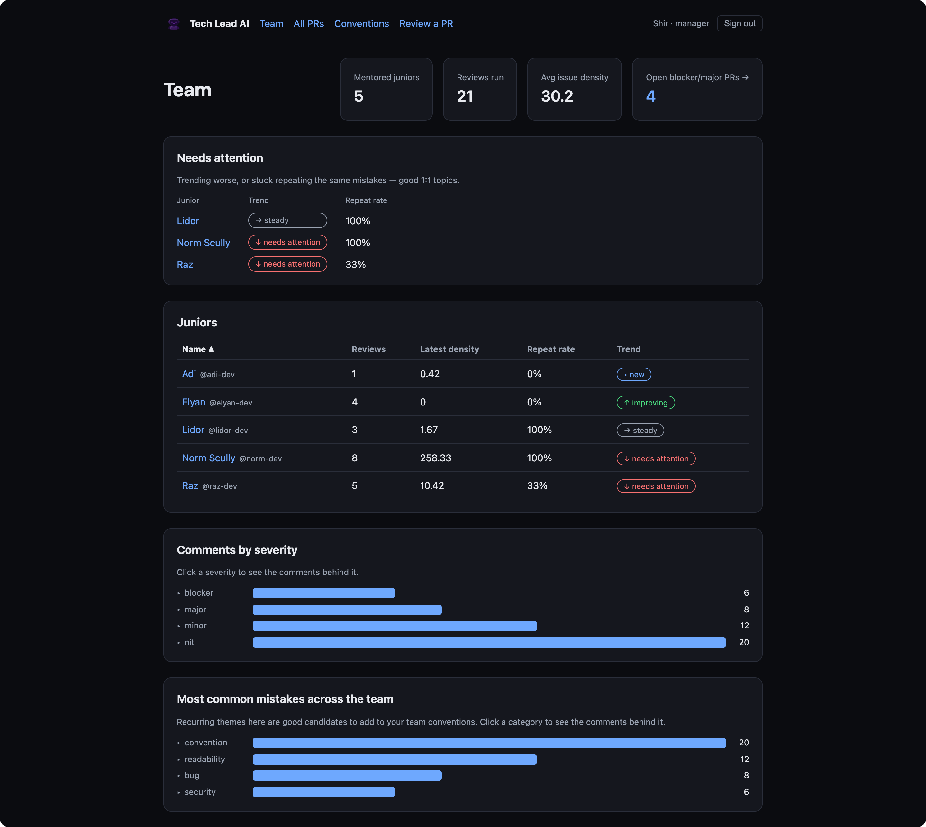
Tech Lead AI
An AI senior engineer that mentors junior developers — it reviews their pull requests, posts feedback on GitHub, and tracks each junior's growth over time.
Most AI reviewers check a PR. Tech Lead AI mentors a person.
Colman Dev Club · project presentation
presenter & date: __________
Notes:
Open with the wedge: most AI reviewers check a PR; we mentor a person over time. Colman Dev Club project.

Slide 2




THE NEED
Juniors grow fastest with good review — which rarely happens
Senior time is scarce
Thorough reviews are the first thing dropped when the team is busy. Juniors get a rushed “LGTM” instead of mentoring.
Feedback is inconsistent
Different reviewers care about different things — the junior gets contradictory signals and no clear standard.
Nobody tracks growth
Comments live and die inside one PR. No one can answer: “is this person actually getting better, and at what?”
Tech Lead AI reviews a developer, not a PR
02
Notes:
Three real failure modes on teams. This is the gap we fill.

Slide 3



THE SOLUTION
A tireless senior reviewer that mentors over time
Reviews against YOUR rules
Explains the why
Remembers & shows growth
Every junior PR is checked against the team’s own written conventions — not generic opinions.
Every comment teaches: it states why it matters, not just what to change.
It tracks each junior over time — spotting repeated mistakes and real improvement.
NORTH STAR
Mentor a junior over time — not just review one PR. Noticing repeated mistakes and showing growth is the core value, more than catching any single bug.
Tech Lead AI reviews a developer, not a PR
03
Notes:
Three things we do, then the north star: it's about the trajectory, not one bug.

Slide 4


IN 30 SECONDS
How it works, end to end
1
2
3
4
A junior opens a PR
AI reviews it
It posts mentoring comments
It tracks growth
on a connected GitHub repo
against your team’s own written rules
on the PR — each explains the why
every review feeds the junior’s dashboard
Everything after this slide is just how each of these four steps works.
Tech Lead AI reviews a developer, not a PR
04
Notes:
The elevator version. The rest of the deck zooms into these four steps.

Slide 5


WHO IT’S FOR
Two people, two views — both see growth, not a score
Manager
Junior
Defines the team’s conventions (“what good means”)
Marks which juniors are mentored
Sees the team dashboard + who needs attention
Gets a weekly digest + regression alerts (planned)
Gets a mentoring review on every PR — with the why
Sees their own growth over time
Compared only to their own past — never to peers
Identified by GitHub handle (no separate login in v1)
Built multi-tenant from day one: organization → team → user, so it can serve many companies later.
Tech Lead AI reviews a developer, not a PR
05
Notes:
Manager and junior both see the same growth framing — the junior is never compared to peers, only their own past. Admin/org setup sits underneath (multi-tenant from day one).

Slide 6
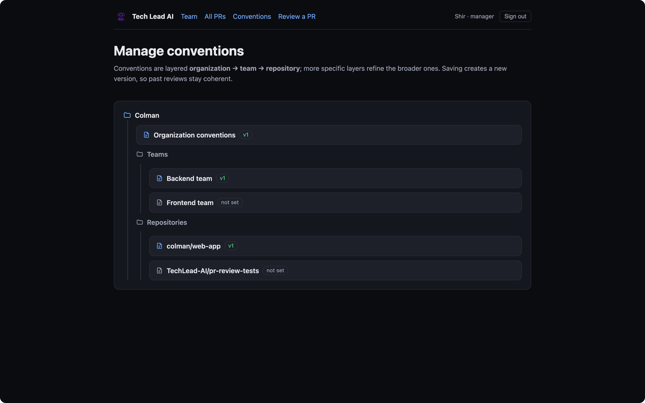
WHAT “GOOD” MEANS
The manager defines the team’s conventions
Plain-English rules
templated markdown — style, testing, security, language specifics, with good / bad examples
Layered & merged
org → team → repo; the engine merges all three for each PR’s author
Versioned
edit anytime — past reviews keep the rules they ran with
Insight loop
a mistake recurring across the team is suggested as a new shared rule
Better rules → better reviews. The template exists to help you be specific.
Tech Lead AI reviews a developer, not a PR
06
Notes:
Component 2 — the human input. These conventions are the standard the AI reviews against; quality is capped by how specific they are, which is why the format is templated.

Slide 7

DIFFERENTIATION
It reviews a developer, not a pull request
Most AI reviewers | Tech Lead AI
Stateless — each PR in isolation | Remembers the junior across PRs
Output = comments to act on now | Comments + a growth trajectory over time
A gate on the way to merge | A mentor — visible to the junior, not merge-blocking
Generic best-practice opinions | Grounded in your team’s versioned conventions
Ranks / scores developers | No leaderboard — you vs. your own past only
The wedge is memory + mentoring — not “another linter with an LLM.” That’s the one line a skeptical audience needs.
Tech Lead AI reviews a developer, not a PR
07
Notes:
The money slide. Competitors review a PR; we review a developer.

Slide 8

ARCHITECTURE
Two triggers → one pipeline → the outputs
TRIGGERS
ONE PIPELINE
OUTPUTS
Postgres (data + queue)
GitHub PR
Review Service
opened / pushed → webhook
gather → review → gate → measure
(a worker runs it off a queue)
GitHub — posted review
“Review a PR” form
Dashboards
paste a diff (manual)
Claude / FakeReviewer
the AI brain — swappable
Both triggers run the SAME pipeline; a separate worker process keeps webhooks fast.
No Redis — queue on Postgres
Idempotent by commit SHA
org_id everywhere (SaaS-ready)
Frozen metric snapshots
Tech Lead AI reviews a developer, not a PR
08
Notes:
Two ways in — a real GitHub PR via webhook, or pasting a diff in the app — both hit the same Review Service. A separate worker does the heavy AI work so webhook responses stay fast.

Slide 9





CODE ARCHITECTURE
Small modules, one responsibility each
One Next.js app + a worker process, split into many small focused files — the 9 components from DESIGN.md. Tests sit next to the code; STRUCTURE.md is the live map of the repo.
app/
server/review
server/github
server/conventions
dashboard pages + API routes (incl. the webhook)
the engine: pipeline · reviewer · gates · repeat
webhook parse · Octokit client · post review
merge org → team → repo rules, versioned
server/grading
server/db
server/queue + worker
components/
issue-density / repeat-rate metrics
Prisma queries — every read is org-scoped
pg-boss jobs + the worker process
charts, tables, comment cards (all tested)
Tech Lead AI reviews a developer, not a PR
09
Notes:
How the codebase is organized: small single-purpose modules behind clear seams. The review engine is split into pipeline/reviewer/gates/repeat so features slot in, and the reviewer is an interface so the whole thing is testable offline.

Slide 10

COMMENT + GRADING MODEL
Three layers, kept strictly separate
1
The COMMENT about the code
location · category · severity · confidence · message · why (mandatory) · suggestion · convention · repeat-of
2
The GATES no human in the loop
confidence threshold · cap on trivial “nit” comments · (planned) a 👎 “this was wrong” signal
3
The PROFILE growth over time, not a score
issue density · repeat-mistake rate · category mix — a small profile, never one 0–100 grade
Severity describes the code, never the person — and Layer 3 is a profile you compare to your own past, not a grade.
Tech Lead AI reviews a developer, not a PR
10
Notes:
Keeping these layers distinct is the whole game. Layer 3 is deliberately a PROFILE (density, repeat-rate, mix) — not a single grade or score — so it reads as growth, never a threat.

Slide 11



THE COOL PART
How we actually steer the AI
A strict system prompt
OUR CODE — the schema every comment is validated against
Persona (“senior engineer mentoring a junior”), tone, and one hard rule: explain WHY. “Only flag real issues — prefer fewer, high-value comments.”
src/server/review/types.ts
category: bug | security | design |
test | convention | ...
severity: blocker | major | minor | nit
confidence: 0 .. 1
message: string
why: string ← the mentoring,
NOT optional
suggestion: string?
conventionRef: string?
Structured output, validated
The model must return JSON of a fixed shape, checked in code against our Zod schema. Wrong shape → rejected. No free-form prose leaks out.
Context is injected
PR title + merged conventions + the junior’s recent mistake categories + the diff — “if you see the same issue again, call out the pattern.”
Tech Lead AI reviews a developer, not a PR
11
Notes:
This is a snippet of OUR code (not a screenshot of a tool) — the Zod schema in types.ts. Every comment the model returns is parsed against it; a bad shape is rejected, and the why field is required.

Slide 12
THE GROWTH METRIC
Issue density — simple, deterministic, frozen
issue density
WORKED EXAMPLE — ELYAN’S FIRST PR
= ( Σ severity weights ÷ lines changed ) × 100
blocker + major + minor + nit
over 120 lines changed
Lower is better. Frozen per PR, so the trend can’t be rewritten when the formula later changes.
(8 + 4 + 2 + 0.5) ÷ 120 × 100
12.08
SEVERITY WEIGHTS
8
4
2
0.5
blocker
major
minor
nit
repeat rate = share of comments that repeat a past mistake. Together: density ↓ and repeat-rate ↓ = the junior is learning.
Tech Lead AI reviews a developer, not a PR
12
Notes:
Weighted severity per 100 lines, frozen per PR. Walk the 12.08 calc so the trend charts feel credible.

Slide 13
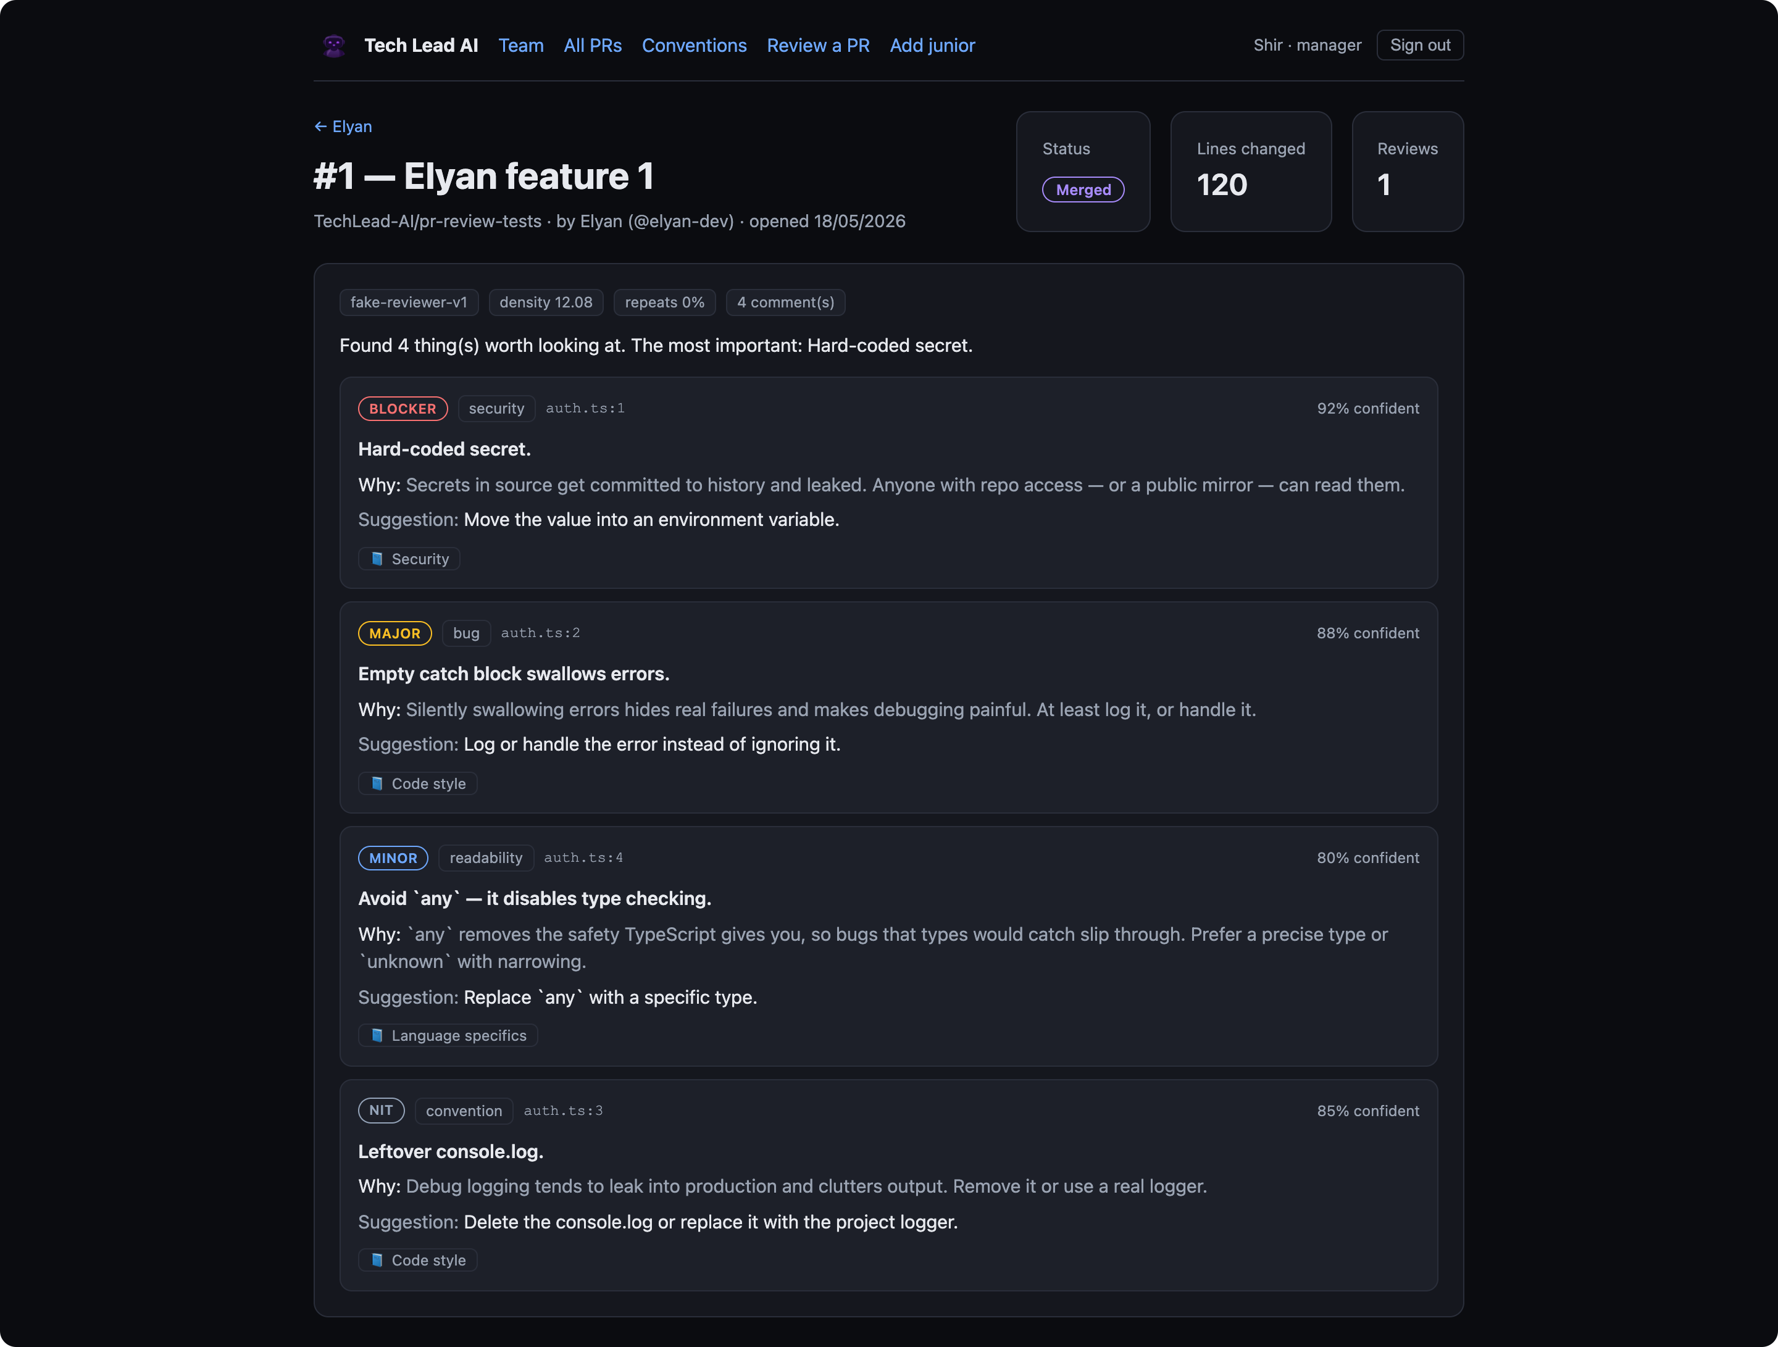
WORKED EXAMPLE · BEAT 1
Anatomy of one review (Elyan’s first PR)
auth.ts
+ const apiKey = "sk-live-secret123";
+ try { doThing(); } catch (e) {}
+ console.log(value);
+ let data: any = fetchData();
4 comments, ranked by severity — blocker → nit
Each carries a why + a concrete suggestion + a convention reference
Frozen metrics on the header: density 12.08, repeats 0% (her first PR)
Tech Lead AI reviews a developer, not a PR
13
Notes:
Read one comment's why out loud. Point out the severity ladder and the frozen density 12.08.

Slide 14
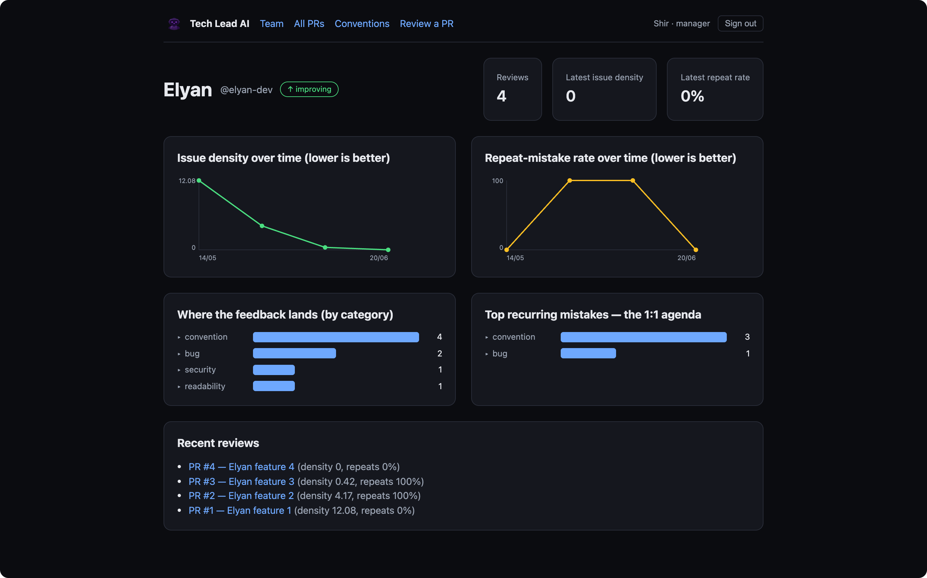
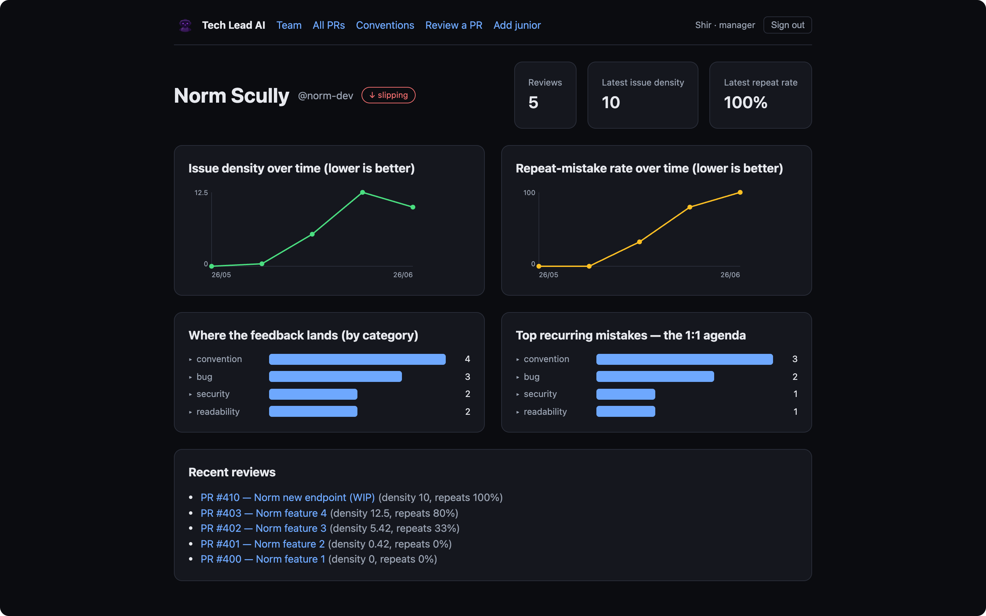
WORKED EXAMPLE · BEAT 2
The same data over time — two trajectories
Elyan — improving ↑
Norm Scully — slipping ↓
Issue density 12.08 → 0, repeat-rate back to 0: she stopped re-making the same mistakes.
Density climbs and repeat-rate hits 100% — flagged “slipping,” lands in needs-attention.
Tech Lead AI reviews a developer, not a PR
14
Notes:
Same engine, same metrics: one junior graduating (Elyan, she), one regressing (Norm). The arrow shows the direction of the developer's trajectory — up is good. Catching the bug is table stakes; the trajectory is the product.

Slide 15
THE WEBSITE
An interactive dashboard — we’ll open it live
Sign in as a manager or a junior. Everything drills down — nothing is a static chart. We’ll walk through it live; here’s what you can do:
Team overview
Per-junior profile
All PRs
stats, needs-attention, roster, severity
trends + top recurring mistakes
pie + histogram + searchable table
PR detail
Manage conventions
Review a PR
every comment, full data, all runs
org → team → repo tree, versioned
paste a diff, run a real review on demand
Drill-down: hover a trend point for its date & value, click it to open the PR behind it; mistake bars expand to the contributing comments.
Tech Lead AI reviews a developer, not a PR
15
Notes:
Switch to the live app here (sign in as Shir). The earlier slides already showed real screenshots, so this slide just frames the live walk-through.

Slide 16
THE REVIEW FLOW
PR → review → posted, in one pipeline
1
2
3
4
Receive & filter
Gather context
Review (AI)
Gate
confirm it’s really from GitHub, skip drafts & non-juniors, never review a commit twice
the diff + merged conventions + the junior’s past mistakes
structured comments, each grounded in a rule
drop low-confidence ones; cap trivial “nit” comments so the junior isn’t buried
5
6
7
8
Detect repeats
Measure & freeze
Post to GitHub
Reflect
match against history — the mentoring memory
density · repeat-rate · category mix → frozen snapshot
ONE batched review = one notification, not spam
dashboards update instantly
The manual “Review a PR” trigger runs the same pipeline inline (skips steps 1–2) for an instant result.
Tech Lead AI reviews a developer, not a PR
16
Notes:
Plain-language: step 1 confirms the webhook is genuinely from GitHub (signed), skips drafts and anyone who isn't a mentored junior, and uses the commit hash so the same commit is never reviewed twice. Step 4's 'nit' = a trivial/cosmetic issue; we cap how many post so the feed isn't noise.

Slide 17
LIVE, NOT A MOCK
What the bot posts on a real GitHub PR
On the real repo TechLead-AI/pr-review-tests, the App posts one batched review plus inline comments — exactly the format below.
tech-lead-ai-dev bot reviewed · 3 days ago
Tech Lead AI review
Found 6 thing(s) worth looking at. The most important: Hard-coded secret.
tech-lead-ai-dev[bot] the App’s own identity
auth.ts · line 1
PR #5 authored by junior norm-dev
🛑 Blocker · security — Hard-coded secret.
Secrets in source get committed to history and leaked. Anyone with repo access — or a public mirror — can read them.
6 findings one review event, not spam
Suggestion: Move the value into an environment variable.
⚠ Illustrative recreation — replace with a real screenshot of PR #5 before presenting.
Convention: Security
Tech Lead AI reviews a developer, not a PR
17
Notes:
REMINDER: replace the white mock card with a real screenshot of PR #5 (logged-in). The text reproduces the real bot comment format exactly.

Slide 18

DEPLOYMENT
Three services on Railway, one database
Push to GitHub and it deploys. Three services share one managed Postgres — no extra infrastructure.
Web
Postgres
Worker
dashboards + login + the webhook
the data + the job queue
runs the pipeline, posts back
the only public URL
no Redis needed
no public URL
Migrations run automatically on every deploy. The same demo runs locally with Docker.
Tech Lead AI reviews a developer, not a PR
18
Notes:
Keep it simple on the slide. If asked for detail: web is the only public service; the worker has no URL; Postgres backs both data and the pg-boss queue. Two engineering war-stories live here if pushed — a dependency-pruning fix and a proxy-safe redirect — but they're optional.

Slide 19
HONEST TRADEOFFS
Risks we hold consciously — each with a mitigation
Trust under full automation
No human approves a comment before it posts.
Mitigation: Today: a confidence threshold + a cap on trivial comments. Planned: a 👎 “this was wrong” button and an AI self-check pass.
The AI is only as good as your rules
Vague team conventions → vague reviews.
Mitigation: A guided template with concrete good / bad code examples.
Sensitive performance data
These are lasting judgments about named people.
Mitigation: Before going wider: decide how long data is kept, allow deleting a person’s data, and make the company (not us) the owner.
Tech Lead AI reviews a developer, not a PR
19
Notes:
Be honest. Note clearly: the 👎 button and the self-check pass are PLANNED, not built yet. 'Retention policy' = how long we keep the data before deleting it; 'ownership' = the company owns this HR-sensitive data, not the tool's builder.

Slide 20


WHAT’S NEXT
Roadmap — staged to slot in without a rewrite
Self-check pass
Fix-acknowledgment
the AI reviews its own comments before posting
“✅ you fixed this” on re-review, instead of silence
The 👎 feedback button
Smarter repeat-detection
let a junior flag a wrong comment — our error signal
spot the same kind of mistake in a different file or worded differently (today: only within one category)
Notifications
The SaaS path
manager weekly digest + regression / stuck alerts
multi-tenant base is in place — add OAuth, retention, billing
Tech Lead AI reviews a developer, not a PR
20
Notes:
The pipeline was staged so these slot in cleanly. The 👎 button is here because it's a known gap, not yet built.

Slide 21
Code review, from a one-off gate to a relationship that compounds.
Catch the bug · explain the why · remember the pattern · show the growth
109
3
9
0
tests passing
Railway services
components
Redis / leaderboards
Runs offline (FakeReviewer) or on Claude · live GitHub App 4126235 · deploys to Railway
Thank you
Notes:
Close on the compounding idea + quick facts. Offer the live demo.

