Slide 1

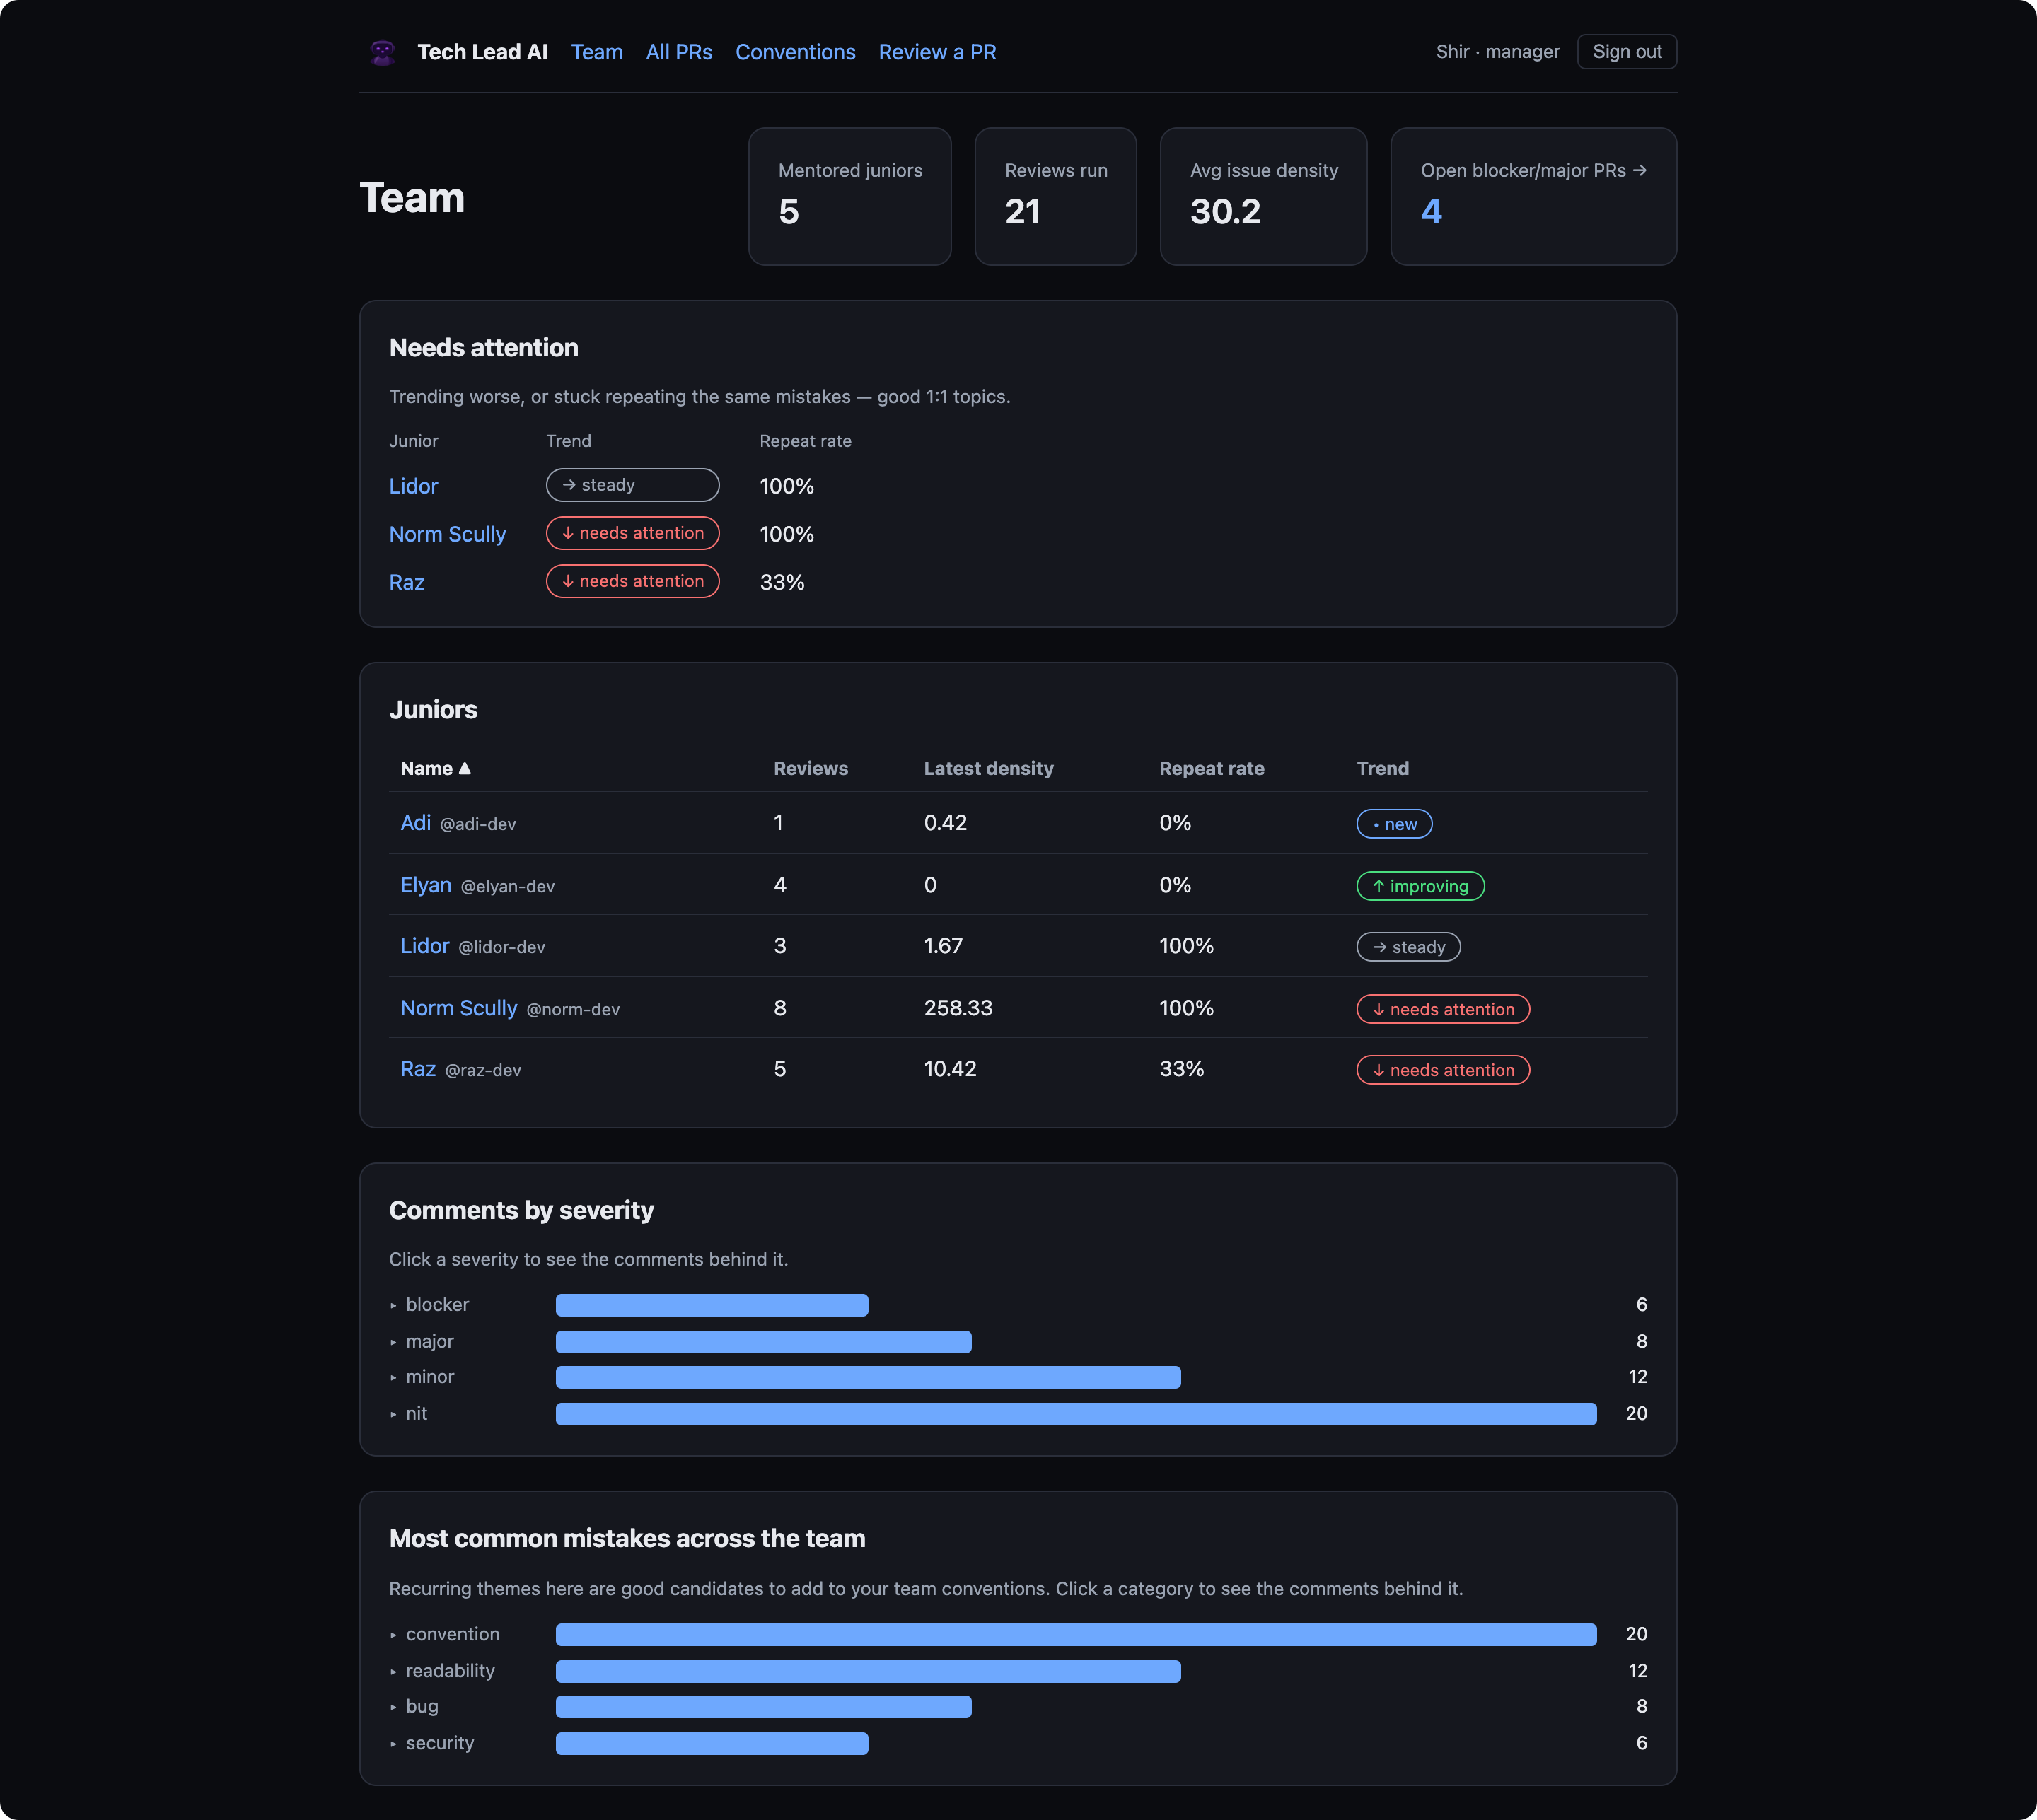
Tech Lead AI
An AI senior engineer that mentors junior developers — it reviews their pull requests, posts feedback on GitHub, and tracks each junior's growth over time.
Most AI reviewers check a PR. Tech Lead AI mentors a person.
Colman Dev Club · project presentation
presenter & date: __________
Notes:
Open with the wedge: most AI reviewers check a PR; we mentor a person over time. This is a Colman Dev Club project.

Slide 2




THE NEED
Junior devs grow fastest with good review — which rarely happens
Senior time is scarce
Thorough reviews are the first thing dropped when the team is busy. Juniors get a rushed “LGTM” instead of mentoring.
Feedback is inconsistent
Different reviewers care about different things — the junior gets contradictory signals and no clear standard.
Nobody tracks growth
Comments live and die inside one PR. No one can answer: “is this person actually getting better, and at what?”
Tech Lead AI reviews a developer, not a PR
02
Notes:
Three real failure modes on teams. Set these up as the gap we fill.

Slide 3



THE SOLUTION
A tireless senior reviewer that mentors over time
Reviews against YOUR rules
Explains the why
Remembers & shows growth
Every junior PR is checked against the team’s own written conventions — not generic opinions.
Every comment teaches: it states why it matters, not just what to change.
It tracks each junior over time — spotting repeated mistakes and real improvement.
NORTH STAR
Mentor a junior over time — not just review one PR. Noticing repeated mistakes and showing growth is the core value, more than catching any single bug.
Tech Lead AI reviews a developer, not a PR
03
Notes:
Three things we do, then the north star: it's about the trajectory, not one bug.

Slide 4


DIFFERENTIATION
It reviews a developer, not a pull request
Most AI reviewers | Tech Lead AI
Stateless — each PR in isolation | Remembers the junior across PRs
Output = comments to act on now | Comments + a growth trajectory over time
A gate on the way to merge | A mentor — visible to the junior, not merge-blocking
Generic best-practice opinions | Grounded in your team’s versioned conventions
Ranks / scores developers | No leaderboard — you vs. your own past only
The wedge is memory + mentoring — not “another linter with an LLM.” That’s the one line a skeptical audience needs.
Tech Lead AI reviews a developer, not a PR
04
Notes:
The money slide. Competitors review a PR; we review a developer. Note CodeRabbit etc. now have some memory — our edge is the growth profile + no-leaderboard framing.

Slide 5

ARCHITECTURE
One app, one shared pipeline, two entry points
GitHub PR
opened / pushed
Webhook + queue
Review Service
pg-boss → worker
one shared pipeline
Manual: Review a PR
paste a diff
Postgres
Claude / FakeReviewer
data + queue
the AI brain
Dashboards (Next.js) read from Postgres → every review shows up instantly.
No Redis — pg-boss runs on Postgres
Idempotent by commit SHA
org_id everywhere (SaaS-ready)
Frozen metric snapshots
Tech Lead AI reviews a developer, not a PR
05
Notes:
One Next.js app + a separate worker. The manual trigger and the webhook converge on ONE review service. Postgres backs both data and the queue — no Redis.

Slide 6

COMMENT + GRADING MODEL
Three layers, kept strictly separate
1
The COMMENT about the code
location · category · severity · confidence · message · why (mandatory) · suggestion · convention · repeat-of
2
The GATES no human in the loop
confidence threshold · nit budget · 👎 “this was wrong” feedback
3
The GRADE about the person, over time
issue density · repeat-mistake rate · category mix — a small profile, never one 0–100 score
Severity describes the code, never the person.
Tech Lead AI reviews a developer, not a PR
06
Notes:
Keeping these three layers distinct is the whole game: the comment is about code, the gates decide what posts, the grade is about the person over time.

Slide 7



THE COOL PART
How we actually steer the AI
A strict system prompt
ReviewCommentSchema (Zod)
Persona (“senior engineer mentoring a junior”), tone, and one hard rule: explain WHY. “Only flag real issues — prefer fewer, high-value comments.”
category: bug | security | design |
test | convention | ...
severity: blocker | major | minor | nit
confidence: 0 .. 1
message: string
why: string ← the mentoring,
NOT optional
suggestion: string?
conventionRef: string?
Structured output, validated
The model must return JSON of a fixed shape, parsed through the same Zod schema the app uses. Bad shape → it throws. No free-form prose leaks out.
Context is injected
PR title + merged conventions + the junior’s recent mistake categories + the diff — “if you see the same issue again, call out the pattern.”
Tech Lead AI reviews a developer, not a PR
07
Notes:
Not 'ask the model what it thinks.' It's constrained: strict prompt, schema-validated structured output, injected context. The mandatory why is enforced in code.

Slide 8

THE GROWTH METRIC
Issue density — simple, deterministic, frozen
issue density
WORKED EXAMPLE — ELYAN’S FIRST PR
= ( Σ severity weights ÷ lines changed ) × 100
blocker + major + minor + nit
over 120 lines changed
Lower is better. Frozen per PR, so the trend can’t be rewritten when the formula later changes.
(8 + 4 + 2 + 0.5) ÷ 120 × 100
12.08
SEVERITY WEIGHTS
8
4
2
0.5
blocker
major
minor
nit
repeat rate = share of comments that repeat a past mistake. Together: density ↓ and repeat-rate ↓ = the junior is learning.
Tech Lead AI reviews a developer, not a PR
08
Notes:
The growth story rests on this number. Weighted severity per 100 lines, frozen per PR. Walk the 12.08 calc so the trend charts feel credible.

Slide 9

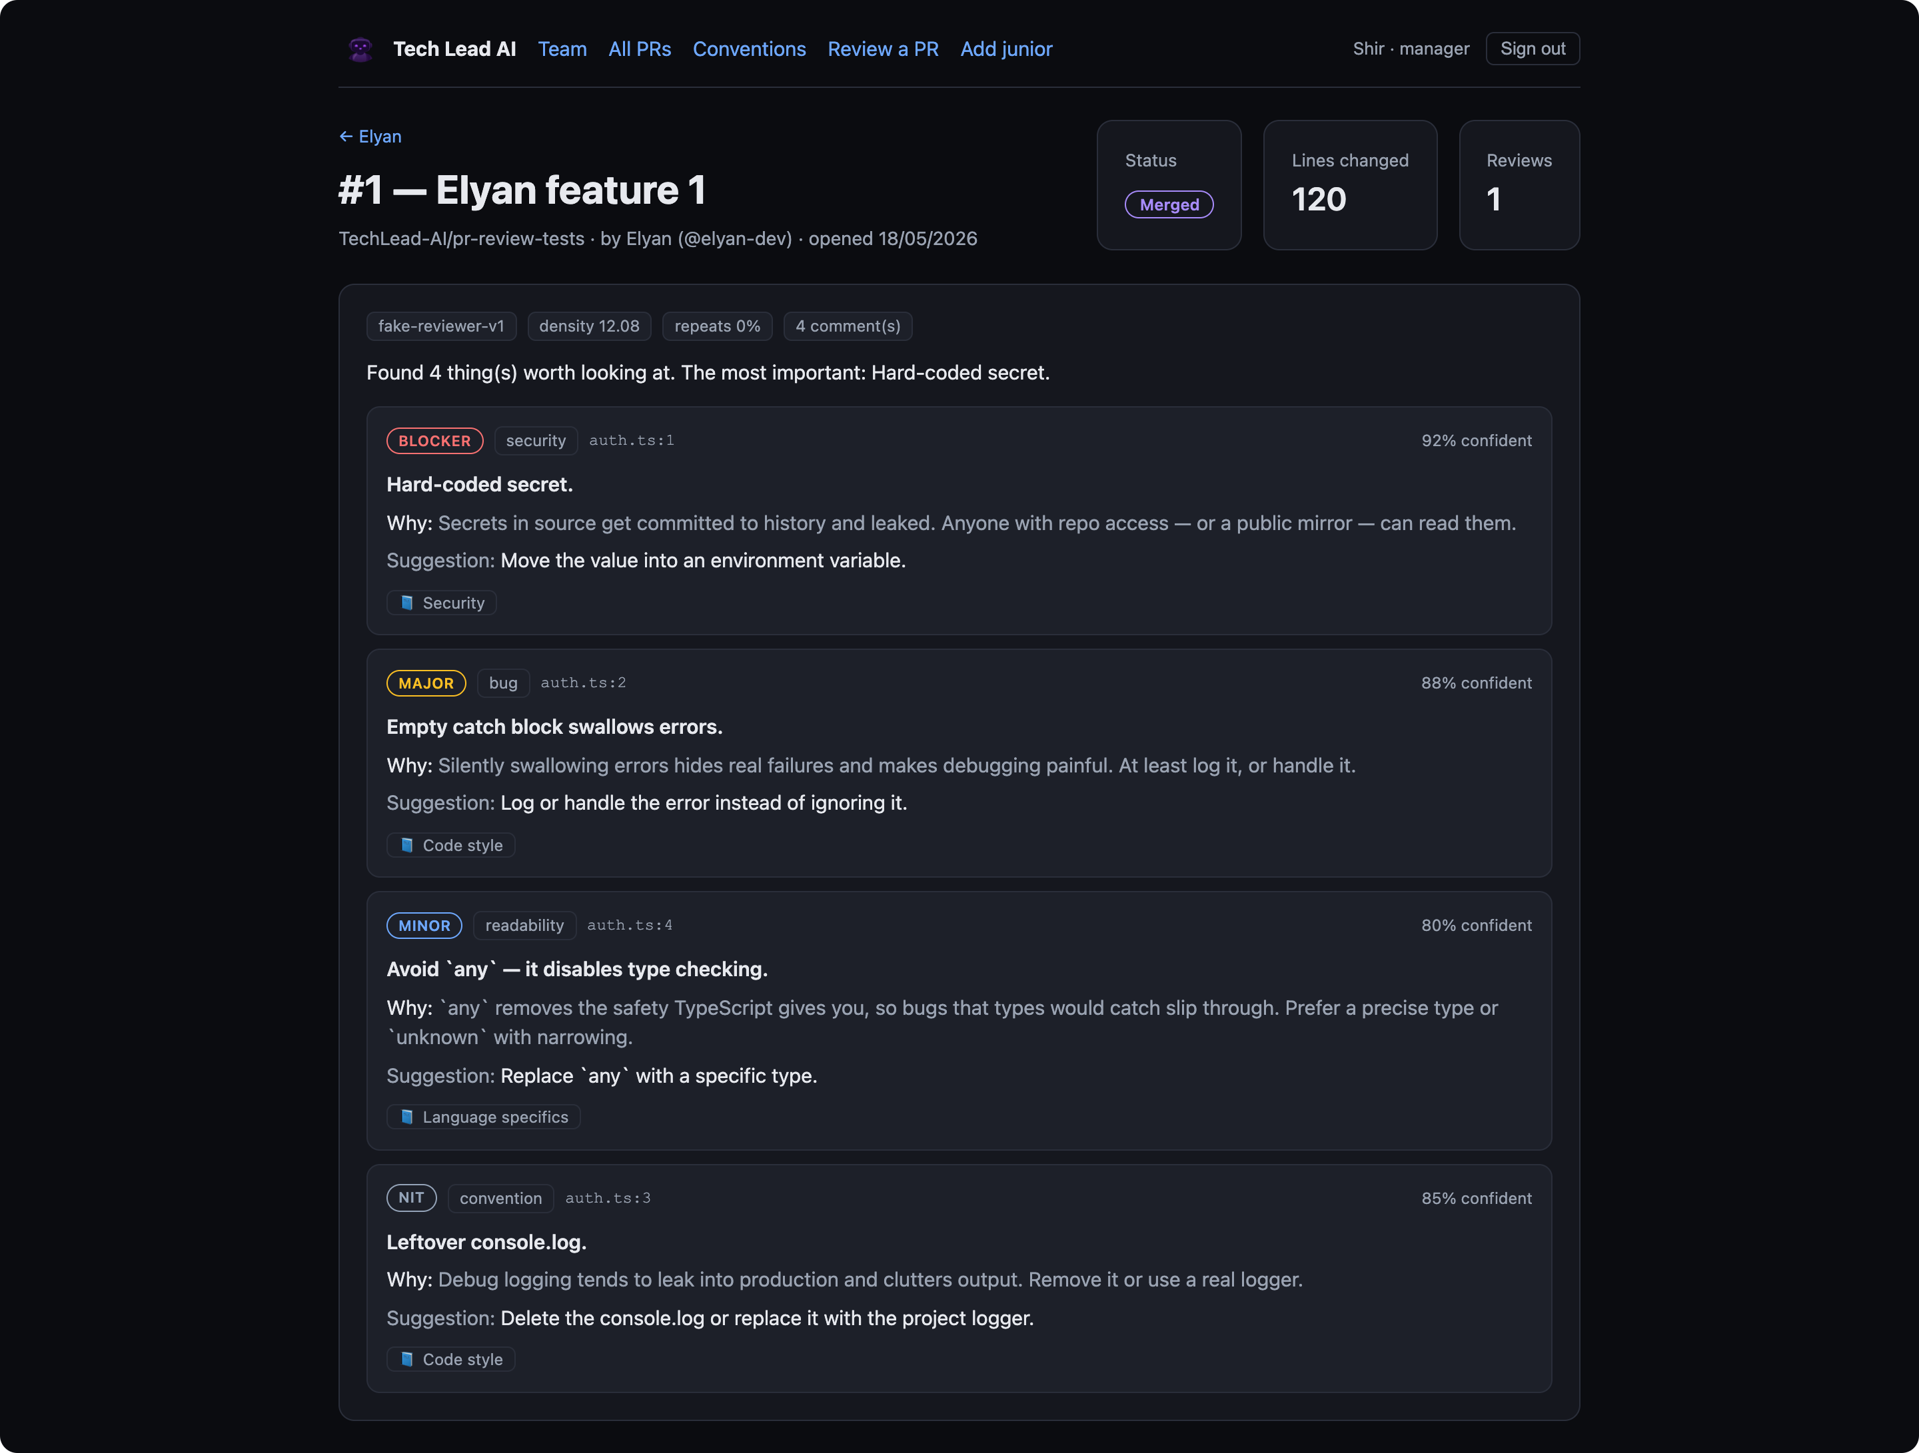
WORKED EXAMPLE · BEAT 1
Anatomy of one review (Elyan’s first PR)
auth.ts
+ const apiKey = "sk-live-secret123";
+ try { doThing(); } catch (e) {}
+ console.log(value);
+ let data: any = fetchData();
4 comments, ranked by severity — blocker → nit
Each carries a why + a concrete suggestion + a convention reference
Frozen metrics on the header: density 12.08, repeats 0% (first PR)
Tech Lead AI reviews a developer, not a PR
09
Notes:
Read one comment's why out loud. Point out the severity ladder and the frozen density 12.08 on the header.

Slide 10
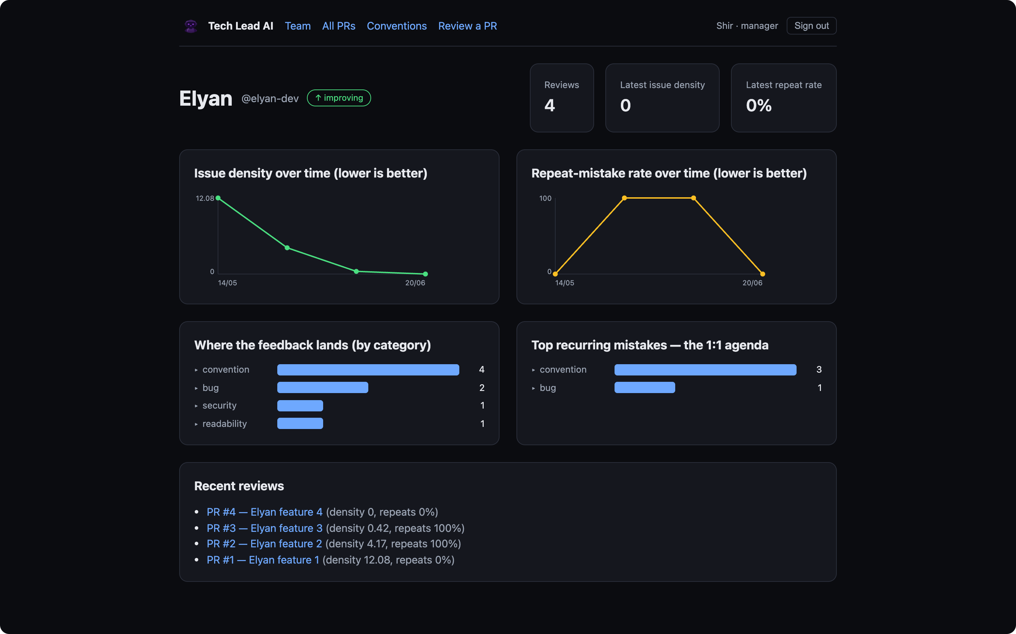
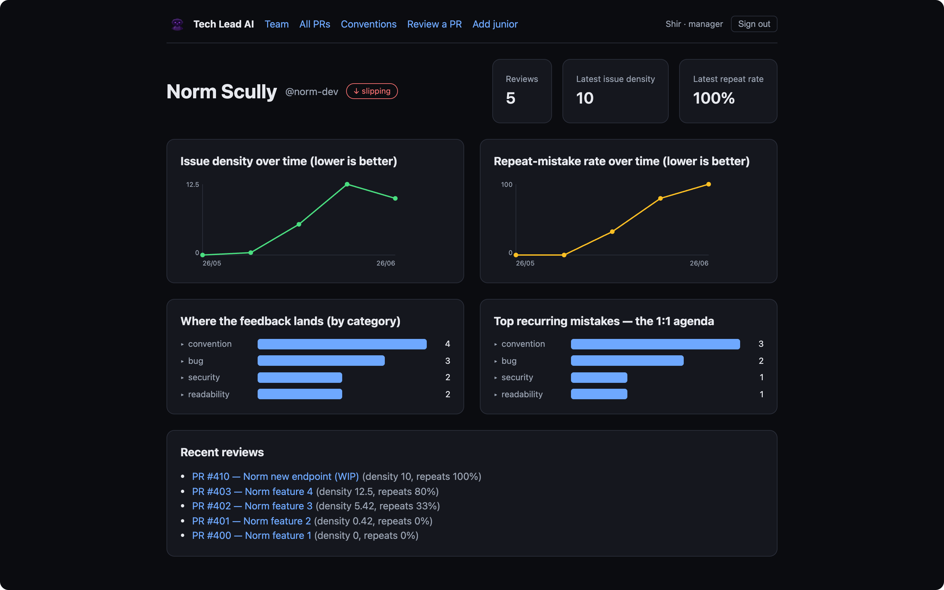
WORKED EXAMPLE · BEAT 2
The same data over time — two trajectories
Elyan — improving ↓
Norm Scully — slipping ↑
Density 12.08 → 0, repeat-rate back to 0: he stopped re-making the same mistakes.
Density climbs, repeat-rate hits 100% — flagged “slipping,” lands in needs-attention.
Tech Lead AI reviews a developer, not a PR
10
Notes:
Same engine, same metrics: one junior graduating, one regressing. Catching the bug is table stakes; showing the trajectory is the product.

Slide 11

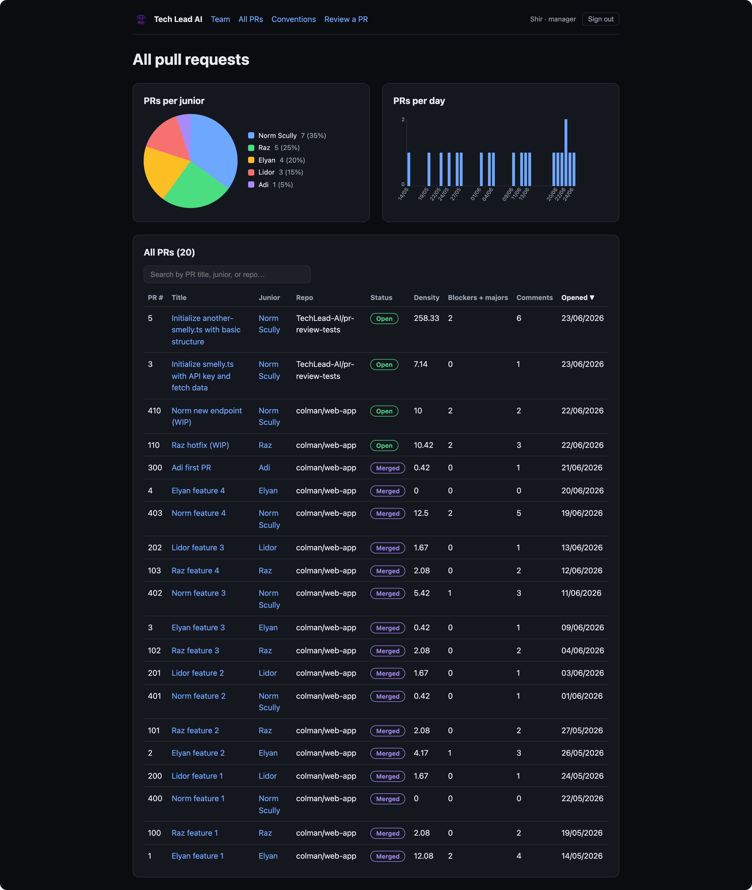
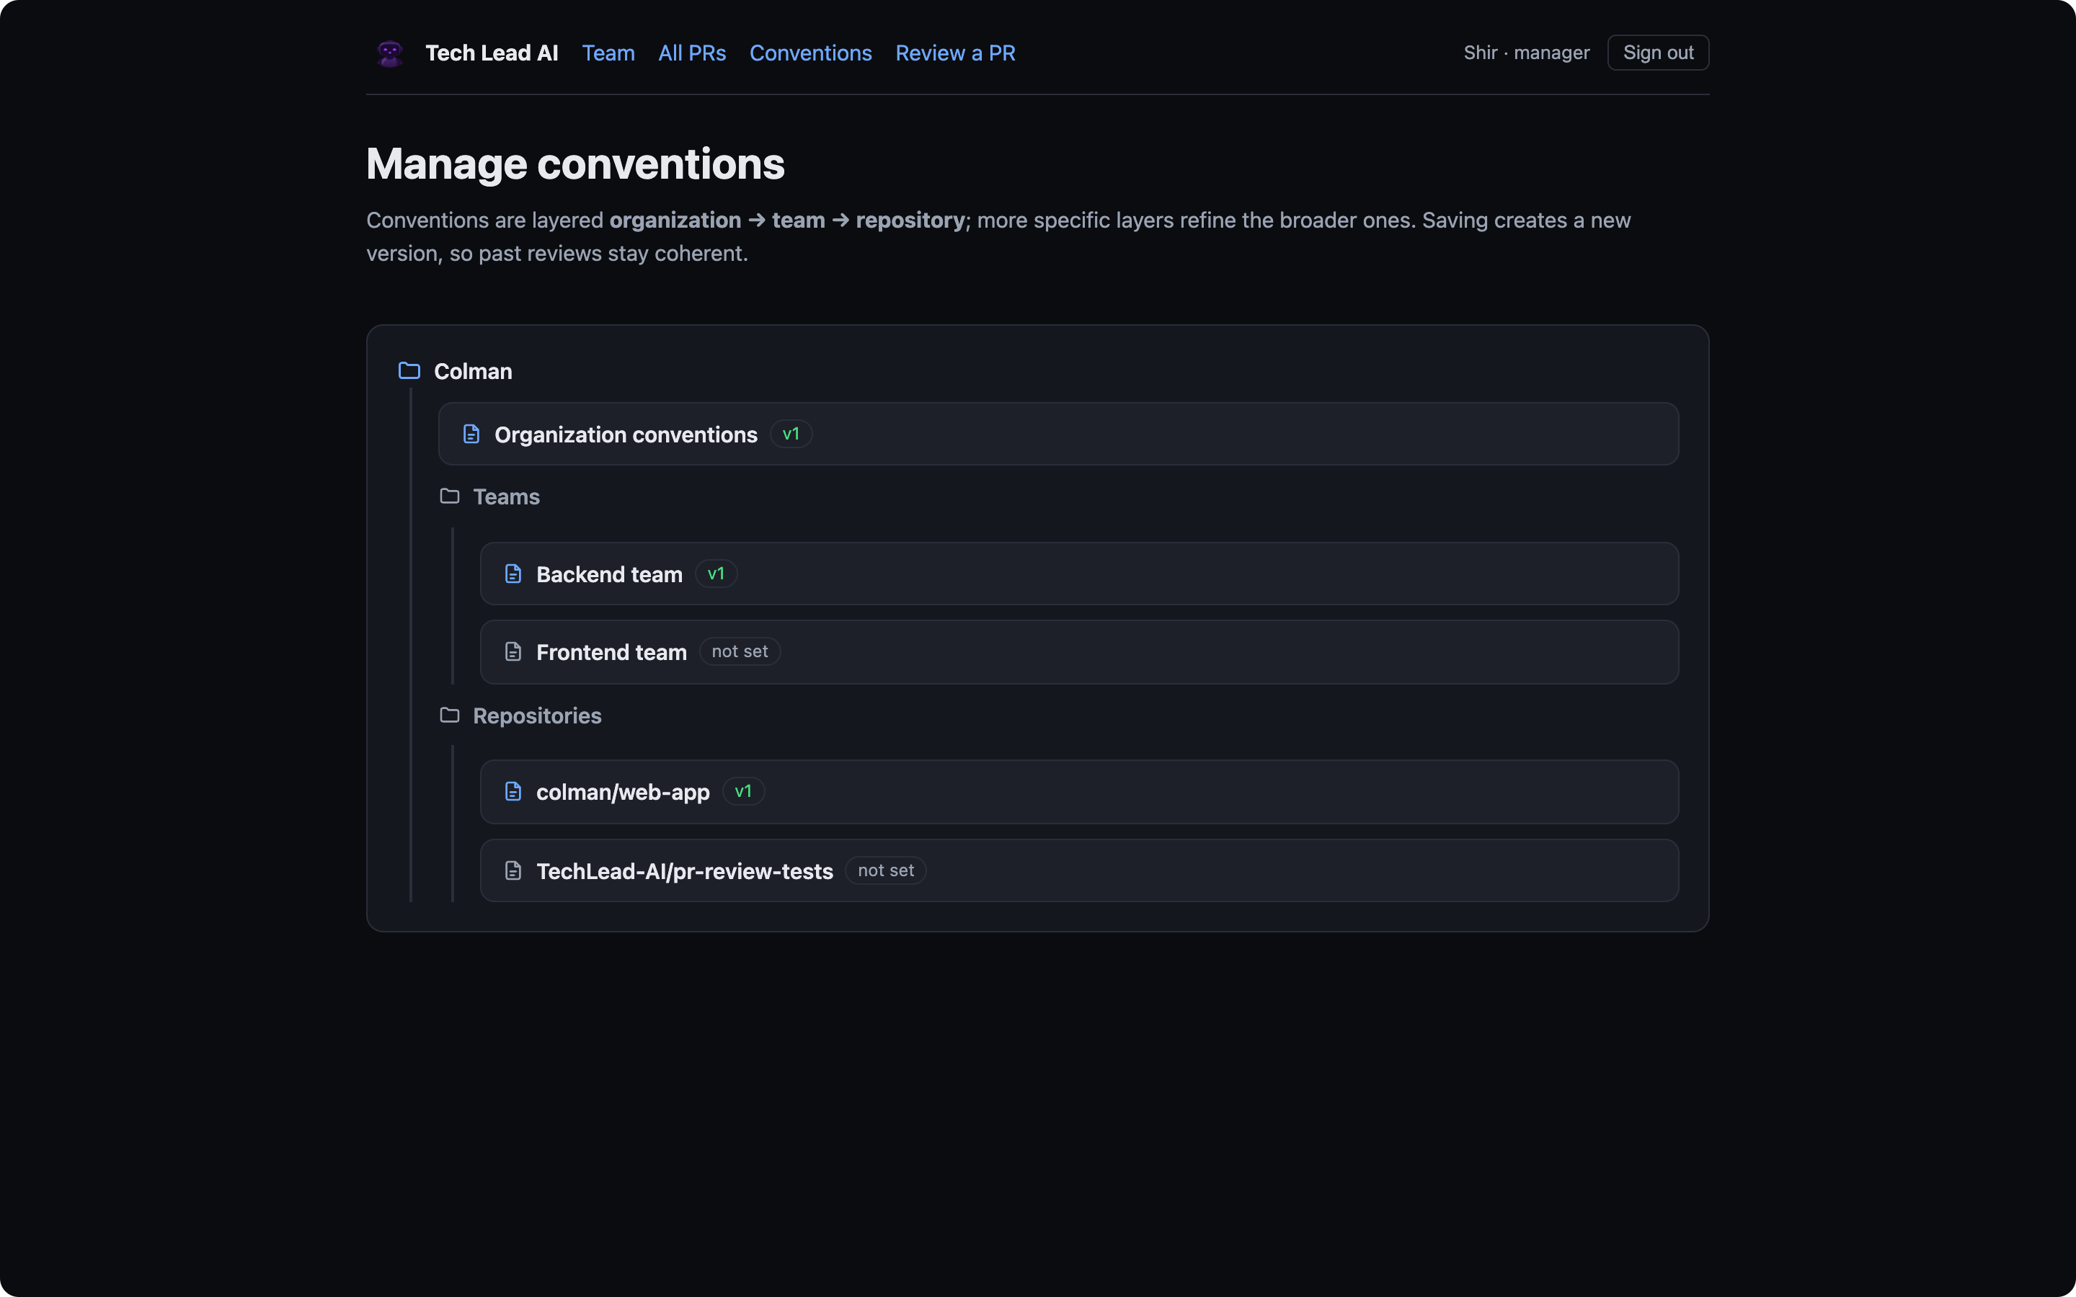
THE WEBSITE
An interactive dashboard — everything drills down
Team overview — stats, needs-attention, roster, severity
Per-junior profile — trends + top recurring mistakes
All PRs — pie + histogram + searchable table
PR detail — every comment, full data, all runs
Manage conventions — org → team → repo tree, versioned
Review a PR — paste a diff, run a real review
Drill-down: hover a trend point for its date/value, click it to open the PR. Mistake bars expand to the contributing comments.
Tech Lead AI reviews a developer, not a PR
11
Notes:
Real interactive app, not static charts. Everything drills down to the PR behind it.

Slide 12

THE REVIEW FLOW
PR → review → posted, in one pipeline
1
2
3
4
Receive & filter
Gather context
Review (AI)
Gate
verify signature, skip drafts/non-juniors, key off commit SHA
diff + merged conventions + the junior’s history
structured, convention-grounded comments
confidence threshold + nit budget decide what posts
5
6
7
8
Detect repeats
Grade & freeze
Post to GitHub
Reflect
match against history → the mentoring memory
density · repeat-rate · category mix → snapshot
ONE batched review = one notification
dashboards update instantly
The manual “Review a PR” trigger runs the same pipeline inline (skips steps 1–2) for an instant result.
Tech Lead AI reviews a developer, not a PR
12
Notes:
Both entry points converge here. Idempotent by SHA, gated, graded, frozen, posted as ONE batched review.

Slide 13

LIVE, NOT A MOCK
What the bot posts on a real GitHub PR
On the real repo TechLead-AI/pr-review-tests, the App posts one batched review plus inline comments — exactly the format below.
tech-lead-ai-dev bot reviewed · 3 days ago
Tech Lead AI review
Found 6 thing(s) worth looking at. The most important: Hard-coded secret.
tech-lead-ai-dev[bot] the App’s own identity
auth.ts · line 1
PR #5 authored by junior norm-dev
🛑 Blocker · security — Hard-coded secret.
Secrets in source get committed to history and leaked. Anyone with repo access — or a public mirror — can read them.
6 findings one review event, not spam
Suggestion: Move the value into an environment variable.
Convention: Security
Tech Lead AI reviews a developer, not a PR
13
Notes:
This is genuinely live on PR #5 (private repo). The card reproduces the real bot comment format: severity, message, why, suggestion, convention.

Slide 14

DEPLOYMENT
Running it for real on Railway
GitHub PR → https webhook → web → enqueue → worker → posts review back
Web service
Postgres
Worker service
dashboards + login + webhook
the only public URL
data + pg-boss queue
(still no Redis)
runs the pipeline, posts back
no public URL
⚡ Dependency prune
⚡ Proxy-safe redirects
tsx / dotenv / prisma moved to runtime deps — a prod prune would otherwise break the worker + migrations.
Behind Railway’s proxy req.url is internal, so absolute redirects break — we send a relative Location + 303.
Hands-off deploys: postinstall regenerates Prisma, release migrates prod before each release. smee is local-only; the same seed/onboard scripts target prod.
Tech Lead AI reviews a developer, not a PR
14
Notes:
Three services from one repo, sharing one Postgres. Mention the two war-stories only for an engineer audience.

Slide 15
HONEST TRADEOFFS
Risks we hold consciously — each with a mitigation
Trust under full automation
No human gate before a comment posts.
Mitigation: Safety net: confidence threshold + nit budget + the junior’s 👎 signal. Planned: a self-check pass.
Convention quality caps review quality
The review is only as good as the team’s rules.
Mitigation: Fought with a templated convention format — concrete good/bad examples beat vague prose.
HR-sensitive data
Durable judgments about named employees.
Mitigation: Needs a retention policy, per-user deletion, and clear ownership before going SaaS.
Naming the hard parts reads as engineering maturity — and each risk already has a designed mitigation.
Tech Lead AI reviews a developer, not a PR
15
Notes:
Don't hide the hard parts. Each risk has a mitigation already designed in.

Slide 16


WHAT’S NEXT
Roadmap — staged to slot in without a rewrite
Self-check pass
Fix-acknowledgment
the biggest quality lever once auto-posting
“✅ you fixed this” on re-review, instead of silence
Notifications
Semantic repeat-detection
manager weekly digest + regression / stuck alerts
“same mistake” across files & wording, not just category
Tune the review prompt
The SaaS path
default model claude-sonnet-4-6 is already set
multi-tenant foundation is in place — add OAuth, retention, billing
Tech Lead AI reviews a developer, not a PR
16
Notes:
The pipeline was staged so these slot in cleanly. The multi-tenant base is already there for SaaS.

Slide 17
Code review, from a one-off gate to a relationship that compounds.
Catch the bug · explain the why · remember the pattern · show the growth
109
3
9
0
tests passing
Railway services
components
Redis / leaderboards
Runs offline (FakeReviewer) or on Claude · live GitHub App 4126235 · deploys to Railway
Thank you
Notes:
Close on the compounding idea + the quick facts. Offer the live demo (sign in as Shir, Elyan's curve, Review a PR).

