Slide 1

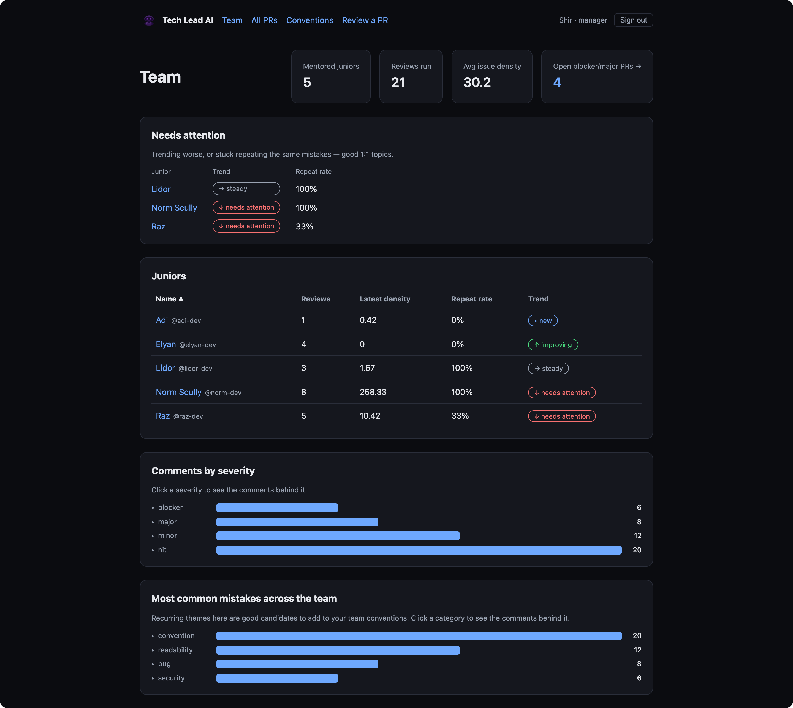
Tech Lead AI
An AI senior engineer that mentors junior developers — it reviews their pull requests, posts feedback on GitHub, and tracks each junior's growth over time.
Most AI reviewers check a PR. Tech Lead AI mentors a person.
Colman Dev Club · project presentation
presenter & date: __________
Notes:
Open with the wedge: most AI reviewers check a PR; we mentor a person over time.

Slide 2




THE NEED
Juniors grow fastest with good review — which rarely happens
Senior time is scarce
Thorough reviews are the first thing dropped when the team is busy. Juniors get a rushed “LGTM” instead of mentoring.
Feedback is inconsistent
Different reviewers care about different things — the junior gets contradictory signals and no clear standard.
Nobody tracks growth
Comments live and die inside one PR. No one can answer: “is this person actually getting better?”
Tech Lead AI reviews a developer, not a PR
02
Notes:
Three real failure modes. This is the gap we fill.

Slide 3



THE SOLUTION
A tireless senior reviewer that mentors over time
Reviews against YOUR rules
Explains the why
Remembers & shows growth
Every PR checked against the team’s own written conventions — not generic opinions.
Every comment teaches: it says why it matters, not just what to change.
Tracks each junior over time — spotting repeated mistakes and real improvement.
NORTH STAR
Mentor a junior over time — not just review one PR. Noticing repeated mistakes and showing growth is the core value, more than catching any single bug.
Tech Lead AI reviews a developer, not a PR
03
Notes:
Three things we do, then the north star: it's about the trajectory, not one bug.

Slide 4


IN 30 SECONDS
How it works, end to end
1
2
3
4
A junior opens a PR
AI reviews it
It posts comments
It tracks growth
on a connected GitHub repo
against your team’s written rules
on the PR — each explains the why
every review feeds the dashboard
Tech Lead AI reviews a developer, not a PR
04
Notes:
The elevator version — the rest of the deck zooms into these four steps.

Slide 5


WHO IT’S FOR
Two people, two views — both see growth, not a score
Manager
Junior
Defines the team’s conventions (“what good means”)
Marks which juniors are mentored
Sees the team dashboard + who needs attention
Gets a weekly digest + alerts (planned)
Gets a mentoring review on every PR — with the why
Sees their own growth over time
Compared only to their own past — never to peers
Identified by GitHub handle (no separate login)
Multi-tenant from day one: organization → team → user, so it can serve many companies later.
Tech Lead AI reviews a developer, not a PR
05
Notes:
Both see the same growth framing; the junior is never compared to peers.

Slide 6

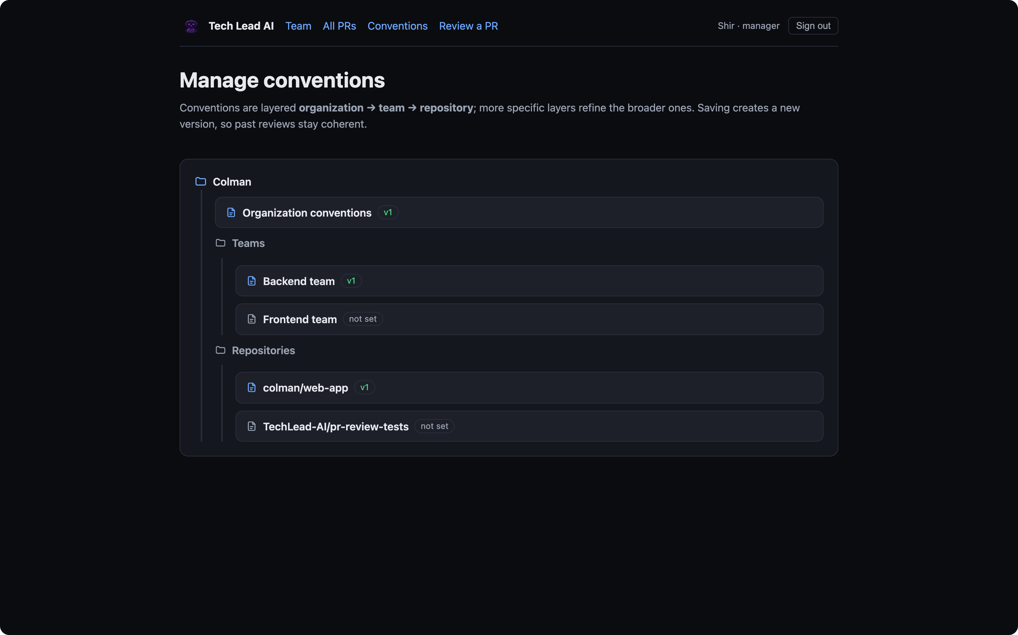
WHAT “GOOD” MEANS
The manager defines the team’s conventions
Plain-English rules — templated markdown, with good / bad examples
Layered & merged — org → team → repo, merged per PR
Versioned — old reviews keep the rules they ran with
Better rules → better reviews. The template exists to help you be specific.
Tech Lead AI reviews a developer, not a PR
06
Notes:
Component 2 — the human input. Review quality is capped by how specific these rules are, which is why the format is templated. The insight loop: a mistake recurring across the team is suggested as a new rule.

Slide 7

DIFFERENTIATION
It reviews a developer, not a pull request
MOST AI REVIEWERS
TECH LEAD AI
Stateless — each PR alone
Remembers the junior across PRs
Comments to act on now
Comments + a growth trajectory
A gate before merge
A mentor — never merge-blocking
Generic best practices
Grounded in your team’s rules
Ranks developers
No leaderboard — you vs. your past
The wedge is memory + mentoring, not “another linter with an LLM.”
Tech Lead AI reviews a developer, not a PR
07
Notes:
Us vs Them. Competitors review a PR; we review a developer. CodeRabbit etc. have some memory now — our edge is the growth profile + no-leaderboard framing.

Slide 8
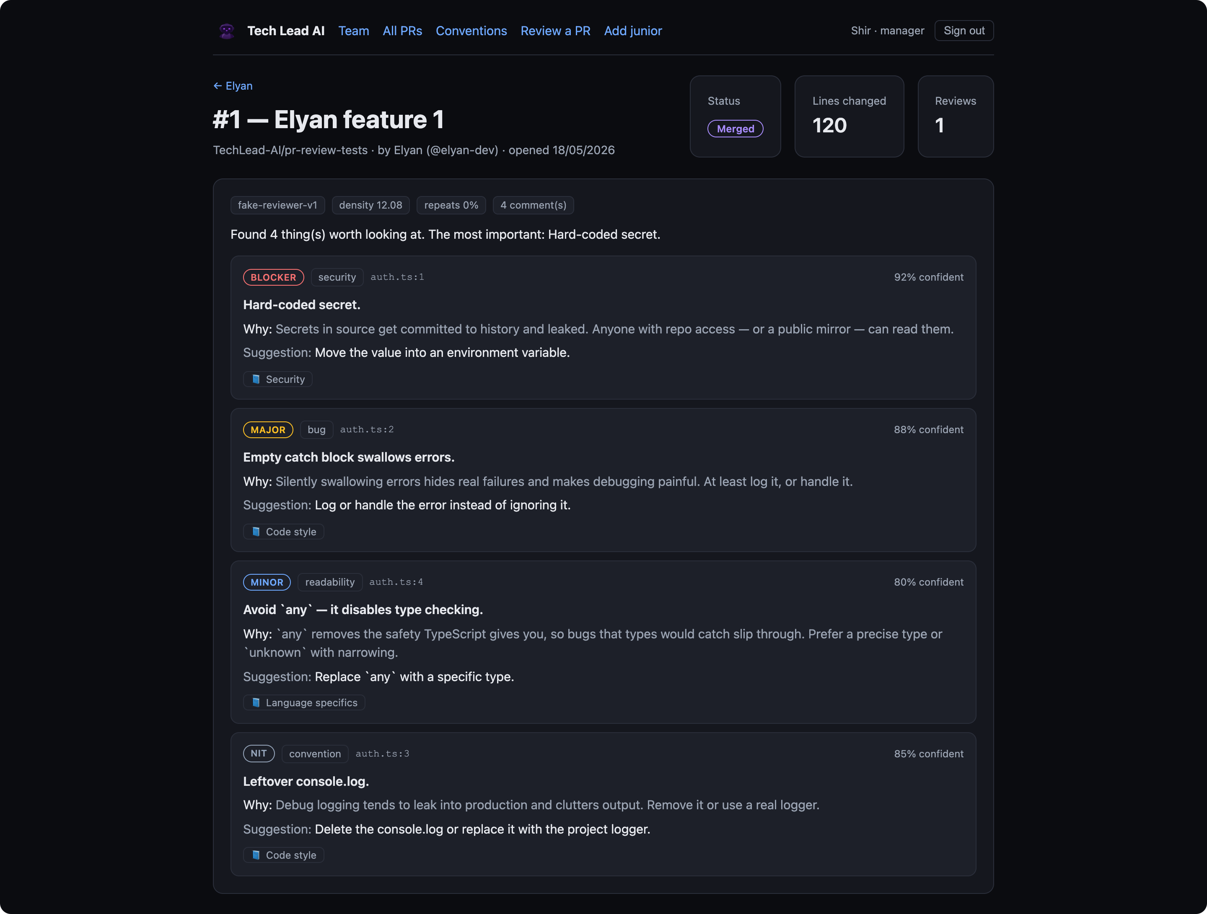
SEE IT WORK · 1
Anatomy of one review (Elyan’s first PR)
auth.ts
+ const apiKey = "sk-live-secret123";
+ try { doThing(); } catch (e) {}
+ console.log(value);
+ let data: any = fetchData();
4 comments, ranked blocker → nit
Each carries a why + a suggestion + a convention
Frozen metrics: density 12.08, repeats 0%
Tech Lead AI reviews a developer, not a PR
08
Notes:
Read one comment's why out loud. Severity ladder; frozen density 12.08.

Slide 9
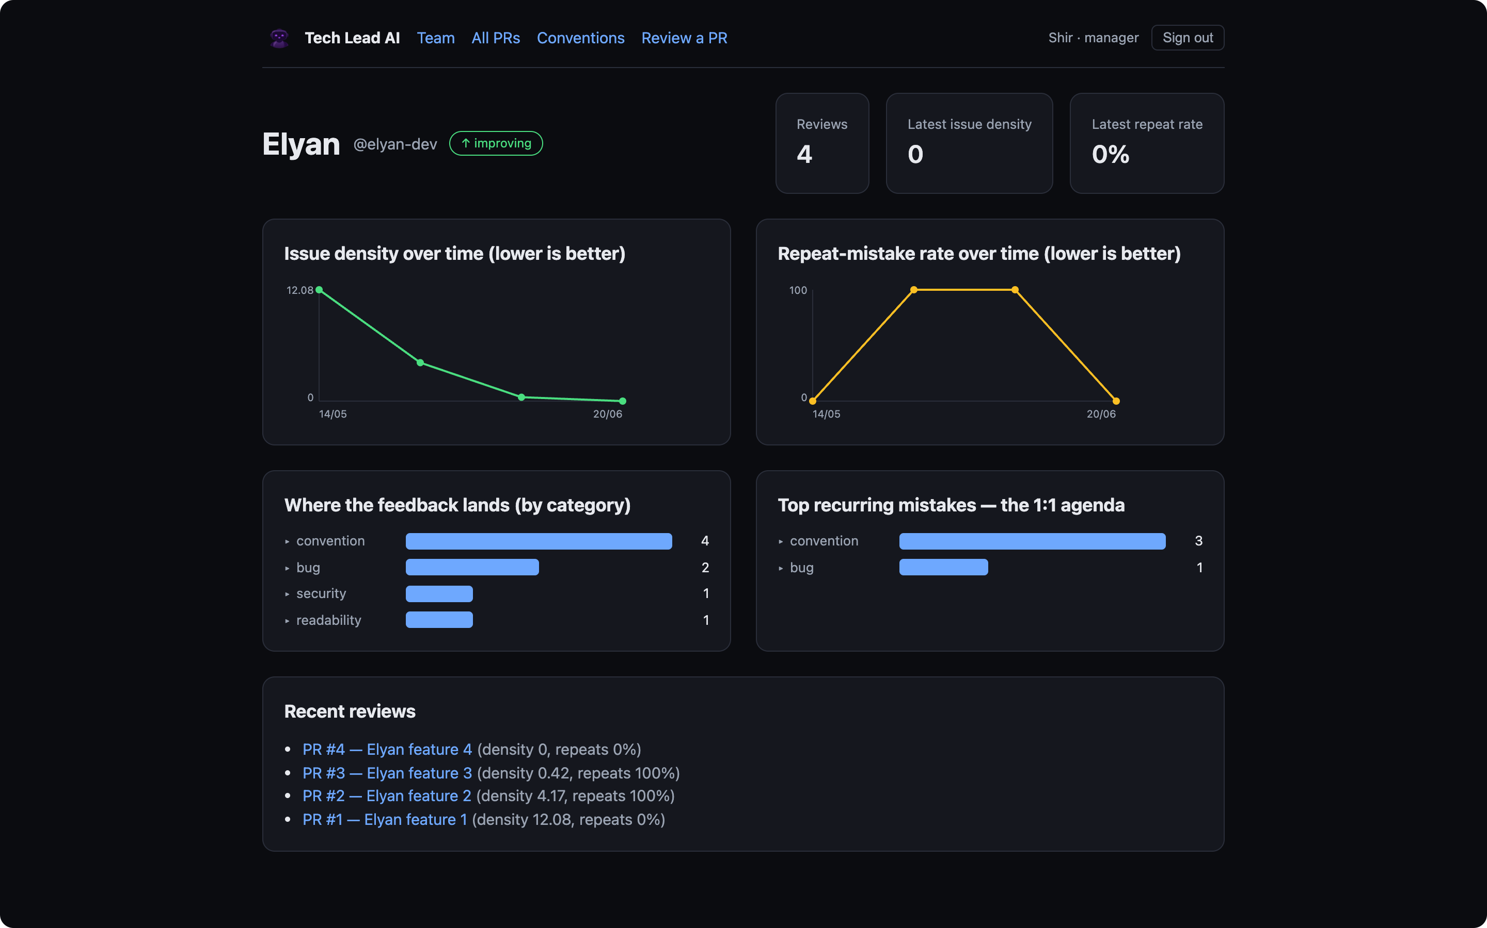
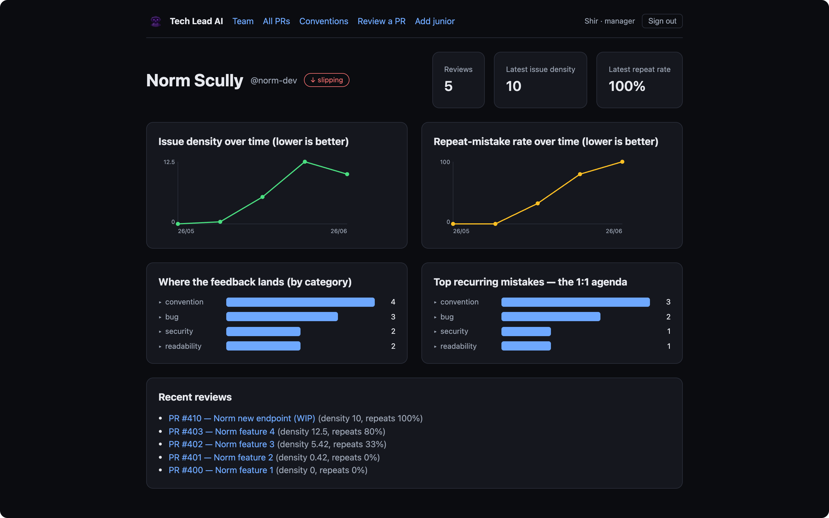
SEE IT WORK · 2
The same data over time — two trajectories
Elyan — improving ↑
Norm Scully — slipping ↓
Density 12.08 → 0: she stopped re-making the same mistakes.
Density climbs, repeat-rate hits 100% — flagged in needs-attention.
Tech Lead AI reviews a developer, not a PR
09
Notes:
Same engine, same metrics: one graduating (Elyan, she), one regressing (Norm). Arrow = developer's trajectory; up is good.

Slide 10


SEE IT WORK · 3
An interactive dashboard — we’ll open it live
Sign in as a manager or a junior. Everything drills down — nothing is static.
Team overview
Per-junior profile
All PRs
stats, needs-attention, roster
trends + top recurring mistakes
pie + histogram + searchable table
PR detail
Manage conventions
Review a PR
every comment, full data, all runs
org → team → repo tree, versioned
paste a diff, run a real review
Drill-down: hover a trend point for its date & value, click it to open the PR; mistake bars expand to the contributing comments.
Tech Lead AI reviews a developer, not a PR
10
Notes:
Switch to the live app here (sign in as Shir). This slide just frames the live walk-through.

Slide 11

ARCHITECTURE
How it all connects
1 PR opens
Tech Lead AI
2 diff + rules
GitHub
Next.js app · background worker · Postgres
Claude
where the PRs live
4 review posted
3 comments
the AI reviewer
Dashboard — each junior’s growth
Tech Lead AI reviews a developer, not a PR
11
Notes:
Three players: GitHub, our app, and Claude. (1) a PR opens → (2) we send the diff + the team's rules to Claude → (3) it returns structured comments → (4) we post one review back to the PR. The dashboard reads from the app to show growth. Inside, the app is Next.js + a background worker + Postgres (pg-boss queue) — that detail stays here in the notes.

Slide 12
THE REVIEW FLOW
What happens on every PR
1
A PR arrives
2
Read the context
3
AI writes the review
from a mentored junior
the diff, your rules, past mistakes
clear comments, each tied to a rule
6
Post & track
5
Flag repeats
4
Keep what matters
one review on GitHub · dashboard updates
mistakes seen before
drop unsure & trivial notes
Tech Lead AI reviews a developer, not a PR
12
Notes:
Plain language. Step 1 also: confirms the webhook is genuinely from GitHub (signed), skips drafts, and never reviews the same commit twice. Step 4 drops low-confidence comments and caps trivial cosmetic ones. The manual 'Review a PR' form runs the same flow inline.

Slide 13

UNDER THE HOOD
From one comment to a growth story
1
2
3
The comment
The filter
The progress
What’s wrong, and why
Only what’s worth their time
Comments add up over time
severity · why · how to fix — about the code
skip the unsure & the trivial
two numbers that should fall: issues-per-line & repeat-rate
Severity describes the code — never the person.
Tech Lead AI reviews a developer, not a PR
13
Notes:
Three steps for every finding: the comment (about the code), the filter (only post what's worth the junior's time), and the progress (comments roll up into two numbers that should fall — the trends from the earlier slide). Exact density formula if asked: weighted severity per 100 lines (blocker 8, major 4, minor 2, nit 0.5).

Slide 14


THE COOL PART
How we actually steer the AI
A strict system prompt
OUR CODE — every comment is validated against this
one hard rule: explain WHY. Flag only real issues.
src/server/review/types.ts
filePath: string
lineStart / lineEnd: number
category: bug | security | …
severity: blocker | major | minor | nit
confidence: 0 .. 1
message: string
why: string ← required
suggestion: string?
conventionRef: string?
Structured output
must match our exact schema — wrong shape is rejected.
Context injected
the PR + your rules + the junior’s past mistakes.
Same interface runs Claude or an offline fake → fully testable (109 tests).
Tech Lead AI reviews a developer, not a PR
14
Notes:
A snippet of OUR code (not a tool screenshot). The model must return this exact shape or it's rejected; the why field is required. The reviewer is an interface, so Claude or an offline fake both work — the whole pipeline is tested (109 tests).

Slide 15
LIVE, NOT A MOCK
What the bot posts on a real GitHub PR
On the real repo pr-review-tests, the App posts one batched review + inline comments — this exact format.
tech-lead-ai-dev bot reviewed · 3 days ago
Tech Lead AI review
Found 6 thing(s) worth looking at. The most important: Hard-coded secret.
tech-lead-ai-dev[bot] the App’s own identity
auth.ts · line 1
PR #5 authored by junior norm-dev
🛑 Blocker · security — Hard-coded secret.
Secrets in source get committed to history and leaked. Anyone with repo access can read them.
6 findings one review event, not spam
Suggestion: Move the value into an environment variable.
⚠ Illustrative recreation — replace with a real screenshot of PR #5 before presenting.
Convention: Security
Tech Lead AI reviews a developer, not a PR
15
Notes:
REMINDER: replace the white mock card with a real screenshot of PR #5 (logged-in). Reproduces the real bot comment format exactly.

Slide 16



DEPLOYMENT
Three services on Railway, one database
Push to GitHub and it deploys. Three services share one managed Postgres — no extra infrastructure.
Web
Postgres
Worker
dashboards + login + webhook
the data + the job queue
runs the pipeline, posts back
the only public URL
no Redis needed
no public URL
Migrations run automatically on every deploy. The same demo runs locally with Docker.
Tech Lead AI reviews a developer, not a PR
16
Notes:
Simple on the slide. If asked: web is the only public service; worker has no URL; Postgres backs both data and the queue. War-stories (dependency prune, proxy-safe redirect) optional.

Slide 17
HONEST TRADEOFFS
Risks we hold consciously — each with a mitigation
Trust under full automation
No human approves a comment first.
Now: confidence threshold + cap trivial notes. Planned: a 👎 button + a self-check pass.
Only as good as your rules
Vague conventions → vague reviews.
A guided template with good / bad examples.
Sensitive performance data
Lasting judgments about people.
Keep-data rules, per-person deletion, company-owned.
Tech Lead AI reviews a developer, not a PR
17
Notes:
Be honest: the 👎 button and self-check are PLANNED, not built. Retention = how long we keep data; ownership = the company owns it, not the builder.

Slide 18


WHAT’S NEXT
Roadmap — staged to slot in without a rewrite
Self-check pass
Fix-acknowledgment
the AI reviews its own comments before posting
“✅ you fixed this” on re-review
The 👎 feedback button
Smarter repeat-detection
let a junior flag a wrong comment
same mistake across files / wording, not just category
Notifications
The SaaS path
weekly digest + regression alerts
multi-tenant base is in place — add OAuth, billing
Tech Lead AI reviews a developer, not a PR
18
Notes:
Staged so these slot in cleanly. The 👎 button is a known gap, not yet built.

Slide 19
Don’t just review the code.
Grow the developer.
Catch the bug · explain the why · remember the pattern · show the growth
Thank you
Colman Dev Club · Tech Lead AI
Notes:
Land the thesis: don't just review code — grow the developer. Then open the live demo / take questions.

