Slide 1
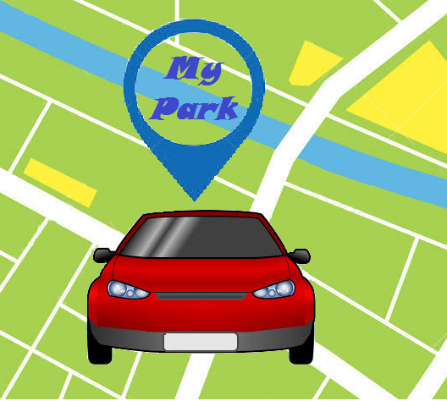
Mission Innovation 16
Hackathon
Solution Name : MyPark – smart parking solution App
Location :Noida-NSEZ
Team Name : CodeHypers
Team lead Name : Anshuman Bhagwat
NAME | EmpID | Email
Nishchay Tiwari | 431474 | nt00431474@techmahindra.com
Kashish Bakshi | 431191 | kb00431191@techmahindra.com
Ankit Sinha | 354265 | AS00354265@TechMahindra.com
Adarsha Meher | 365680 | AM00365680@TechMahindra.com
Ayush Tiwari | 354384 | AT00354384@TechMahindra.com
Anshuman Bhagwat | 13572 | Anshuman@techmahindra.com

Slide 2
Solution Summary
Problem statement
Cars, cars everywhere, just no place to park!
Finding a space for a car park can be difficult and one of the biggest urban nightmares .
Reduce the time of searching space in order to reduce parking struggle.
Prevent a long queue of cars at the entrance points
Brief Description
Once a user registers on MyPark, the parking solution App enables user to fetch the parking AVAILABILITY at his desired destination with the real time count showing with the pinned marker.
Just in case the parking at my destination is full , MyPark will show you available parking lots at nearby places ,again with the available count.
After selecting the desired location for parking ,the user will be provided with a BOOK NOW option.
In Book Now option multi Payment options are provided ,allowing user to pay as per his convenience.
After the user has confirmed the payment ,an automatic QR code is generated encrypting the unique booking ID.
Congrats!—Your pre booking for Stress Free Parking has been done .

Slide 3
What is unique about my solution?
Assurance for your car parking by pre booking in order to plan the itinerary for the day.
Technologies used
Domains that can consume this solution
Angular Js
Bootstrap
Java
Azure
Collaborate with:
Event Bookings (get your parking with your show ticket )
Public/Community parking: Also get a long term Subscription.
Google maps(Navigation)
Trend analysis:
Obtaining the frequency(footfall for any location)
Advertisements for the Recreational center aggregated
for parking.(B-Model)

Slide 4
Thank You

