Slide 1


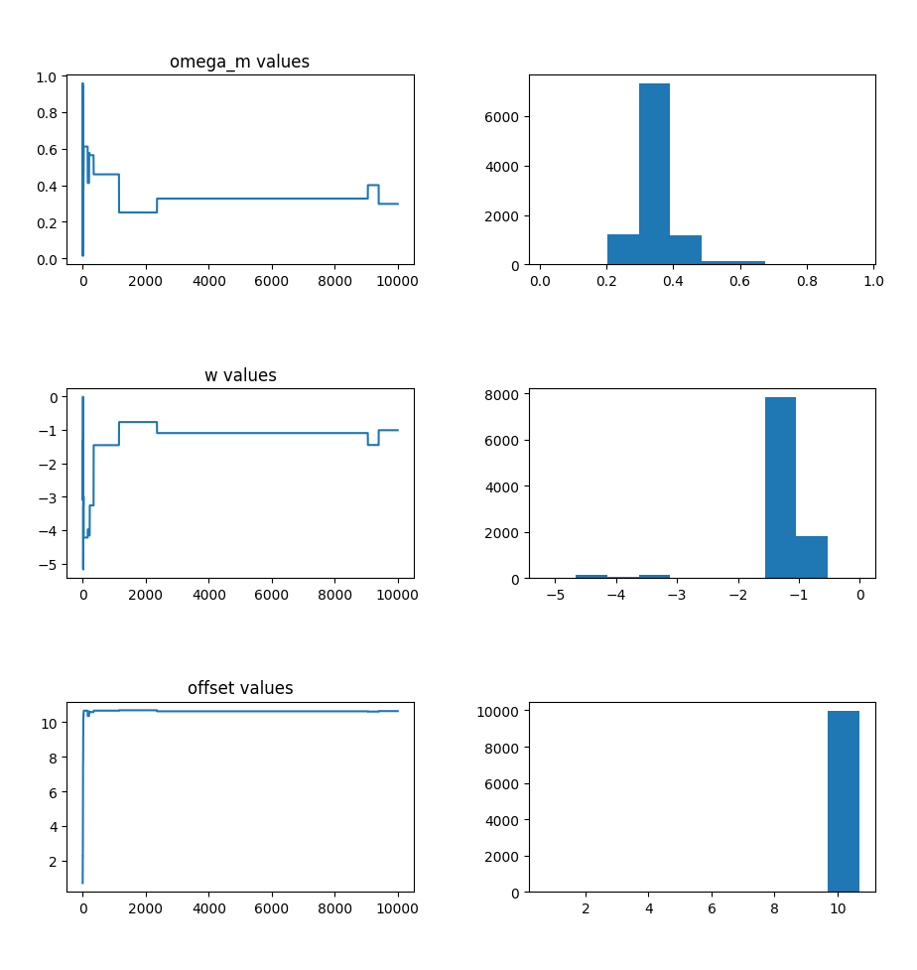
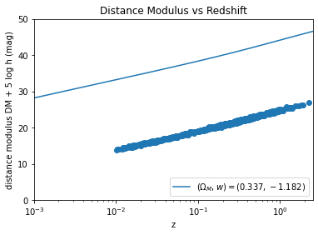
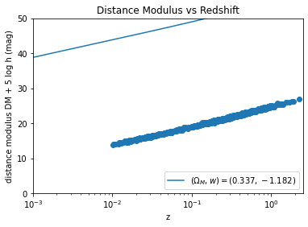
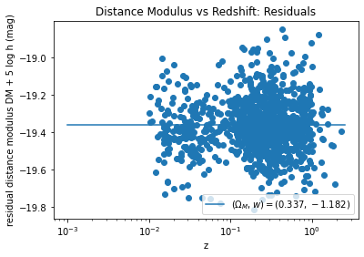
Determining the Hubble Constant from Observations of Distance Modulus and Redshift for Type Ia Supernovae
Henry Shi, Will Farr
Department of Physics and Astronomy, Stony Brook University
Cosmology Group
Background and Introduction
Research Objective
The universe has been expanding since the Big Bang 13.7 billion years ago. Its expansion is governed by the Hubble constant, via the equation
v=H₀d (1)
where the velocity v of a galaxy receding away from us depends on H₀ and its distance d.
v2 Galaxy 2
v1 Galaxy 1
However, cosmologists disagree on the value of H₀. The current accepted value of H₀ is 72 ± 2 km s⁻¹ Mpc⁻¹.
This project draws upon prior research by Scolnic 2018. They conducted observations of distance modulus and redshift for 1048 Type Ia supernovae, an event in which a dying star expels its outer layers. This dataset is hereafter referred to as the Pantheon dataset.
Distance modulus corresponds to distance d in the universe expansion equation, and redshift corresponds to recessional velocity v. Therefore, fitting a model to the Pantheon dataset could help determine H₀.
This experiment seeks to determine a precise value of H₀ by fitting a model to a plot of distance modulus vs redshift for Type Ia supernovae and using the parameters to calculate H₀.
Figure 1: A diagram relating v to d for two galaxies. Galaxy 2 is farther from the observer than Galaxy 1, so it recedes at a greater velocity.
Results
Procedure
Key:
Ω_{m} = mass density of universe w = p/ρ = pressure / energy density = equation of state of universe
Δdm = distance modulus offset between the model and data
We begin with a plot of distance modulus vs redshift for the Type Ia supernovae, as shown in Figure 2. The distance modulus roughly corresponds to the supernova’s calculated distance from Earth and the redshift is the amount by which the supernova’s spectrum is lengthened compared to a supernova at rest.
Each Markov-Chain Monte Carlo (MCMC) iteration runs as follows:
We take the latest ordered pair in the chain as θ. For each parameter θ we draw a proposal θ' from a normal distribution centered on θ.
We calculate the natural log likelihood function of the original parameters lnf(Ω_{m}, w, Δdm), proposed parameters lnf(Ω_{m}', w’, Δdm'), and of a random number ln(r) where 0<r<1.
If
lnf(Ω_{m}', w’, Δdm') - lnf(Ω_{m}, w, Δdm) > ln(r),
then we add θ' = (Ω_{m}', w’, Δdm') to the chain. Otherwise we add θ = (Ω_{m}, w, Δdm).
Discussion and Conclusion
Scolnic obtained Ω_{m} = 0.307±0.012 and w = -1.026±0.041, which are the basis for this analysis.
Both of our parameters Ω_{m} and w exhibit greater relative error than those of Scolnic, and are hence less precise. At an α=0.05 two-tailed significance level, our Ω_{m} and w values are not significantly different from those of Scolnic. Overall, our results are inconclusive.
In our future work, we hope to minimize systematic error in our model fit to ensure more precise values for Ω_{m}, w, and Δ_{dm}. We also hope to determine the value of the Hubble constant as a function of the parameter values Ω_{m}, w, and Δ_{dm}.
Acknowledgments
Papers consulted
Scolnic, D.M. The Astrophysical Journal, 859:101 (2018).
Kirshner, Robert. PNAS, 101:8-13 (2004).
Hogg, David W. "Data Analysis Recipes: Using Markov Chain Monte Carlo," (2017).
Hogg, David W. “Distance Measures in Cosmology,” (2000).
Hogg, David W. “Fitting a Model to Data,” (2010).
MCMC program written in Python and its libraries SciPy, NumPy, Matplotlib, and Jupyter Notebook, courtesy of the Python Software Foundation. www.python.org
The log likelihood function incorporated cosmological distance functions from Hogg 2000.
This project was supported with a grant from the PSEG Explorations in STEM 2020 program.
Figure 1: Results of 10,000-iteration MCMC algorithm to fit a distance modulus vs redshift model to Pantheon dataset. The left column is the trace of each parameter, illustrating how they change over time. The right column is the histogram of parameter values generated by algorithm. The algorithm was initially seeded with (Ω_{m}, w, Δdm) = (0.0,-1.0,0.0).
Figure 2: Fit of the distance modulus model using our obtained parameters before (top) and after (middle) adding Δdm, as well as residual plot (bottom).
Final parameter values obtained
Ω_{m} = 0.337±0.066 w = -1.182±0.521 Δdm = 10.634±0.261

