Slide 1


Determining the Hubble Constant from Observations of Distance Modulus and Redshift for Type Ia Supernovae
Henry Shi, Will Farr Ph.D.
Department of Physics and Astronomy, Stony Brook University
Cosmology Group
Notes:
Done

Slide 2
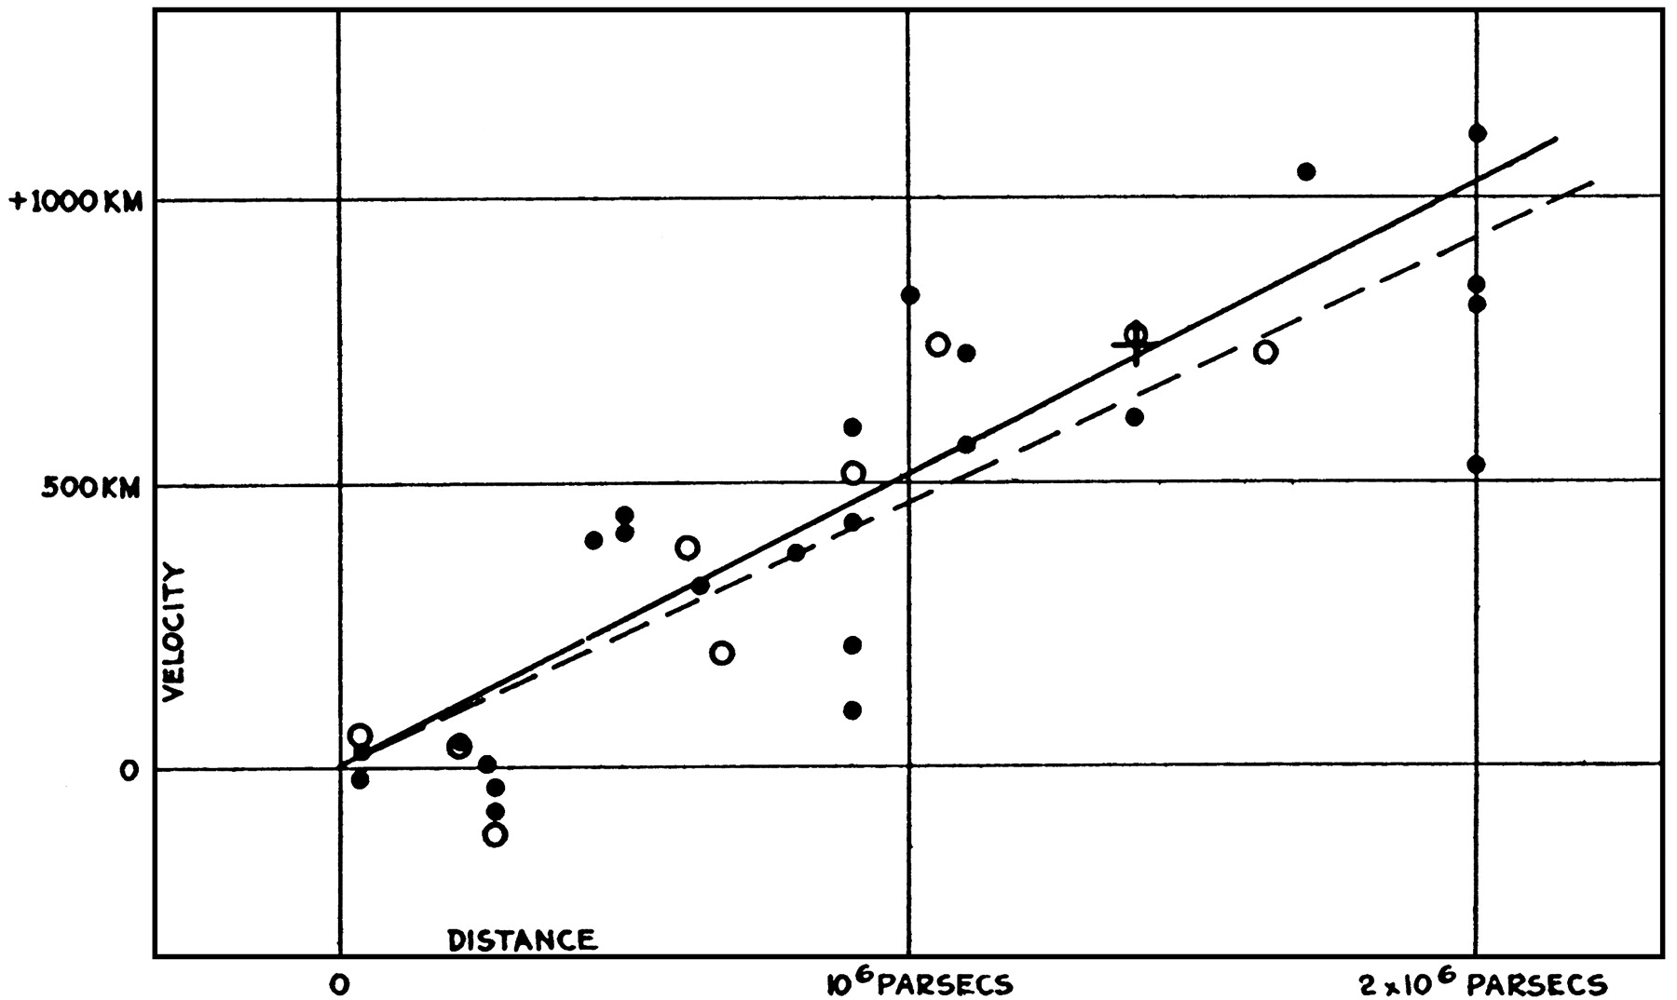
Background & Purpose
Universe is expanding, modeled by equation
v=H₀d
where v = recessional velocity of galaxy
H₀ = Hubble’s constant
d = distance of galaxy
Disagreement on H₀: current accepted value is H₀ = 72 ± 2 km s⁻¹ Mpc⁻¹.
Prior research: Scolnic 2018¹ - Pantheon Dataset
Observed distance modulus and redshift for 1048 Type Ia supernovae
distance modulus ~ distance d, redshift ~ velocity v.
Purpose of experiment: To determine a precise value of H₀ by fitting a model to the Pantheon dataset and using the model parameters to calculate H₀.
Plot of recessional velocity v vs distance d for several galaxies. The slope of the best-fit line is the Hubble constant H₀.
Notes:
Done

Slide 3
Procedure
Definitions of parameters:
Ω_{m} = mass density of universe
w = p/ρ = pressure / energy density = equation of state of universe
Δdm = distance modulus offset between the model and data
Plot distance modulus vs redshift values for Pantheon dataset of 1048 points.
Initialize Markov Chain with (Ω_{m0}, w₀, Δdm₀) = (0.0,-1.0,0.0).
Iterate through Markov Chain. Each Markov-Chain Monte Carlo (MCMC) iteration:
Draw the latest value of chain θ, as original parameters. Draw proposal θ' from normal distribution centered on θ.
Calculate log likelihood function of original parameters lnf(Ω_{m}, w, Δdm) and proposed parameters lnf(Ω_{m}', w’, Δdm').
Calculate ln(r) where 0<r<1.
If lnf(Ω_{m}', w’, Δdm') - lnf(Ω_{m}, w, Δdm) > ln(r),
then add proposed parameters θ' = (Ω_{m}', w’, Δdm') to chain. Otherwise add current parameters θ = (Ω_{m}, w, Δdm) again.
After desired number of iterations, for each parameter:
mean → experimental value
standard deviation → uncertainty in experimental value
Notes:
Done

Slide 4
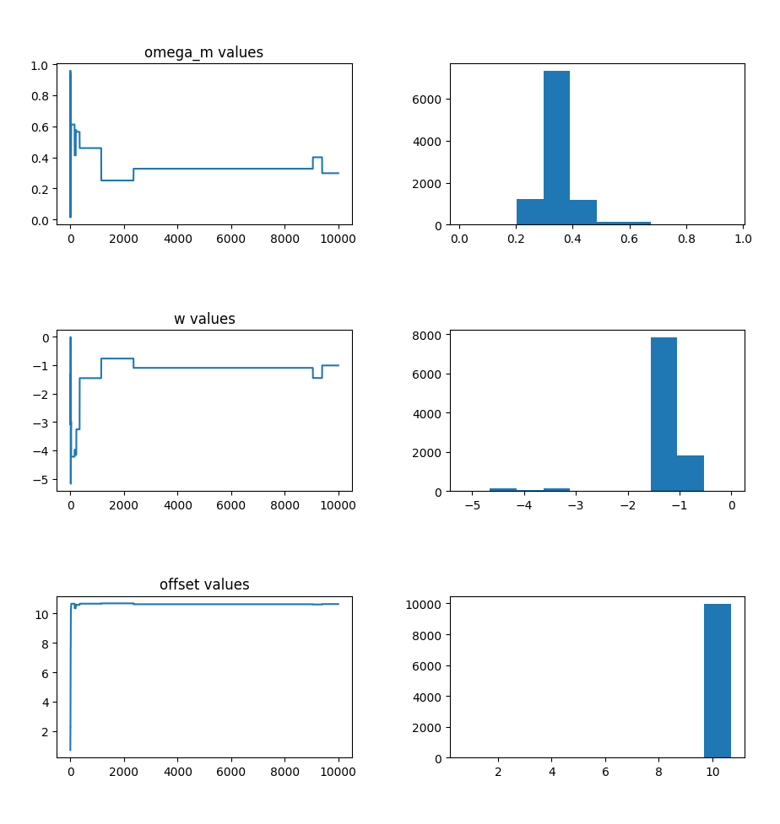
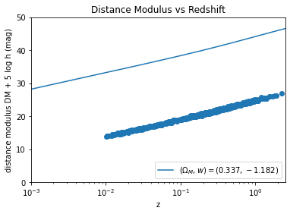
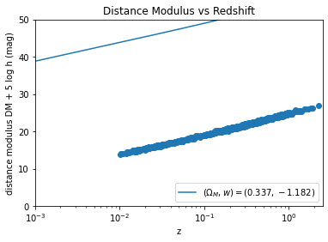
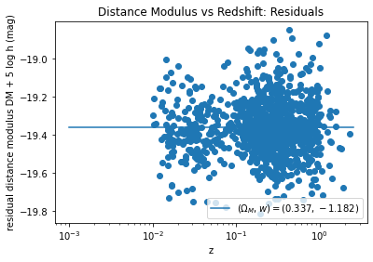
Results
Experimental values: Ω_{m} = 0.337±0.066, w = -1.182±0.521, Δdm = 10.634±0.261
Traces
Histograms
Plot of Pantheon dataset and model before adding Δdm
Ω_{m}
Plot of Pantheon dataset and model after adding Δdm
Δdm
Residual plot
w
Notes:
Done

Slide 5
Discussion & Conclusion
 | Scolnic (2018) | Shi and Farr | z-score | p-value | Significant? (α=0.05)
Ω_{m} | 0.307 ± 0.012 | 0.337 ± 0.066 | 0.447 | 0.655 | no
w | -1.026 ± 0.041 | -1.182 ± 0.521 | -0.299 | 0.765 | no
Our Ω_{m} and w values are not significantly different from Scolnic (2018)
Adding Δdm decreased quality of fit → sampling process may be faulty!
Unable to calculate H₀ from parameters → results are inconclusive
Future goals:
Minimize systematic error in model fit → improve precision and accuracy for Ω_{m}, w, Δ_{dm}
Determine the value of the Hubble constant H₀ based on Ω_{m}, w, Δ_{dm}
Notes:
Done

Slide 6
References & Acknowledgments
Papers consulted
Scolnic, D.M. The Astrophysical Journal, 859:101 (2018).
Kirshner, Robert. PNAS, 101:8-13 (2004).
Hogg, David W. "Data Analysis Recipes: Using Markov Chain Monte Carlo," (2017).
Hogg, David W. “Distance Measures in Cosmology,” (2000).
Hogg, David W. “Fitting a Model to Data,” (2010).
MCMC program written in Python and its libraries SciPy, NumPy, Matplotlib, and Jupyter Notebook, courtesy of Python Software Foundation <www.python.org>
Log likelihood function uses cosmological distance functions from Hogg (2000)
Supported with a grant from the PSEG Explorations in STEM 2020 program
Notes:
Done

