Slide 1

WEEK 3 · SESSION 3.2
Embeddings Demystified
Vector representations, semantic similarity, and cosine distance
How "find the relevant text" becomes actual, computable math
Session 3.2 — Embeddings Demystified
1

Slide 2
The librarian who can't read a single word
Every book has had its cover and title torn off. She can't read a word of any language. Yet hand her any book and she'll shelve it correctly, near other books on the same topic — by measuring shape, weight, page density, diagram frequency. Not content. Pattern.
An embedding does almost exactly this: it converts text into numbers that capture meaning, without "reading" the way you do. Similar meaning → similar numbers.
Session 3.2 — Embeddings Demystified
2

Slide 3

From words to numbers: a vector is just coordinates
You already know this
An embedding is the same idea
A point at (2, 3) on a graph is close to (2.1, 3.2)
and far from (50, -30).
Two numbers. A position in space.
Except instead of 2 numbers describing a point
in physical space, it uses hundreds of numbers
describing a point in MEANING space.
"The cat sat on the mat"
"A feline rested on the rug"
→ nearby vectors (similar meaning)
"The cat sat on the mat"
"Quarterly earnings rose 4%"
→ distant vectors (different meaning)
(2, 3) → a point
(2.1, 3.2) → a nearby point
(50, -30) → a distant point
Session 3.2 — Embeddings Demystified
3

Slide 4


A leap beyond matching keywords
Keyword matching
Semantic (embedding) search
Query: "how do I get reimbursed for travel"
Document: "Expense Submission Procedures"
Zero literal word overlap → keyword search
finds nothing, even though the document is
exactly what the person needs.
Same query and document — but compared by
MEANING, not literal words.
Closely related concepts land as nearby
vectors, despite almost no shared vocabulary.
The match succeeds.
Session 3.2 — Embeddings Demystified
4

Slide 5

Measuring closeness: cosine similarity
Two arrows from the same point. The question: how aligned is their DIRECTION? (Length doesn't matter.)
1
0
-1
Same direction
Right angle
Opposite direction
Maximally similar meaning
Essentially unrelated
Maximally dissimilar (rare in practice)
In practice, real text mostly scores 0.1–0.95 — there's no universal "similar enough" cutoff.
Session 3.2 — Embeddings Demystified
5

Slide 6

The formula
cosine_similarity(A, B) = (A · B) / (|A| × |B|)
A · B
Dot product — multiply matching components, then sum
|A|, |B|
Vector length (norm) — square root of sum of squared components
Direction matters more than magnitude for text meaning — which is exactly what this formula isolates.
Session 3.2 — Embeddings Demystified
6

Slide 7

A worked example, by hand
"I adopted a puppy"
"I got a new dog"
"Stock prices fell"
(4, 3)
(5, 2)
(-2, 4)
Puppy vs. dog sentence
Puppy vs. stock-market sentence
Dot product: (4×5)+(3×2) = 26
|A| = √25 = 5
|B| = √29 ≈ 5.39
cosine = 26 / (5×5.39) ≈ 0.97
Dot product: (4×-2)+(3×4) = 4
|A| = 5
|B| = √20 ≈ 4.47
cosine = 4 / (5×4.47) ≈ 0.18
Session 3.2 — Embeddings Demystified
7

Slide 8

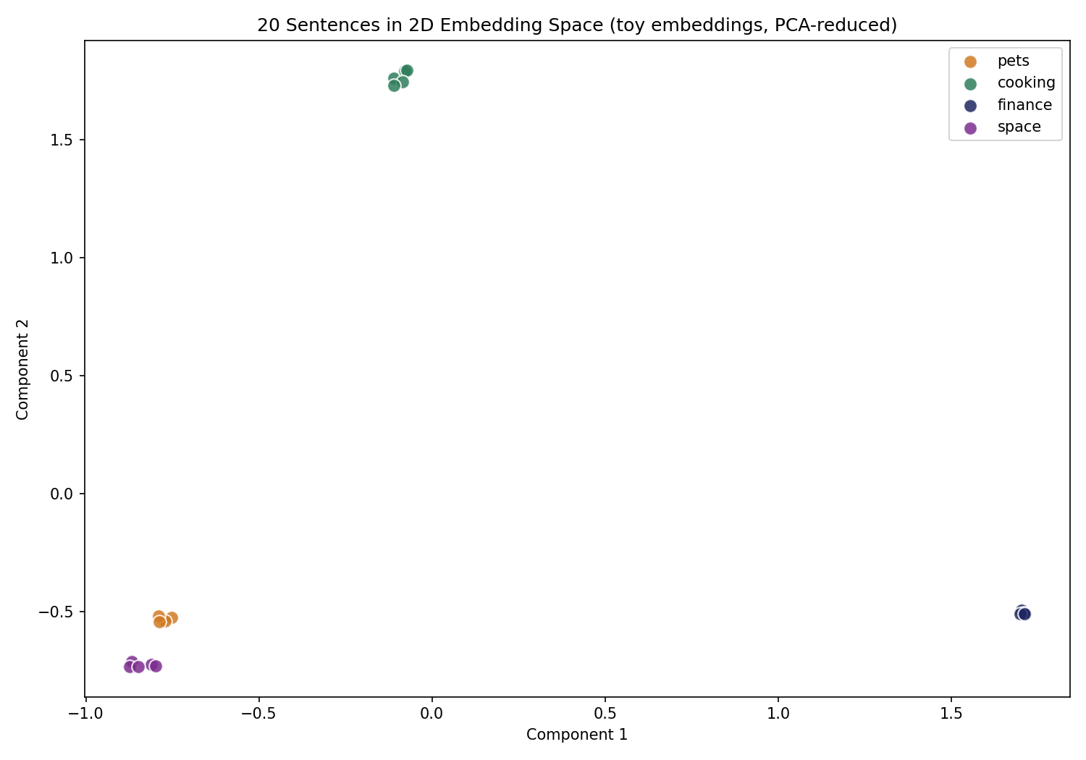
Today's artifact: 20 sentences, 2D, real output
pets
cooking
finance
space
Four tight, distinct clusters — emerging from vectors built from the sentences' own words, then reduced to 2D and plotted with the math from this session.
Session 3.2 — Embeddings Demystified
8

Slide 9

An honest note on today's toy embedding
Pure word counts: barely any clustering
20 short sentences share almost no literal vocabulary, even within the same topic — not enough raw text for statistics alone.
Today's fix: hand-seeded "concept anchors"
A small topic-word list stands in for what a real model learns automatically — engineered help, not emergent discovery.
Real embedding models don't need the help
Trained on billions of words, they learn "puppy" and "canine" are related with no hand-built list, no labels, at all.
Session 3.2 — Embeddings Demystified
9

Slide 10

You built the engine. Next, it goes in a car.
Today's exercise didn't organize a large document set, didn't chunk long documents, and didn't retrieve anything for a live query. That's Session 3.3.
Session 3.3 — Vector Databases & Retrieval
Chunking strategies for splitting long documents into sensible pieces, vector stores for holding embeddings at real scale, and top-k retrieval for actually pulling back the most relevant matches to a live question.
Hands-on artifact: build a local vector store over a real PDF.
Quiz, then Session 3.3: Vector Databases & Retrieval
Session 3.2 — Embeddings Demystified
10

