Slide 1
Open Source
Your JavaScript
Tooling and best practices

Slide 2

NickSullivan.prototype
VP of Technology at Krux - It's your data.
Help organize SFJS* and 106 Miles in SF
creationeer.me
* Dave Nugent does all the work

Slide 3

Give me feedback in real time
Instead of "hmm"... +1 (by giving me a thumbs up) for stuff:
You learn
You find interesting
You want to know
more about
Notes:
Instead of making the "Hmm" noise...

Slide 4
Just like most sites nowadays...
I will be recording and collecting that data
You don't get to control how that data is being used...
AND
I will be selling it to advertisers later.

Slide 5
So before we go further...
Terms and conditions for this talk (standard stuff)
Do you see any Teletubbies in here? Do you see a slender plastic tag clipped to my shirt with my name printed on it? Do you see a little Asian child with a blank expression on his face sitting outside on a mechanical helicopter that shakes when you put quarters in it? No? Well, that's what you see at a toy store. And you must think you're in a toy store, because you're here shopping for an infant named Jeb.
Now that we know who you are, I know who I am. I'm not a mistake! It all makes sense! In a comic, you know how you can tell who the arch-villain's going to be? He's the exact opposite of the hero. And most times they're friends, like you and me! I should've known way back when... You know why, David? Because of the kids. They called me Mr Glass.
Do you see any Teletubbies in here? Do you see a slender plastic tag clipped to my shirt with my name printed on it? Do you see a little Asian child with a blank expression on his face sitting outside on a mechanical helicopter that shakes when you put quarters in it? No? Well, that's what you see at a toy store. And you must think you're in a toy store, because you're here shopping for an infant named Jeb.
My money's in that office, right? If she start giving me some bullshit about it ain't there, and we got to go someplace else and get it, I'm gonna shoot you in the head then and there. Then I'm gonna shoot that bitch in the kneecaps, find out where my goddamn money is. She gonna tell me too. Hey, look at me when I'm talking to you, motherfucker. You listen: we go in there, and that nigga Winston or anybody else is in there, you the first motherfucker to get shot. You understand?
However, the first round of drinks will be purchased by Nick Sullivan for everyone who accepts these terms and goes out after the talk
Normally, both your asses would be dead as fucking fried chicken, but you happen to pull this shit while I'm in a transitional period so I don't wanna kill you, I wanna help you. But I can't give you this case, it don't belong to me. Besides, I've already been through too much shit this morning over this case to hand it over to your dumb ass.
Do you see any Teletubbies in here? Do you see a slender plastic tag clipped to my shirt with my name printed on it? Do you see a little Asian child with a blank expression on his face sitting outside on a mechanical helicopter that shakes when you put quarters in it? No? Well, that's what you see at a toy store. And you must think you're in a toy store, because you're here shopping for an infant named Jeb.
Now that we know who you are, I know who I am. I'm not a mistake! It all makes sense! In a comic, you know how you can tell who the arch-villain's going to be? He's the exact opposite of the hero. And most times they're friends, like you and me! I should've known way back when... You know why, David? Because of the kids. They called me Mr Glass.
Do you see any Teletubbies in here? Do you see a slender plastic tag clipped to my shirt with my name printed on it? Do you see a little Asian child with a blank expression on his face sitting outside on a mechanical helicopter that shakes when you put quarters in it? No? Well, that's what you see at a toy store. And you must think you're in a toy store, because you're here shopping for an infant named Jeb.
My money's in that office, right? If she start giving me some bullshit about it ain't there, and we got to go someplace else and get it, I'm gonna shoot you in the head then and there. Then I'm gonna shoot that bitch in the kneecaps, find out where my goddamn money is. She gonna tell me too. Hey, look at me when I'm talking to you, motherfucker. You listen: we go in there, and that nigga Winston or anybody else is in there, you the first motherfucker to get shot. You understand?
[ ] Please raise your hand and "tick" to accept

Slide 6

Just kidding
For those who accepted:
"The first round of drinks will be purchased by Nick Sullivan for everyone who accepts these terms and goes out after the talk."
First drink on me!

Slide 7
Why am I doing this?
I'm passionate about open source, engineering productivity, and tooling.
Creating my own open source projects, postscribe, pilotfish.io - I went looking for a best practices list.
Scanned other open source projects to see what they were doing. jQuery, backbone, bootstrap, and others.
Project idea at the end.
Notes:
Have an idea to talk to you guys about at the end

Slide 8
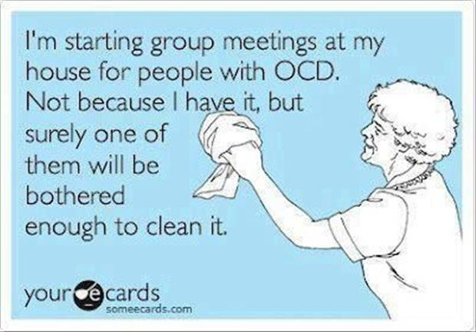
And maybe I'm a little OCD

Slide 9
Why Open Source Your JavaScript?

Slide 10
The good reasons
Help other people
Turns you into a producer, not a consumer
Improves your project
More usage
More feedback
More contributors

Slide 11
Guiding principles
Increase quality
With: Repeatable processes to increase software quality. Tooling for code creation, testing, and release.
Encourage usage
With: Great documentation, demonstrations, and communication

Slide 12
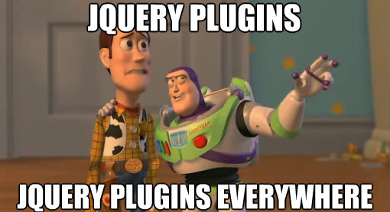
Current Landscape

Slide 13
Why is there fragmentation in JS?
"It doesn't do exactly what I want"
"I couldn't get it working" aka "The documentation sucks"
Net - it was easier to just rewrite myself.
Javascript is easy - lowers the bar for rewriting.
Which means we need to raise the bar for ease of use and implementation. Let's fix this.

Slide 14
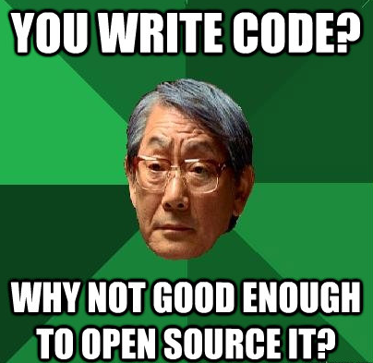
On Quality

Slide 15
Quality - Internal vs Open Source
Good enough isn't... good enough.
It's the ultimate code review. Your reputation is on the line.
Most of these concepts apply to internal software too, we just don't take the time. Let's make that easier.

Slide 16
But we balance quality with speed
A quote on *when* to release.
When you start community-building, what you need to be able to present is a plausible promise. Your program doesn't have to work particularly well. It can be crude, buggy, incomplete, and poorly documented. What it must not fail to do is (a) run, and (b) convince potential co-developers that it can be evolved into something really neat in the foreseeable future.
- Eric S. Raymond

Slide 17
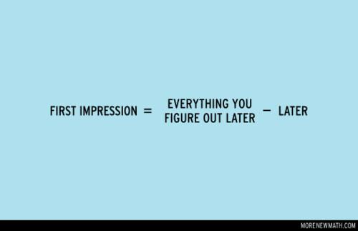
First Impressions

Slide 18
Make it count
Developers review dozens, if not hundreds of projects per year. From this experience we filter out projects that:
Don't work
Have poor documentation
Can't get support for
Seem immature/unpolished
Have low activity
Your project won't likely get a second chance.
More from thechangelog.org - http://tinyurl.com/4ec4lpx

Slide 19
Two different first impressions
End Users - README.md, /docs, or minisite
Contributors - DEVELOPMENT.md, CONTRIBUTING.md, and TODOS.md

Slide 20
What end users are looking for
Your README is your marketing doc
Potential end users are looking for:
Will it do what I want?
Good description of the problem and solution
Does it work?
Can I see a demo? Is the repo active?
Can I see it live on a real site (who is using it?)
Will I be able to get support?
File a bug report? Are they getting fixed?
Mailing list? Is the community active?

Slide 21
What contributors are looking for
How do I get the code running?
Development environment. < 15 minutes
Running tests
What is the process for submitting changes?
Pull requests
Branching strategy
Style guides
Rules
What is the release process?
What else can I help with?
Public TODOs
Github issues

Slide 22
Repo Setup

Slide 23
2 hard things in computer science
1. Cache Invalidation
2. Naming things
I propose a 3rd -
3. Asynchronous Programming
#1 and #2 Phil Karton. #3 Nick Sullivan.

Slide 24
Choosing a name
SEO
What will *users* be searching for solve their problem?
Good: "node-geoip-server". Bad: "$futurama_character"
Is there an existing github project/organization by that name? github/$name
Other things to check for availability
domain name, twitter, facebook
Tip: ${projectname}js is a growing trend

Slide 25
Github organizations
Project big enough for more than one repo?
http://github.com/$organization/$project1
http://github.com/$organization/$project2
https://github.com/blog/674-introducing-organizations

Slide 26
README driven development
Organize your thoughts around what you want to build, in present tense.
The documentation evolves with the product - instead of being an afterthought.
Cater to your initial audience - write the readme as you would want to see it if you were a user.
http://tom.preston-werner.com/2010/08/23/readme-driven-development.html

Slide 27
README format
Use markdown, not plain text.
Tip - Mou for mac
Note that github uses github flavored markdown
Anyone from github here?
Anyone want to build a web-based markdown editor that displays github markdown in real time?

Slide 28
What should be in your README
About*
Getting started / Download / Usage*
Dependencies
Who is using it? (USING.md)
Where to go for help
How to contribute
Licensing
* = Cater to your initial audience. Get up and running as quickly as possible.

Slide 29
Repo files

Slide 30
NPM
Make your javascript project a node package - even if it is browser only. Lets you use npm, travis, and other tools for automation.
How?
Set up a package.json. That's it!
Optional:
$ npm publish
Tip: private: true in your package.json to prevent it from being published to npm registry

Slide 31
Package.json validation
Surprisingly, no easy way to do this.
Multiple standards
CommonJS Packages 1.0
CommonJS Packages 1.1
Nodejitsu
NPM (use this one)
http://package-json-validator.com/
(I created last weekend)

Slide 32
Repo directories / code organization
Standards for directories (from Packages 1.0 spec)
/src
/doc
/lib - external libraries
/build - doesn't really apply to js
/dist - released versions
/test - unit and functional
/docs and /tests ok, but be consistent

Slide 33
Licensing
LICENSE or LICENSE.txt
Masochists:
http://en.wikipedia.org/wiki/Comparison_of_free_and_open-source_software_licenses
MIT the most open; BSD requires credit.
New: WTFPL license (do whatever the f*ck you want)
Notes:
This could be a talk all by itself

Slide 34
Consistent formatting
.editorconfig - definitions of spacing for the project. Stop fixing other peoples formatting
Consistency is more important than preference
Allows for definitions by file for .js, .html, etc.
Supported by the editor - I couldn't get it to work with vim. :(
More at editorconfig.org

Slide 35
Gitignore
.gitignore
node_modules # never check these in
.*.swp #vim
npm-debug.log
Exhaustive - html5boilerplates .gitignore

Slide 36
Release notes
Release notes build trust. Recommend format:
### Version 0.2 - Date
* [BUG] Fix
* [NEW] Feature
* [API CHANGE]
### Version 0.1 - Date
...
Either in README or separate CHANGELOG*, CHANGES, or HISTORY file
Notes:
Google search says CHANGELOG is the most popular

Slide 37
Contributor Workflows
Productivity for everyone

Slide 38

Repeatable process
Increase your productivity and avoid missed steps by letting the computers do repetitive tasks (they are good at it)
grunt.js is awesome
Minification
Release
Linting
Testing
More! Sample gruntfile for pilotfish
Notes:
Demo pilotfish grunt tasks

Slide 39
Version numbers build trust
Semantic versioning - semver.org, node-semver, APR version guide
Major.Minor.Patch.Trivial+build
Major - Backward incompatible changes
Minor - New Functionality
Patch - Fixes
Trivial - Documentation, formatting
Build - build id
Put version in the code! As part of your build!
Notes:
Contract

Slide 40
Branching/Tagging strategy
Common approaches:
Work in master. Branches for features.
Work in dev branch. Merge to master for release.
#1 works best, particularly when you consider forking and pull requests. For familiarity and ease of use within the community use #1 unless you have a good reason not to.
Tip: Tag release/$version (with repeatable process so it's consistent - use grunt!). Github tag = downloadable .zip - sample

Slide 41

Static analysis
jshint / jslint
I prefer jshint, better integration with editor
.jshintrc - sample from pilotfish
When to run:
on every save with your editor
grunt lint
part of integration tests
Notes:
Demo on command line

Slide 42
Production/Debug versions
Minification with Uglify - via grunt
Consider permanent urls with version numbers (also done with grunt)
/1.8.3/pilotfish.min.js
/1.8/pilotfish.min.js
/1/pilotfish.min.js
/stable/pilotfish.min.js
/latest/pilotfish.js (debug)
Notes:
Cloudfront makes this pretty easy

Slide 43
Testing
If it's not tested, it's not done

Slide 44


Unit tests
Run in the browser, manually. Main two I found being used:
QUnit FTW.
Sample
Notes:
Demo of http://cdn.pilotfish.io/client/plugins/speaker/test/qunit-speaker.html

Slide 45

Phantomjs
Run tests on command line with a webkit-based browser.
Awesome. No more Firefox in xvfb!
phantomjs.org

Slide 46

Casperjs
Thin layer on top of phantomjs
Completely emulate browser behavior. Clicks, submit forms, back, reload, refresh.
Run on command line with grunt-casperjs
Notes:
Demo of grunt-casperjs running tests in pilotfish

Slide 47
Run tests across multiple browsers
browserling / testling
browserstack
testem

Slide 48
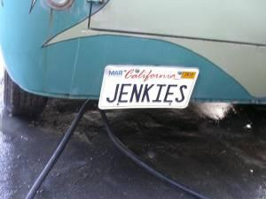
Detour - let's kill Selenium
Casperjs much easier to work with and much more robust, but it is not cross browser.
Can we get browserstack / browserling to read casperjs files and have them run against all browsers?!

Slide 49

Travis-ci!
Distributed continuous integration testing - Hosted Jenkins - without the suck.
Github webhook. Every commit, run tests. Sample travis.yml for pilotfish
Phantomjs is installed, casperjs isn't - see pilotfish travis.yml for pre install script
travis-ci.org
Notes:
Demo https://travis-ci.org/pilotfish/pilotfish and github webhooks

Slide 50
Github/Travis integration
Test all branches - you can see if a branch passes the tests before merging, right in the pull request.

Slide 51
Testing recap
Unit tests
Integration tests
Across multiple browsers with browser stack
Kill selenium
Continuous Integration with Travis

Slide 52
Generated documentation
What's the only thing worse than no documentation?
Documentation that is wrong!
docco - markdown is in the js
Sample from pilotfish
Fire it off as part of your build/release process in grunt.

Slide 53
Github Pages for a mini site
If you are using a github organization, you can create a repo called $organization.github.com, and this will be served from http://$organization.github.com
Faster than raw.github.com, because it is generated flat files instead of pulling from the repo
Great for demos
Also see husky
Notes:
Demo Postscribe

Slide 54
Community
Simple philosophy
Don't be a dick
I'm not a community expert, and that's a talk in itself, but at least consider these for communication:
Mailing List
IRC

Slide 55
Repo Health
Idea that I'm working on an automated tool to scan this stuff for you. Starting point: Pilotfish rating scale
Service would scan, and make recommendations. Like Yslow for repos.
Some elements common for all projects, but plugin driven support for other languages needed.
I have the readme written :)
https://github.com/gorillamania/repo-health
See me after if you want to help

Slide 56
;
Go out and open source your code!
First drink on me.
Find me and these slides at creationeer.me

