Slide 1
How to be a 10X Engineer
Tips and Tricks from a Geek

Slide 2
About Me
Founder of ChangeTip
Mentor at Plug & Play and 500Startups
16 years in software, 4x VP of Engineering
Have been called a 15x engineer
Obsessed about productivity
Software craftsman
Nick Sullivan - @gorillamania - nick@sullivanflock.com
Slides available at the end

Slide 3
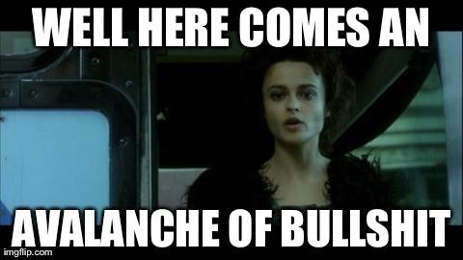

Slide 4
What is this talk about?
Definition
How-to
Tooling
Focus

Slide 5
The Software Process
What we do is hard

Slide 6

The Mythical Man-Month
The Bible of software engineering management
The process
Software team dynamics

Slide 7
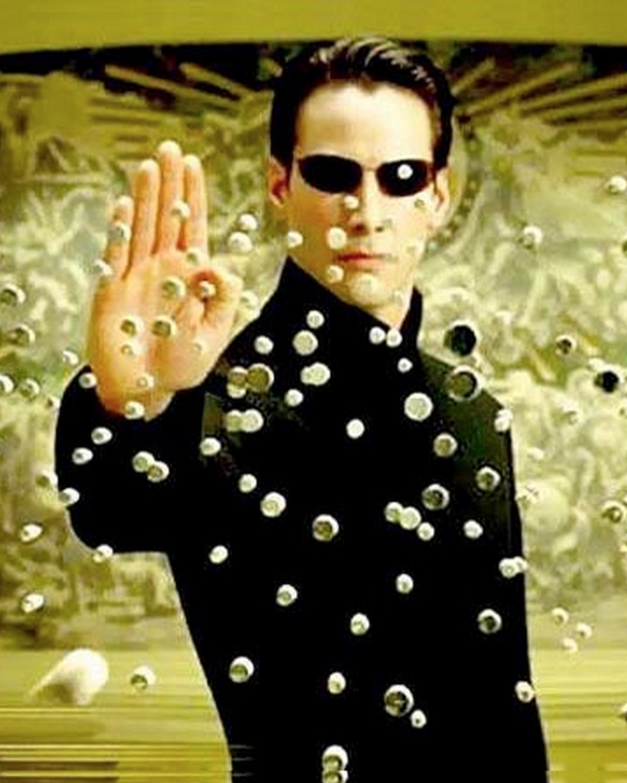
What is a 10x Engineer
If you get 10 engineers in a room, the best will be 100x more effective than the worst.
This has implications on all phases of the Software Development Life Cycle.

Slide 8
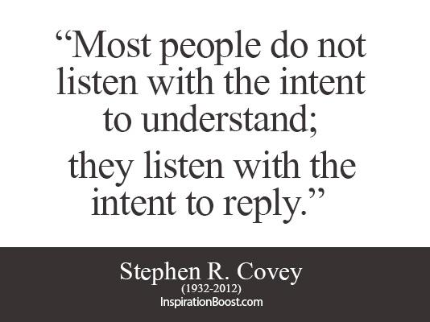
Understanding the problem
Gathering proper requirements is a skill. Listening can be learned.
Pro Tip - README-driven development

Slide 9
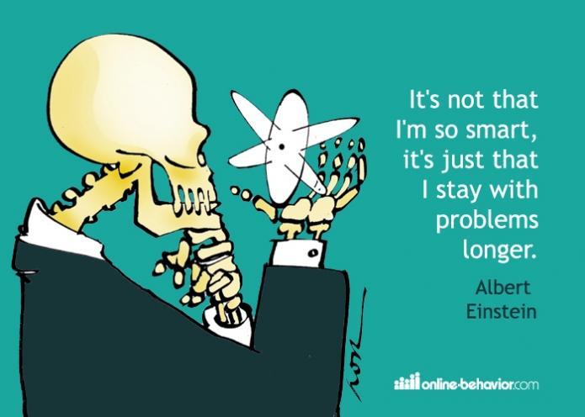
Solving the problem
Pro Tip: Architecture Diagrams FIRST
Communication, documentation, and planning in one step
www.lucidcharts.com

Slide 10
Estimating the scope
Yes, estimating is hard - http://qr.ae/vsLbf
But… A 10x engineer will be able to give good estimates instinctively
People aren’t looking for accuracy/deadlines, they are looking for easy/medium/hard
Pro tip - give estimates in hours, days, or weeks

Slide 11
Speed of development
Proficiency
Familiarity with the tech stack
avoid new-framework-of-the-month
Experience (right tool for the job)
Tooling
Decision Making
Taking the right shortcuts (especially with startups)
Predicting & catching rat-holes
Debugging

Slide 12
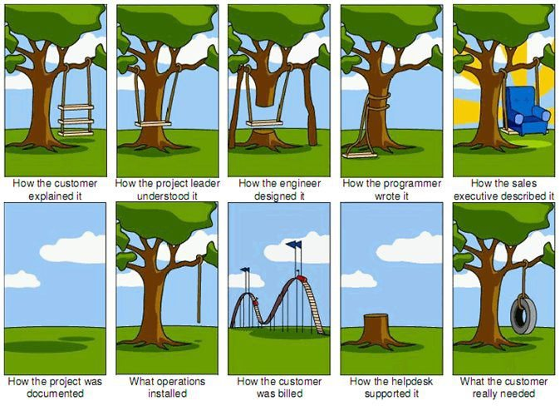
Does the solution match the problem
Pro Tip - Lean Startup helps here.
TDD for product development

Slide 13
Simplicity (maintainability)
“If you can't explain it to a six year old, you don't understand it yourself.”
- Albert Einstein
“Any intelligent fool can make things bigger, more complex, and more violent. It takes a touch of genius — and a lot of courage to move in the opposite direction.”
- E.F. Schumacher
#1 metric for code quality is simplicity.
DON’T:
Unnecessarily optimize
Be clever
Be terse

Slide 14
Robustness
Does it work?
Tests, verification
Does it scale?
Rule of thumb - 10x without changes
Does the Ops team like deploying it?
Health checks, status, logging
Is it extensible?
If you are continually refactoring, see Understanding the Problem

Slide 15
Communication
Most conflict/problems are the result of poor communication
Small, highly competent groups of people build software
Each new team member is someone else to “Get on the same page”

Slide 16
It’s not linear
“I’ve never ****** a 10, But I’ve ****** 5 2s”
- George Carlin
Especially considering communication expense
Lower than an 8 is a net negative for the team

Slide 17
Be a 10xer
Accelerate your team

Slide 18
Employee Math
Dividers cause dysfunction in the company
Fire them immediately!
Subtractors - Pull everyone down
New role or fire
Adders - the bare minimum to contribute
Multipliers - accelerate the entire team!
Keep them happy

Slide 19
10xers
Champion for Productivity
Champion for Culture
Take everyone out drinking (we bond over drink)
Critique is cheap; craftsmanship is priceless
Be the one people complain to. Fix it.
Be a talent magnet - attract others

Slide 20
10x character formula
4 must-have attributes
Intelligence
Passion
Integrity
Communication (can be taught)
Focus your interview process on all 4.

Slide 21
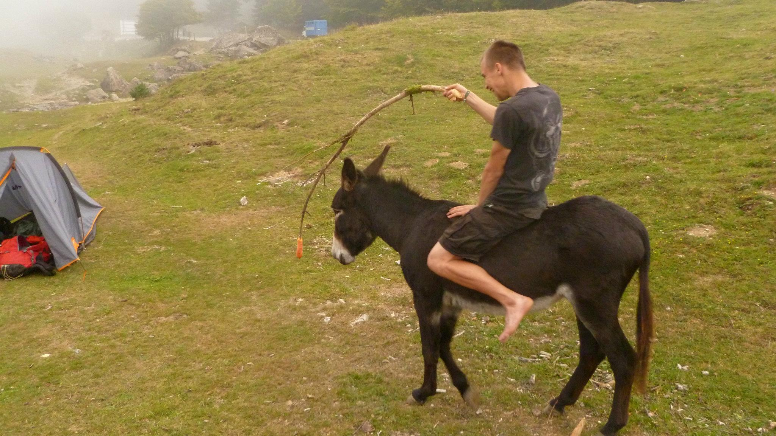
Create a culture of celebration
http://nick.sullivanflock.com/olympic.mp3

Slide 22

Accept ultimate responsibility
10xers solve the hardest problems
Inspire confidence that if you are “on it”, it will be taken care of, without follow-up
You don’t get promoted and then get responsibility - you do the job and then you get promoted

Slide 23
Integrity and Trust
Do what you say you are going to do
Set proper expectations
You said it was done, is it really?
Have you used product as a potential user?
You said it was fixed, is it really?
Have tests that give you high confidence
Verify yourself - don’t throw over the wall

Slide 24
Expert Tooling
Increase development velocity

Slide 25
Investments in dev environments
The quality of a development environment is a reflection on the quality of your team - measured by how long a new hire takes for first commit/deploy. Re-reference: Simplicity
Broken development environments are drop-everything events, because they affect the productivity of the team
Work should be fun - like a video game
Pro tip: Be a multiplier by improving dev environments

Slide 26
Editing
Invest in your editor - it is the tool of your trade. Sharpen and refine.
Static Analysis in real time
Check on every file write
Changes should be viewable immediately
Invest to reduce cycle time
Pro tip - pre-commit linting to ensure consistency. Quality through tooling.

Slide 27
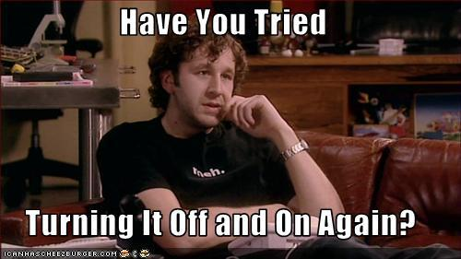
Debugging

Slide 28
Debugging
Most of our time is spent debugging. Become an expert debugger (solve the hardest problems)
Reproduce the problem
Lessons from mechanics
Isolate and Test
Change one thing at a time
Keep iteration time low - invest in tooling
Extra logging with a flag
Reporting of errors from production

Slide 29
Continuous Deployment
Reduced iteration time == increased velocity
Investments in development process will pay off forever. Step 0 of a new project is setting up Continuous Deployment workflow
Continuous Deployment requires a higher level of rigor for testing - it’s good for quality *and* productivity

Slide 30
Good tests
Make others comfortable making changes to your code with good tests
Good tests allow for merciless refactoring
Don’t punish bugs - punish lack of tests
Separate release from deployment with feature flags. See: Django Waffle

Slide 31
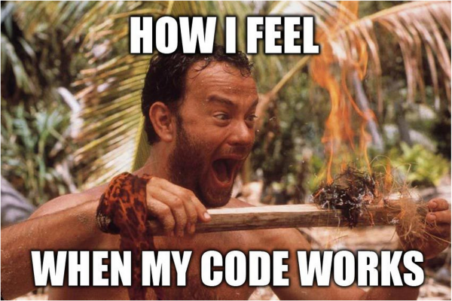

Slide 32
Focus

Slide 33
Attention Quotient
The problems we are solving are hard. They require load time, and the smallest distraction can interrupt flow and force a reload.
Your success depends on your ability to guard your focus. Aggressively defend it.
Cartoon version

Slide 34

Flow
The efficient movement around obstacles
Optimal state of productivity
Get there
Stay there

Slide 35
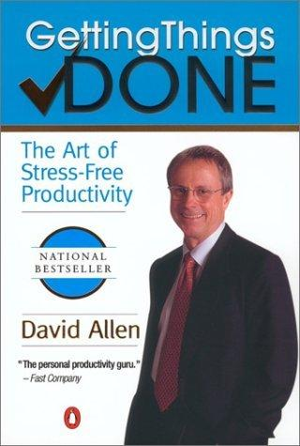
Getting Things Done
Key point - separate task management from doing.
Block off time for coding that is uninterrupted
Good project managers provide this buffer, help you stay focused, and multiply your efforts

Slide 36

Computer Setup
Turn off desktop notifications. Seriously.
Hide the dock so you don’t see new messages
Get rid of interrupts
RescueTime for Mac
Log time spent
Block distracting sites

Slide 37
Office Hacks
Educate on the importance of focus
Allow 1 high-interrupt channel (shoulder tap)
Noise cancelling headphones
Office rule - headphones on == no interruptions
Separate the talkers from the non-talkers
Schedule meetings in groups - leave large blocks of uninterrupted time.
Pro tip - scrum right before lunch

Slide 38
Company email management
Hunt down and kill noisy emails
Champion good email habits
http://three.sentenc.es/
Informative, searchable subject lines
[ACTION REQUIRED] prefixes
Proper CC/Bcc

Slide 39
Our Brains
Understanding and Hacking

Slide 40
Different brains
Left brain vs right brain
Heart vs head
Brain vs Gut
Conscious vs subconscious
All are different explanations of the way our brains have evolved - often called the triune brain. Lizard, Mammal, and Homo Sapien.

Slide 41
Lizard Brain
The four F’s.
Food
Flight
Fight
Sex

Slide 42
The mammal brain
Relationships
Empathy
Passion/Drive

Slide 43
Homo Sapien brain (neocortex)
Introspection
Logic
Delayed Gratification

Slide 44
Understand which brain to use
Geeks think more with the homo sapien brain
Good for code, bad for interacting with people
Geeks aren’t usually good managers
User Experience, Creativity, and Meetings (listening) are better with mammal brain
Understand it and Hack it

Slide 45
Sleep/Time of day
Pay attention to when you are the most creative versus focused
Sometimes tired is better (lower creativity)
Ray Kurzweil dreams ideas, then spends his days making them real
Master the power nap. Seriously.
Hypnosis Downloads

Slide 46
Showering
Besides the obvious office morale reasons
Causes different flows of blood to different parts of the brain.
Combine with doing it first thing in the morning when you just wake up - best ideas of the day

Slide 47

Brain Health
Your brain is a temple
Proper nutrition
True Focus
Essential fatty acids
Sushi!

Slide 48
Brain Hacks
Buzz - Science of Alcohol and Caffeine
Caffeine
Good for logic. Bad for creativity. Not too much.
Situation dependent & men vs women
Alcohol/being hungover (ballmer peak)
A little - good for focus & creativity
A lot - bad for productivity, great for stories
Marijuana
Good for creativity; for some it improves focus
Me personally: alcohol + caffeine at night

Slide 49
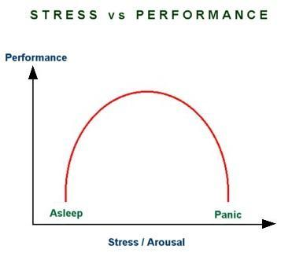
Stress - good and bad

Slide 50
Be Happy
We are the most productive when we enjoy our work.
Change the circumstances - accept responsibility for making it work and go do it.

Slide 51
Go forth and Multiply
Questions? nick@sullivanflock.com
Twitter/Github/Everywhere: @gorillamania
Slides available at http://creationeer.me/10x

Slide 52
Links
The Mythical Man-month
Flow
True Focus pills
Buzz - Science of Alcohol and Caffeine
README-driven Development
The Cathedral and the Bazaar
Getting Things Done
How to say it at work
My homedir settings

