Slide 1
Online Complaint Registration and Management System
By:
Sanjay - 211521104135
Sai Niranjan - 211521104131
Suban Sri - 211521104159
Yogul Kishore S - 211521104187
Seamlessly handle customer complaints and streamline resolutions with our intuitive, cloud-based platform.

Slide 2
Introducing the Complaint Management System
Efficiently manage customer complaints across three user roles: Users, Admins, and Agents.
User:
Raises complaints,
tracks status.
Admin:
Manages users, assigns complaints.
Agent:
Resolves assigned complaints.

Slide 3
Streamlining Complaint Resolution
Our system aims to improve efficiency and provide quick resolutions for customer complaints.
01
Raise Complaint
02
Assign to Agent
03
Market & competition
Users submit issues with detailed descriptions.
Admins review and delegate complaints to agents.
Agents investigate and provide solutions.

Slide 4
User Features
Raise Complaints
Complaint Tracking
Empowering users to easily submit and track their complaints.
Users can file issues with detailed descriptions.
Users can view the status of their complaints.

Slide 5
User Management
Admin Features
Complaint Allocation
System Oversight
Create and maintain user accounts.
Assign complaints to appropriate agents.
Comprehensive tools for admins to manage the complaint system.
Monitor and maintain the overall system.

Slide 6
Agent Features
Enabling agents to efficiently resolve customer complaints.
View Complaints:
Agents can see their assigned complaints.
Investigate Issues:
Agents research and find solutions.
Update Status:
Agents communicate progress and resolutions.

Slide 7
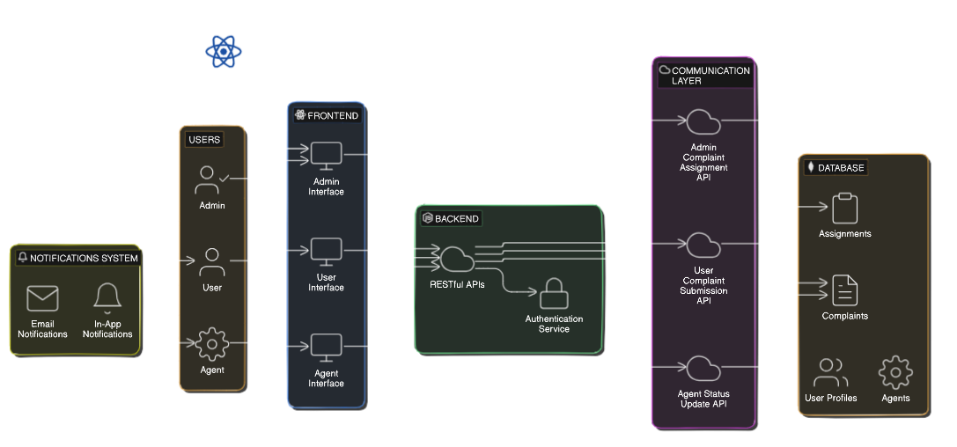
System Architecture

Slide 8




Technologies Utilized
React.js
Node.js
MongoDB
AWS
Leveraging the latest technologies to deliver a robust and scalable solution.
Modern web framework for the frontend.
Powerful runtime for the backend.
Flexible NoSQL database for storage.
Cloud platform for hosting and scaling.

Slide 9
Faster Resolutions
Benefits of the System
Enhanced Visibility
Improved Customer Satisfaction
Streamlined workflow reduces complaint response times.
Admins and agents have full oversight of complaints.
Improving efficiency and providing better resolutions for customer complaints.
Efficient handling of complaints leads to happier customers.

Slide 10
Thank You

