Slide 1
Sensors

Slide 2
Contents
contents
Title | Page
What is sensor?
Types of sensors
IR Sensor
Potentiometer Sensor

Slide 3
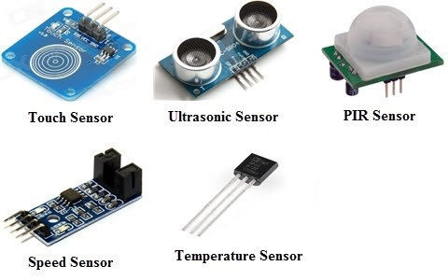
What is Sensor?
What is sensors
A sensor is a device that measures a physical quantity and converts it into a signal which can be read by an observer or by an instrument.
Sensors are used in everyday objects such as touch-sensitive elevator buttons (tactile sensor) and lamps which dim r brighten by touching the base.
Applications include cars, machines, aerospace, medicine, manufacturing and robotics.

Slide 4
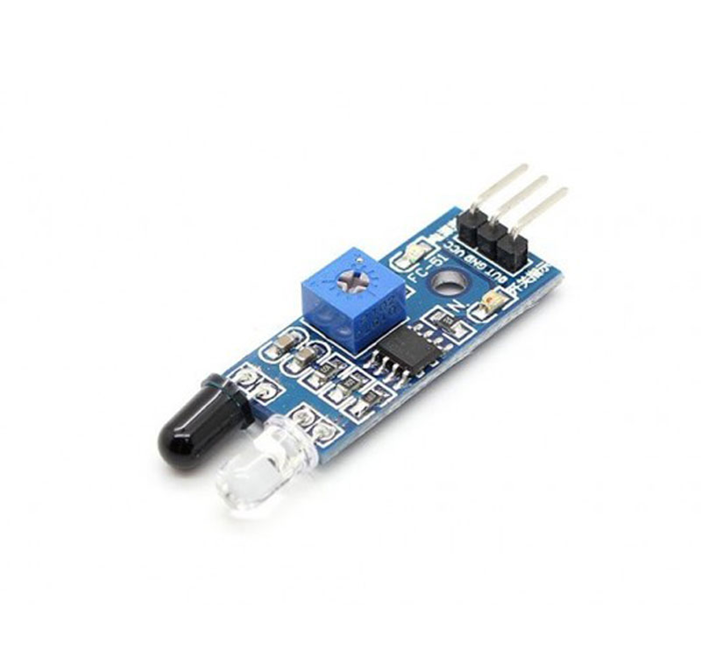
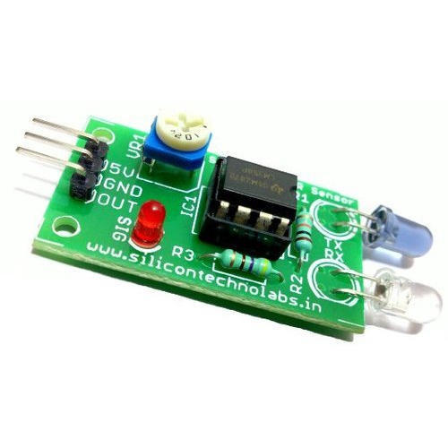
Types of Sensors
IR Sensor

Slide 5
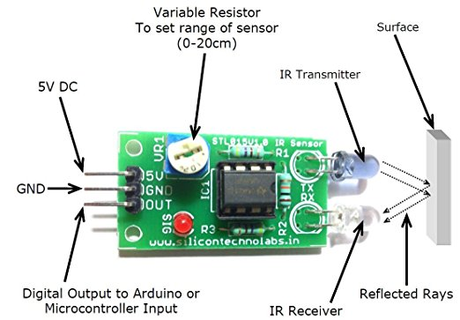
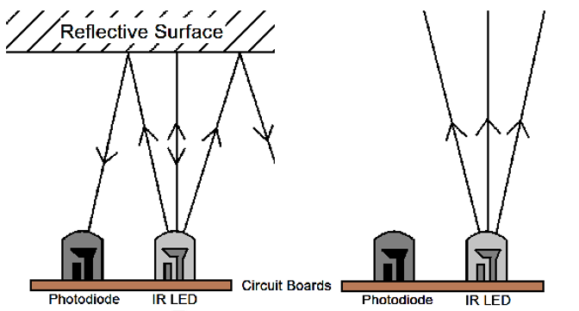
IR Sensor

Slide 6
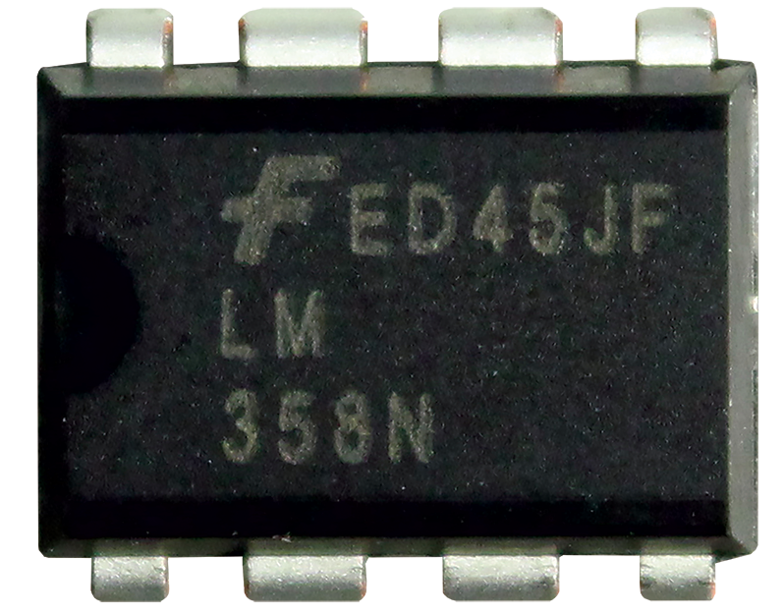
Voltage Comparator
A comparator is a device which compares two voltages or currents and switches its output to indicate which is larger.
Comparator is On-Amp.

Slide 7
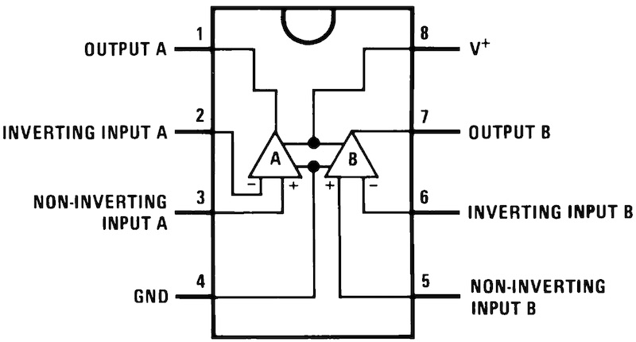
Pin Diagram

Slide 8
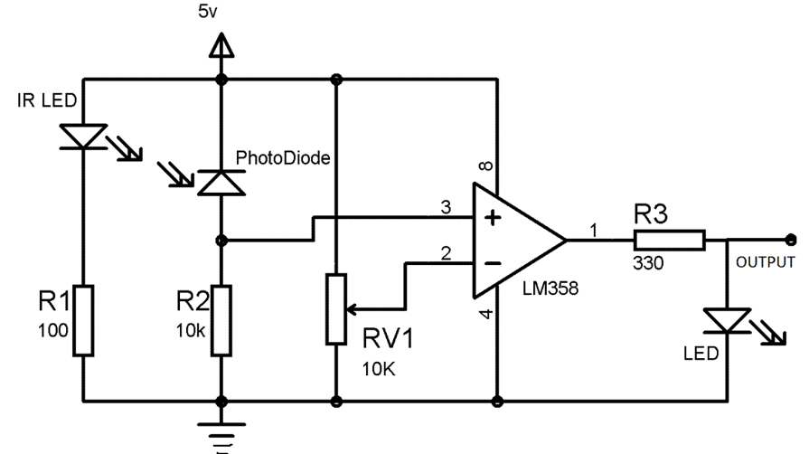
Circuit
Diagram

Slide 9
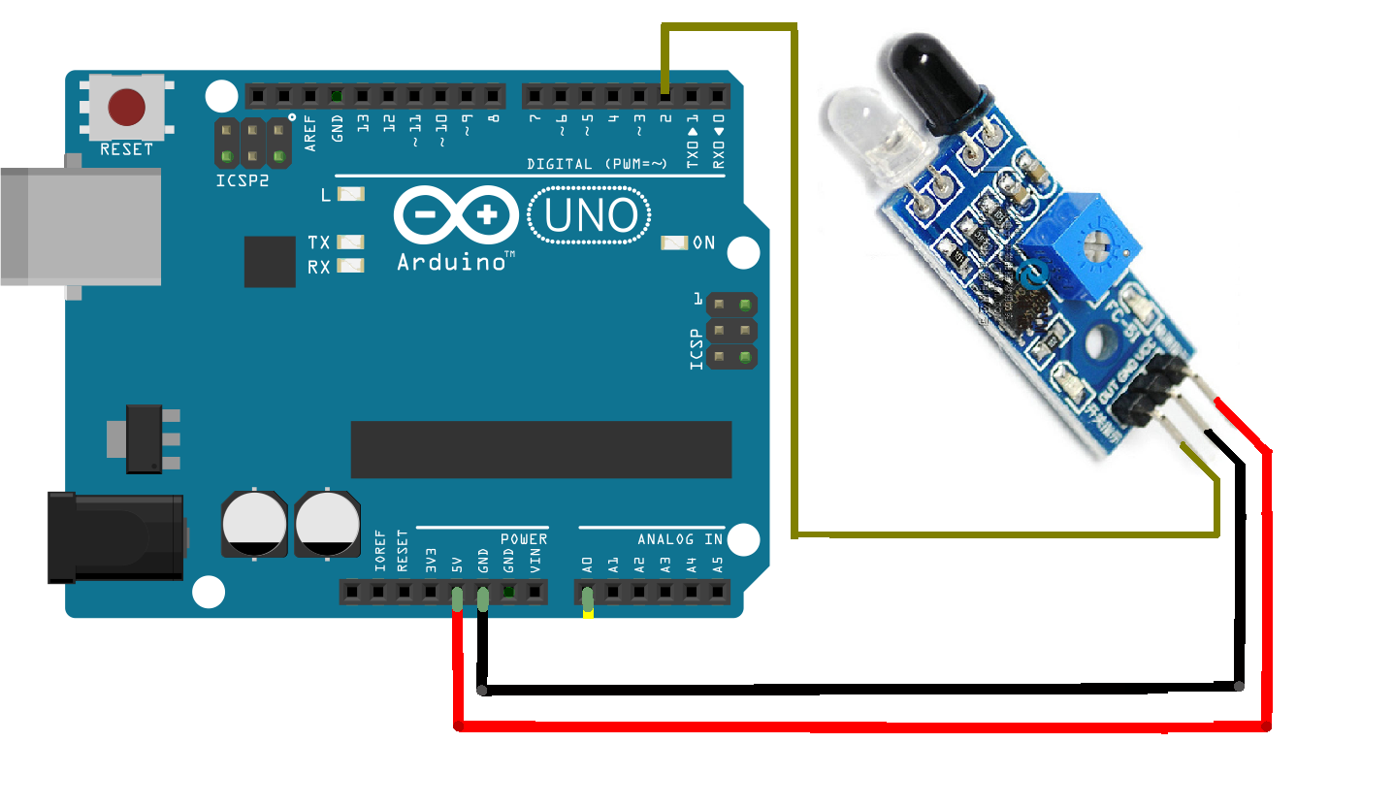
Circuit
Diagram

Slide 10
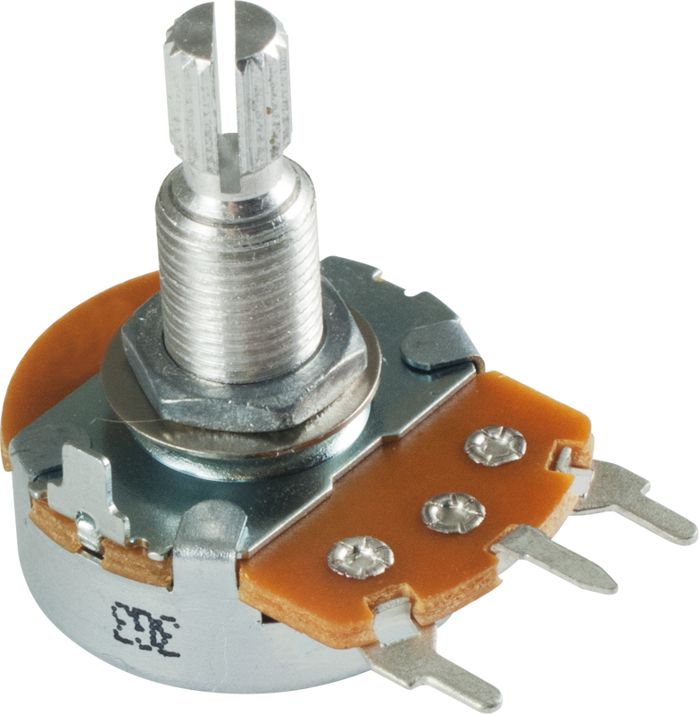
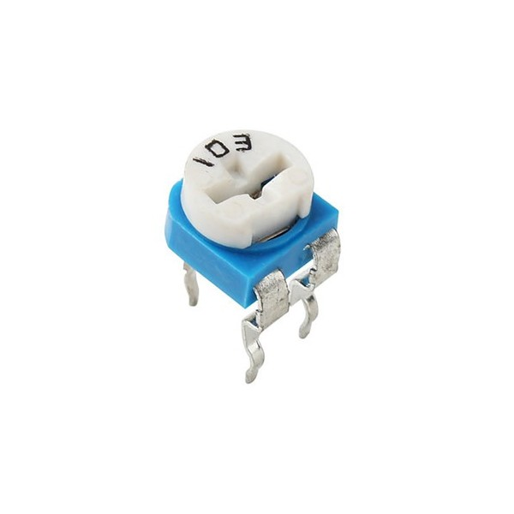
Potentiometer Sensor
A potentiometer is a three-terminal resistor with a sliding or rotating contact that forms an adjustable voltage divider.

Slide 11
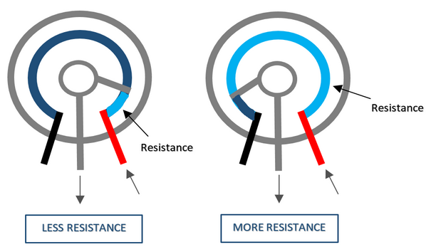
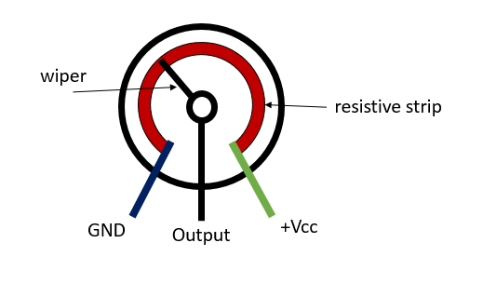
Circuit
Diagram

Slide 12
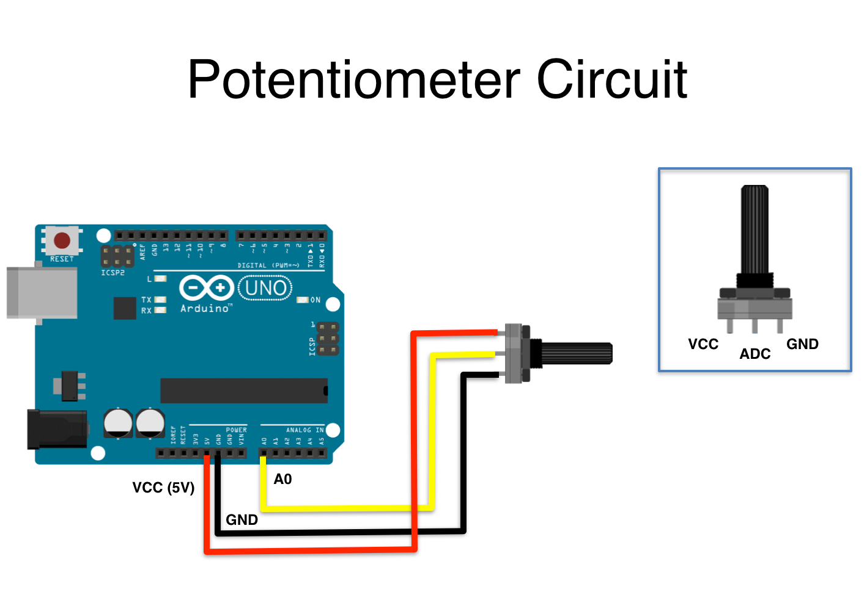
Circuit
Diagram

Slide 13
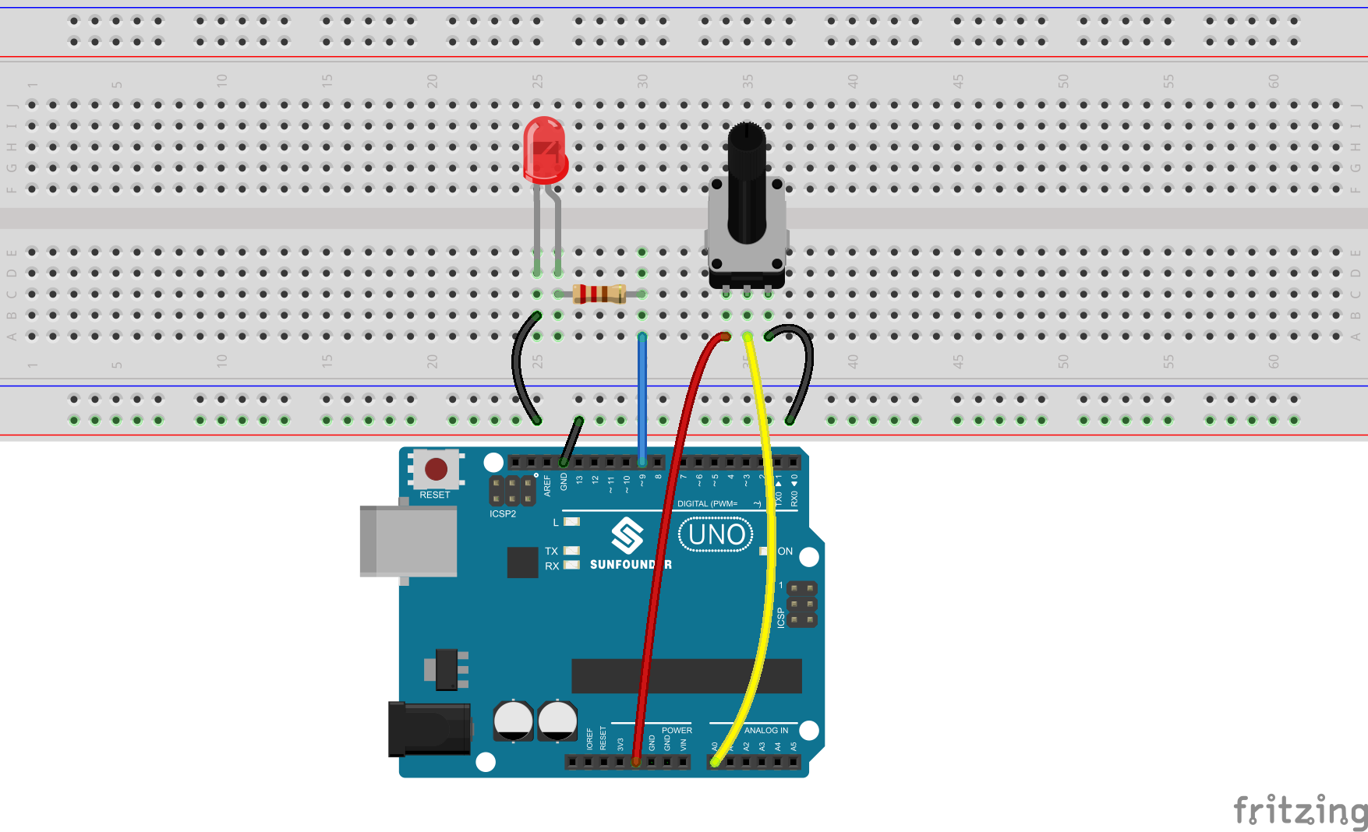
Controlling led brightness

Slide 14
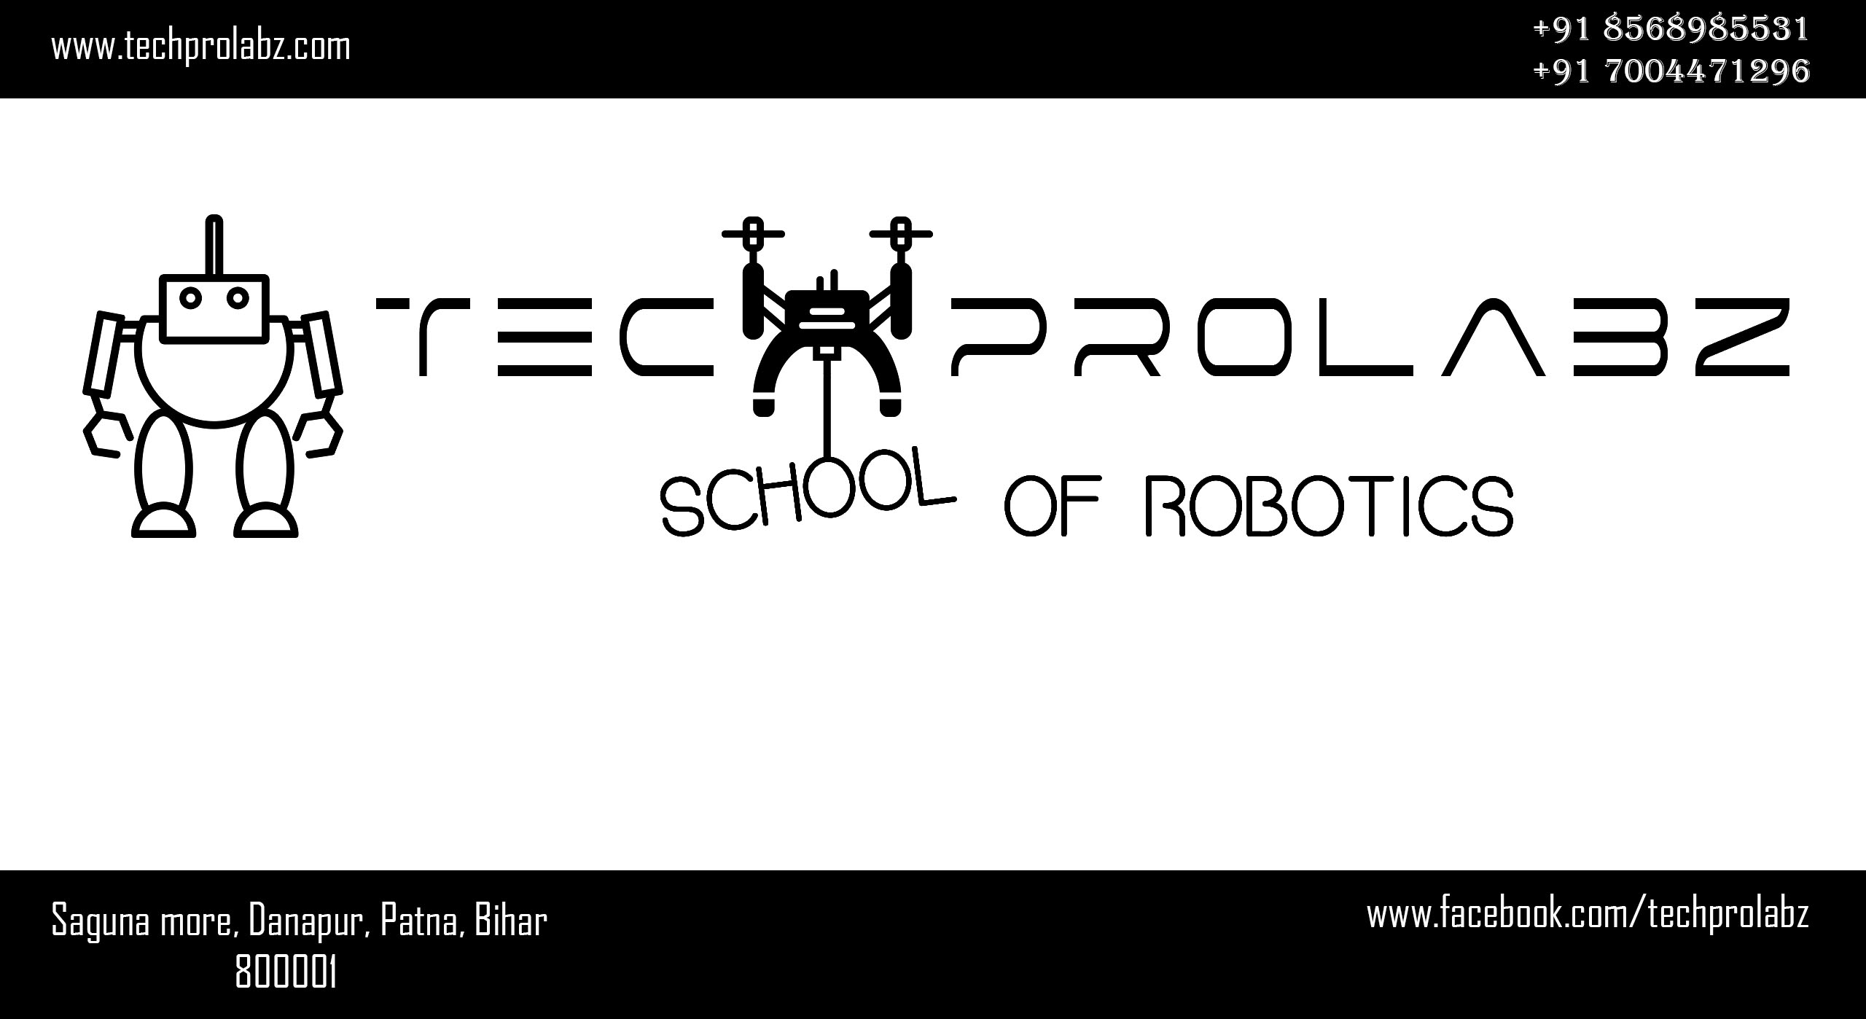
THANK YOU

