Slide 1
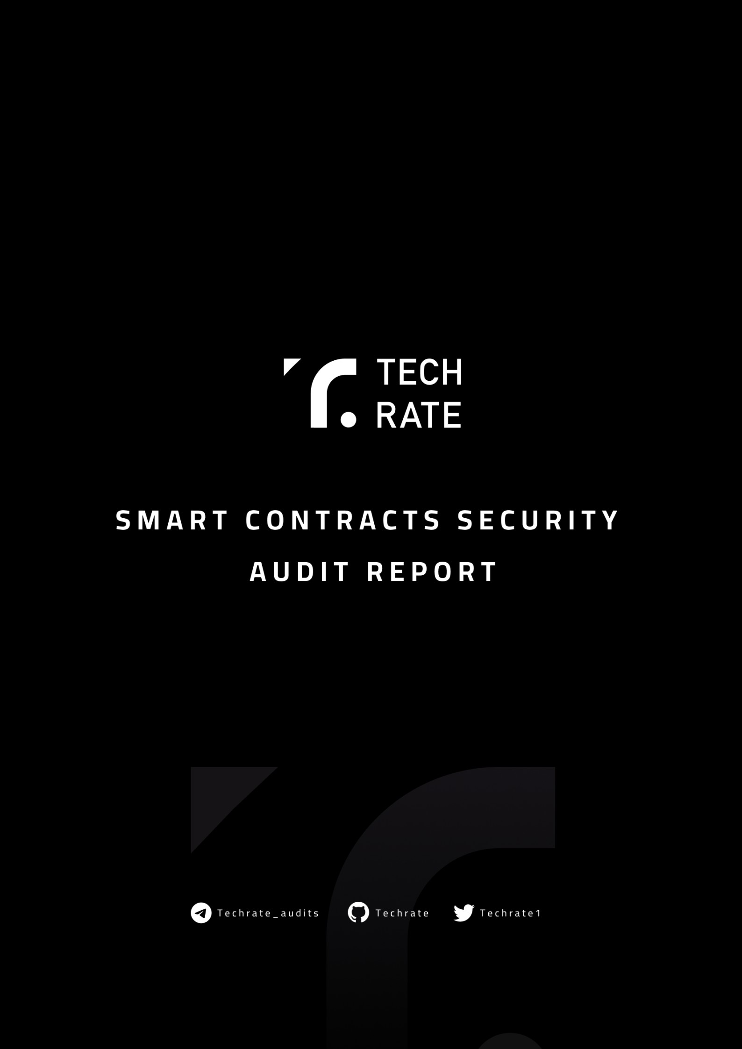
TechRate January, 2024

Slide 2

Audit Details
Audited project
MYRADOGE
Deployer address
0x413178403bcE833B19642df6d4d10C3D9EF47abD
Client contacts:
MYRADOGE team
Blockchain
Binance Smart Chain
Project website:
https://myradoge.pro

Slide 3

Disclaimer
This is a limited report on our findings based on our analysis, in accordance with good industry practice as at the date of this report, in relation to cybersecurity vulnerabilities and issues in the framework and algorithms based on smart contracts, the details of which are set out in this report. In order to get a full view of our analysis, it is crucial for you to read the full report. While we have done our best in conducting our analysis and producing this report, it is important to note that you should not rely on this report and cannot claim against us on the basis of what it says or doesn’t say, or how we produced it, and it is important for you to conduct your own independent investigations before making any decisions. We go into more detail on this in the disclaimer below – please make sure to read it in full.
DISCLAIMER: By reading this report or any part of it, you agree to the terms of this disclaimer. If you do not agree to the terms, then please immediately cease reading this report, and delete and destroy any and all copies of this report downloaded and/or printed by you. This report is provided for information purposes only and on a non-reliance basis, and does not constitute investment advice. No one shall have any right to rely on the report or its contents, and TechRate and its affiliates (including holding companies, shareholders, subsidiaries, employees, directors, officers and other representatives) (TechRate) owe no duty of care towards you or any other person, nor does TechRate make any warranty or representation to any person on the accuracy or completeness of the report. The report is provided "as is", without any conditions, warranties or other terms of any kind except as set out in this disclaimer, and TechRate hereby excludes all representations, warranties, conditions and other terms (including, without limitation, the warranties implied by law of satisfactory quality, fitness for purpose and the use of reasonable care and skill) which, but for this clause, might have effect in relation to the report. Except and only to the extent that it is prohibited by law, TechRate hereby excludes all liability and responsibility, and neither you nor any other person shall have any claim against TechRate, for any amount or kind of loss or damage that may result to you or any other person (including without limitation, any direct, indirect, special, punitive, consequential or pure economic loss or damages, or any loss of income, profits, goodwill, data, contracts, use of money, or business interruption, and whether in delict, tort (including without limitation negligence), contract, breach of statutory duty, misrepresentation (whether innocent or negligent) or otherwise under any claim of any nature whatsoever in any jurisdiction) in any way arising from or connected with this report and the use, inability to use or the results of use of this report, and any reliance on this report.
The analysis of the security is purely based on the smart contracts alone. No applications or operations were reviewed for security. No product code has been reviewed.

Slide 4

Background
TechRate was commissioned by AEONODEX to perform an audit of smart contracts: https://www.bscscan.com/token/0x385fdd34c1432b7ac0ed19c51dcff3136b5b70dc#code
The purpose of the audit was to achieve the following:
Ensure that the smart contract functions as intended.
Identify potential security issues with the smart contract.
The information in this report should be used to understand the risk exposure of the smart contract, and as a guide to improve the security posture of the smart contract by remediating the issues that were identified.

Slide 5

Issues Checking Status
 | Issue description | Checking status
1. | Compiler errors. | Passed
2. | Race conditions and Reentrancy. Cross-function race conditions. | Passed
3. | Possible delays in data delivery. | Passed
4. | Oracle calls. | Passed
5. | Front running. | Passed
6. | Timestamp dependence. | Passed
7. | Integer Overflow and Underflow. | Passed
8. | DoS with Revert. | Passed
9. | DoS with block gas limit. | Passed
10. | Methods execution permissions. | Passed
11. | Economy model of the contract. | Passed
12. | The impact of the exchange rate on the logic. | Passed
13. | Private user data leaks. | Passed
14. | Malicious Event log. | Passed
15. | Scoping and Declarations. | Passed
16. | Uninitialized storage pointers. | Passed
17. | Arithmetic accuracy. | Passed
18. | Design Logic. | Passed
19. | Cross-function race conditions. | Passed
20. | Safe Open Zeppelin contracts implementation and usage. | Passed
21. | Fallback function security. | Passed

Slide 6


Security Issues
High Severity Issues
No high severity issues found.
Medium Severity Issues
No medium severity issues found.
Low Severity Issues
No low severity issues found.
Owner privileges (In the period when the owner is not renounced)
Owner can change the marketing, buyBack and liquidity fees.
Owner can exclude from the fee and maxTX.
Owner can change marketing and buyBack wallets.
Owner can change Uniswap router address.
Owner can change swap and liquify settings.
Owner can mark addresses as market pairs.
Owner can change _maxTxAmount.
Owner can change _walletMax.
Owner can change minimumTokensBeforeSwap.

Slide 7
Testnet deployment
Contracts Description Table
Contract | Type | Bases
└ | Function Name | Visibility | Mutability | Modifiers
avalyzer | Implementation | Context, IERC20, Ownable
└ | increaseAllowance | Public ! | ● | NO !
└ | decreaseAllowance | Public ! | ● | NO !
└ | approve | Public ! | ● | NO !
└ | setMarketPairStatus | Public ! | ● | onlyOwner
└ | setIsTxLimitExempt | External ! | ● | onlyOwner
└ | setIsExcludedFromFee | Public ! | ● | onlyOwner
└ | setBuyTaxes | External ! | ● | onlyOwner
└ | setSelTaxes | External ! | ● | onlyOwner
└ | setDistributionSettings | External ! | ● | onlyOwner
└ | setMaxTxAmount | External ! | ● | onlyOwner
└ | enableDisableWalletLimit | External ! | ● | onlyOwner
└ | setIsWalletLimitExempt | External ! | ● | onlyOwner
└ | setWalletLimit | External ! | ● | onlyOwner
└ | setMarketingWalletAddress | External ! | ● | onlyOwner
└ | setBuyBackWalletAddress | External ! | ● | onlyOwner
└ | setSwapAndLiquifyEnabled | Public ! | ● | onlyOwner
└ | setSwapAndLiquifyByLimitOnly | Public ! | ● | onlyOwner
└ | changeRouterVersion | Public ! | ● | onlyOwner
└ | transfer | Public ! | ● | NO !
└ | transferFrom | Public ! | ● | NO !
Legend
Symbol | Meaning
● | Function can modify state
⬛I ±' | Function is payable

Slide 8
Contract: AEONODEX
✔ should deploy the token with the correct name and symbol (1133ms)
✔ should assign the initial supply to the deployer (1721ms)
✔ should set market pair status (11033ms)
✔ should set tx limit exemption (10978ms)
✔ should set excluded from fee status (11296ms)
✔ should set buy taxes (9863ms)
✔ should set sell taxes (10955ms)
✔ should set distribution settings (11331ms)
✔ should set max transaction amount (11894ms)
✔ should enable/disable wallet limit (11925ms)
✔ should set wallet limit exemption (17174ms)
✔ should set wallet limit (18150ms)
✔ should set marketing wallet address (6367ms)
✔ should set buyBack wallet address (7259ms)
✔ should set swap and liquify enabled (8330ms)
✔ should set swap and liquify by limit only (13984ms)
✔ should get circulating supply (1326ms)
✔ should change router version (20431ms)
✔ should transfer tokens between accounts (11640ms)
✔ should allow approvals and transfers from (32397ms)
✔ should increase and decrease allowances (44536ms)
21 passing (5m)

Slide 9
Conclusion
Smart contracts do not contain high severity issues! Liquidity pair contract’s security is not checked due to out of scope. The further transfers and operations with the funds raise are not related to this particular contract. minimumTokensBeforeSwapAmount is private.
Liquidity locking details are provided by the team: https://app.uncx.network/amm/pancake- v2/pair/0xA66856F29B3a31dD4f7391596cee53f445E20b0e
Security score: 95.
TechRate note:
Please check the disclaimer above and note, the audit makes no statements or warranties on business model, investment attractiveness or code sustainability. The report is provided for the only contract mentioned in the report and does not include any other potential contracts deployed by Owner.

