Slide 1
The Pythagorean theorem
13 flashcards: question, then answer
From three short videos: squares on the sides, the sliding proof, and real life
Notes:
Press next for the question, then next again for its answer.

Slide 2
QUESTION
1 / 13
What is the Pythagorean theorem?
Video 1

Slide 3
ANSWER
1 / 13
In a right triangle, a² + b² = c².
The squares on the two short sides add up to the square on the long side.
Video 1

Slide 4
QUESTION
2 / 13
What is a right triangle?
Video 1

Slide 5
ANSWER
2 / 13
A triangle with one square corner (a 90° angle).
Video 1

Slide 6
QUESTION
3 / 13
Which side is c?
Video 1

Slide 7
ANSWER
3 / 13
The longest side, opposite the square corner. It is called the hypotenuse.
Video 1

Slide 8
QUESTION
4 / 13
Which sides are a and b?
Video 1

Slide 9
ANSWER
4 / 13
The two shorter sides that meet at the square corner. They are called the legs.
Video 1

Slide 10
QUESTION
5 / 13
Check the 3-4-5 triangle.
Video 1

Slide 11
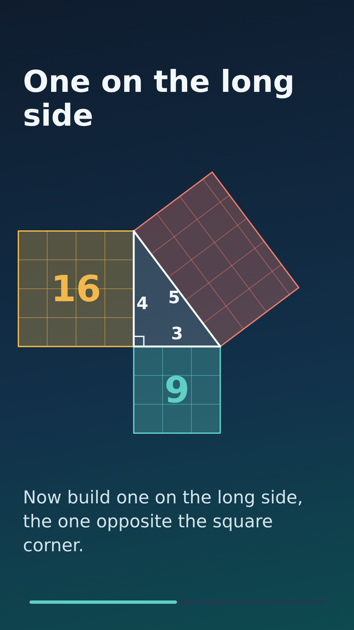
ANSWER
5 / 13
3² + 4² = 9 + 16 = 25 = 5².
The two small squares hold 9 and 16 little squares. The big one holds 25.
Video 1

Slide 12
QUESTION
6 / 13
Check the 5-12-13 triangle.
Video 1

Slide 13
ANSWER
6 / 13
5² + 12² = 25 + 144 = 169 = 13².
It works again.
Video 1

Slide 14
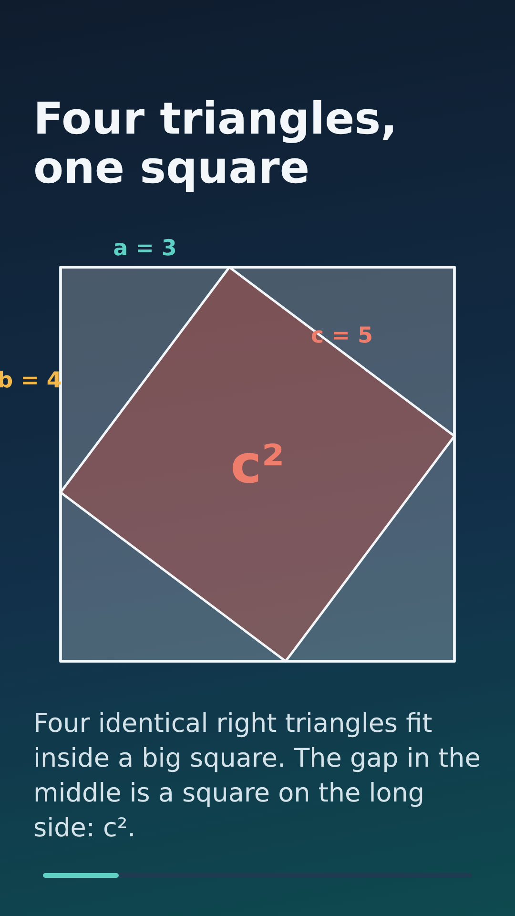
QUESTION
7 / 13
How does the sliding proof work?
Video 2

Slide 15
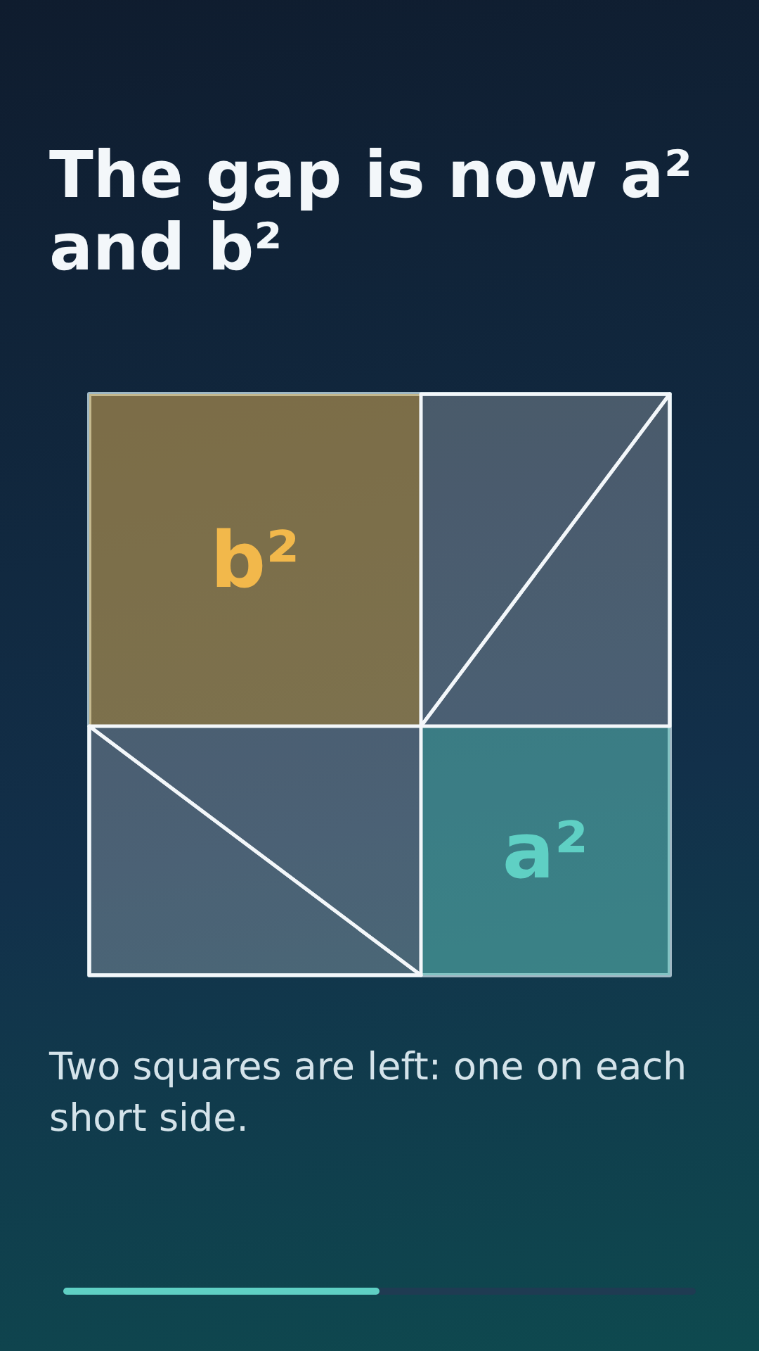
ANSWER
7 / 13
Four identical right triangles sit in a big square and leave a gap shaped like c². Slide the same triangles and the gap becomes a² and b². The gap has the same area both times, so c² = a² + b².
Video 2

Slide 16
QUESTION
8 / 13
Why is the gap the same area both times?
Video 2

Slide 17
ANSWER
8 / 13
Because it is the big square minus the same four triangles. The big square and the triangles do not change when you slide them.
Video 2

Slide 18
QUESTION
9 / 13
A 2.5 m ladder has its foot 0.7 m from a wall. How high does it reach?
Video 3

Slide 19
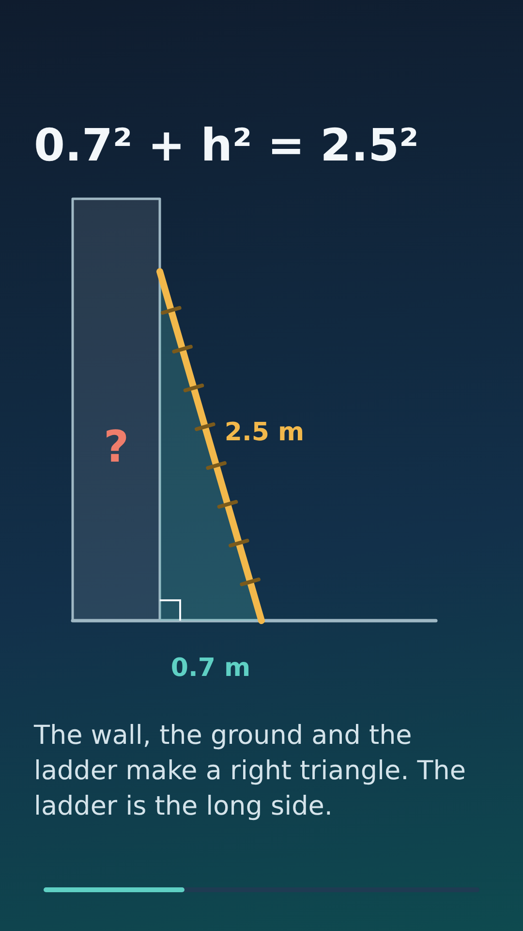
ANSWER
9 / 13
0.7² + h² = 2.5²
0.49 + h² = 6.25
h² = 5.76
h = 2.4 m
The ladder is the long side (c).
Video 3

Slide 20
QUESTION
10 / 13
How do you find a missing short side?
Video 3

Slide 21
ANSWER
10 / 13
Subtract. a² = c² − b². Then take the square root.
Video 3

Slide 22
QUESTION
11 / 13
Common mistake: you get h² = 5.76. Are you done?
Video 3

Slide 23
ANSWER
11 / 13
No. Take the square root: h = 2.4. The answer is the side, not its square.
Video 3

Slide 24
QUESTION
12 / 13
How can builders check that a corner is square?
Video 3

Slide 25
ANSWER
12 / 13
Mark 3 m along one wall and 4 m along the other. If the marks are 5 m apart, the corner is square.
Video 3

Slide 26
QUESTION
13 / 13
Does the theorem work for every triangle?
Video 3

Slide 27
ANSWER
13 / 13
No. Only for right triangles. If a² + b² = c² for the three sides, the triangle is a right triangle.
Video 3

Slide 28
a² + b² = c²
Only for right triangles. c is the long side opposite the square corner.
Find a missing side: subtract, then take the square root.

