Slide 1

Note: The data and information in this document is reflective of a hypothetical situation and client. This document is to be used for KPMG Virtual Internship purposes only.
Sprocket Central Pty Ltd
Data analytics approach
[Division Name] - [Engagement Manager], [Senior Consultant], [Junior Consultant]

Slide 2
Note: The data and information in this document is reflective of a hypothetical situation and client. This document is to be used for KPMG Virtual Internship purposes only.
Agenda
Introduction
Data Analytics Pre-requisites approach
Data Exploration
Model Development
Interpretation

Slide 3
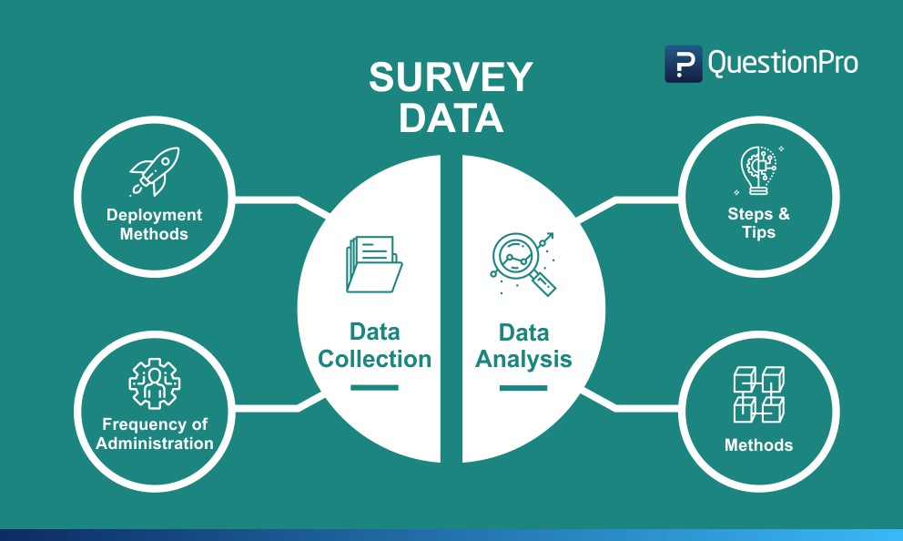
Data Analytics Pre-requisites approach
Note: The data and information in this document is reflective of a hypothetical situation and client. This document is to be used for KPMG Virtual Internship purposes only.
Ensure availability of the necessary analytical skills
Ensure appropriate implementation of data collection methods and analysis.
Determine the statistical significance
Check for inappropriate analysis
Ensure the presence of legitimate and unbiased inference
Ensure the reliability and validity of data, data sources, data analysis methods, and inferences derived.
Account for the extent of analysis

Slide 4

Note: The data and information in this document is reflective of a hypothetical situation and client. This document is to be used for KPMG Virtual Internship purposes only.
Introduction
Customer Analysis
Customer Age Distribution.
  Their current Job Industry.
  Wealth and State.
  No of cars and bikes each customer own.
  Property Valuation.

Slide 5
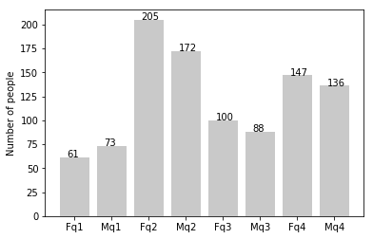
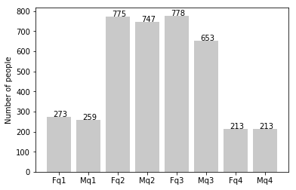
Note: The data and information in this document is reflective of a hypothetical situation and client. This document is to be used for KPMG Virtual Internship purposes only.
Data Exploration
Customer Age Distribution
New
As from observing New Customers graph there are majority customers who’s age between 25 to 48 years.
New customers that ages below 25 years are less.
The interest showed by new customer is age between 25 to 48 and above 59 years.
As from observing old customer graph there are majority customers age’s between 25 to 48 and below 59 years.
Age between 25 to 48 years are greater then new customers but over 59 years old customers are less then new one.
Old

Slide 6
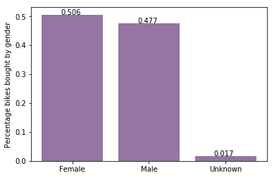
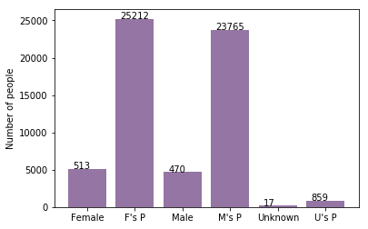
Note: The data and information in this document is reflective of a hypothetical situation and client. This document is to be used for KPMG Virtual Internship purposes only.
Model Development
Bike Purchase Last Year
Almost 50% females bought bikes and 47% by males which means females are more interested in purchasing the bikes.
Females purchased 25212 bikes comparing to Male they purchased 23765.
We should advertise or make bikes that attracts females to engage more audience as females are buying more then males and unknown.

Slide 7
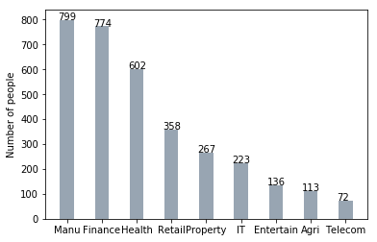
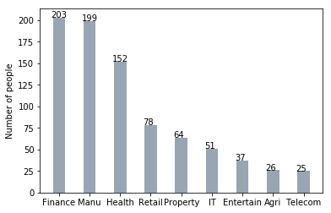
Note: The data and information in this document is reflective of a hypothetical situation and client. This document is to be used for KPMG Virtual Internship purposes only.
Interpretation
New
Job Industry
By observing both graph, it shows that people with Manufacturing and Finance jobs are increasing as Manufacturing is in now top and finance is in 2nd.
Other Industries our still lack behind.
Old

Slide 8
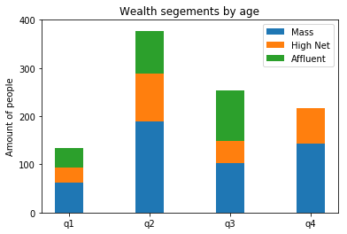
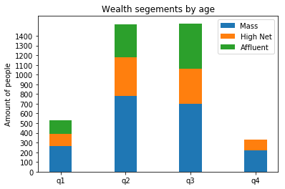
Note: The data and information in this document is reflective of a hypothetical situation and client. This document is to be used for KPMG Virtual Internship purposes only.
Interpretation
New
Wealth Segment
By Observing New and Old, the mass customers are high so we should focus or pay attention to that.
After that the high net customers come which should also be focused to increase their rate also.
While Affluent customers are minimum but they are mostly in q2 and q3 only.
Old

Slide 9
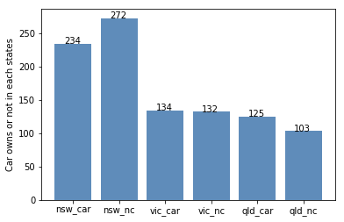
Note: The data and information in this document is reflective of a hypothetical situation and client. This document is to be used for KPMG Virtual Internship purposes only.
Interpretation
Cars being Owned
NSW state customers owned car more then the cars.
VIC and QLD owned minimal amount of cars, so we should focus on them to buy bikes.

Slide 10
Note: The data and information in this document is reflective of a hypothetical situation and client. This document is to be used for KPMG Virtual Internship purposes only.
Appendix

Slide 11
Note: The data and information in this document is reflective of a hypothetical situation and client. This document is to be used for KPMG Virtual Internship purposes only.
Appendix
All Data Is being attached in the PPT.

