Slide 1


Quality Assurance Training
Email. info@techsolutionsprogram.com

Slide 2
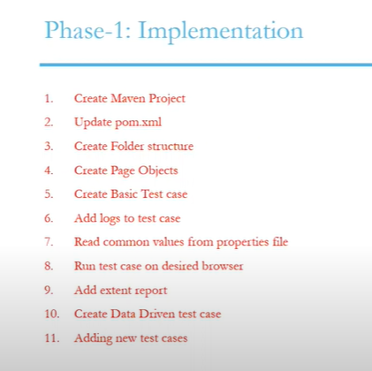

Slide 3
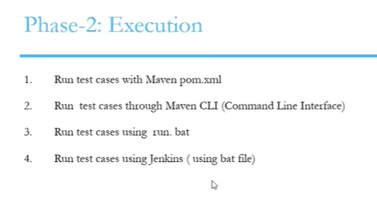

Slide 4
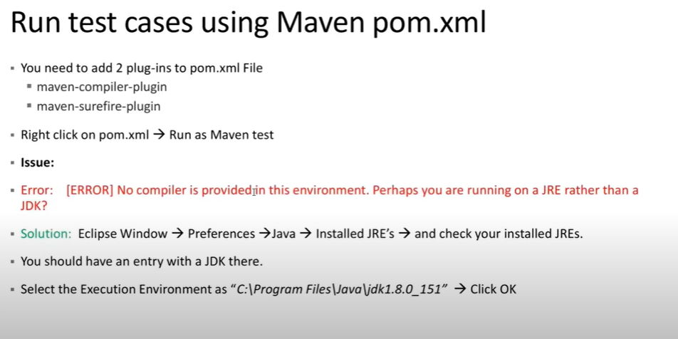

Slide 5
Git Commands
Init
Status
Add
Commit
Log
config

Slide 6
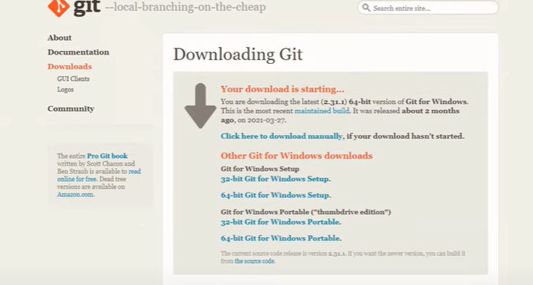
Git-scm.com/downloads

Slide 7
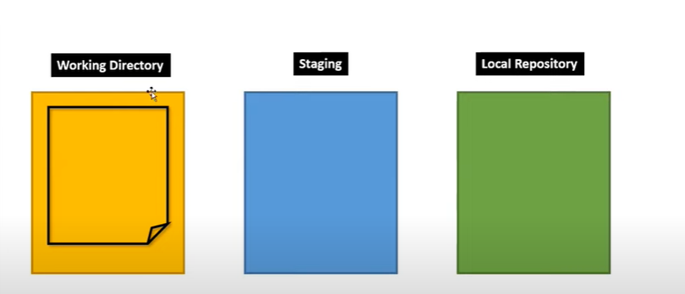
GIT command
Git diff

Slide 8
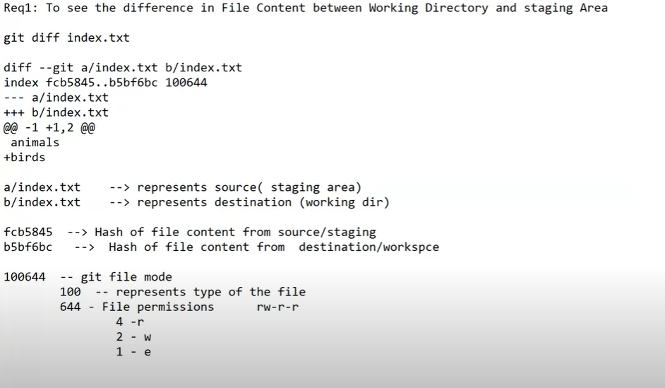


Slide 9
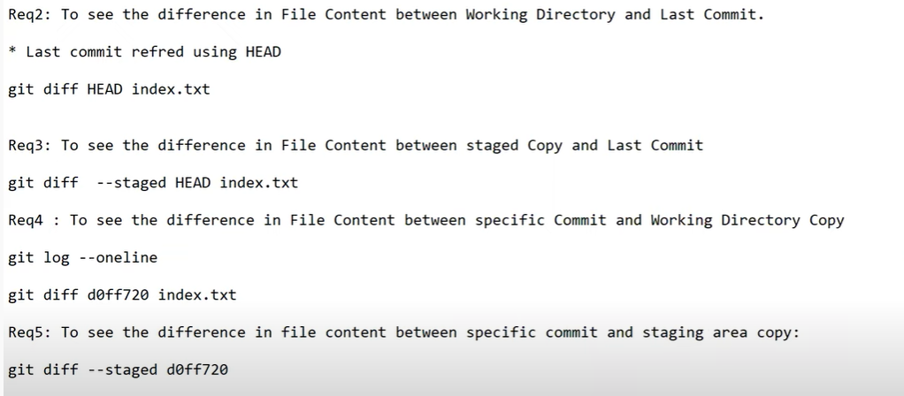

Slide 10


Slide 11
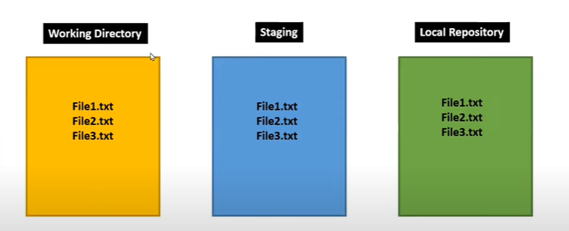
Git command-rm removing files

Slide 12
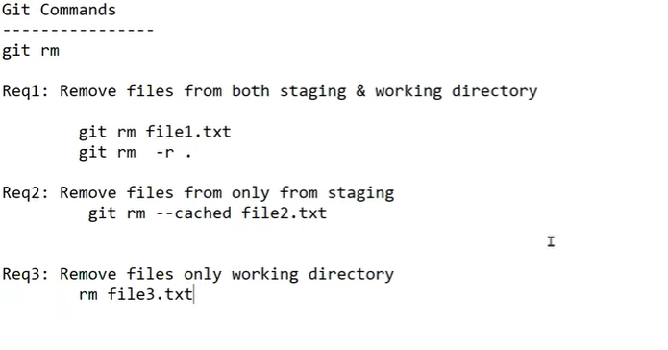

Slide 13
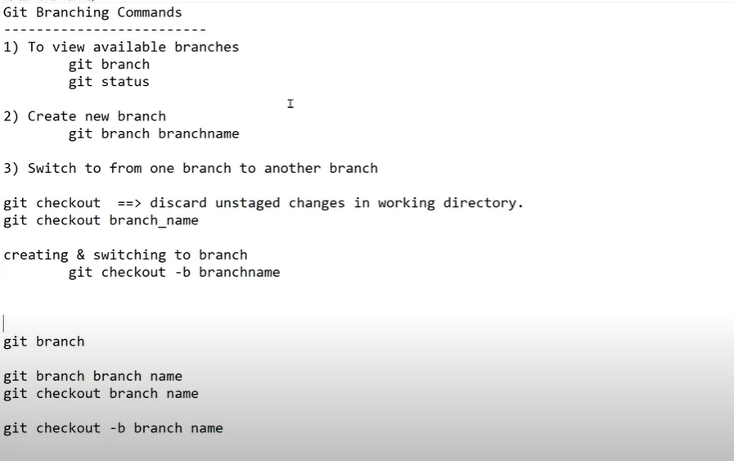
Git branch

Slide 14
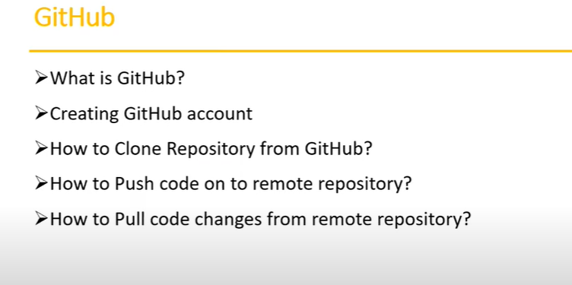
Remote Repo

Slide 15
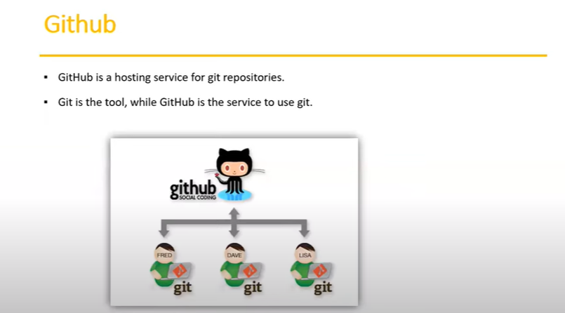

Slide 16
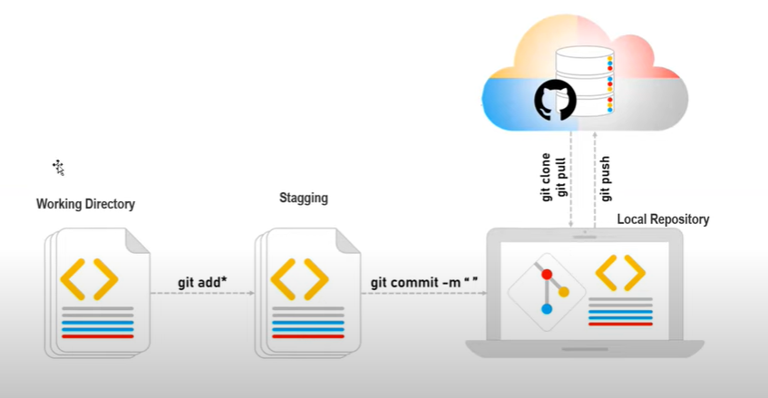

Slide 17
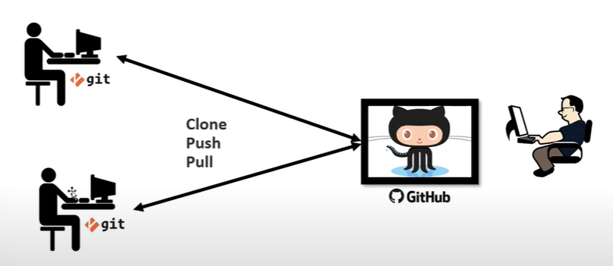

Slide 18
How to work with remote repo through eclipse and intellij IDE

