Slide 1
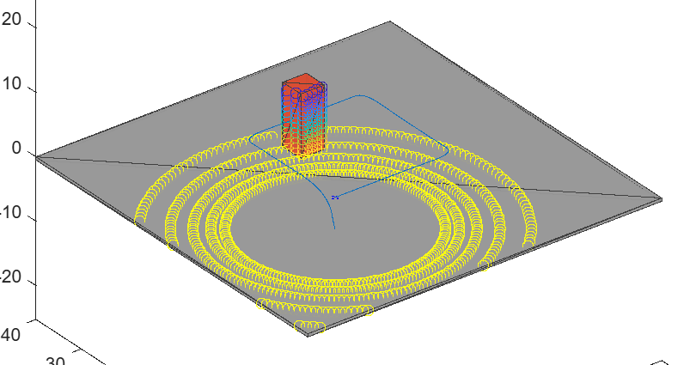




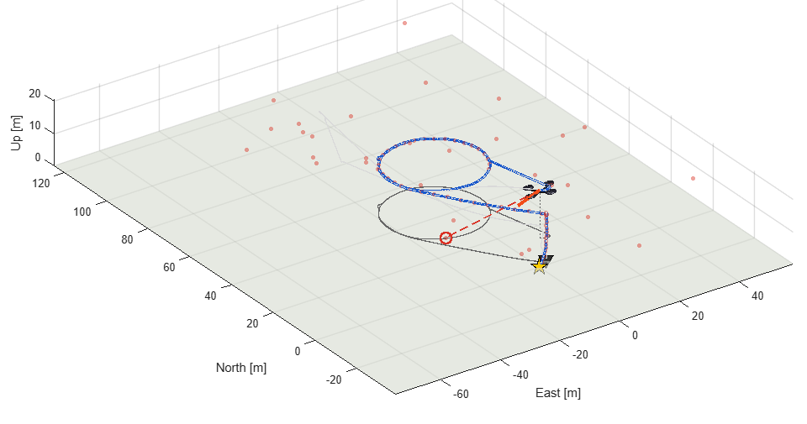


UAV Toolbox: capabilities overview
Design, simulate, test and deploy drone, UAV and advanced air mobility applications, from first model to flight log.
Reference applications
Prebuilt, customizable models to start a project, e.g. VTOL controller tuning and a multirotor delivery mission.
Scenario simulation
Author scenarios with meshes and sensor models, generate synthetic data, view in 3D or Unreal Engine.
Autonomy algorithms
Missions for fixed-wing and multirotor UAVs: waypoint following, orbit following and custom path planning.
PX4 deployment and HIL
Design flight controllers, deploy to Pixhawk / PX4 autopilots, and validate hardware-in-the-loop.
In the workflow: UAV Scenario, stage 3
Flight log analysis
Flight Log Analyzer app imports TLOG, ULOG and ArduPilot logs, with predefined and custom plots.
MAVLink connectivity
Talk to UAVs and ground stations over MAVLink: telemetry, mission upload and parameter tuning.
In the workflow: flight log playback
Works with PX4 · ArduPilot · Pixhawk · MAVLink · Unreal Engine · Simulink and Embedded Coder · Source: mathworks.com/products/uav
Notes:
UAV Toolbox overview, the opening page. UAV Toolbox provides tools and reference applications to design, simulate, test and deploy drone, UAV and advanced air mobility applications. Six capability areas: reference applications (for example VTOL controller tuning and a multirotor package delivery mission); UAV scenario simulation with sensor models, synthetic data and Unreal Engine visualization; autonomy algorithms such as waypoint following, orbit following and path planning; controller deployment to Pixhawk and PX4 with hardware-in-the-loop testing; flight log analysis with the Flight Log Analyzer app (TLOG, ULOG, ArduPilot dataflash); and MAVLink connectivity to UAV hardware and ground control stations. The two pictures are from this workflow: the stage 3 UAV Scenario and the flight log playback. Source: mathworks.com/products/uav.

Slide 2




UAV guidance workflow: four-stage overview
A staged Simulink build. Each stage keeps its own model, so every new capability is compared against the one before it.
Done
Done
Done
Next
1. Step response
2. Waypoints
3. Scene + lidar
4. Avoidance
Multirotor Guidance Model from hover. Step roll, pitch, yaw rate and thrust one at a time; plot command vs. response.
Waypoint Follower + position/yaw controller close the loop. 20 m square at 5 m altitude, viewed in UAV Animation.
Same mission in a UAV Scenario with a 10 m building on the path. Lidar and Scenario Scope; clearance measured.
Add a lidar-based Obstacle Avoidance block. Re-run the same scene and mission, compare against stage 3.
0.06 s
0.00 m
−2.0 m
> 0.6 m
roll / pitch rise time, 0 % overshoot
final error, hovers on last waypoint
clearance: flies through the building
target clearance (UAV radius)
Toolchain MATLAB R2026a · Simulink · UAV Toolbox (Guidance Model, Waypoint Follower, UAV Scenario, Lidar) · NED frame throughout the plant
Notes:
Overview of the staged UAV workflow. Stages 1 to 3 are built and verified: step response, closed-loop waypoint following with UAV Animation, and the same mission in a UAV Scenario with a building on the path, where the baseline flies through the obstacle (minimum clearance -2.0 m). Stage 4 adds lidar-based obstacle avoidance and is compared against stage 3 on the same scene and mission.

Slide 3
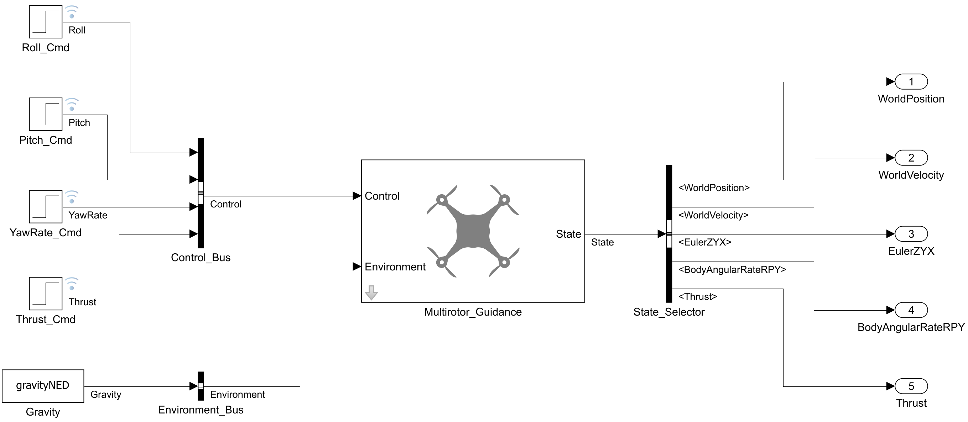
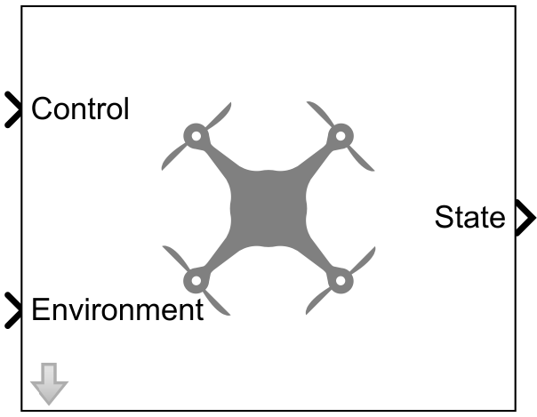
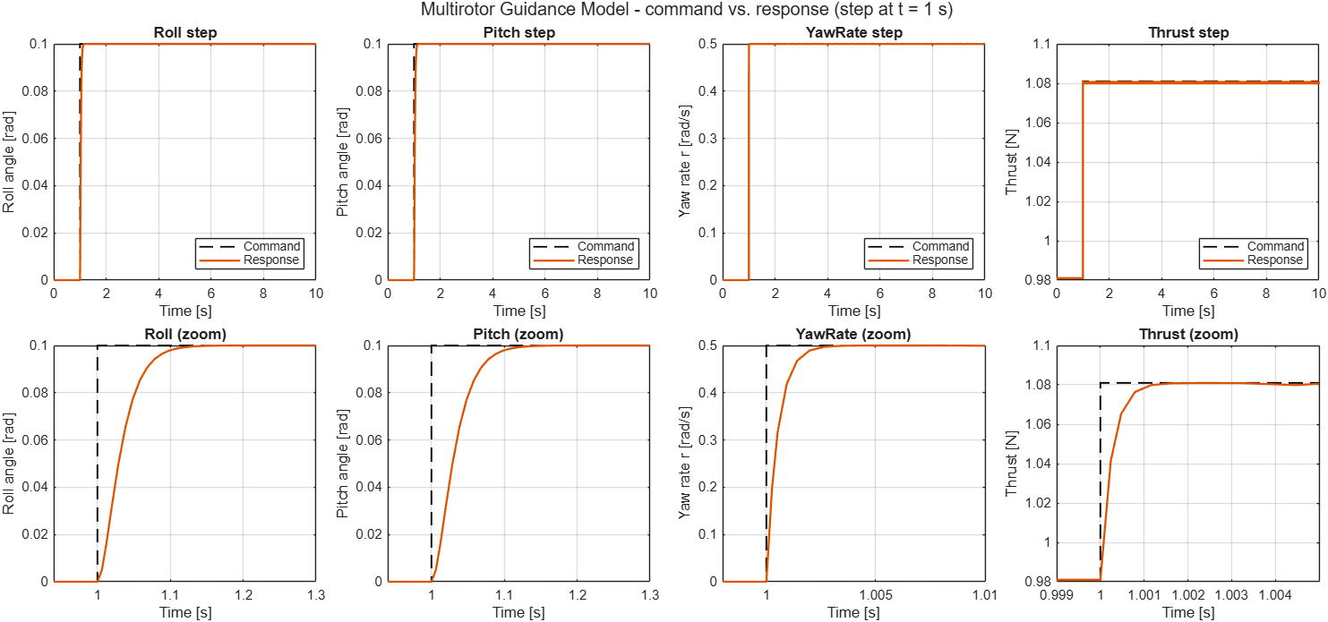
Stage 1 · Step response
Open-loop test of the reduced-order multirotor plant, starting from hover (NED frame).
Simulink model · UAV_GuidanceStepResponse.slx
Key Simulink block
Guidance Model
UAV Toolbox · Algorithms library
Reduced-order, closed-loop UAV model: takes autopilot-level commands and returns the vehicle state, so guidance and missions simulate fast.
Result: command (dashed) vs. response for each input
Multirotor or fixed-wing model type
In: roll, pitch, yaw rate, thrust (+ gravity)
Out: NED position, velocity, Euler ZYX, body rates
Tunable mass, gains and initial state
0.06 s
roll / pitch rise time, 0 % overshoot
Notes:
Stage 1 · Step response. Model: UAV_GuidanceStepResponse.slx. Open-loop test of the reduced-order multirotor plant, starting from hover (NED frame). Guidance Model: Reduced-order, closed-loop UAV model: takes autopilot-level commands and returns the vehicle state, so guidance and missions simulate fast. Multirotor or fixed-wing model type; In: roll, pitch, yaw rate, thrust (+ gravity); Out: NED position, velocity, Euler ZYX, body rates; Tunable mass, gains and initial state. Key result: 0.06 s, roll / pitch rise time, 0 % overshoot.

Slide 4
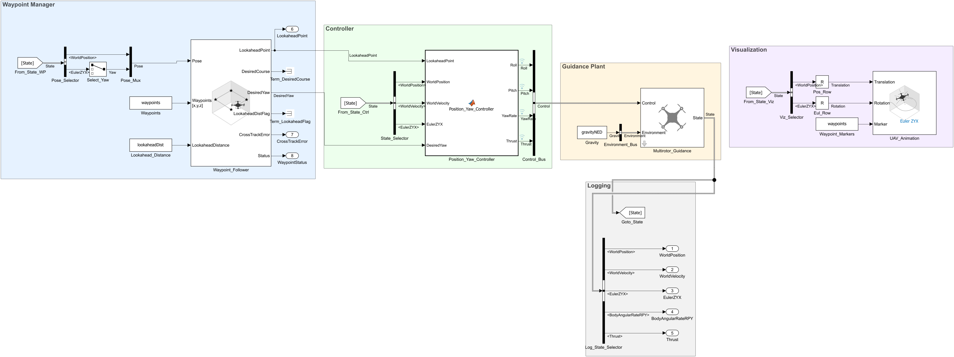
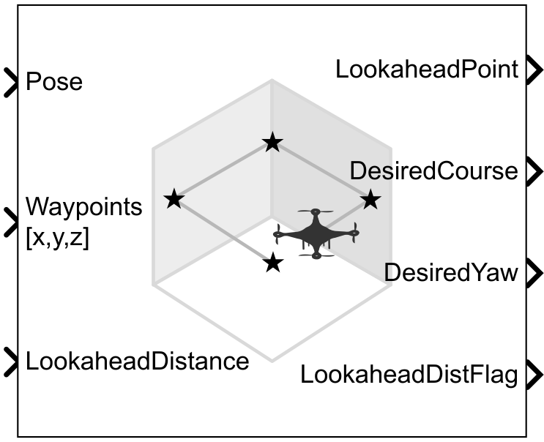
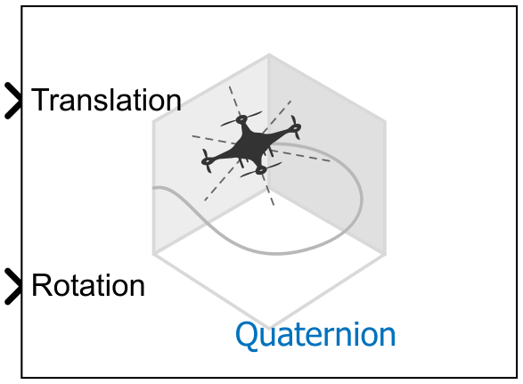
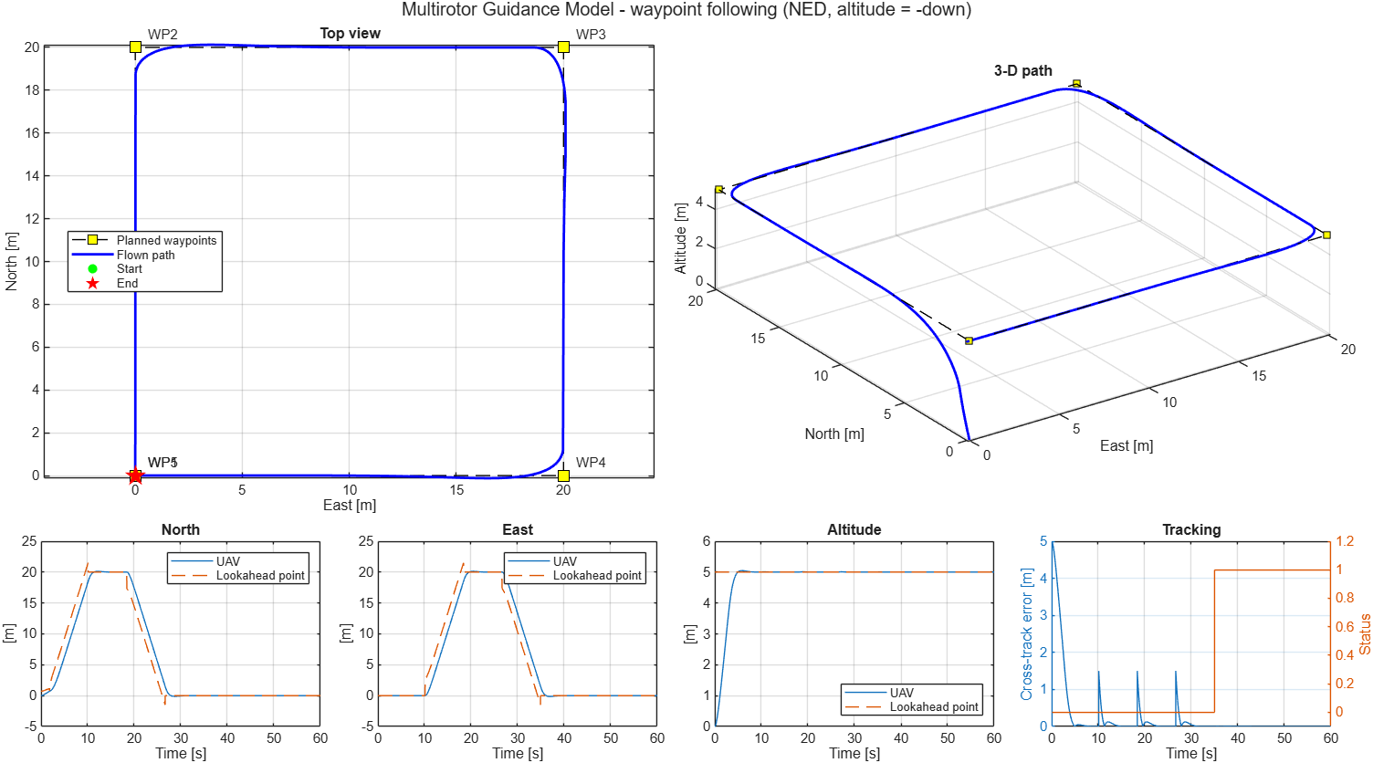
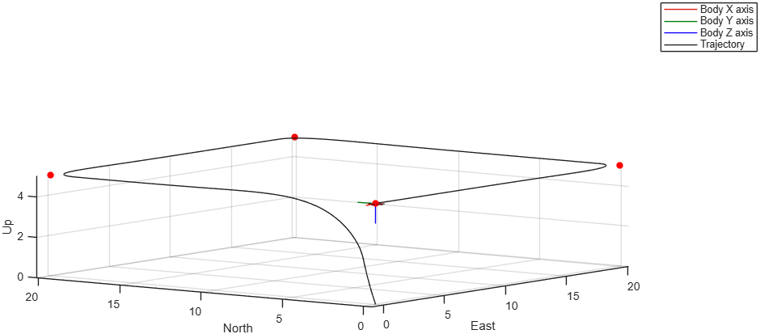
Stage 2 · Waypoint following
Closed loop: the Waypoint Follower drives a position/yaw controller; UAV Animation shows the flight.
Simulink model · UAV_GuidanceWaypointFollowing.slx · Waypoint → Controller → Plant → Visualization
Key Simulink blocks
Waypoint Follower
Tracks a waypoint list by chasing a lookahead point on the path.
Out: lookahead point, desired course and yaw
Optional cross-track error and mission status
Transition radius, hover at last waypoint
UAV Animation
Lightweight 3-D view of UAV position and attitude while it runs.
Result: 20 m square at 5 m altitude, and the UAV Animation view
Rotation as quaternion or Euler ZYX
NED or ENU axes, multiple UAVs
Waypoint markers; no scene or meshes needed
0.00 m
final error; all waypoints done at 34.9 s
Notes:
Stage 2 · Waypoint following. Model: UAV_GuidanceWaypointFollowing.slx. Closed loop: the Waypoint Follower drives a position/yaw controller; UAV Animation shows the flight. Waypoint Follower: Tracks a waypoint list by chasing a lookahead point on the path. Out: lookahead point, desired course and yaw; Optional cross-track error and mission status; Transition radius, hover at last waypoint. UAV Animation: Lightweight 3-D view of UAV position and attitude while it runs. Rotation as quaternion or Euler ZYX; NED or ENU axes, multiple UAVs; Waypoint markers; no scene or meshes needed. Key result: 0.00 m, final error; all waypoints done at 34.9 s.

Slide 5
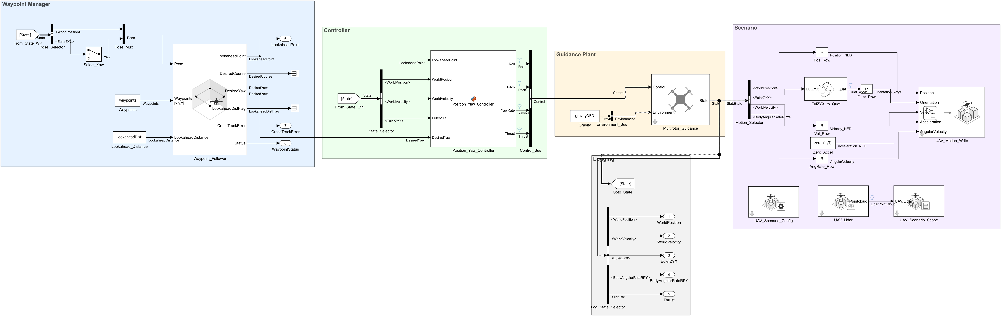
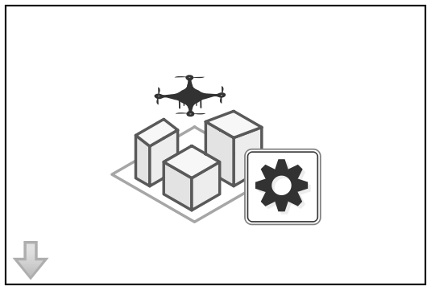
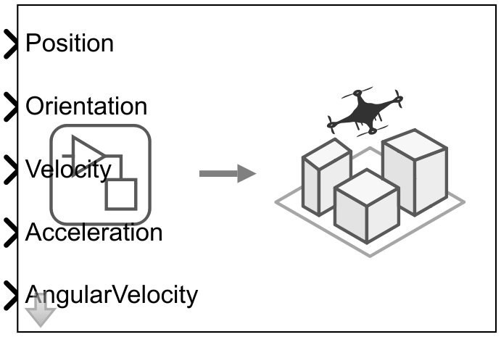
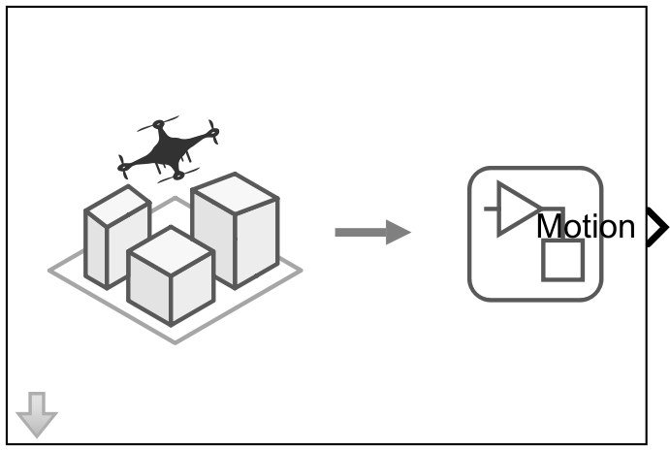
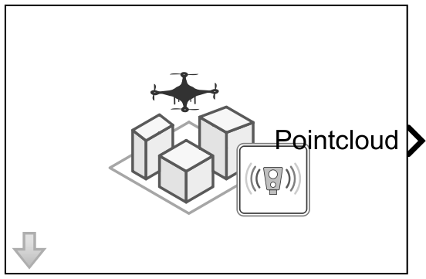
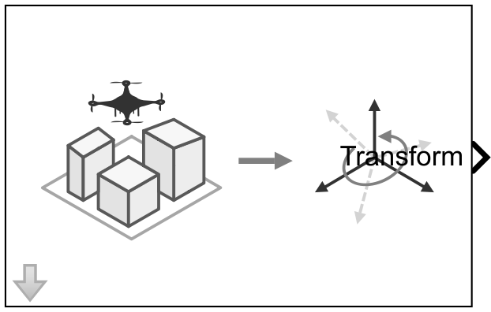
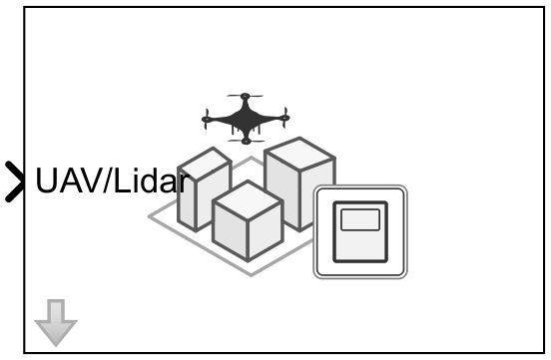
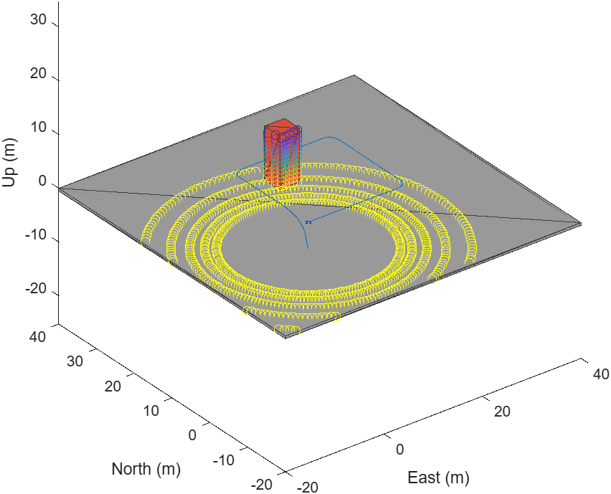
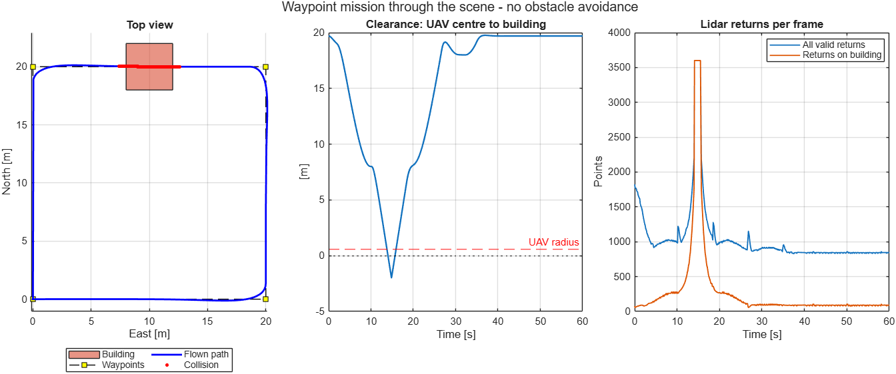
Stage 3 · Scene + lidar
Same mission inside a UAV Scenario, with a 10 m building on the WP2 → WP3 leg.
Simulink model · UAV_GuidanceWaypointScenario.slx · Waypoint → Controller → Plant → Scenario
UAV Scenario blocks
Run a uavScenario (meshes, platforms, sensors) with the model. Configuration loads the scene; the others move platforms, read motion, simulate sensors and visualize it.
Configuration
Motion Write
Motion Read
Result: Scenario Scope view, and clearance to the building
Lidar
Get Transform
Scope
Bold = used in this model
−2.0 m
clearance: collision 13.8–15.9 s (no avoidance yet)
Notes:
Stage 3 · Scene + lidar. Model: UAV_GuidanceWaypointScenario.slx. Same mission inside a UAV Scenario, with a 10 m building on the WP2 → WP3 leg. Run a uavScenario (meshes, platforms, sensors) with the model. Configuration loads the scene; the others move platforms, read motion, simulate sensors and visualize it. Blocks: Configuration, Motion Write, Motion Read, Lidar, Get Transform, Scope. Key result: −2.0 m, clearance: collision 13.8–15.9 s (no avoidance yet).

Slide 6



Flight log analysis demo: prompt overview
Two plain-language prompts take a raw PX4 telemetry log to an explained, replayable flight.
Done
Done
Objective
1. Log analysis
2. Playback
Ask in plain language what happened to the UAV; get an engineering answer back
The agent writes and runs MATLAB itself through MATLAB MCP and UAV Toolbox
Leave reviewable outputs: timeline, health check, anomaly, plot and playback
Reads Sample_Log.tlog with UAV Toolbox, rebuilds the flight timeline, checks vehicle health and flags anomalies.
Writes a MATLAB script that replays the flight in 3D with synchronized telemetry panels, exported as MP4.
14.6
4×
EKF position test ratio: GPS glitch 79–137 s
playback speed; 40 s MP4, 3D view + telemetry
Input Sample_Log.tlog · PX4 quadrotor, 184 s, 15,068 MAVLink messages · MATLAB R2026a · UAV Toolbox · MATLAB MCP Server
Notes:
Flight log analysis demo: prompt overview. Objective: ask the agent in plain language what happened to the UAV and get an engineering answer back. The agent writes and runs MATLAB itself through the MATLAB MCP Server and UAV Toolbox, and leaves reviewable outputs: timeline, health check, anomaly, plot and playback. Step 1, log analysis: reads Sample_Log.tlog (PX4 quadrotor, 184 s, 15,068 MAVLink messages) and finds an OFFBOARD mission, a GPS glitch between 79 and 137 s (EKF horizontal position test ratio up to 14.6), a pilot takeover in POSCTL and a kill-switch landing. Step 2, playback: a MATLAB script replays the flight in 3D at 4x speed with synchronized altitude, speed and GPS-health panels, exported as a 40 s MP4.

Slide 7
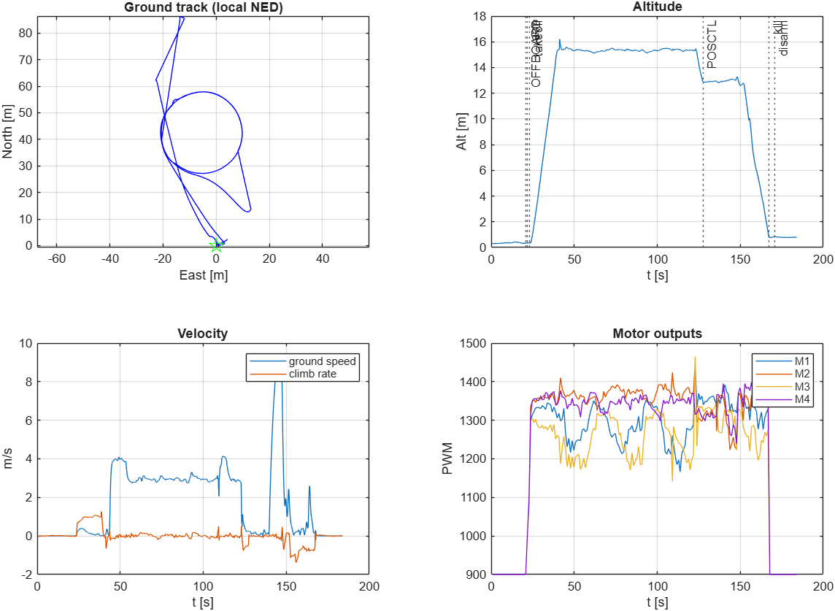
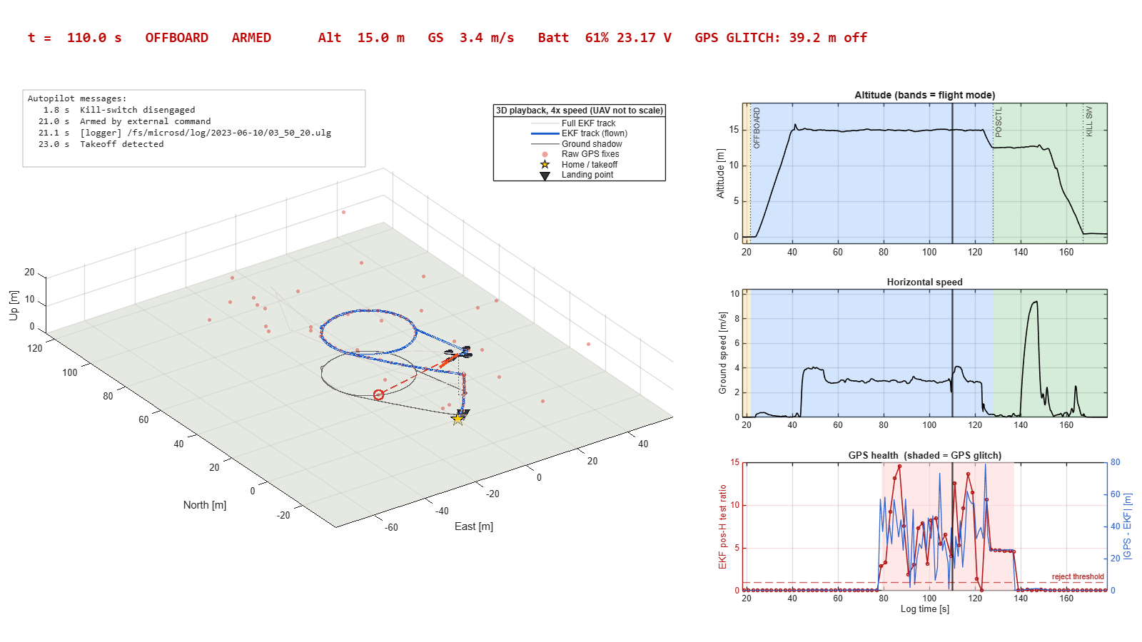
Prompt steps and key functions
Each step is one prompt; the agent chooses the MCP tool and the UAV Toolbox functions on its own.
Prompt 1 ~2 min 15 s
“Please help me analyze this log: what happened to the UAV, as an overview?” + Sample_Log.tlog
Prompt 2 ~5 min + 8 min render
“Could you create the playback animation for us?” then “…speed playback x4”
Key functions
mavlinkdialect
mavlinktlog
readmsg
AvailableTopics
bitshift
exportgraphics
MCP tool
evaluate_matlab_code
Key functions
stlread
hgtransform
eul2rotm
scatter3
VideoWriter
writeVideo
MCP tool
evaluate_matlab_code
What the agent does
Lists 35 message types; merges MAVLink v1/v2 tables
Decodes arming, PX4 modes and status text into a timeline
Checks track, battery, GPS vs EKF, vibration and motors
Flags the GPS glitch and saves the overview plot (left)
What the agent does
Writes work/create_sample_log_playback.m
Renders a preview still, then fixes the layout
Renders the MP4 in a separate matlab -batch run
4x speed, 1,201 frames: a 40 s MP4 at 1600x900
Pattern read and decode the log → explain → visualize; long renders run in matlab -batch, outside the MCP call timeout
Notes:
Prompt steps and key functions. Prompt 1 (about 2 min 15 s): mavlinkdialect and mavlinktlog open the log, readmsg reads each message type (merging MAVLink v1 and v2 tables), bitshift decodes the PX4 custom_mode into flight modes, and exportgraphics saves the overview plot shown: ground track, altitude with flight events, velocity and motor outputs. Prompt 2 (about 5 min plus an 8 min render): the agent writes work/create_sample_log_playback.m using stlread for the multirotor mesh, hgtransform and eul2rotm for attitude, scatter3 for raw GPS fixes, and VideoWriter/writeVideo for the MP4. The snapshot is taken at t = 110 s, during the GPS glitch. The full render runs in a separate matlab -batch process with a hidden figure because it takes longer than the MCP request timeout.

