Slide 1
2022届本科毕业论文（设计）
Class of 2022 Undergraduate Thesis
Design and Implementation of Face Recognition System Based on Convolutional Neural Network (CNN)
Major: Computer Science and Technology Name: Touhidur Rahman

Slide 2
Abstract of the Thesis
Face recognition is one of the crucial corridors of active exploration areas and also refers to a biometric point that has an expansive range of operations similar to identity operation and security and it’s a big part of computer vision and security. The process of learning good features for machine learning operations can be truly computationally precious and may prove delicate in cases where little data is available. Basically in this research paper, we explore a particular system for learning siamese neural networks which serve a unique structure to naturally rank parallels between inputs. A convolutional neural network was designed and constructed, and the model was trained on its own data set and also data set collected from the internet. The delicacy rate attained on the test set was 97.63. Eventually, the trained model was applied to the factual system. The system model is simple, occupies a small amount of memory, and can fast and accurately detect and recognize human faces.

Slide 3
Research Background
The proposed research has shown the implementation state of art face recognition methods and compared them. The benefit of Siamese CNN are explored for the face recognition task by [3] W. Cui, W. Zhan, J. Yu, C. Sun, and Y. Zhang.
Authors of [7] have used Weighted PCA-EFMNet deep-learning feature extraction method to solve problems related to changes in expression, position, illumination and obstruction.
Authors of [8] have proposed a part-based learning method for face verification, in which feature representation is extracted by convolutional fusion network (CFN).
The authors have trained over four thousand individuals to perform face recognition. The work explored the Siamese network and optimized the L1-distance between two face features. by [10] Y. Sun, Y. Chen, X. Wang, and X. Tang,

Slide 4
Research significance
In case of standard classification, the input image is fed into a series of layers, and finally at the output we generate a probability distribution over all the classes.
For example, if we are trying to classify an image as cat or dog or horse or elephant, then for every input image, we generate 4 probabilities, indicating the probability of the image belonging to each of the 4 classes.
Two important points must be noticed here. First, during the training process, we require a large number of images for each of the class (cats, dogs, horses and elephants). Second, if the network is trained only on the above 4 classes of images, then we cannot expect to test it on any other class.

Slide 5
Research significance
If we want our model to classify the images of zebra as well, then we need to first get a lot of zebra images and then we must re-train the model again
There are applications wherein we neither have enough data for each class and the total number classes is huge as well as dynamically changing. Thus, the cost of data collection and periodical re-training is too high.
On the other hand, in a one shot classification, we require only one training example for each class. Yes, just one. Hence the name One Shot.

Slide 6
Research Method
The one specifically intriguing task is a bracket under the constraint that we may only observe a single illustration of each possible class before prognosticating a test case. This is called one-shot literacy, and this paper uses the Siamese convolutional Neural Network for One-short face recognition.
In the paper on Siamese convolutional neural network for one-shot face recognition, we are using three-part of images the anchor image, the positive image, and the negative image, and training the CNN model with these three types of images to learn the pattern of the faces, then recognize the face using the trained CNN using one-short method model.

Slide 7
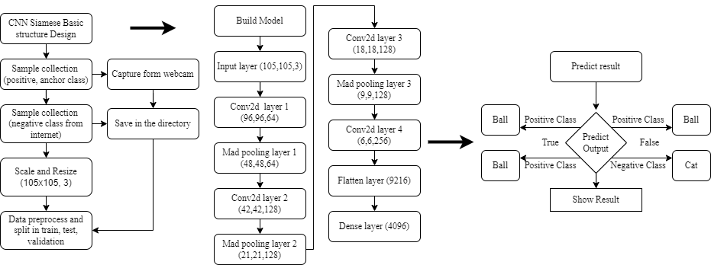
System Functional Structure Design

Slide 8
use of tools or techniques
These are the tools that used in this thesis:
Windows 10 operating system
Lenovo Idea pad, core i5 11th gen laptop
TensorFlow machine learning framework
Anaconda Environment with Jupiter lab/notebok

Slide 9
use of tools or techniques
These are the techniques that used in this thesis:
Siamese convolutional neural network
One short Image capture technique

Slide 10
System Implementation
Overall states:
Topic | Start status | End status
Epoch | 1 | 50
Loss | 0.2126203179359436 | 9.872399459709413e-06
Recall | 0.7819225192070007 | 1.0
Precision | 0.9909090995788574 | 1.0
Time | 68s 349ms/step | 64s 365ms/step

Slide 11
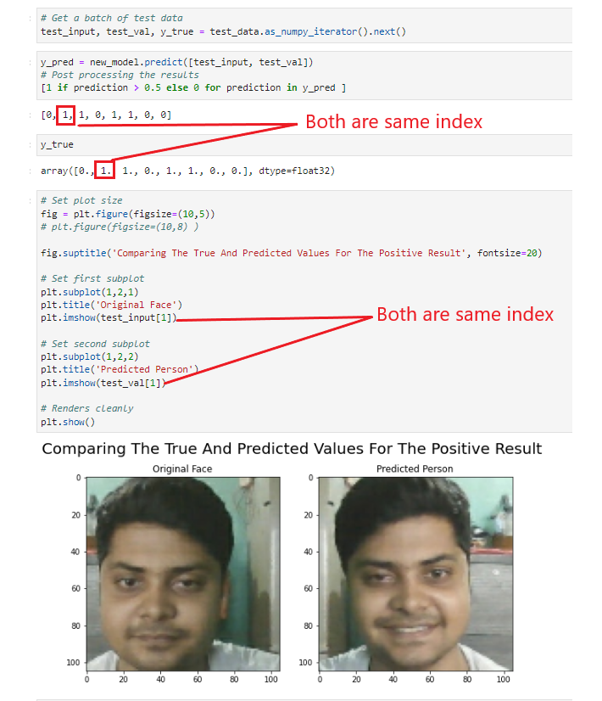
Experimental Result
Positive result:

Slide 12
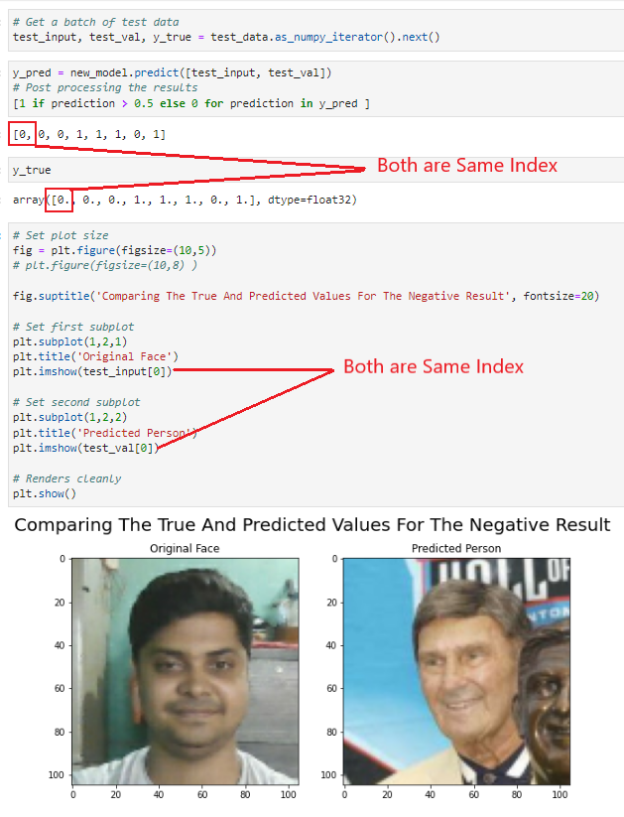
Experimental Result
Negative result:

