Slide 1

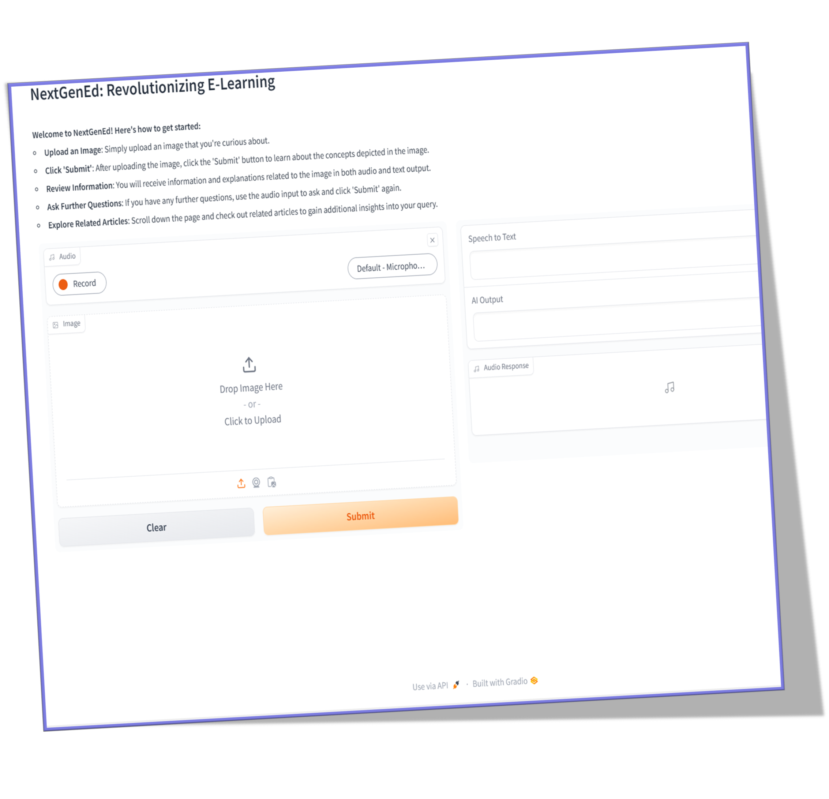
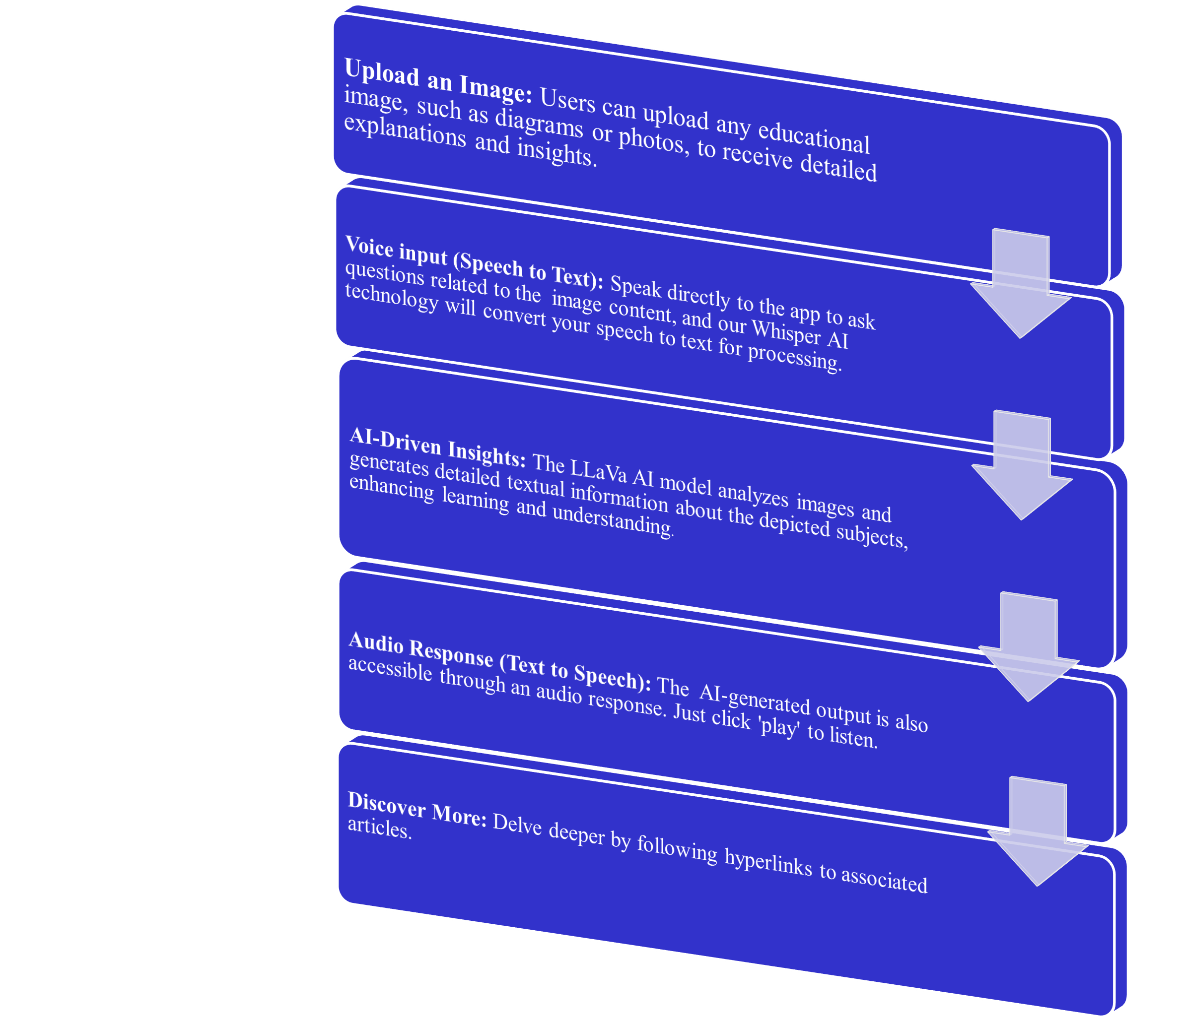
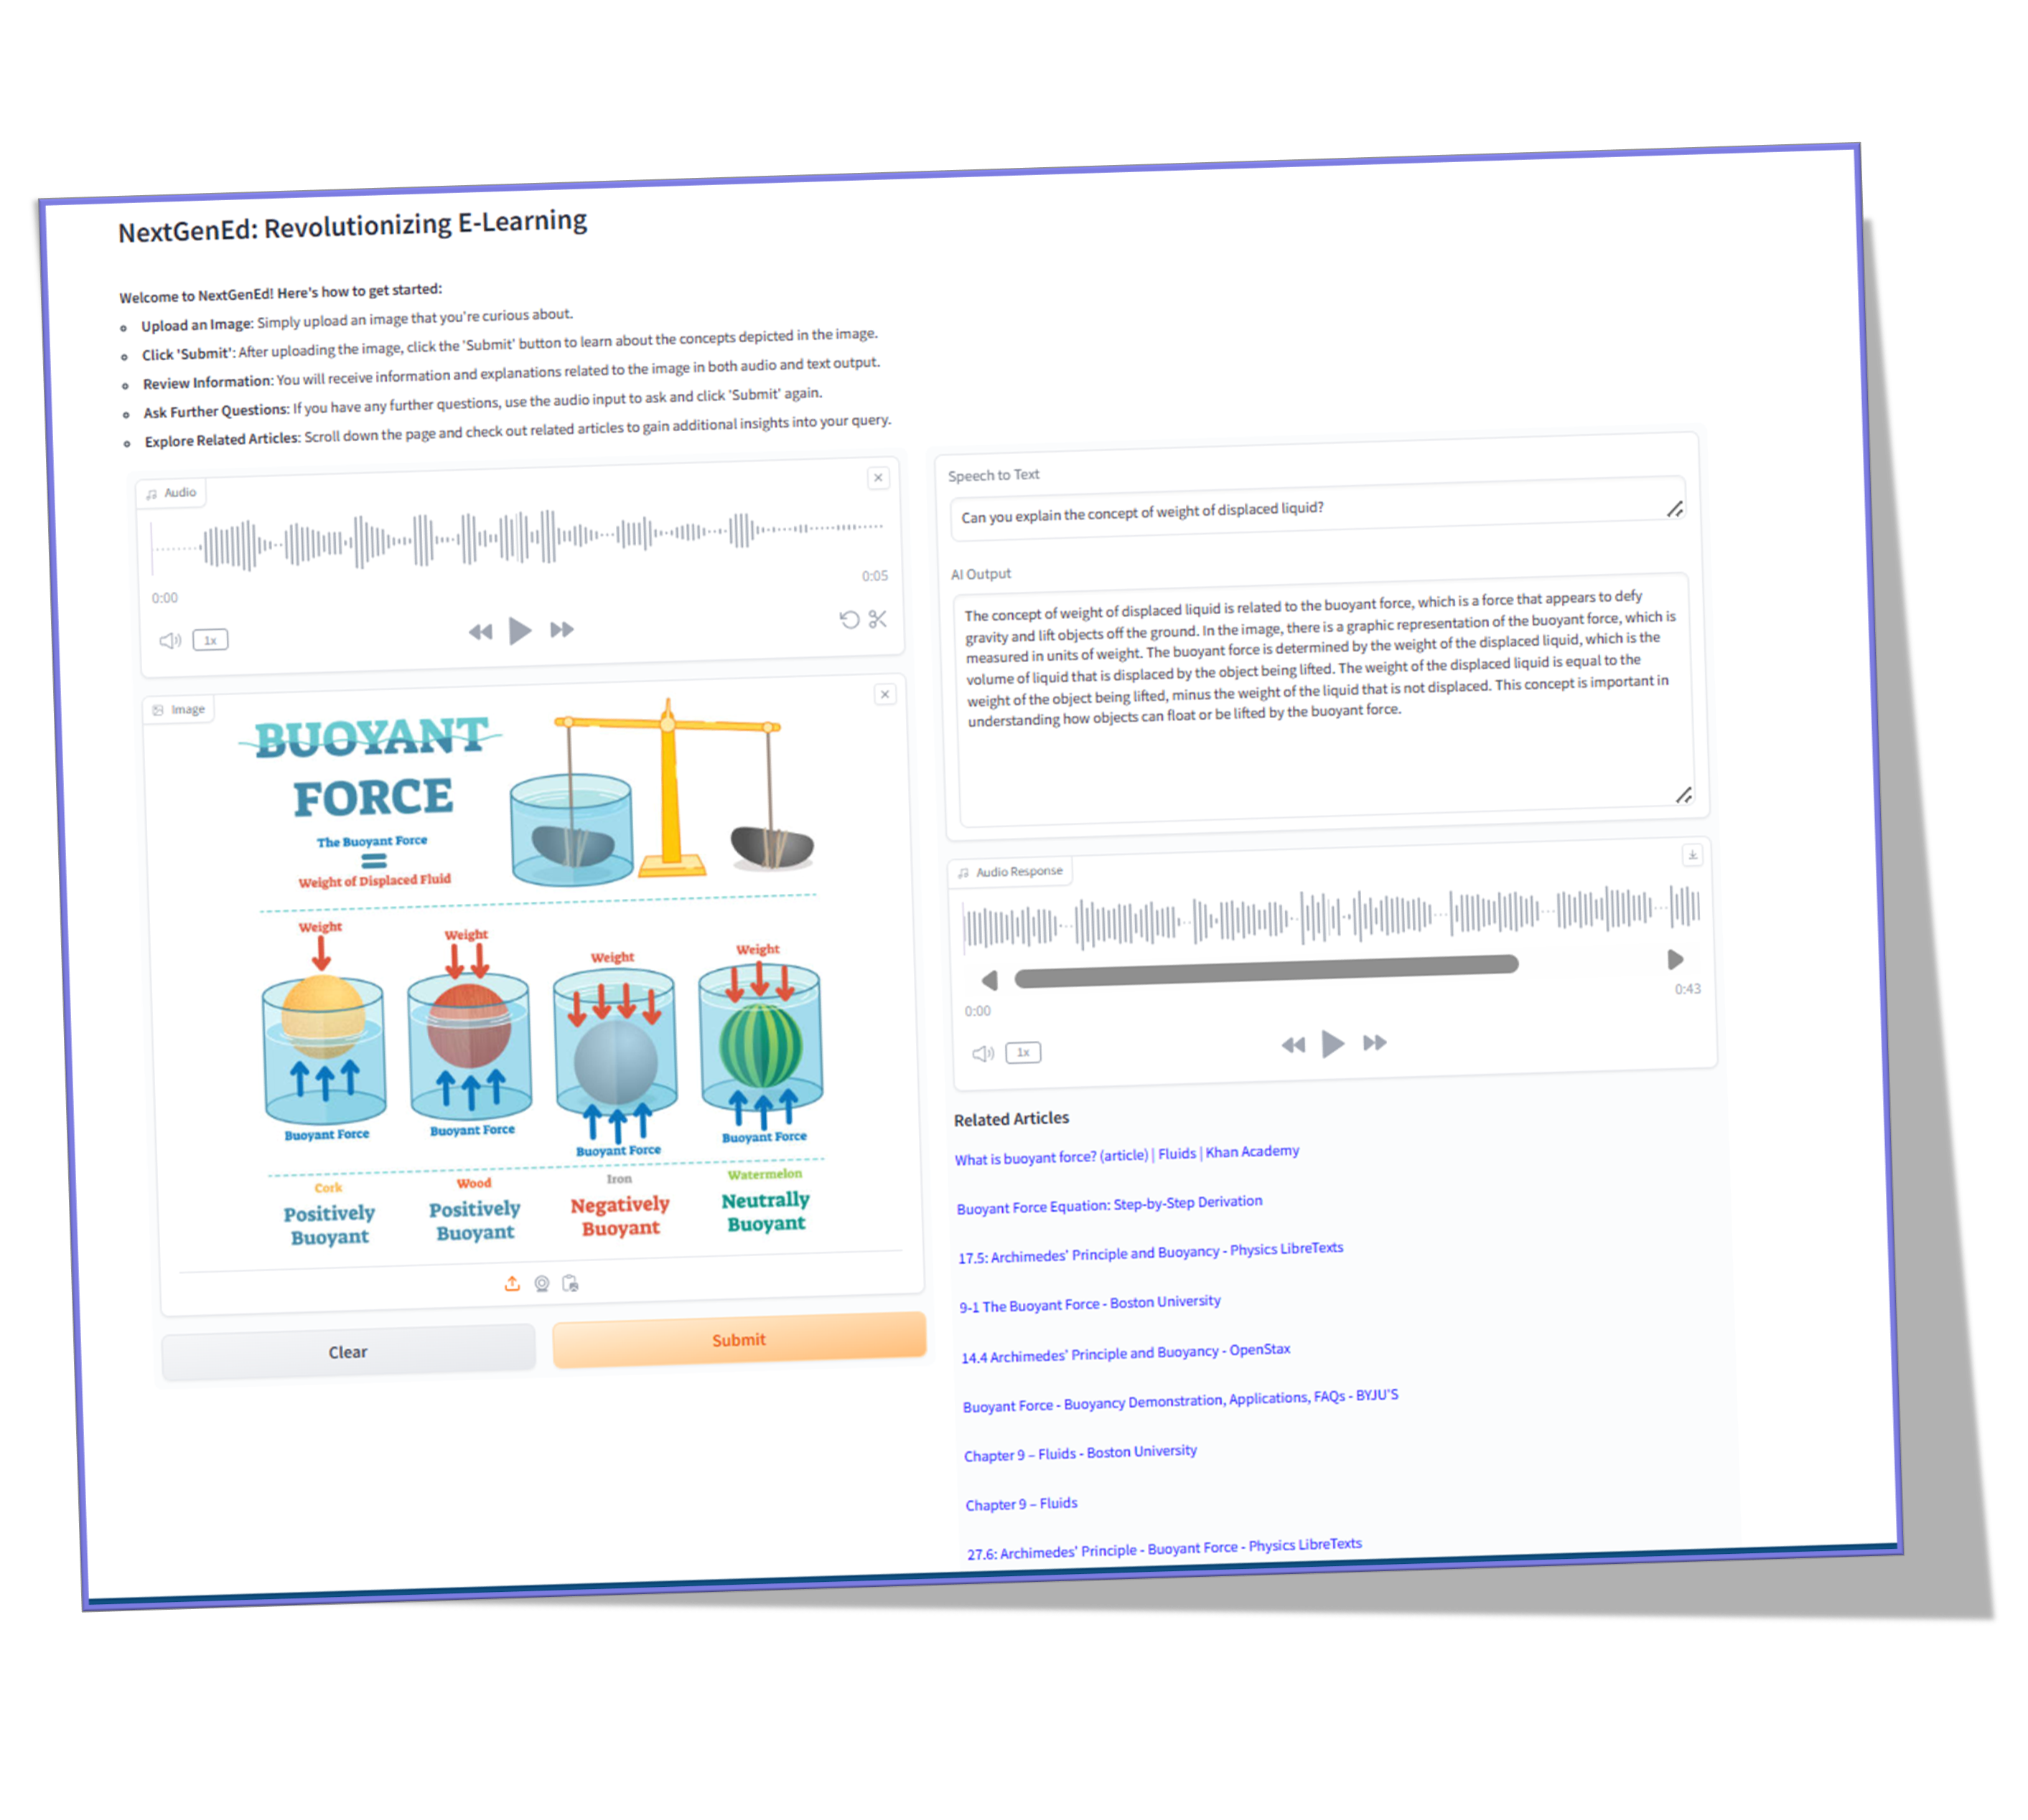
 | NextGenEd: Revolutionizing E-Learning Ruchika Arora (student NMIT, s4683671) Supervisor: Dr. Alex (Wenjie) Ye College of Engineering and Science Sponsor: Dr. Alex (Wenjie) Ye, Victoria University
 | JOIN ON THE FOREFRONT OF EDUCATIONAL TECHNOLOGY! TRY! NEXTGENED: REVOLUTIONIZING E-LEARNING

