Slide 1
AI-Powered Smart Support Assistant for Internal Organisational Support
Using Microsoft Copilot Studio, Power Automate, Excel Online, and Outlook V2 Email Workflows
Prototype Demonstration

Slide 2
Overview
Smart Support Assistant is an internal workplace support agent that helps employees with HR, IT, Admin & Facilities, Security & Compliance, Payroll, Benefits, and Onboarding questions.
It supports policy guidance, support ticket creation, ticket status lookup, and urgent callback escalation through Power Automate and Outlook V2 email workflows.
The assistant uses only the approved internal knowledge base for policy responses and follows safety, privacy, compliance, and fallback guardrails.

Slide 3
Key Features
AI-powered internal support assistant using Microsoft Copilot Studio
Guided conversational workflows for employee support requests
Internal policy assistance using a knowledge-grounded knowledge base
Structured support ticket creation with automatic ticket ID generation
Ticket status tracking using ticket ID or employee details
Official company email validation and input checking

Slide 4
Key Features
Outlook V2 email workflow integration for escalation notifications
Excel Online integration for ticket storage and retrieval
Multi-turn conversational support experience
Feedback and rating collection workflow
Fallback handling for unsupported or unclear queries
Conversation-based evaluation testing with 100% quality scores across key workflows

Slide 5
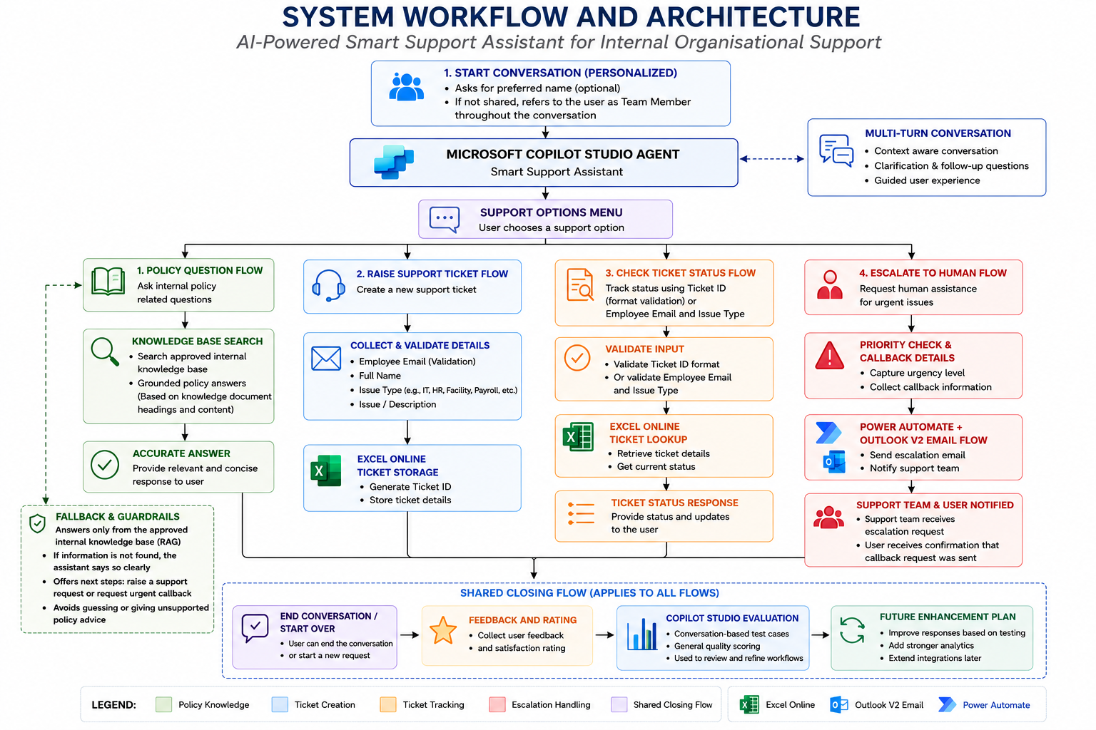

Slide 6
Working Demonstrations (screenshots) are in the following slides:
Note: Employees can directly choose support ticket creation, ticket status lookup, or human escalation workflows from the beginning as needed.
However, the demonstration scenarios assume employees first attempt self-service support through knowledge-grounded conversational assistance before progressing to support ticket or escalation workflows if additional help is required.

Slide 7
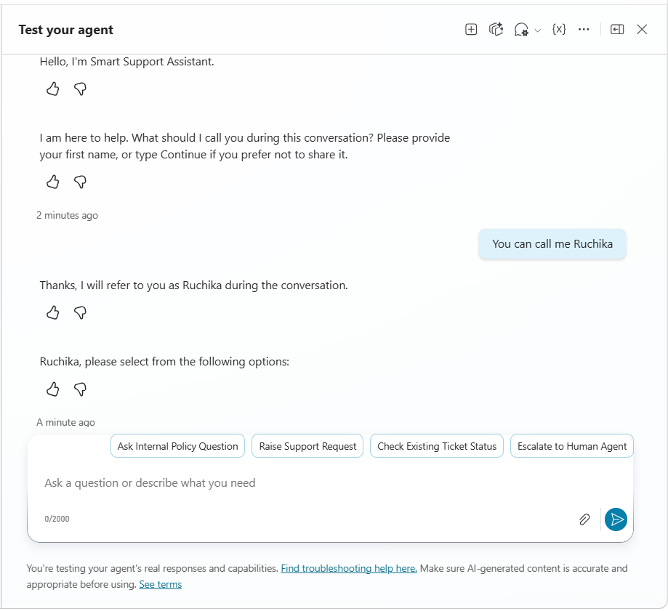
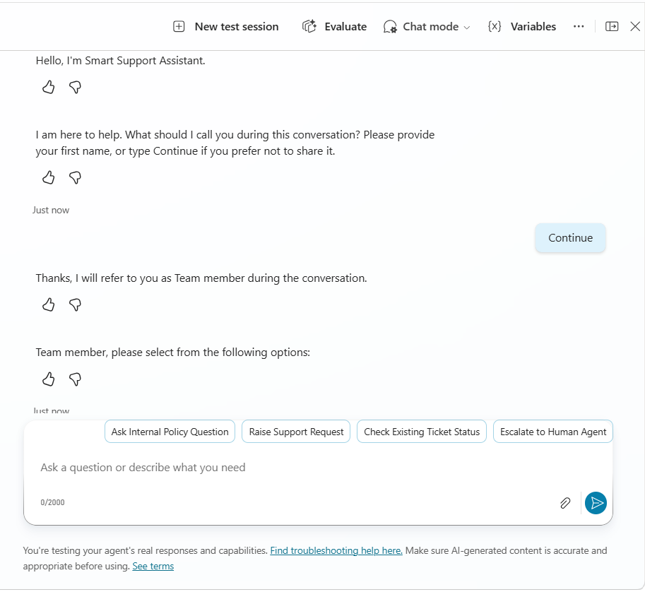
Personalised Greeting to Support Options flow
The assistant personalises the interaction by optionally collecting a preferred name before routing employees to policy questions, ticket creation, ticket status lookup, or human escalation workflows.

Slide 8
Demonstration - 1
Internal Policy Question Workflow
The employee asks an internal payroll policy question through the conversational support assistant. After receiving a grounded response from the approved knowledge base, the employee asks another question related to their individual payroll update status, which the assistant cannot access. The assistant then offers support ticket creation, validates employee input details, generates a ticket ID, validates ticket ID formats during status lookup, and allows the employee to check ticket status before ending the conversation.

Slide 9
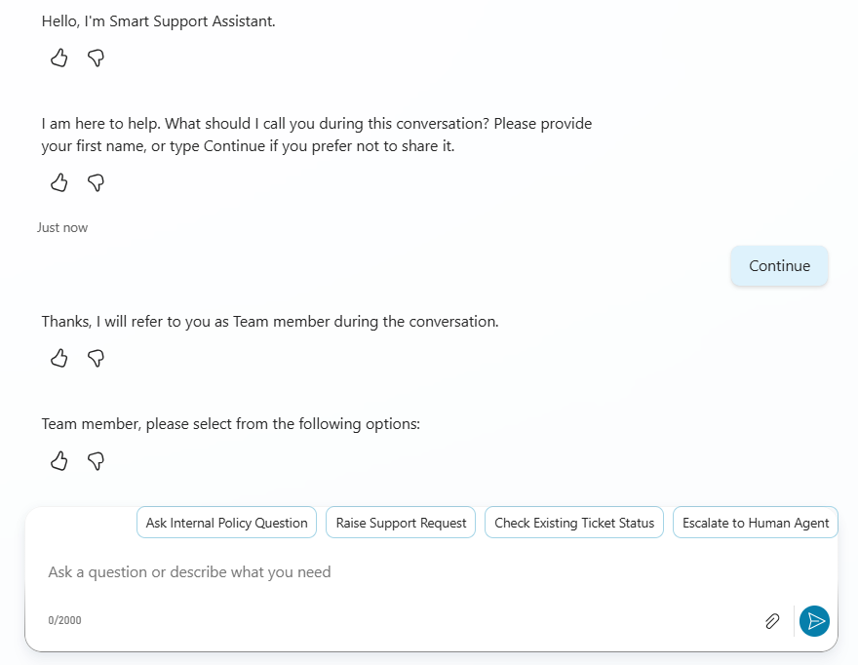
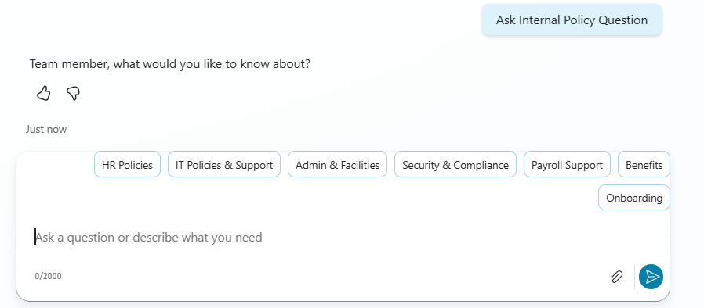
Greeting and Policy Question Flow (Question Selection)
The employee selects the relevant support category and submits a payroll policy question through the assistant.

Slide 10
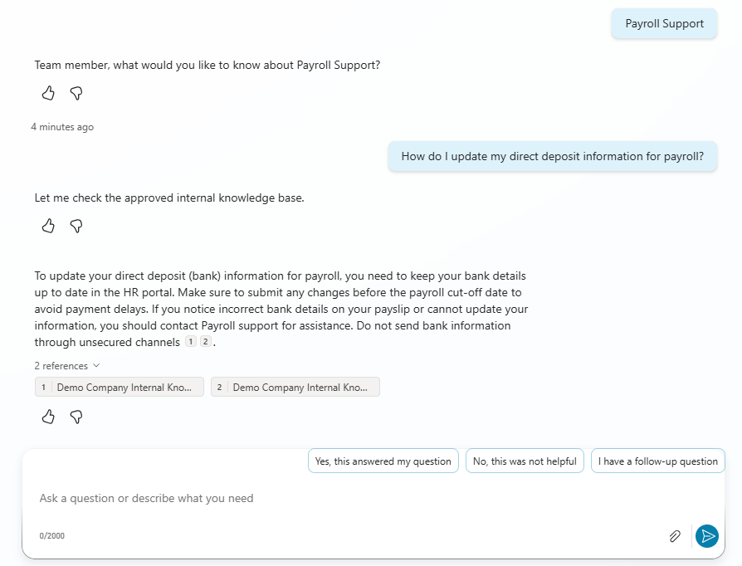
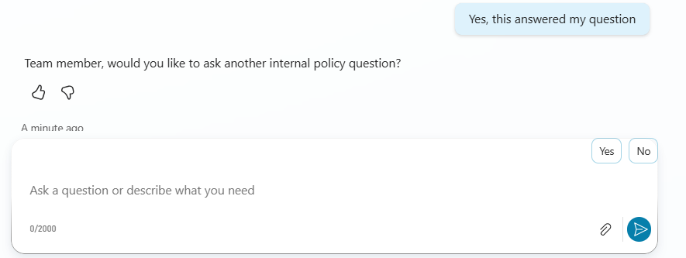
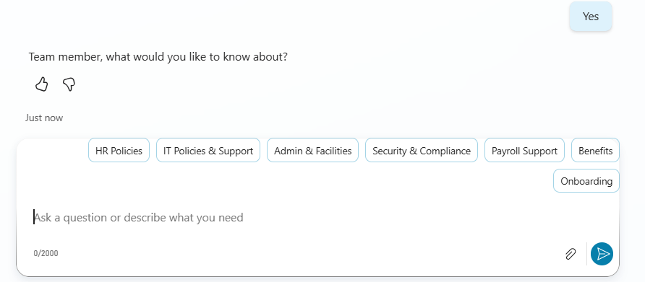
Knowledge-Base Answer Found
The assistant retrieves a grounded answer from the approved internal knowledge base about updating payroll bank details and asks whether the response was helpful before continuing the conversation.

Slide 11
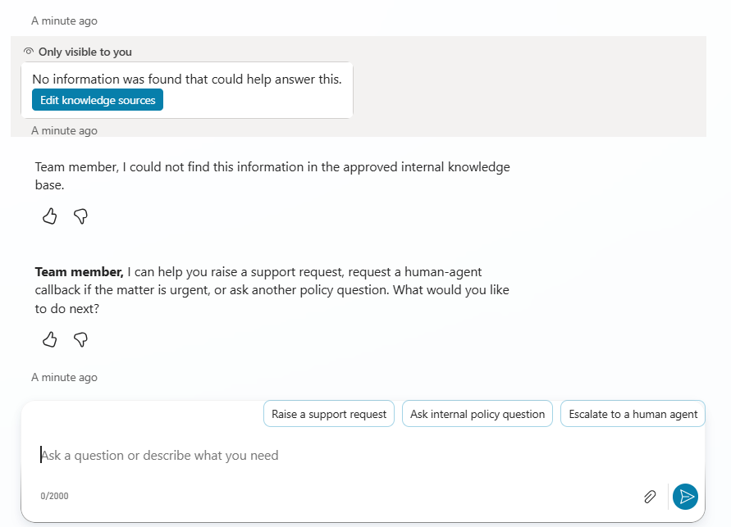
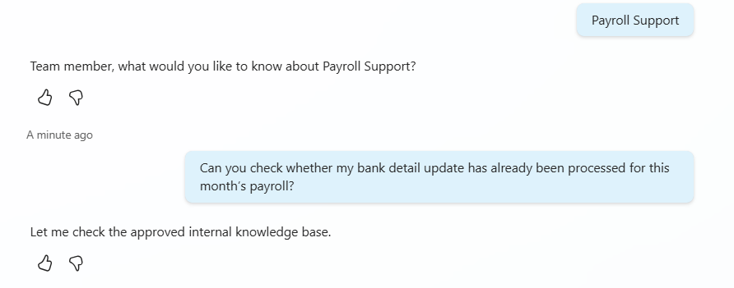
Policy Question Flow (Another Question Selection)
The employee asks whether their specific bank detail update has been processed, which the assistant cannot verify from the approved knowledge base and therefore offers additional support options.

Slide 12
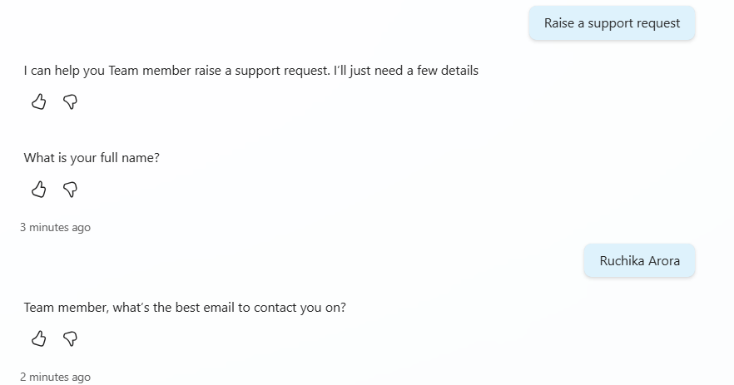
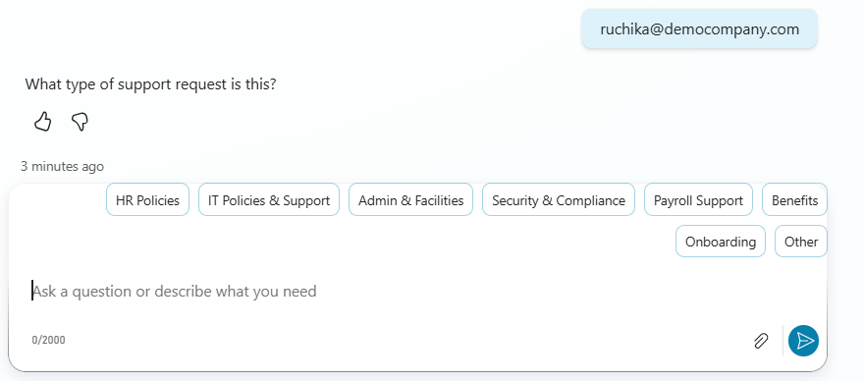
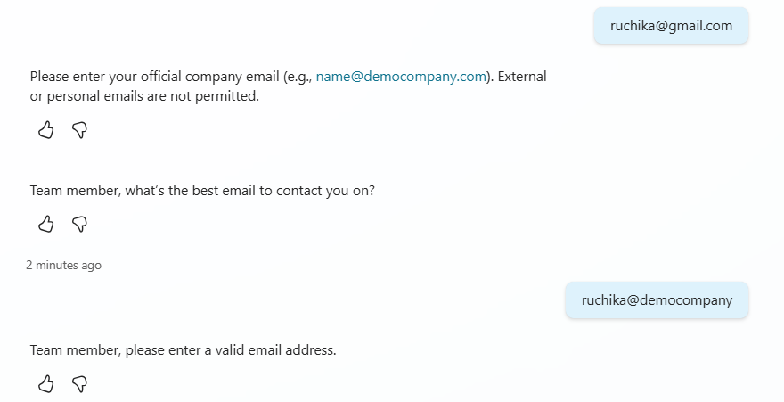
Support Ticket Creation: Employee Details & Email Validation
The employee chooses to raise a support request and provides the required details. The assistant collects the employee name, validates the official company email, captures the issue type and description, for ticket generation.

Slide 13
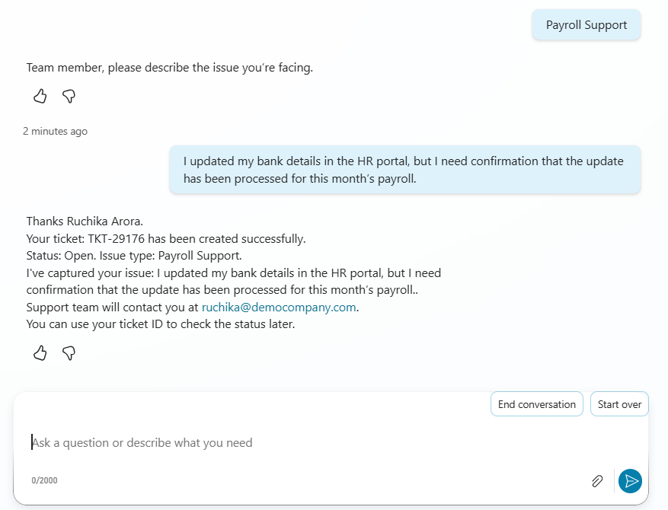
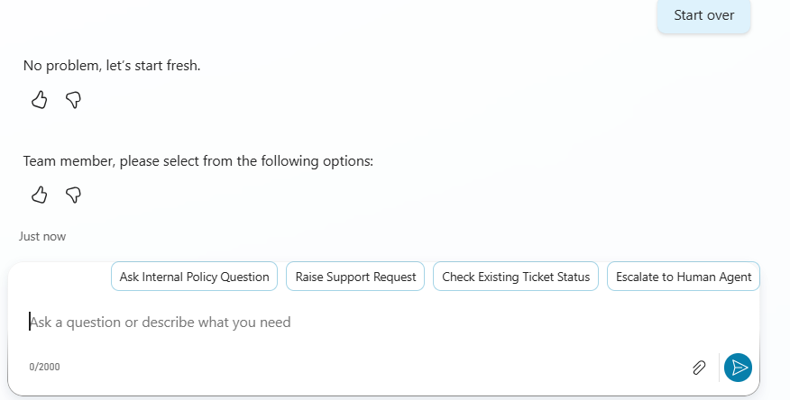
Ticket Created Successfully
The assistant validates employee details, records the issue type and description, generates a ticket ID, and confirms the ticket status as Open.

Slide 14
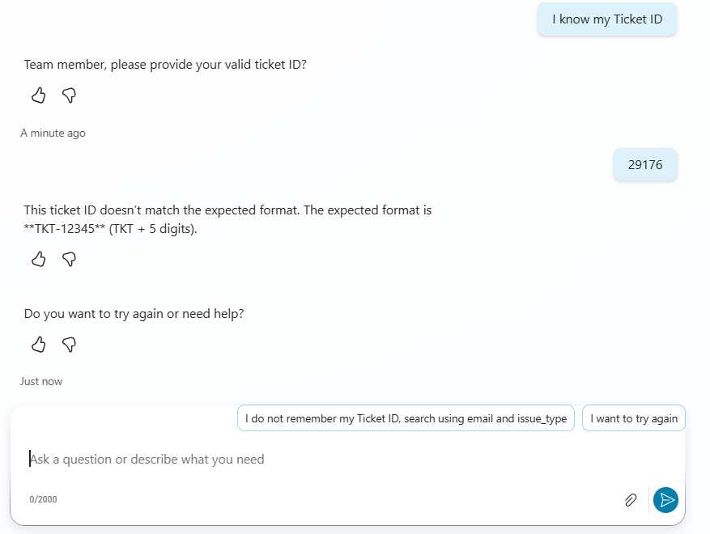
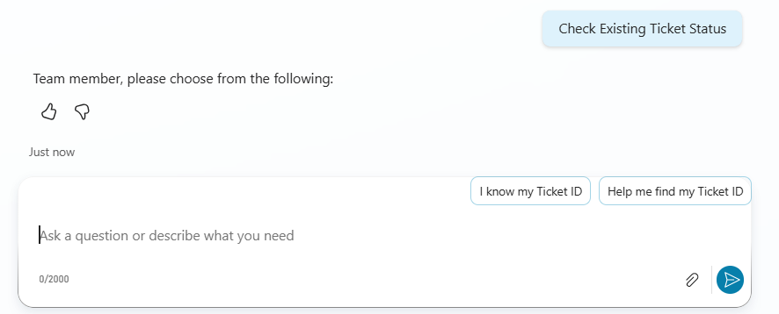
Ticket Status Lookup
The employee starts the ticket status workflow to check the progress of the submitted Payroll support request.

Slide 15
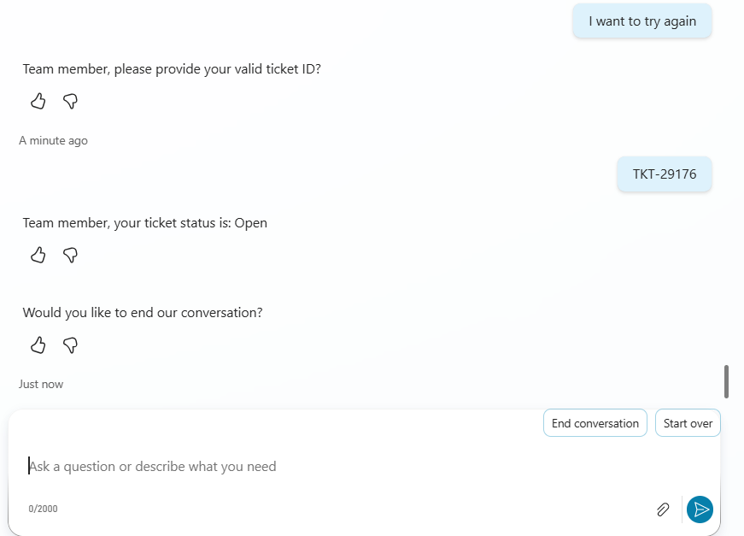
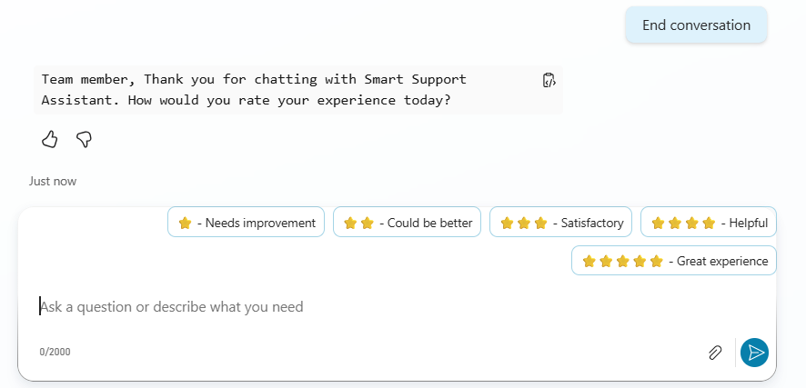
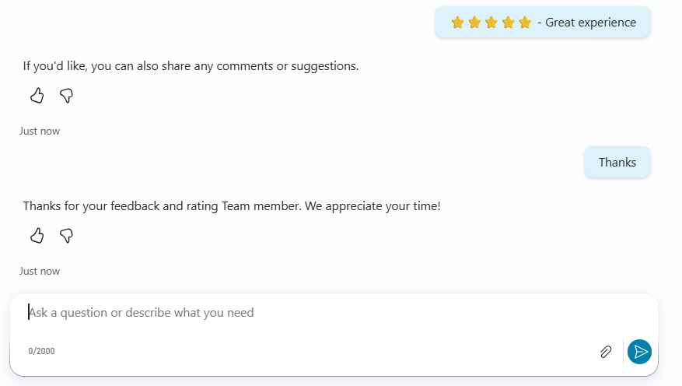
Ticket Validation and Closure
The assistant validates the ticket ID format, retrieves the ticket status, then supports conversation closure and feedback collection.

Slide 16
Demonstration - 2
Ticket Status Lookup Using Email and Issue Type
The employee checks a previously submitted support request without using the ticket ID. The assistant validates the official company email, collects the issue type, searches the Excel Online ticket records, and returns the matching ticket status.

Slide 17
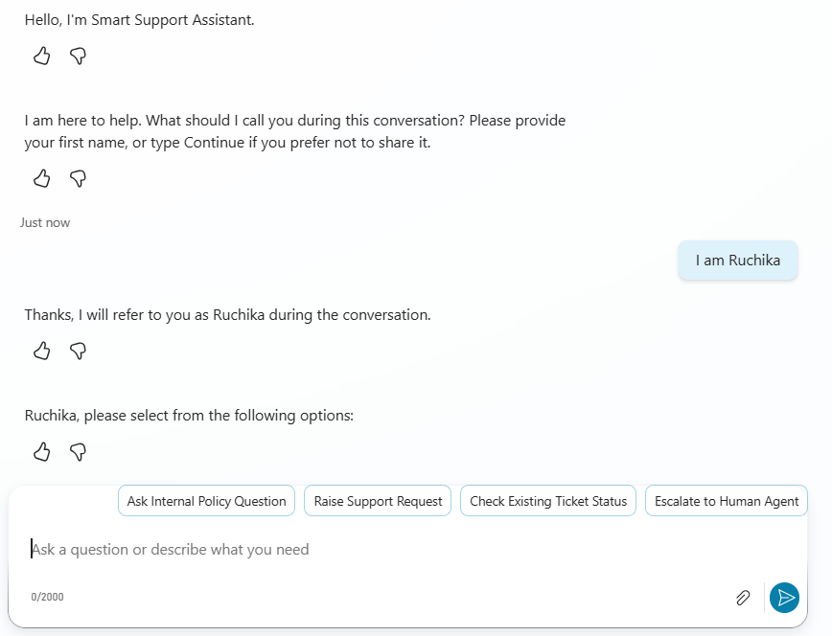
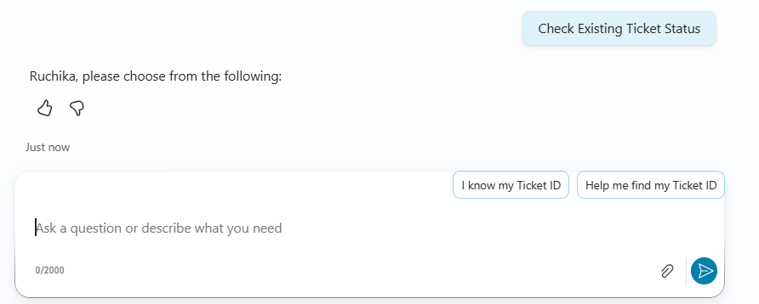
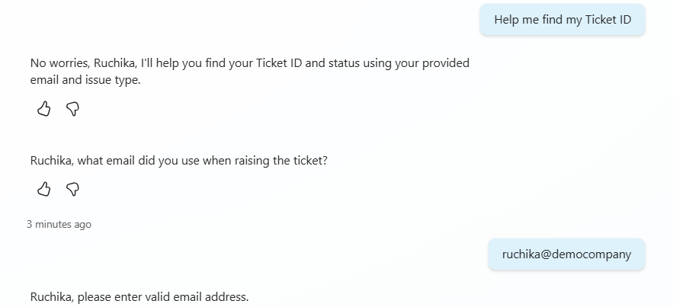
Ticket Status Workflow Initiated
The employee starts the ticket status lookup workflow and chooses to retrieve ticket information without using the ticket ID.

Slide 18
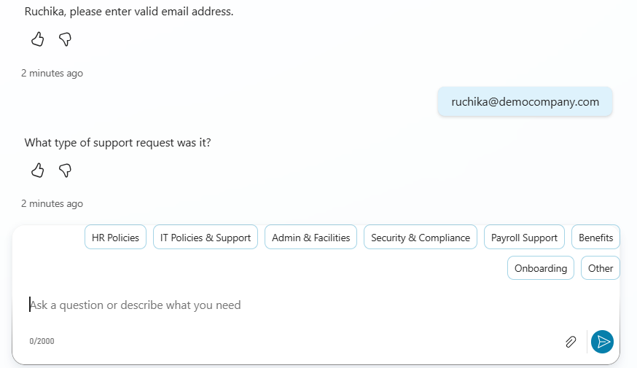
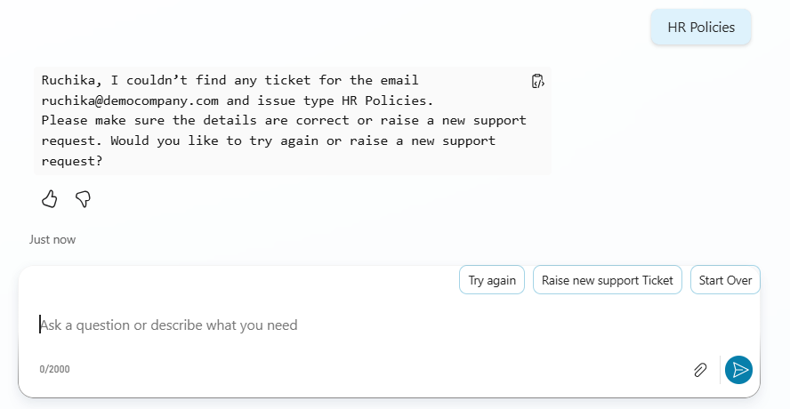
Email Validation and No Match Found
The assistant validates the official company email, collects the issue type and searches the Excel Online ticket records, but no matching support request is found using the provided details.

Slide 19
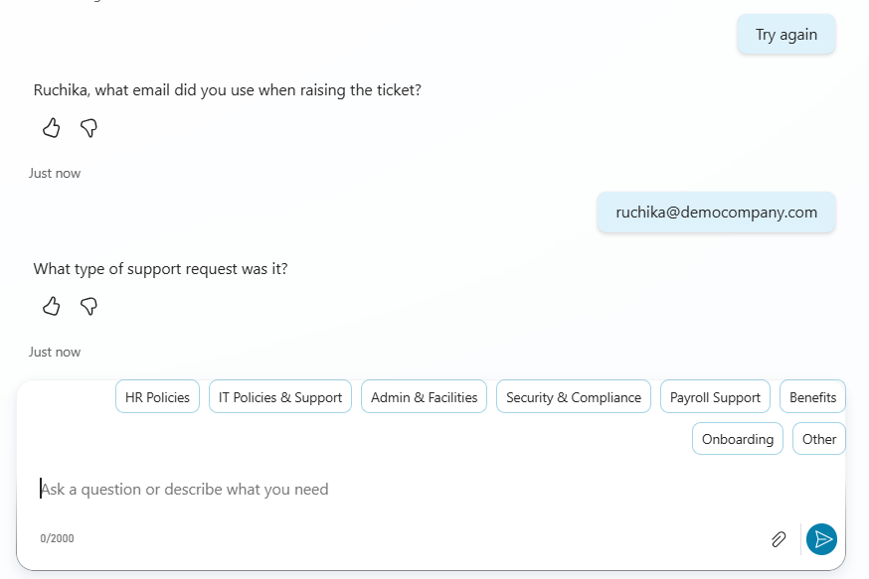
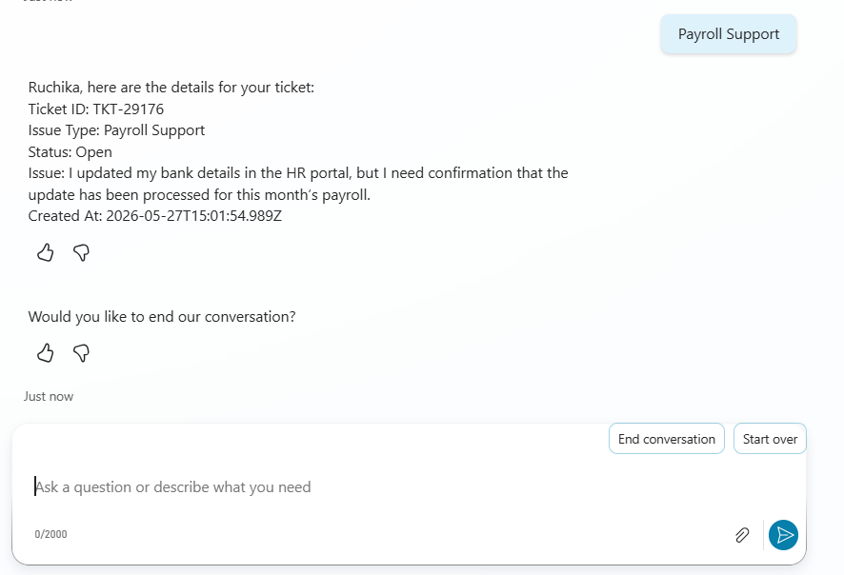
Matching Ticket Retrieved Successfully after Retry with Correct Issue Type
The employee retries the lookup workflow with corrected support request details so the assistant can perform another ticket search. The assistant successfully identifies the matching support request and returns the current ticket status information to the employee.

Slide 20
Demonstration - 3
IT Support Escalation and Human Callback Workflow
The employee requests help after being locked out of their company account. The assistant provides a grounded IT policy response, then offers urgent escalation and callback support through Power Automate and Outlook V2 email workflows.

Slide 21
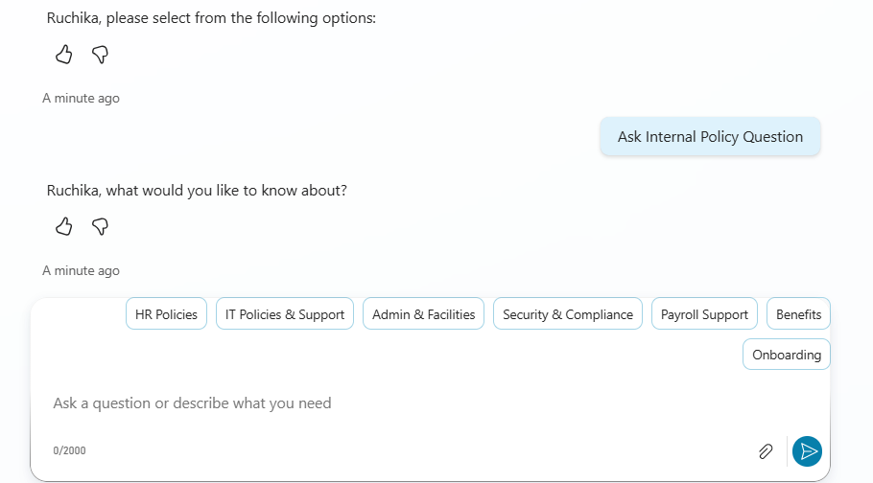
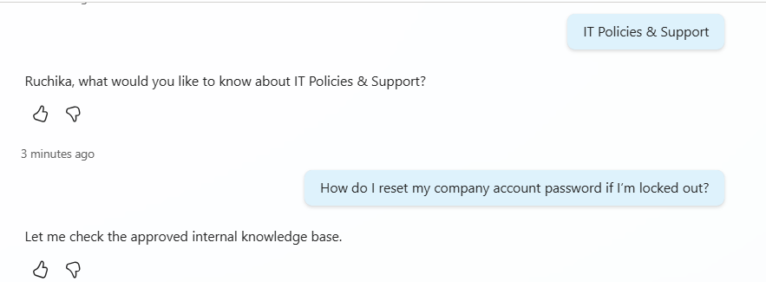
Policy Question Flow (Question Selection)
The employee selects an internal policy support category and submits a knowledge-based IT support question through the conversational interface.

Slide 22
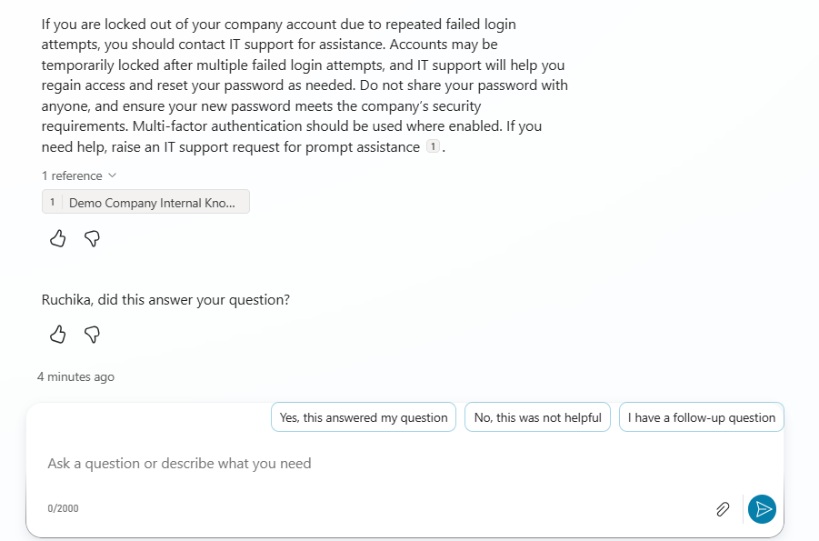
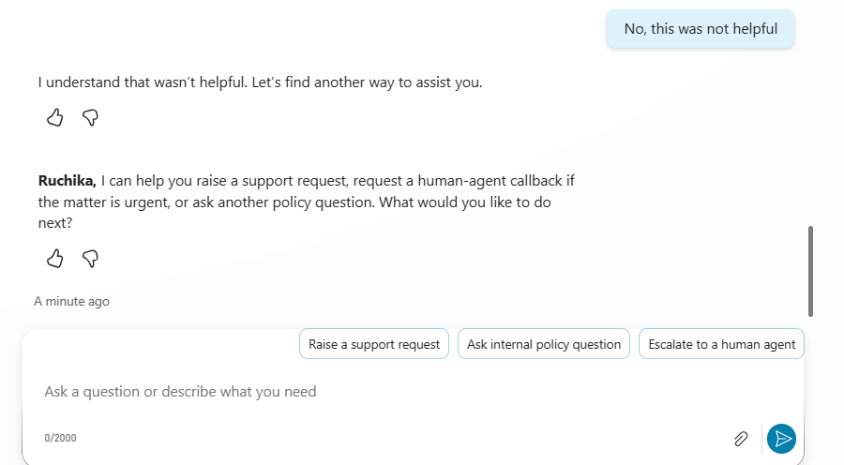
Policy Response & Fallback Handling
The assistant provides a grounded response from the approved internal knowledge base. If additional assistance is required, fallback options such as support request creation or escalation are offered.

Slide 23
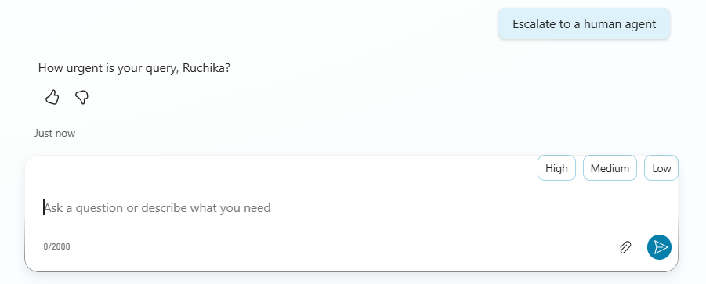
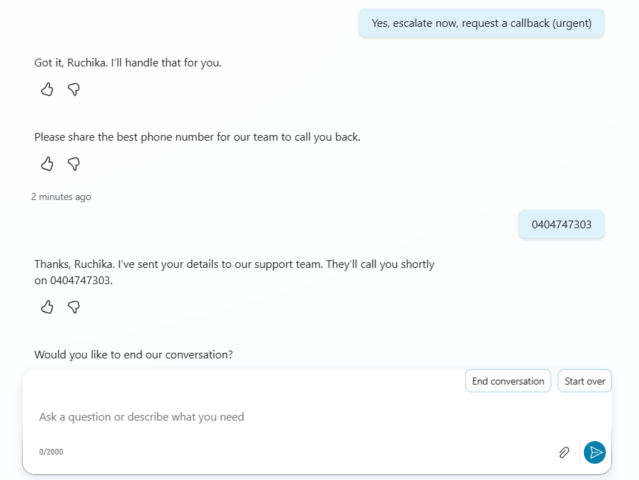
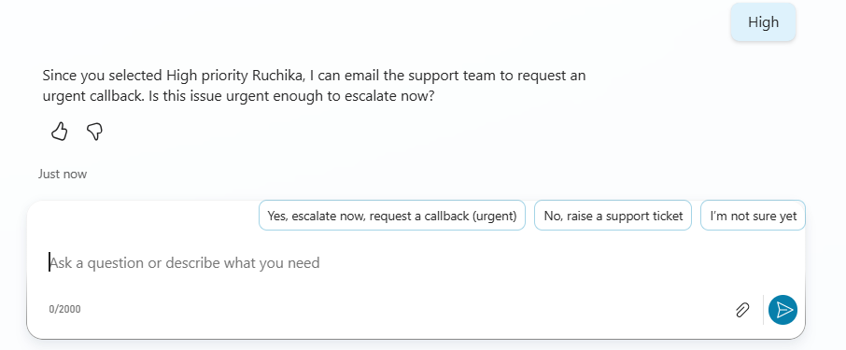
Human Escalation & Callback Workflow
Urgent issues can be escalated to a human support agent by capturing callback priority and contact details through a guided conversational workflow.

Slide 24
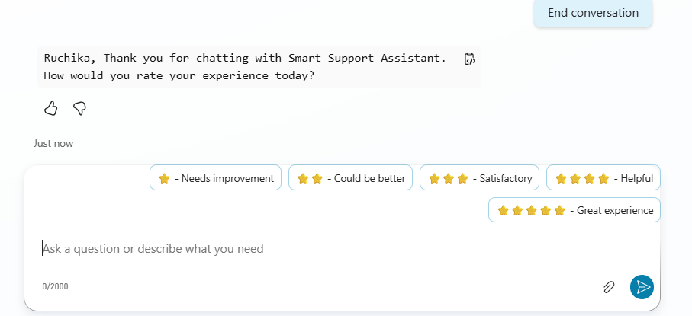
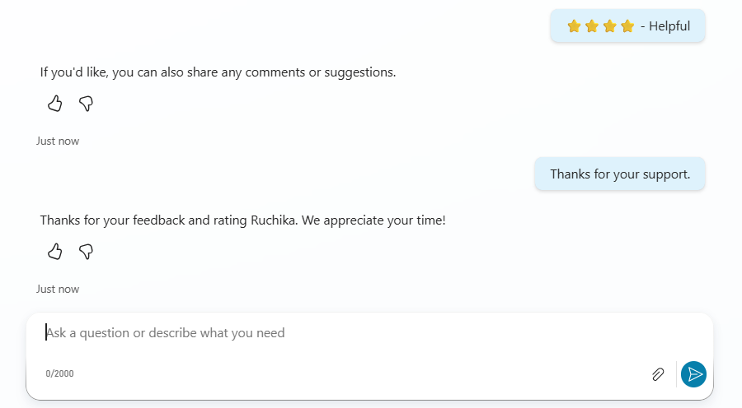
Feedback & Conversation Closure
The assistant supports conversation closure, user feedback collection, and satisfaction rating to assist workflow evaluation and future refinement.

Slide 25
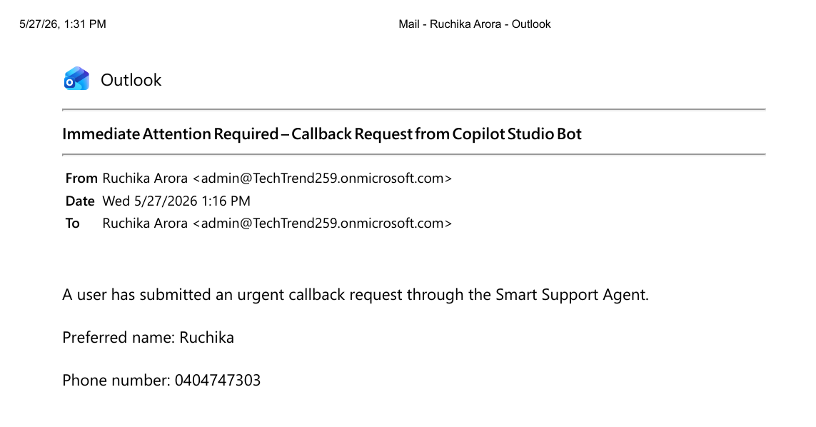
Outlook V2 Email Notification Workflow
Power Automate and Outlook V2 email workflows are used to notify the support team when an urgent callback escalation request is submitted.

Slide 26
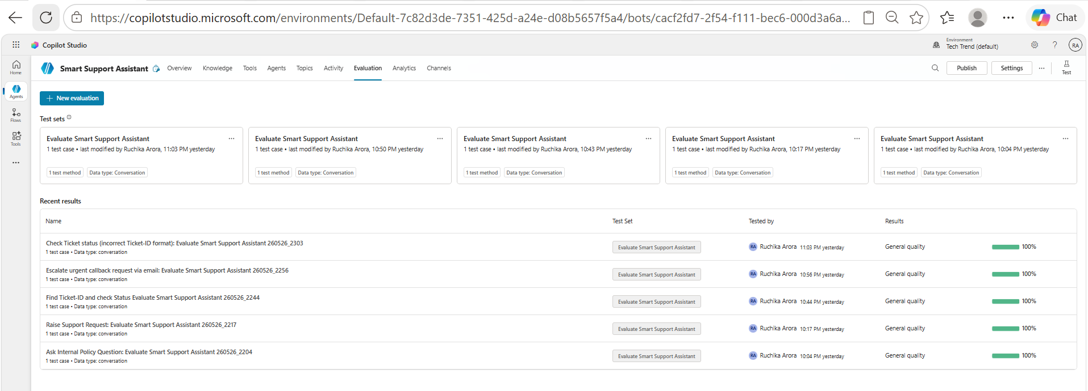
Copilot Studio Evaluation Results

Slide 27
Summary: Copilot Studio Evaluation Results
The prototype was evaluated using Copilot Studio conversation-based testing across five workflows: internal policy assistance, support request creation, ticket lookup, incorrect ticket ID validation, and urgent callback escalation via email.
All evaluated workflows achieved a 100% general quality score during prototype testing.

