Slide 1
5 Freebies Landing Page Content and Edits
5 Micro Rituals to Come Back to Yourself
5 Simple Ways to Ground & Reset
Living More Intentionally
Working with the Moon
Crystal Cheat Sheet

Slide 2
We need a popup confirmation that automatically pops up after they enter their info for each of these 5 freebies
Thank you for being here.
Your guide should arrive in your inbox within the next few minutes.
If you don’t see it right away, check your promotions or spam folder just in case.
I hope these rituals offer a small moment to slow down and reconnect with yourself.
You’ll also find more free rituals, reflections, and intentional living resources at powerfulintention.com if you’d like to explore further.

Slide 3
1 5 MICRO RITUALS ***Just one more change to the original changes already made Website Content Edits

Slide 4
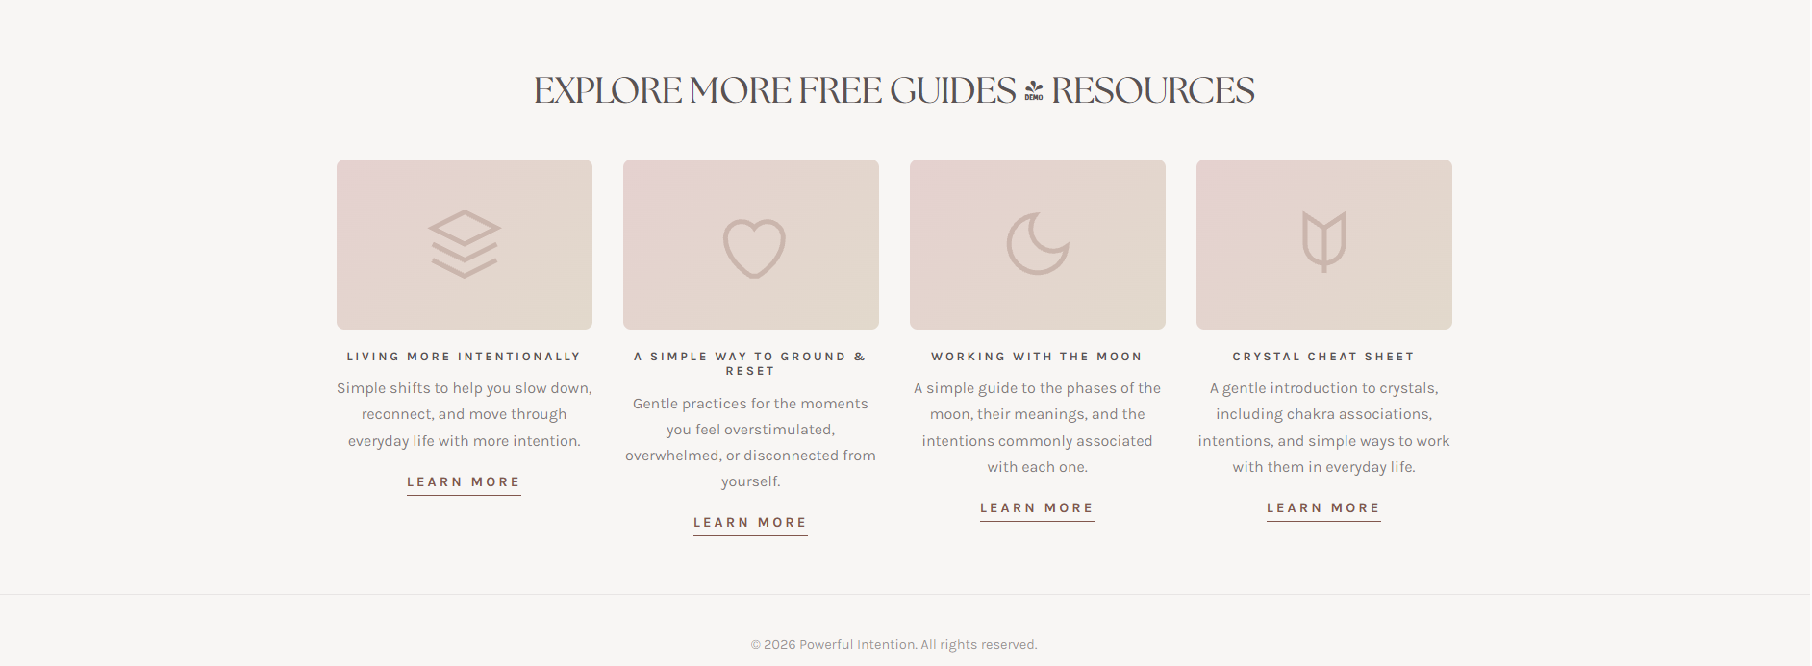
**Just one change, but this change must carry over to all of the other landing pages
Change title to:
5 SIMPLE WAYS TO GROUND & RESET

Slide 5
2 5 SIMPLE WAYS TO GROUND AND RESET Website Content Edits

Slide 6

Vini has instructions on where to place the logo and symbol
Change to this guide’s title:
5 SIMPLE WAYS TO GROUND AND RESET
Small, practical rituals for everyday life
For the moments when everything feels a little overwhelming, overstimulating, or mentally loud.

Slide 7
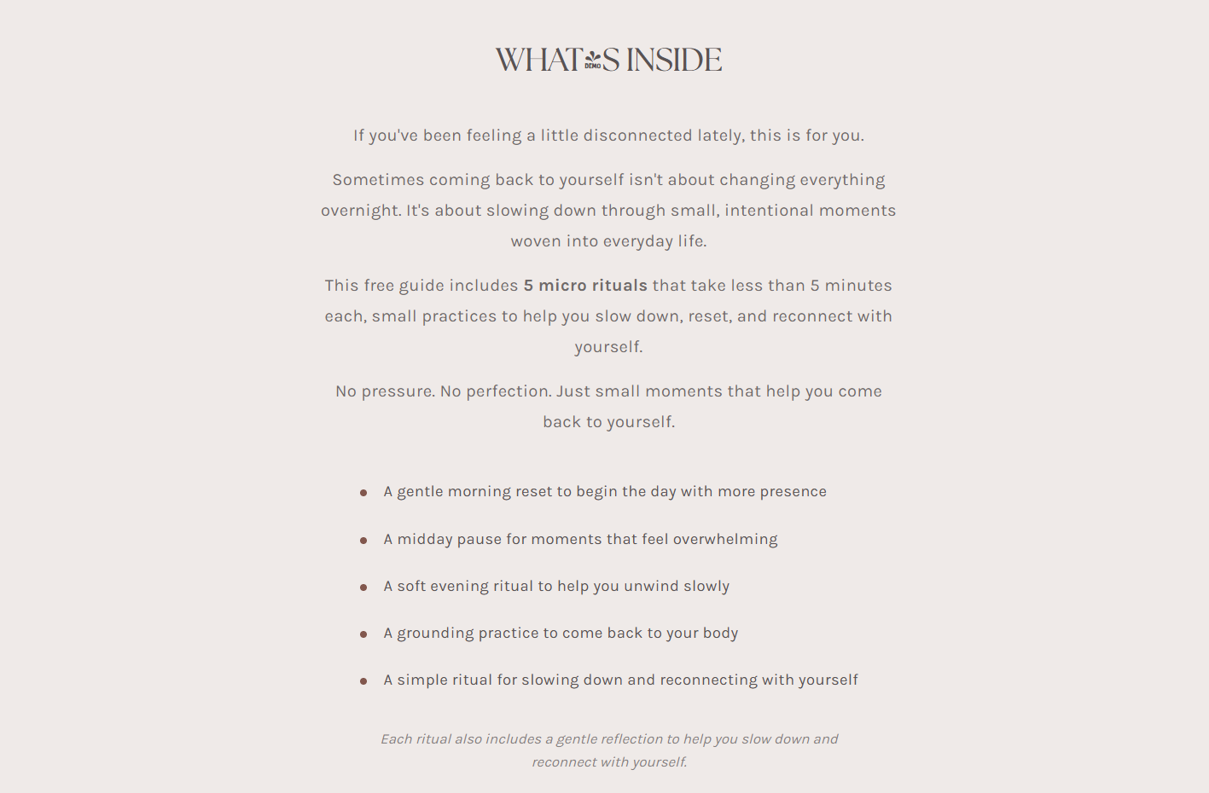

Will this change?
If you’ve been feeling mentally overwhelmed, overstimulated, or disconnected lately, this guide is for you.
Sometimes grounding yourself isn’t about completely changing your life overnight. It’s about creating small moments to pause, reset, and come back to yourself throughout everyday life.
This free guide includes 5 simple grounding resets designed to help you slow down, reset your nervous system, and reconnect with yourself in gentle, practical ways.
No pressure. No perfection. Just small practices to help you feel a little more present, calm, and grounded.
• A small pause to interrupt overwhelm and mental noise • A grounding reset to come back to your body • Simple ways to shift your environment and energy • A calming breath practice for overstimulating moments • Gentle reminders to slow down and stay present
The guide also includes gentle reflections and intentional prompts if you feel like exploring a little deeper.

Slide 8

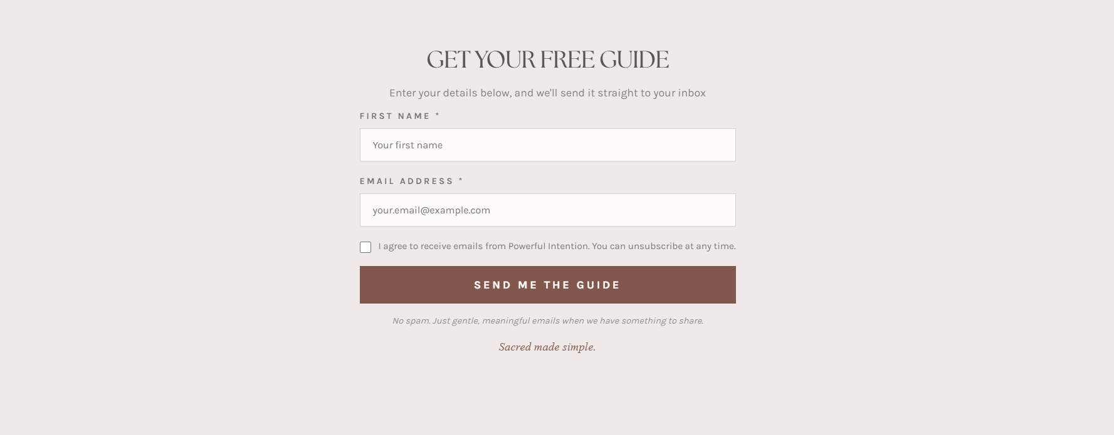
Stays the same
(just different preview pics)
Stays the same

Slide 9
Since this landing page is for the simple ways to ground and reset, we need to swap this one to the Micro Rituals Guide.
Will this change?
Simple rituals for slowing down, reconnecting with yourself, and bringing more presence into everyday life.
5 MICRO RITUALS
TO COME BACK TO YOURSELF

Slide 10
3 LIVING MORE INTENTIONALLY Website Content Edits

Slide 11
Vini has instructions on where to place the logo and symbol
Change to this guide’s title:
LIVING MORE
INTENTIONALLY
Simple shifts to help you live with more intention every day
For the moments you want to slow down and live with a little more awareness.

Slide 12
Will this change?
If you’ve been feeling disconnected from yourself, your routines, or the way you want to move through life lately, this guide is for you.
Living more intentionally doesn’t mean doing everything perfectly. It’s about slowing down, noticing your patterns, and creating small shifts that help you feel more present and aligned in everyday life.
This free guide includes simple reflections and intentional shifts designed to help you reconnect with yourself, become more aware of what supports you, and move through your days with more presence and purpose.
No pressure. No perfection. Just small shifts that help you live with a little more awareness and intention.
• A gentle perspective on what intentional living actually means • Small mindset shifts to help you move through life more consciously • Reflection prompts for noticing your habits, patterns, and routines • Simple ways to create more presence throughout everyday life • Gentle reminders that intentional living doesn’t have to look perfect
The guide also includes gentle reflections and intentional prompts if you feel like exploring a little deeper.

Slide 13
Stays the same
(just different preview pics)
Stays the same

Slide 14
Since this landing page is for Living More Intentionally guide, we need to swap this one to the Micro Rituals Guide.
Will this change?
Simple rituals for slowing down, reconnecting with yourself, and bringing more presence into everyday life.
5 MICRO RITUALS
TO COME BACK TO YOURSELF

Slide 15
4 WORKING WITH THE MOON Website Content Edits

Slide 16
Vini has instructions on where to place the logo and symbol
Change to this guide’s title:
WORKING WITH
THE MOON
Simple ways to work with the moon phases
A gentle introduction to the moon phases and the intentions often associated with each one.

Slide 17
Will this change?
If you’ve been feeling drawn to the moon phases but aren’t sure where to begin, this guide is for you.
Working with the moon doesn’t have to feel complicated or overly spiritual. It can simply be a gentle way to slow down, reflect, and reconnect with the natural rhythms already present in your life.
This free guide introduces the phases of the moon, their common themes and meanings, and simple intentional ways to work with each phase throughout the lunar cycle.
No pressure. No perfect rituals. Just small moments of reflection, awareness, and intention.
• A simple introduction to the phases of the moon • Common themes and intentions associated with each phase • Gentle reflections for slowing down and checking in with yourself • Simple ways to work with the rhythm of the lunar cycle • A grounded, approachable perspective on moon rituals and reflection
The guide also includes gentle prompts and reflections to help you work with the moon in a simple, intentional way.

Slide 18
Stays the same
(just different preview pics)
Stays the same

Slide 19
Since this landing page is for the Working with the Moon guide, we need to swap this one to the Micro Rituals Guide.
Will this change?
Simple rituals for slowing down, reconnecting with yourself, and bringing more presence into everyday life.
5 MICRO RITUALS
TO COME BACK TO YOURSELF

Slide 20
5 CRYSTAL CHEAT SHEET Website Content Edits

Slide 21
Vini has instructions on where to place the logo and symbol
Change to this guide’s title:
CRYSTAL
CHEAT SHEET
Simple ways to work with crystals in everyday life
A beginner-friendly guide to commonly used crystals, their intentions, and simple ways to work with them.

Slide 22
Will this change?
If you’ve been curious about crystals but aren’t sure where to begin, this guide is for you.
Working with crystals doesn’t have to feel complicated or overwhelming. It can simply be a gentle way to bring more intention, awareness, and meaning into everyday life.
This free guide introduces commonly used crystals, the intentions and chakra associations often connected to them, and simple ways to begin working with them in a grounded, approachable way.
No pressure. No perfect rituals. Just simple ways to explore crystals with more intention and curiosity.
• A beginner-friendly introduction to commonly used crystals • Simple intention and chakra associations for each crystal • Gentle ways to work with crystals throughout everyday life • Grounded, approachable explanations without overwhelm • Everyday rituals and small intentional ways to begin
The guide also includes simple reflections and practical ways to begin incorporating crystals into your everyday routines.

Slide 23
Stays the same
(just different preview pics)
Stays the same

Slide 24
Will this change?
Since this landing page is for Crystal Cheat Sheet, we need to swap this one to the Micro Rituals Guide.
5 MICRO RITUALS
TO COME BACK TO YOURSELF
Simple rituals for slowing down, reconnecting with yourself, and bringing more presence into everyday life.

