Slide 1
Micro Rituals Freebie Landing Page

Slide 2
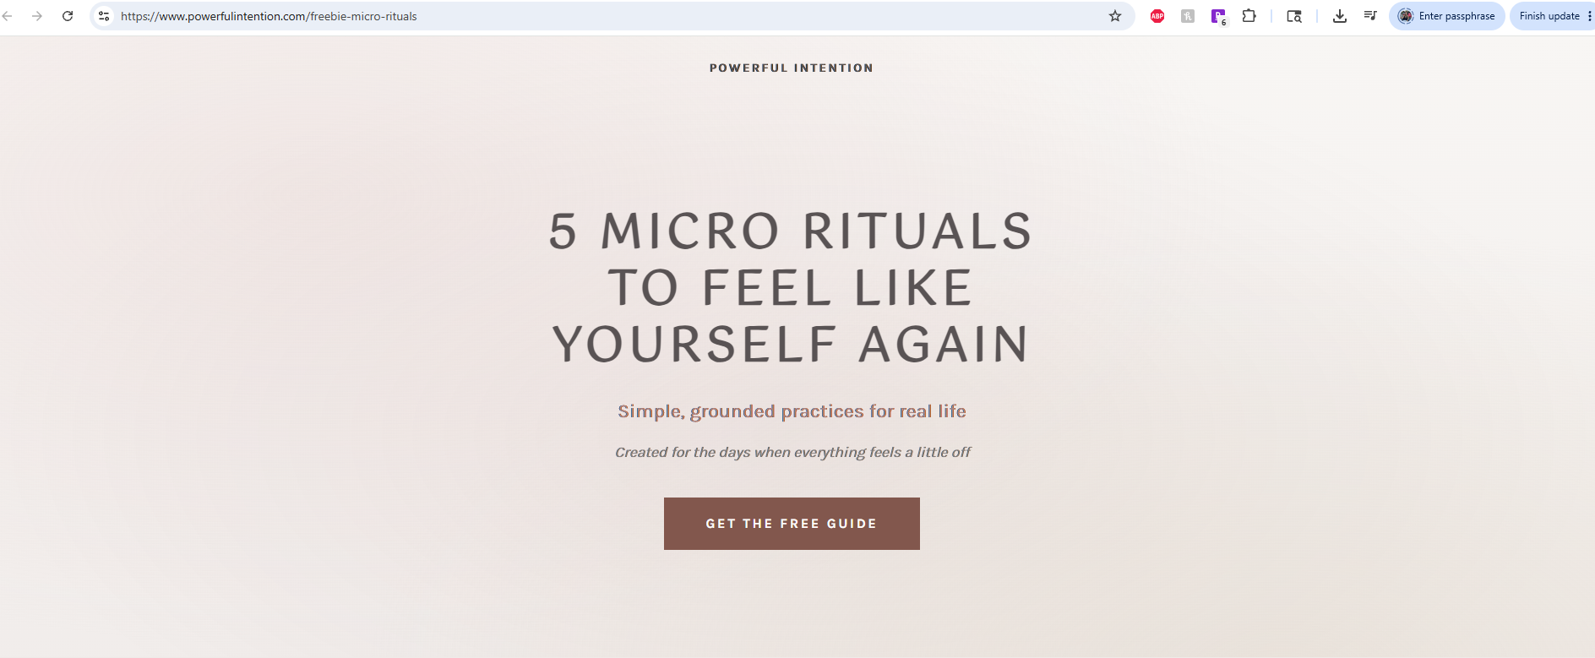
Add logo symbol above
micro-rituals-guide
5 MICRO RITUALS
TO COME BACK
TO YOURSELF
Simple rituals for everyday life
For the moments when you feel a little disconnected from yourself.

Slide 3
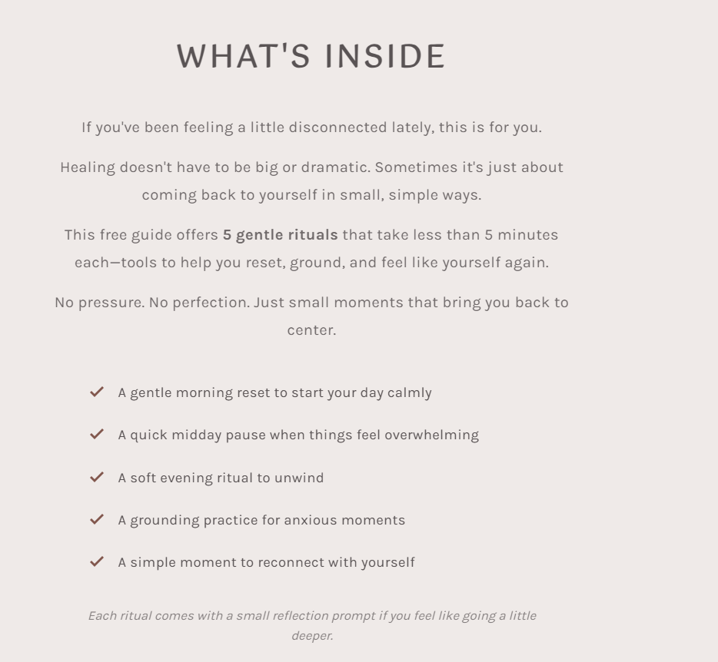

If you've been feeling a little disconnected lately, this is for you.
Sometimes coming back to yourself isn't about changing everything overnight. It's about slowing down through small, intentional moments woven into everyday life.
This free guide includes 5 micro rituals that take less than 5 minutes each, small practices to help you slow down, reset, and reconnect with yourself.
No pressure. No perfection. Just small moments that help you come back to yourself.
Let’s change the checkmarks to bullet points
A gentle morning reset to begin the day with more presence
A midday pause for moments that feel overwhelming
A soft evening ritual to help you unwind slowly
A grounding practice to come back to your body
A simple ritual for slowing down and reconnecting with yourself
Each ritual also includes a gentle reflection to help you slow down and reconnect with yourself.

Slide 4

Vini, we should talk about which pages to use

Slide 5
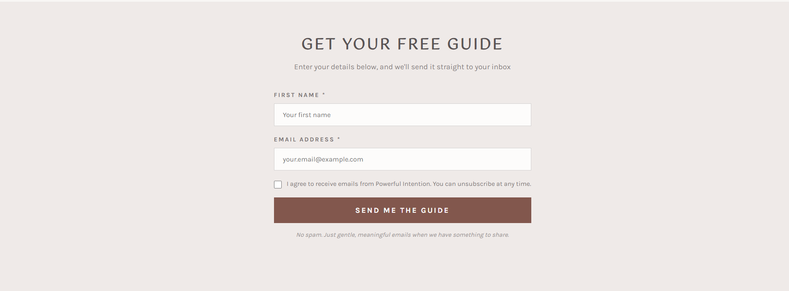
Can we add “sacred made simple” under this line?

Slide 6
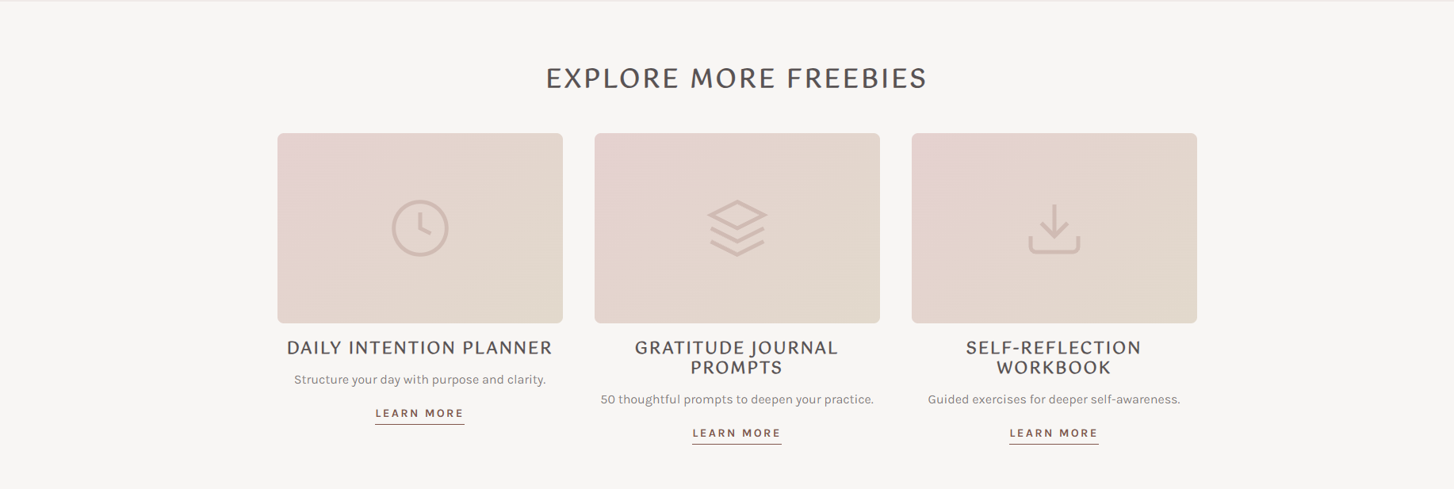
EXPLORE MORE FREE GUIDES & RESOURCES
Add one more picture: Use these 4 below
A SIMPLE WAY TO GROUND AND RESET
Gentle practices for the moments you feel overstimulated, overwhelmed, or disconnected from yourself.
LIVING MORE INTENTIONALLY
Simple shifts to help you slow down, reconnect, and move through everyday life with more intention.
WORKING WITH THE MOON
A simple guide to the phases of the moon, their meanings, and the intentions commonly associated with each one.
CRYSTAL CHEAT SHEET
A gentle introduction to crystals, including chakra associations, intentions, and simple ways to work with them in everyday life.

Slide 7
We need a popup confirmation that automatically pops up after they enter their info
Thank you for being here.
Your guide should arrive in your inbox within the next few minutes.
If you don’t see it right away, check your promotions or spam folder just in case.
I hope these rituals offer a small moment to slow down and reconnect with yourself.
You’ll also find more free rituals, reflections, and intentional living resources at powerfulintention.com if you’d like to explore further.

