Slide 1
Offline OCR-Based Handwritten Notes Summarizer
Team Name : Echelon

Slide 2
TEAM MEMBERS
01
MANGLESH NIMBALKAR (LEADER)
02
RUTVIK KACHGUNDE
03
JAYANT PATIL
04
PRANAV KOLHE

Slide 3

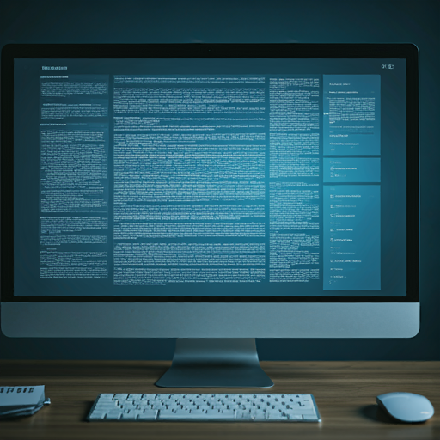
INTRODUCTION
The Handwritten Text Summarization Tool is an offline solution that converts handwritten text into concise, meaningful summaries using OCR and NLP. It handles diverse handwriting styles, ensuring accurate recognition and contextually relevant summaries. Designed for privacy and efficiency, the tool operates offline as well as online, making it suitable for users in areas with limited internet access. It supports multiple input formats, including images and PDFs, and is optimized for devices with minimal resources. Additional features like real-time handwriting input, customizable summaries, and encrypted storage enhance its usability, making it ideal for students, professionals, and researchers.

Slide 4
KEY IDEAS
Resource Efficiency
Handwriting Recognition and Summarization
The tool is optimized to run on local devices with a minimum of 16 GB RAM, ensuring smooth performance on portable systems without requiring internet connectivity.
An offline OCR system that accurately converts diverse handwritten texts into digital format and utilizes an NLP algorithm to generate concise, contextually relevant summaries.
User-Friendly Interface
Multimodal File Format Support
A simple and intuitive interface that allows users to easily input handwritten texts and clearly displays the summarized output, supporting English language processing.
Capability to process various file formats, including images, PDFs, Word, Excel, JSON, and XML, making it versatile for different user needs.

Slide 5
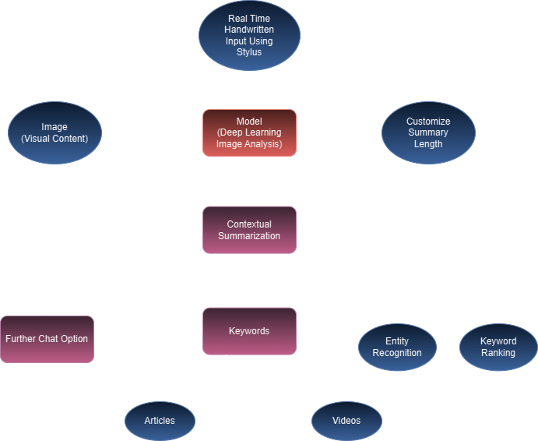
SYSTEM ARCHITECTURE

Slide 6
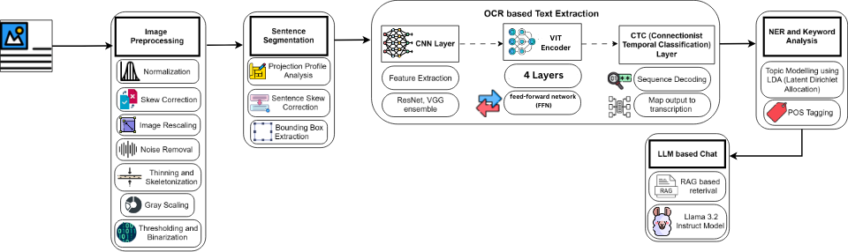
MODEL ARCHITECTURE

Slide 7
MODEL DESCRIPTION
OCR-Based Text Extraction -
CNN Layer: Extract image features using models like ResNet or VGG.
VIT Encoder: The VIT processes the tokens using self-attention and feed-forward layers to extract global and contextual features..
CTC Layer: Convert model predictions into text using Connectionist Temporal Classification (CTC), mapping the output to the final transcription.
NER and Keyword Analysis -
Topic Modelling using LDA: Identify topics in the extracted text.
POS Tagging: Tag parts of speech for further language understanding.
LLM-Based Chat -
RAG (Retrieval-Augmented Generation): Retrieve relevant data to improve chat responses.
Llama 3.2 Instruct Model: Use the LLM (large language model) to generate conversational responses based on the extracted text.
Image Preprocessing -
Normalization: Adjust image intensity for uniformity.
Skew Correction: Correct tilted images. Image Rescaling: Adjust image dimensions for processing.
Noise Removal: Eliminate unwanted noise from the image.
Thinning and Skeletonization: Convert to a simpler, skeletal structure.
Gray Scaling: Convert the image to grayscale.
Thresholding and Binarization: Convert to black-and-white (binary) for easier processing.
Sentence Segmentation -
Projection Profile Analysis: Analyze vertical/horizontal projections to identify sentence boundaries.
Sentence Skew Correction: Align sentences for better recognition.
Bounding Box Extraction: Mark text areas in the image.

Slide 8









TECH STACK
Programming Language : Python
Deep Learning Models: VIT encoder, VGG Ensemble, BiLSTM
Image Processing: OpenCV, NumPy
Text Processing: TextBlob, Gensim
Contextual Summarization: NLTK, SpaCy, LLama
Deployment: Flask or FastAPI, Docker
Content Retrieval: Articles: NewsAPI, ContextualWeb Search API, Semantic Scholar API, BeautifulSoup (for web scraping) Videos: YouTube Data API, Vimeo API, Twitter API, Facebook Graph API
Frontend: HTML5 Canvas API, Fabric.js or Paper.js (for enhanced canvas functionality), Pointer Events API (for better input handling)

Slide 9
UNIQUE SELLING POINTS
Keyword Highlighting
Chat Feature
Adjust Summary Length
enables users to interact with the summary through a chatbot, allowing for questions, clarifications, or further exploration of the content
allows users to customize the length of the summary, choosing between short, medium, or detailed versions based on their needs.
automatically identifies and emphasizes important terms or phrases in the digitized text, making it easier for users to quickly locate key information.
Encrypted Data Storage
Video and Article Recommendation
Realtime Input using Stylus
stored securely using encryption techniques, safeguarding sensitive information from unauthorized access and enhancing user privacy and data security
suggests relevant videos or articles based on the content of the digitized handwritten text, providing users with additional resources for further learning or exploration.
enables users to write directly on the device with a stylus, instantly recognizing and digitizing their handwritten notes.

Slide 10
FEASIBILITY
Offline Capability
Technological Availability
Scalability and Optimization
The technologies for Optical Character Recognition (OCR) and Natural Language Processing (NLP) are well-established and readily available. Open-source libraries like Tesseract for OCR and Hugging Face transformers for NLP simplify development, making implementation accessible and efficient.
Designing the tool to operate offline addresses privacy concerns and makes it suitable for environments with limited or no internet connectivity, enhancing its applicability in diverse scenarios like educational institutions and remote locations.
The project can be optimized for performance on devices with a minimum of 16 GB RAM, ensuring that it runs smoothly on portable systems. Additionally, the modular architecture allows for easy scaling and integration of future features, accommodating evolving user needs and technological advancements.

Slide 11
VIABILITY
Market Demand
User Experience
Cost-Effectiveness
There is a growing need for efficient tools that can digitize and summarize handwritten content, particularly among students, researchers, and professionals who often work with handwritten notes. This project addresses a specific gap in the market, making it relevant and valuable.
By offering features such as real-time input, customizable summary lengths, and keyword highlighting, the tool enhances user experience and engagement, making it more appealing to potential users. A user-friendly interface further increases its adoption likelihood.
Implementing the tool on local devices reduces the need for expensive cloud services or subscriptions, making it a cost-effective solution for users. Additionally, the use of open-source technologies minimizes development costs while ensuring robust functionality.

Slide 12
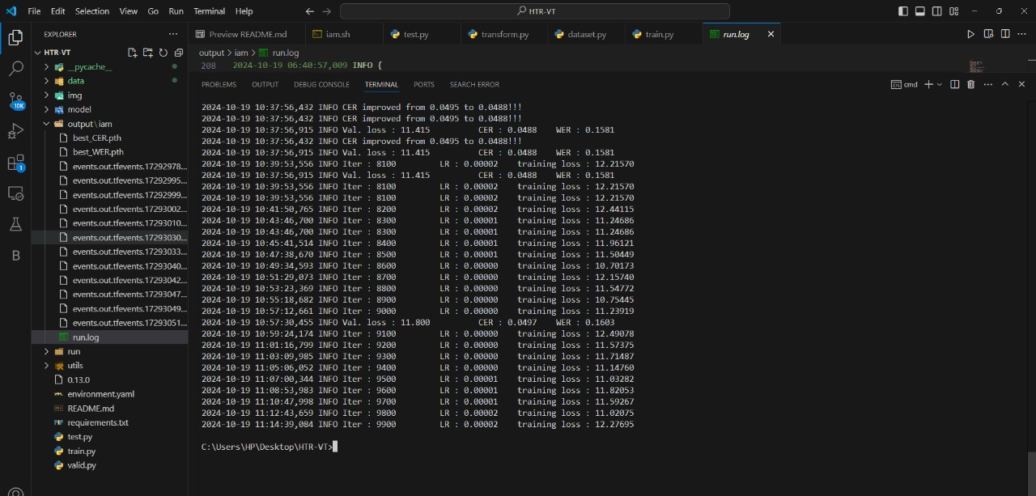
Results :
WER : 0.1603 CER : 0.0497

Slide 13
THANK YOU !

