Slide 1
Project Presentation Securing and authenticating electronic Healthcare Records through Blockchain Technology
By
2001106064 – Rushikesh Shinde
2001106041 – Anish Zaveri
2001106043 – Saad Mujawar
2001106076 – Rohit Kadganche
Guided By,
Dr. Anita Khandizod

Slide 2
Outline
1. INTRODUCTION – Problem Statement and Objectives
2. LITERATURE SURVEY
3. CONCEPTS AND METHODS
4. PROJECT PLAN
5. SOFTWARE REQUIREMENT SPECIFICATION
6. RESULTS (30% Implementation)
7. SOFTWARE TESTING
8. CONCLUSION AND FUTURE WORK
BIBLIOGRAPHY
REFERENCES

Slide 3
Introduction
The healthcare sector is experiencing a significant transformation with the integration of various emerging technologies, resulting in increasingly sophisticated healthcare information technology. Recognized by the World Health Organization as a highly innovative and widely shareable asset, medical information is at the forefront of this evolution. The proliferation of medical institutions globally has led to an exponential growth in medical data. As hospital information systems transition from basic charging systems to comprehensive electronic medical record systems, the complexity and depth of medical data have significantly increased, emphasizing the critical importance of privacy and security.

Slide 4
Problem Statement
Transitioning from paper-based to electronic systems presents healthcare organizations with challenges in maintaining and securing patient data. Paper-based systems require extensive storage space and pose risks to record safety. As healthcare institutions adopt electronic healthcare records (EHRs) for efficiency, centralized systems are vulnerable to cyber threats and privacy breaches, jeopardizing patient confidentiality and trust. Blockchain technology offers a promising solution by decentralizing data storage and ensuring data integrity. However, its implementation in healthcare requires further exploration to address security concerns and enhance record authentication effectively.

Slide 5
Objectives
Assess current challenges in securing electronic healthcare records (EHRs).
Investigate the feasibility of blockchain technology for EHR security.
Understand technical aspects of blockchain relevant to healthcare data.
Design and implement a blockchain-based EHR security framework.
Evaluate the effectiveness and feasibility of blockchain in EHR security.
Assess the scalability and performance of blockchain in healthcare settings.
Identify regulatory considerations for blockchain adoption in healthcare.
Provide recommendations for integrating blockchain into existing healthcare systems.

Slide 6
Concept and Methods
Concepts:
Blockchain technology and its applications in the healthcare industry.
Methodology:
Mixed Research methodology was adopted for the project and implementation strategies.

Slide 7
Literature Survey
"Blockchain for Electronic Health Records: A Survey" by Choudhury, O., and Choudhury, T. (2019)
This survey provides an overview of blockchain applications in electronic health records (EHR) management, including data security, privacy, and interoperability. It discusses various blockchain architectures, consensus mechanisms, and challenges in adopting blockchain technology for healthcare data management.
Securing Electronic Health Records Using Blockchain Technology: A Review" by Hassan, M. M., et al. (2020)
This review paper examines the potential of blockchain technology for securing electronic health records (EHRs) against unauthorized access, tampering, and data breaches. It explores the benefits, challenges, and future directions of integrating blockchain into healthcare systems to enhance data security and patient privacy.

Slide 8
Literature Survey
A Comprehensive Survey of Blockchain in Healthcare: Vision and Future Directions" by Yue, X., et al. (2020)
This comprehensive survey explores the applications of blockchain technology in healthcare, with a focus on electronic health records (EHRs), patient data management, and medical supply chain tracking. It discusses the technical aspects, challenges, and opportunities of blockchain adoption in improving healthcare data security and interoperability.
Blockchain-Based Secure Electronic Health Record Management for Healthcare Applications" by Nguyen, H. T., et al. (2021)
This research paper proposes a blockchain-based framework for secure electronic health record (EHR) management in healthcare applications. It presents a detailed architecture, implementation approach, and evaluation of the proposed solution, highlighting its effectiveness in ensuring data integrity, confidentiality, and accessibility.

Slide 9
Tools and Technologies
Blockchain Platform: Hyperledger Fabric
Consensus Mechanism: Practical Byzantine Fault Tolerance
Smart Contract Protocol: Chaincode (Node js).
Blockchain Test Networks: Hyperledger Caliper.
Integration and Deployment tools: Docker, Kubernetes, Hyperledger Cello.

Slide 10
Process/Steps of Blockchain Implementation
Create network
⁠Create transactions/crypto
⁠Create channel.
Develop chaincode in Node js.
⁠Deploy chain code on docker
⁠Access chain code
⁠Access UI/API on Fabric SDK.

Slide 11
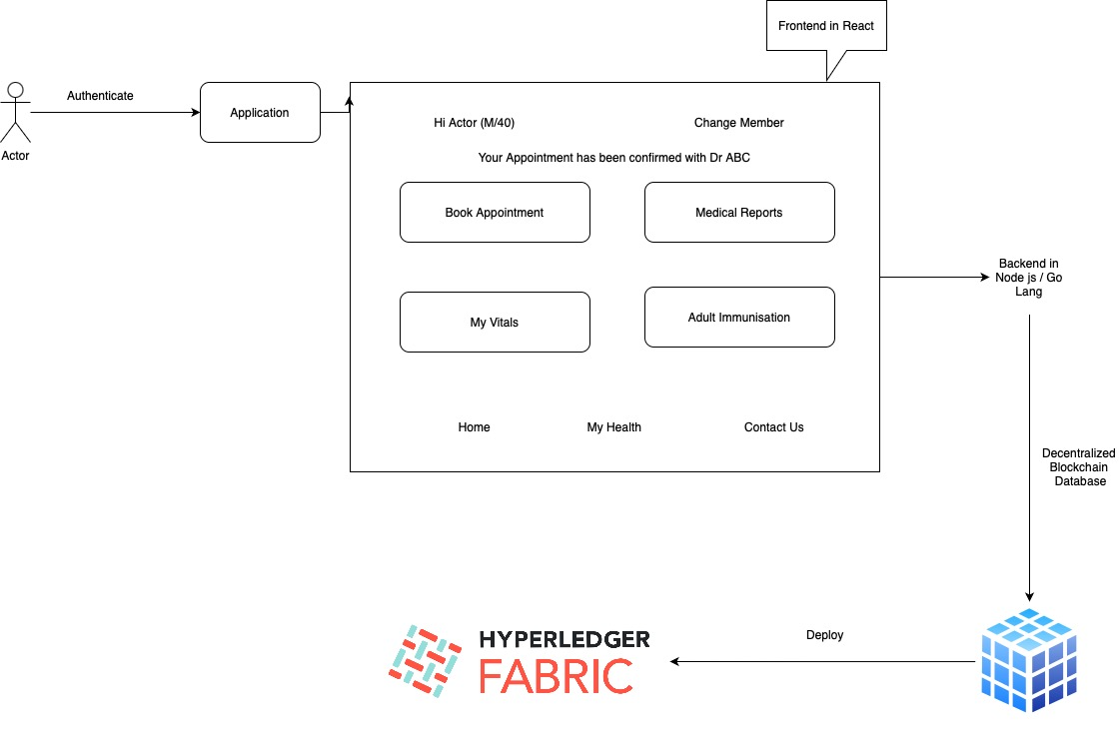
System Architecture

Slide 12
Implementation
Frontend in React Completed (Live Demo)

Slide 13
Results

Slide 14
References
"Blockchain for Electronic Health Records: A Survey" by Choudhury, O., and Choudhury, T. (2019)
securing Electronic Health Records Using Blockchain Technology: A Review" by Hassan, M. M., et al. (2020).
"A Comprehensive Survey of Blockchain in Healthcare: Vision and Future Directions" by Yue, X., et al. (2020).
"Blockchain-Based Secure Electronic Health Record Management for Healthcare Applications" by Nguyen, H. T., et al. (2021)

Slide 15
References
"Securing Electronic Health Records Using Blockchain Technology: A Systematic Review" by Islam, S. M. R., et al. (2020).
"Blockchain Technology for Healthcare: Facilitating Secure Interoperability and Scalability" by Al Omar, A., and Bhuiyan, M. Z. A. (2019).
"Blockchain-Based Healthcare Record Management: A Systematic Review" by Silva, L. M., et al. (2020).
"Blockchain Technology in Healthcare: A Systematic Review" by Kuo, T. T., et al. (2019).

