Slide 1

Securing and authenticating electronic healthcare records through Blockchain Technology
Project Presentation
By
2001006064 – Rushikesh Shinde
2001106041 – Anish Zaveri
2001106043 – Saad Mujawar
2001106076 - Rohit Kadganche
Guided By
Dr. Anita Khandizod
Symbiosis Skills and Professional University, Kiwale, Pune

Slide 2

Outline
1. INTRODUCTION – Problem Statement and Objectives
2. LITERATURE SURVEY
3. CONCEPTS AND METHODS
4. PROJECT PLAN
5. SOFTWARE REQUIREMENT SPECIFICATION
6. RESULTS (30% Implementation)
7. SOFTWARE TESTING
8. CONCLUSION AND FUTURE WORK
BIBLIOGRAPHY
REFERENCES
Symbiosis Skills and Professional University, Kiwale, Pune

Slide 3
1. Introduction
Healthcare Sector Transformation: Integration of Emerging Technologies
Sophisticated Healthcare Information Technology (HIT) Landscape
World Health Organization Recognition of Medical Information as Innovative Asset
Global Proliferation of Medical Institutions: Exponential Growth in Medical Data
Transition from Basic Charging Systems to Comprehensive Electronic Medical Record Systems
Increasing Complexity and Depth of Medical Data
Critical Importance of Privacy and Security in Healthcare Data Management
Symbiosis Skills and Professional University, Kiwale, Pune

Slide 4
2. Problem Statement
Transition to electronic healthcare systems poses data security challenges
Centralized storage exposes institutions to cyber threats, risking patient confidentiality
Blockchain offers decentralized solution for enhanced data security
Implementation of blockchain requires refinement to address security issues
Improved record authentication is essential for bolstering trust in electronic healthcare systems
Symbiosis Skills and Professional University, Kiwale, Pune

Slide 5
3. Objectives
Assess current challenges in securing electronic healthcare records (EHRs).
Investigate the feasibility of blockchain technology for EHR security.
Understand technical aspects of blockchain relevant to healthcare data.
Design and implement a blockchain-based EHR security framework.
Evaluate the effectiveness and feasibility of blockchain in EHR security.
Assess the scalability and performance of blockchain in healthcare settings.
Identify regulatory considerations for blockchain adoption in healthcare.
Symbiosis Skills and Professional University, Kiwale, Pune

Slide 6
4. Concepts and Methods
Concepts:
Blockchain technology and its applications in the healthcare industry.
Methodology:
Mixed Research methodology was adopted for the project and implementation strategies.
Symbiosis Skills and Professional University, Kiwale, Pune

Slide 7
5. Literature Survey
"Blockchain for Electronic Health Records: A Survey" by Choudhury, O., and Choudhury, T. (2019)
This survey provides an overview of blockchain applications in electronic health records (EHR) management, including data security, privacy, and interoperability. It discusses various blockchain architectures, consensus mechanisms, and challenges in adopting blockchain technology for healthcare data management.
Securing Electronic Health Records Using Blockchain Technology: A Review" by Hassan, M. M., et al. (2020)
This review paper examines the potential of blockchain technology for securing electronic health records (EHRs) against unauthorized access, tampering, and data breaches. It explores the benefits, challenges, and future directions of integrating blockchain into healthcare systems to enhance data security and patient privacy.
Symbiosis Skills and Professional University, Kiwale, Pune

Slide 8
Continued ..
A Comprehensive Survey of Blockchain in Healthcare: Vision and Future Directions" by Yue, X., et al. (2020)
This comprehensive survey explores the applications of blockchain technology in healthcare, with a focus on electronic health records (EHRs), patient data management, and medical supply chain tracking. It discusses the technical aspects, challenges, and opportunities of blockchain adoption in improving healthcare data security and interoperability.
Blockchain-Based Secure Electronic Health Record Management for Healthcare Applications" by Nguyen, H. T., et al. (2021)
This research paper proposes a blockchain-based framework for secure electronic health record (EHR) management in healthcare applications. It presents a detailed architecture, implementation approach, and evaluation of the proposed solution, highlighting its effectiveness in ensuring data integrity, confidentiality, and accessibility.
Symbiosis Skills and Professional University, Kiwale, Pune

Slide 9
6. Tools and Languages
Blockchain Platform: Hyperledger Fabric
Consensus Mechanism: Practical Byzantine Fault Tolerance
Smart Contract Protocol: Chaincode (Node js).
Blockchain Test Networks: Hyperledger Caliper.
Integration and Deployment tools: Docker, Kubernetes, Hyperledger Cello.
Symbiosis Skills and Professional University, Kiwale, Pune

Slide 10
7. Process and Architecture
Create network
⁠Create transactions/crypto
⁠Create channel.
Develop chaincode in Node js.
⁠Deploy chain code on docker
⁠Access chain code
⁠Access UI/API on Fabric SDK.
Symbiosis Skills and Professional University, Kiwale, Pune

Slide 11
8. Implementation
Frontend – In Progress
Blockchain and backend – Completed Research and start the implementation.
Symbiosis Skills and Professional University, Kiwale, Pune

Slide 12
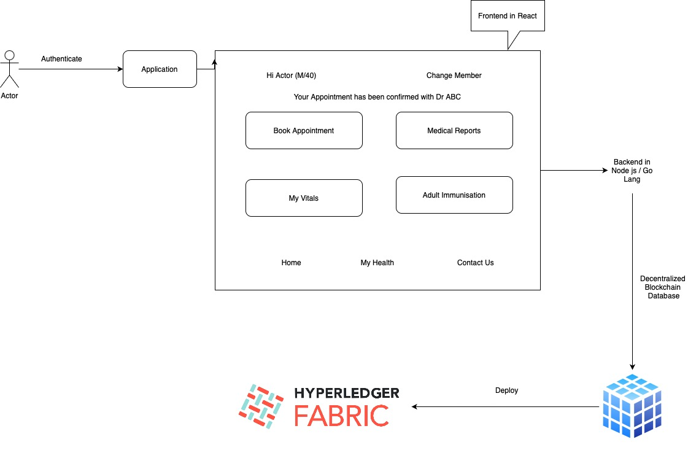
System Architecture
Symbiosis Skills and Professional University, Kiwale, Pune

Slide 13

9. Results
Symbiosis Skills and Professional University, Kiwale, Pune

Slide 14
10. Conclusion
Transition to electronic healthcare systems poses data security challenges
Centralized storage exposes institutions to cyber threats, risking patient confidentiality
Blockchain offers decentralized solution for enhanced data security
Implementation of blockchain requires refinement to address security issues
Improved record authentication is essential for bolstering trust in electronic healthcare systems
Symbiosis Skills and Professional University, Kiwale, Pune

Slide 15
10. Future Work
Start the Blockchain Development (chaincode)
Initially start with Hyperledger Fabric platform
Improve the UI, add more pages/dashboards
Symbiosis Skills and Professional University, Kiwale, Pune

Slide 16
References
"Blockchain for Electronic Health Records: A Survey" by Choudhury, O., and Choudhury, T. (2019)
Securing Electronic Health Records Using Blockchain Technology: A Review" by Hassan, M. M., et al. (2020).
"A Comprehensive Survey of Blockchain in Healthcare: Vision and Future Directions" by Yue, X., et al. (2020).
"Blockchain-Based Secure Electronic Health Record Management for Healthcare Applications" by Nguyen, H. T., et al. (2021)
Symbiosis Skills and Professional University, Kiwale, Pune

Slide 17
Continued ..
"Securing Electronic Health Records Using Blockchain Technology: A Systematic Review" by Islam, S. M. R., et al. (2020).
"Blockchain Technology for Healthcare: Facilitating Secure Interoperability and Scalability" by Al Omar, A., and Bhuiyan, M. Z. A. (2019).
"Blockchain-Based Healthcare Record Management: A Systematic Review" by Silva, L. M., et al. (2020).
"Blockchain Technology in Healthcare: A Systematic Review" by Kuo, T. T., et al. (2019).
Symbiosis Skills and Professional University, Kiwale, Pune

Slide 18
Thank You
Symbiosis Skills and Professional University, Kiwale, Pune

Slide 19
Questions
Symbiosis Skills and Professional University, Kiwale, Pune

