Slide 1
at_env
env_config
otn instrument
(not implement)
Card_admin
shellCmd
20p200(slot2)
1ud200(slot3)
1ud200(slot4)
20p200(slot5)
dbgCut
dbgCut
labctrl
telnet

Slide 2
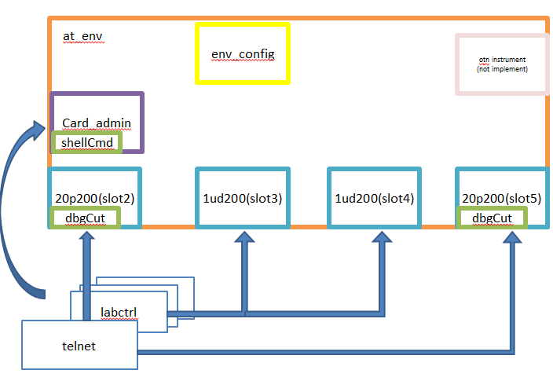
Build phase
Config phase
Run phase
End phase

Slide 3
Config files
Config_phase
Config files
Config files
log
sequence
Run_phase
testcases
report
Card info
scoreboard

