Slide 1
Vehicle Rental Management System

Slide 2
Project_Info
Team_Name | Project_Name | Team_Members | Techniques
TechDevs | Vehicle Rental Management System | Ajay Singh Bartwal (22BTCSE0302) | File Handling , Core Java , OOPS concepts , Exception Handling , Data Structures.

Slide 3
Introduction
Synopsis of Vehicle Rental Management System
The Vehicle Rental Management System is designed to simplify the process of renting vehicles. It provides an efficient and user-friendly platform for managing vehicle rentals, ensuring that customers can easily rent vehicles while owners can effectively manage their fleet.

Slide 4
Purpose
The primary objective of this system is to automate the vehicle rental process, reducing manual efforts, minimizing errors, and enhancing overall efficiency. It ensures that rental agencies can manage their fleet and customer interactions effectively.

Slide 5
Key Features
Vehicle Management: Allows the addition, updating, and removal of vehicles. Each vehicle record includes details like vehicle ID, type, brand, rental rate, and availability status.
Customer Management: Facilitates the addition and management of customer information, including customer ID, name, and contact details.
Rental Transactions: Manages the renting and returning of vehicles, tracking rental dates and return dates to ensure accurate availability.
Search and Sort: Provides functionality to search for vehicles by ID and sort vehicles by type, rental rate, and availability status.
Data Persistence: Utilizes file handling to save and load vehicle, customer, and rental data, ensuring data is retained across sessions.

Slide 6
Technologies Used
Java: Core programming language used for implementing the system.
File Handling: Ensures data persistence by saving and loading records.
Object-Oriented Programming (OOP): Structures the application using classes and objects for vehicles, customers, and rentals.
Data-Structures: The data structure features in the Vehicle Rental Management System project are crucial for organizing and managing the data efficiently.

Slide 7
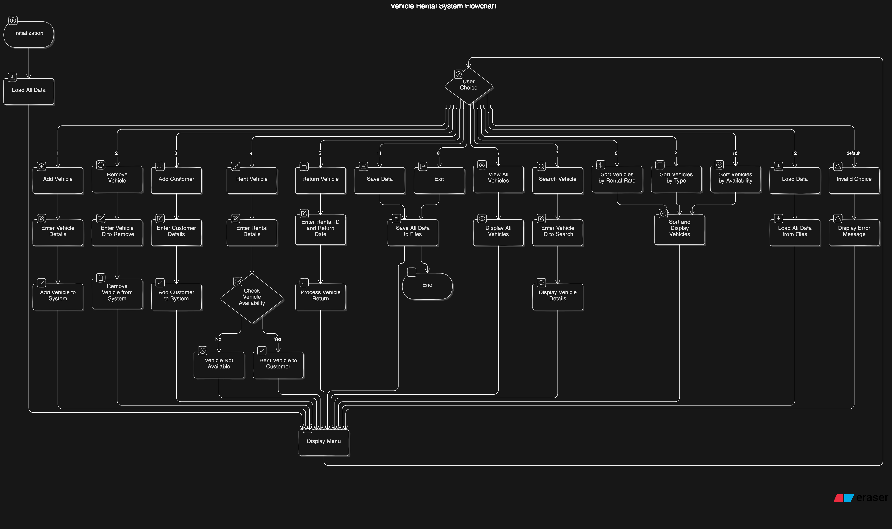
Vehicle Rental System Main Flowchart Diagram

Slide 8
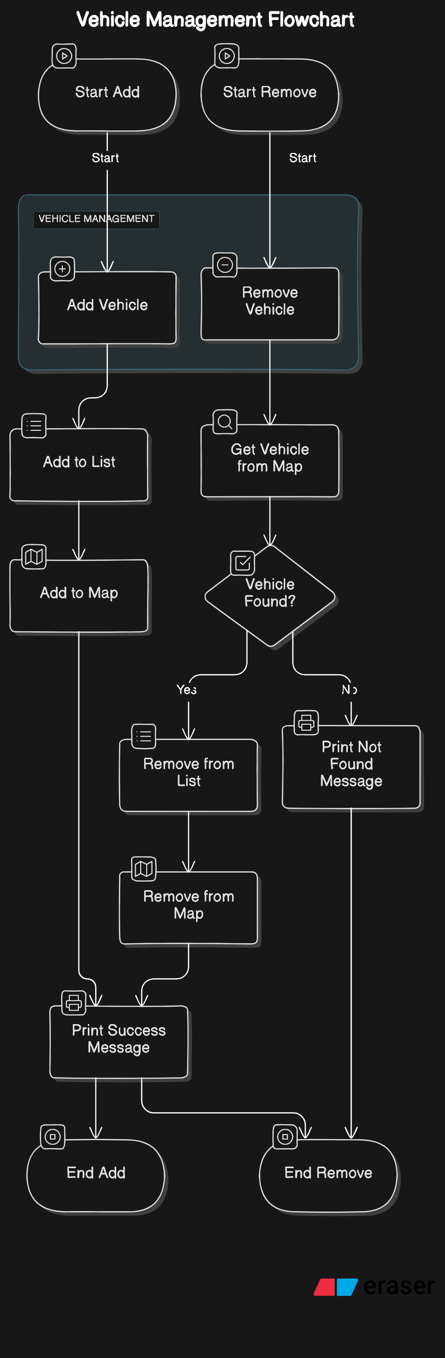
Add / Remove Vehicle Flowchart
Add Vehicle:
Input:-Enter Vehicle ID: V123
Enter Vehicle type: Bike
Enter Vehicle brand: Jupiter
Enter rental rate: 1000.00
Output:-
Vehicle added successfullly: V123 – Jupiter Bike
Remove Vehicle:
Input:- Enter vehicle ID to remove: V123
Output:- Vehicle removed successfully: V123

Slide 9
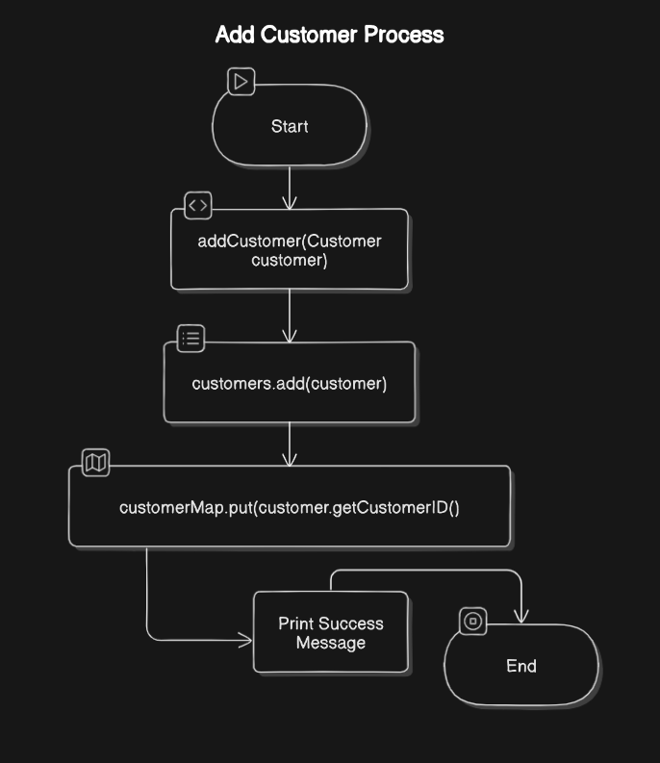
Add Customer
Add Customer:-
Input:-
Enter customer ID:- C124
Enter customer name: Ajay Singh Bartwal
Enter contact number: 9663636265
Output:
Customer added successfully: Ajay Singh Bartwal

Slide 10
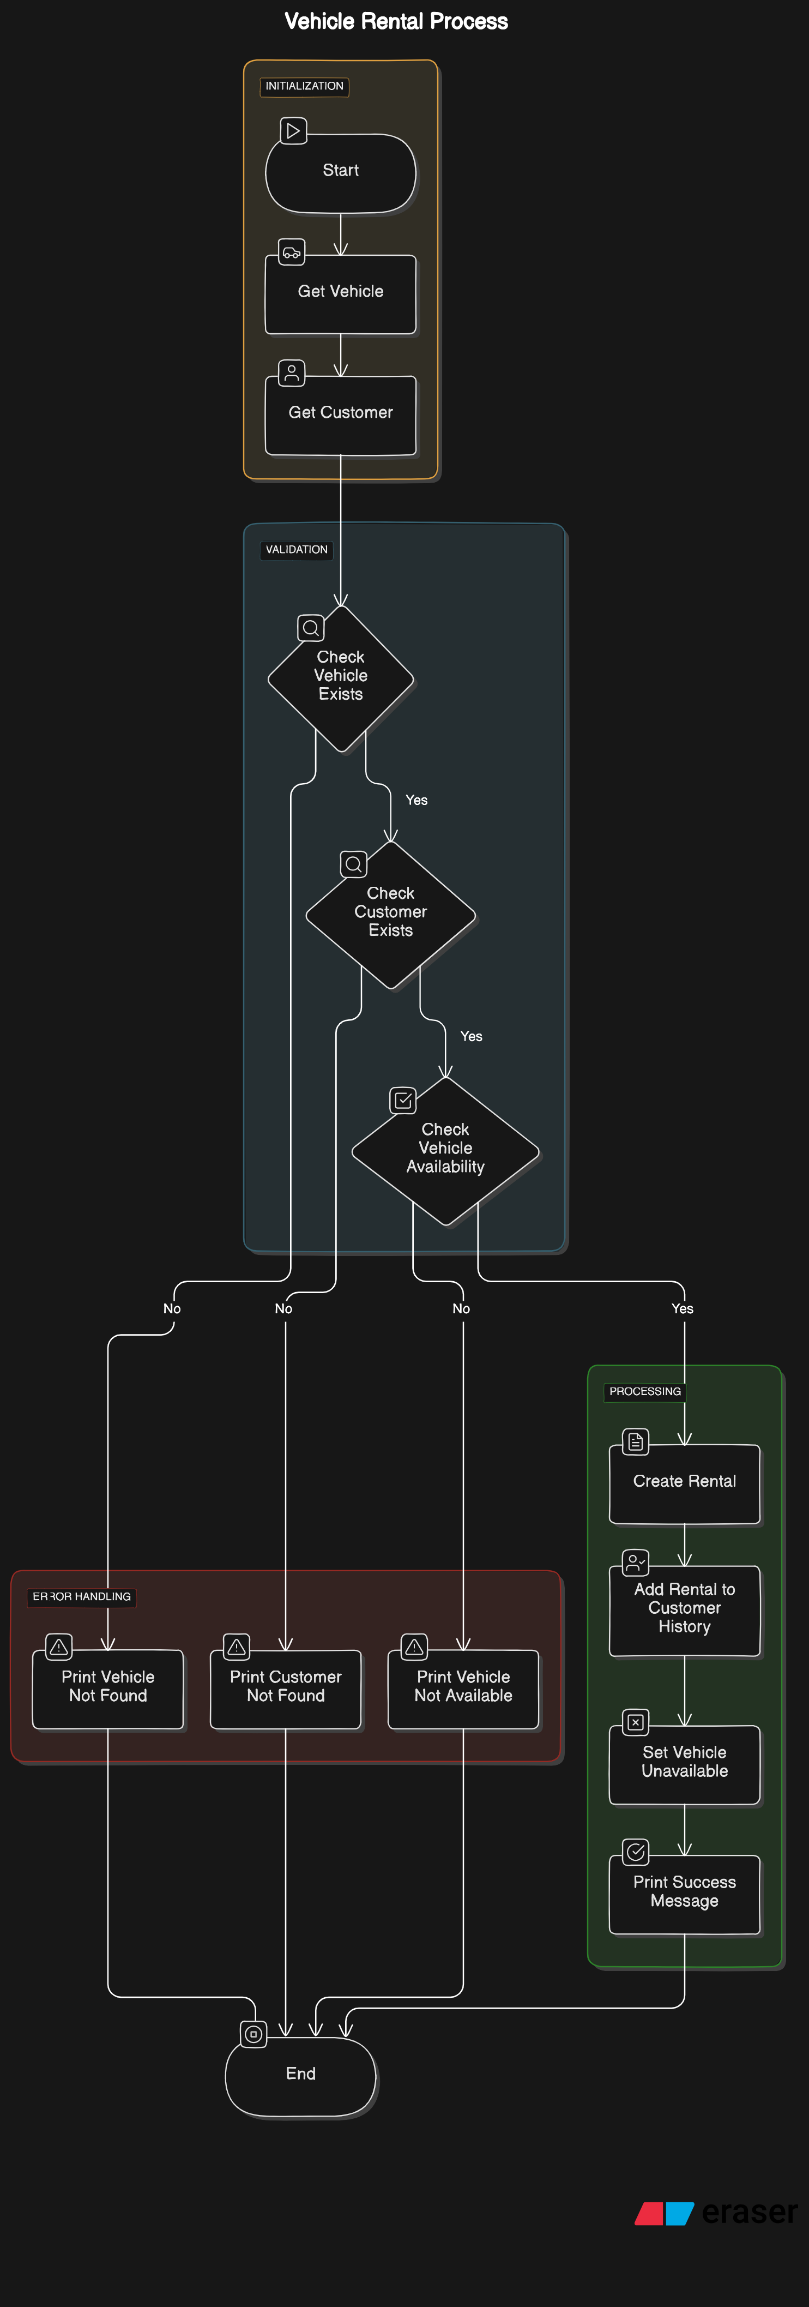
Rent Vehicle
Rent Vehicle
Input:-
Enter vehicle ID to rent: V124
Enter customer ID: C124
Enter rental date(YYYY-MM-DD): 2024-07-11
Output:
If found:-
Vehicle rented successfully: V124 to Ajay Singh Bartwal
Else:-
Vehicle not found with ID: V124
//As we have deleted it from the Vehicles.txt file.

Slide 11
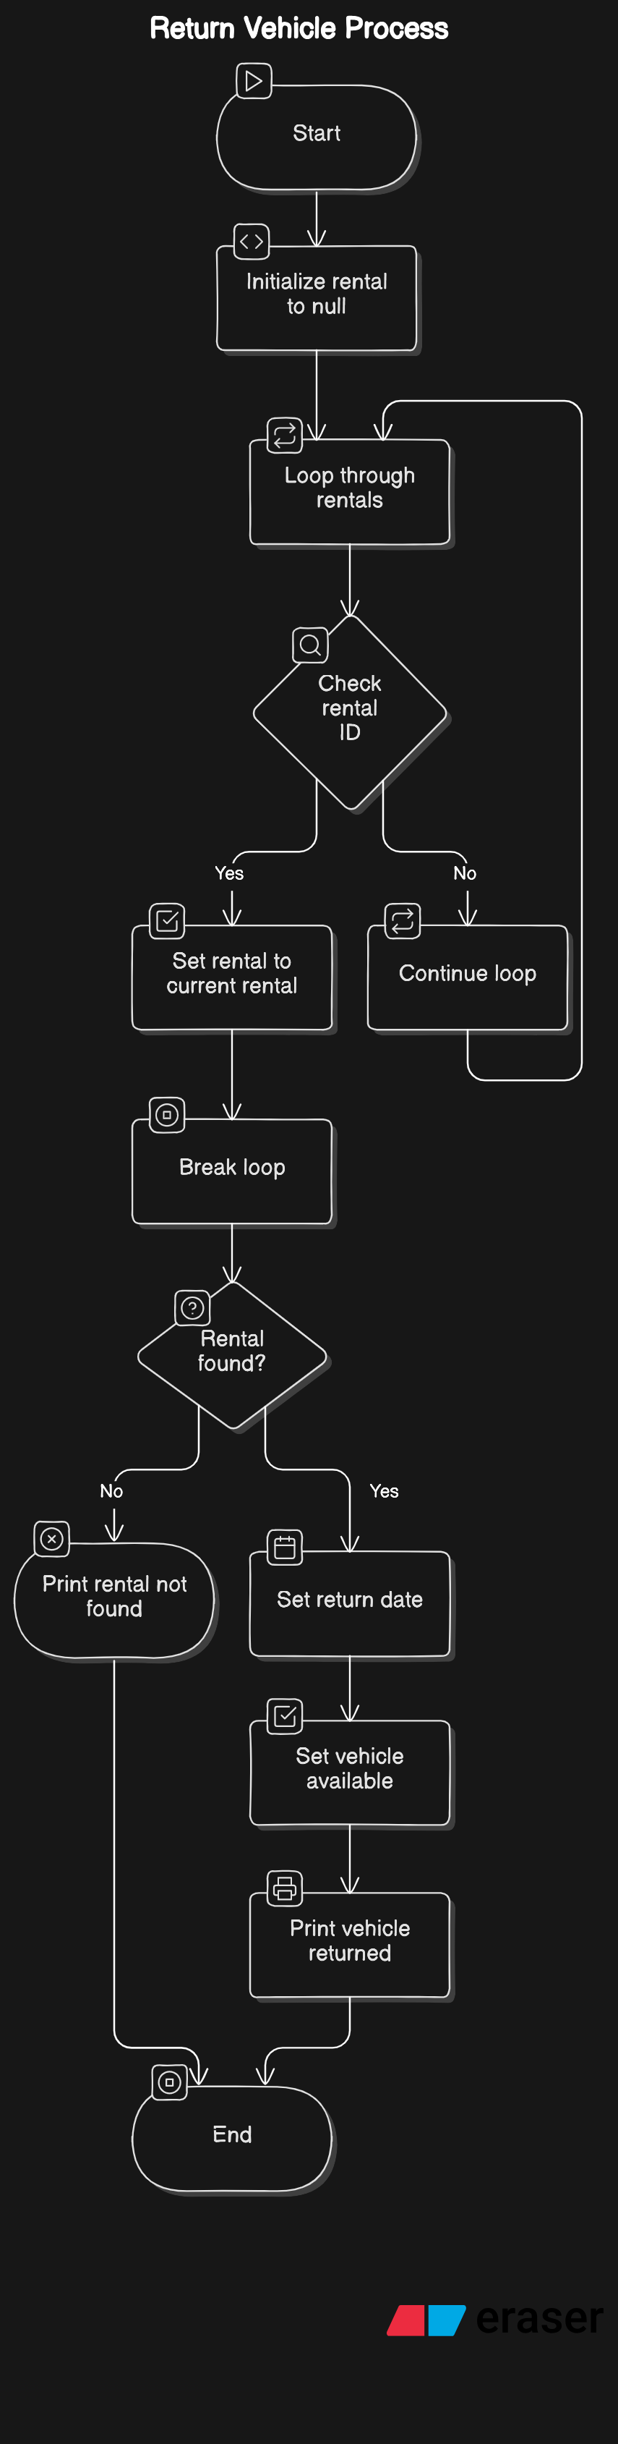
Return Vehicle
Return Vehicle:-
Input:-
Enter rental ID to return: Veh22
Enter return date(YYYY-MM-DD): 2024-07-15
Output:-
IF found:
Vehicle returned successfully: Veh22
Total Rental cost : Rs.10000
Else:
Vehicle not found with ID: Veh22

Slide 12
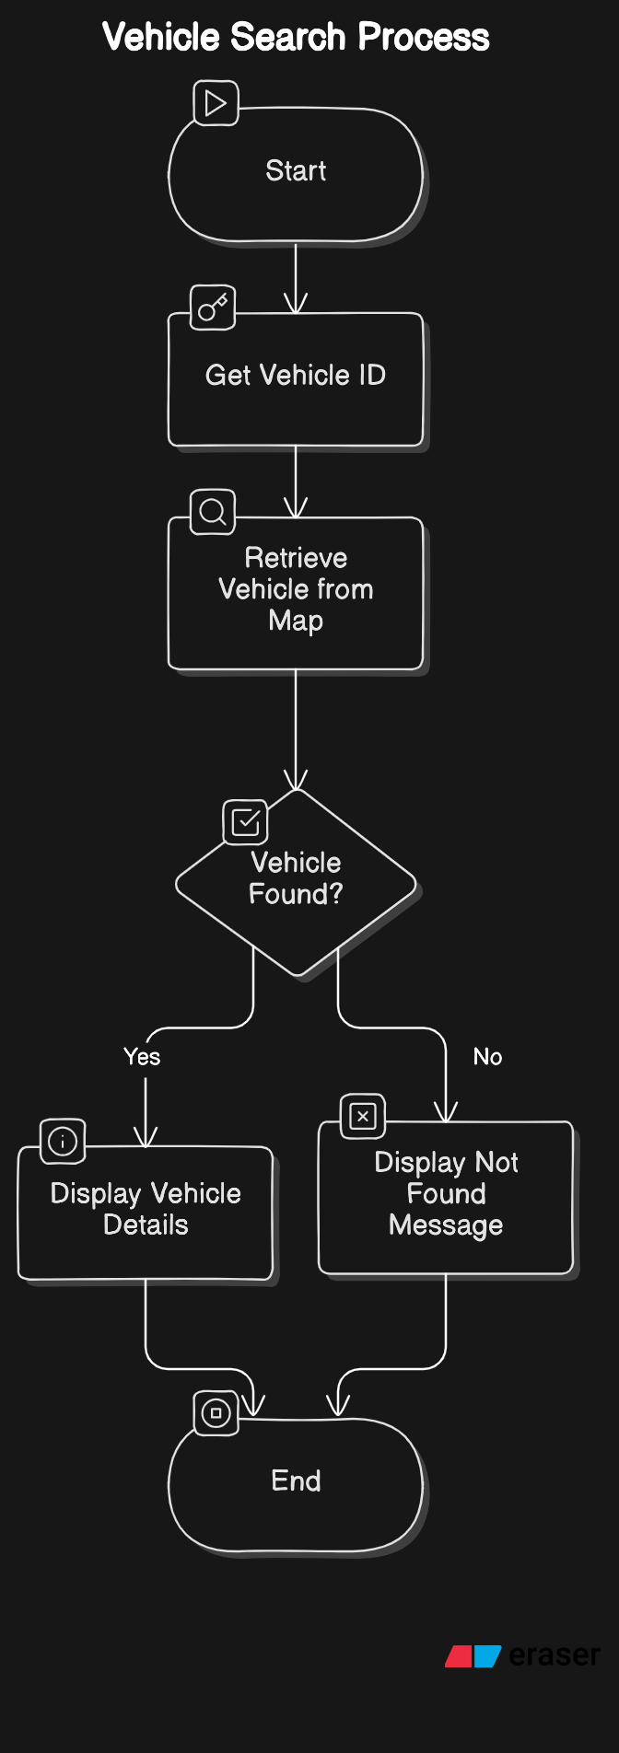
Vehicle Search:
Input:
Enter vehicle ID to search:Veh22
Output:
If found:
Vehicle found:
ID: Veh22, Type: Bike, Brand: TVS, Rental Rate: 1000.0, Available: Yes
Else:
Vehicle not found with ID: Veh22

Slide 13
Benefits
Efficiency: Reduces manual effort and errors in managing vehicle rentals.
Accessibility: Provides a simple and intuitive interface for both customers and administrators.
Scalability: Can be expanded to include more features and handle larger datasets.

Slide 14
Conclusion
The Vehicle Rental Management System is an essential tool for modernizing the vehicle rental process, ensuring a seamless experience for users and effective management for rental companies.

Slide 15
Bibliography
Books
Effective Java by Joshua Bloch. This book provides best practices and design patterns for writing robust, maintainable Java code.
Head First Java by Kathy Sierra and Bert Bates. This book is great for beginners and covers Java basics and object-oriented programming concepts.
Online Articles and Tutorials
Java Documentation. Oracle. Available at: Java Documentation
Java SE 8 for Really Impatient Programmers by Cay Horstmann. Available at: Horstmann Java SE 8
File Handling in Java. GeeksforGeeks. Available at: File Handling
Java Collections Framework. Oracle. Available at: Java Collections
Date and Time API in Java 8. Baeldung. Available at: Date and Time API

Slide 16
Bibliography
Code Repositories and Examples
GitHub Repository: Vehicle Rental Management System. Available at: GitHub
Sample Code for Vehicle Rental Systems. Available at: Sample Code
Stack Overflow - A valuable resource for troubleshooting and finding solutions to specific coding problems. Available at: Stack Overflow
Flowcharts and Diagrams
Eraser.io - A tool for creating flowcharts and diagrams. Available at: Eraser.io

