Slide 1
MDM2 SCREENING PIPELINE · ROOT-CAUSE REVIEW
Why the model looks confident —
but picks compounds outside its range
A visual explanation for a non-specialist, built from the code, the saved metrics, and the cached 154,587-row screening table.
645 training compounds → 154,587 library compounds
0 of the top 100 are inside the applicability domain.
Prepared 2026-10-26 · local review · cached run: 154,587 rows (canonical 154,647; 60-row difference)
Notes:
This deck separates the root cause from the code bugs. The root cause is distribution mismatch plus selection at the extreme. The code bugs make the bias worse, but fixing them alone will not create evidence outside the training chemistry.

Slide 2
THE SINGLE POINT
The model is solving a different problem than the one you need
It is not mainly one wrong line of code. It is a mismatch between the chemistry it learned and the chemistry it is asked to rank — made worse by selecting the most extreme predictions.
It learned
It is asked
It does
645 MDM2 compounds from a limited chemical neighborhood. 204 Murcko scaffolds; top 10 cover 39%.
Rank 154,587 diverse library compounds. 99.4% are below the 0.40 similarity cut; 99.94% are below the strict 0.52 cut.
Takes the top predicted pIC50 values. Those values are highest where the model has the least evidence.
A model can output a number everywhere. That does not mean it has evidence everywhere.
The algorithm is secondary. The data coverage and the selection rule are primary.
MDM2 pipeline review · 645 training compounds / 154,587 screening compounds · data: 2026-10-26
2/10
Notes:
Key line: one model, two different worlds. Training/validation chemistry is analog-rich; the library is mostly outside the training manifold. The model's top predictions are selected precisely from the extrapolation zone.

Slide 3
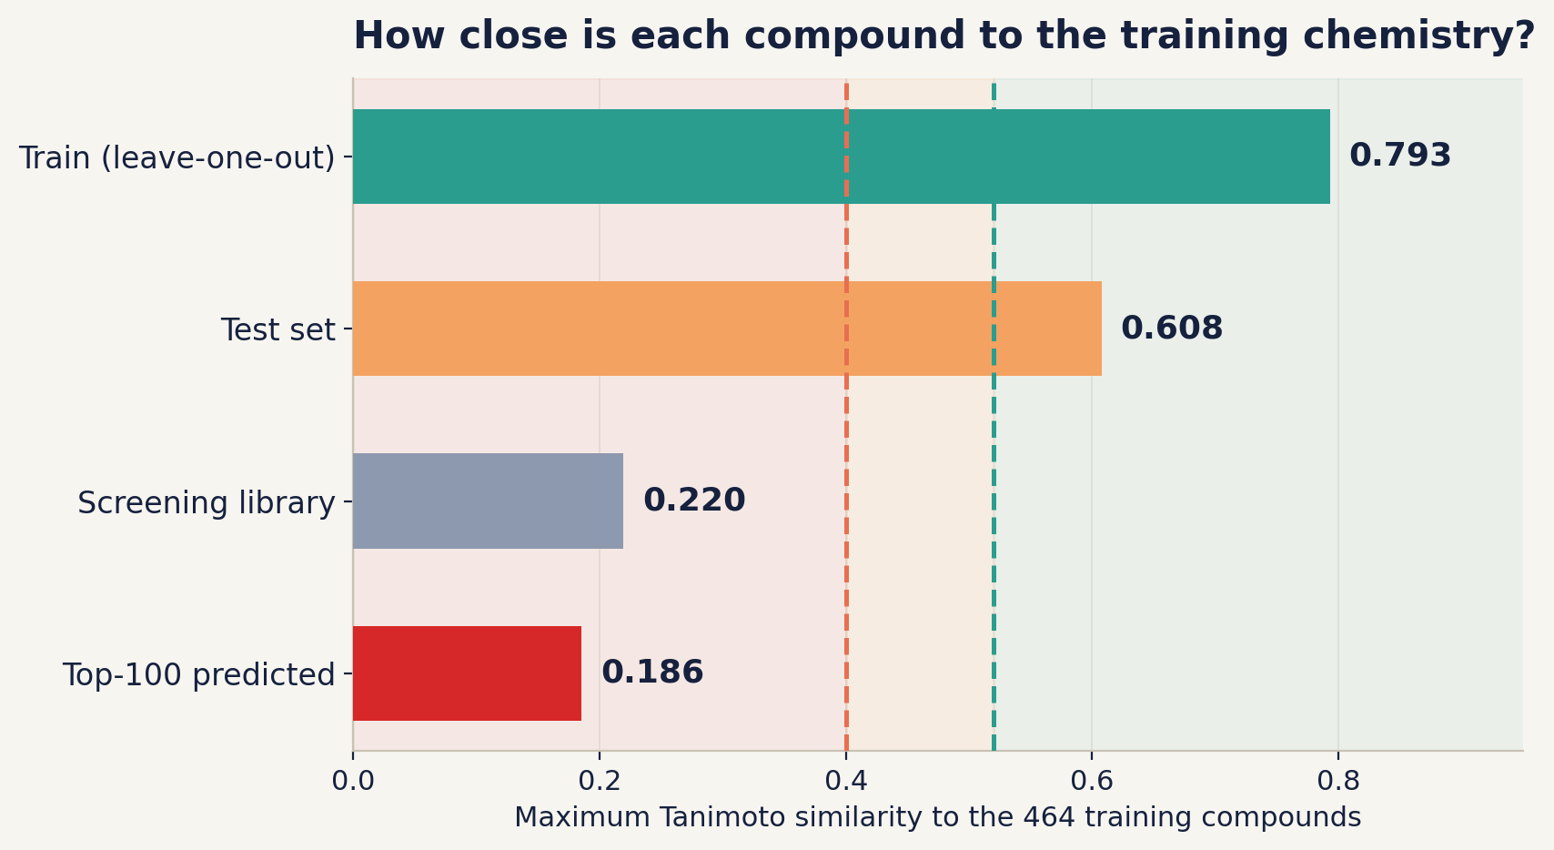
WHAT 'OUT OF RANGE' MEANS
Similarity collapses outside the training set
Max Tanimoto similarity to the 464 training compounds. Higher = more evidence; lower = more extrapolation.
• Train LOO mean: 0.793
• Test mean: 0.608
• Library mean: 0.220
• Top-100 mean: 0.186
• Library median: 0.217
• Top-100 max: 0.239
• Dashed lines: 0.40 AD / 0.52 strict
Only 0.57% of the library is inside the 0.40 cut.
Only 0.062% is inside the strict 0.52 cut.
Red zone = extrapolation (<0.40) · amber = caution (0.40–0.52) · green = in domain (≥0.52).
MDM2 pipeline review · 645 training compounds / 154,587 screening compounds · data: 2026-10-26
3/10
Notes:
The test set is not the library. Test mean similarity is 0.608 and 97.7% of test compounds pass 0.40. The library mean is 0.219, and only 886 of 154,587 pass 0.40. The top-100 predicted compounds are at 0.186 mean — even farther out than the library median.

Slide 4
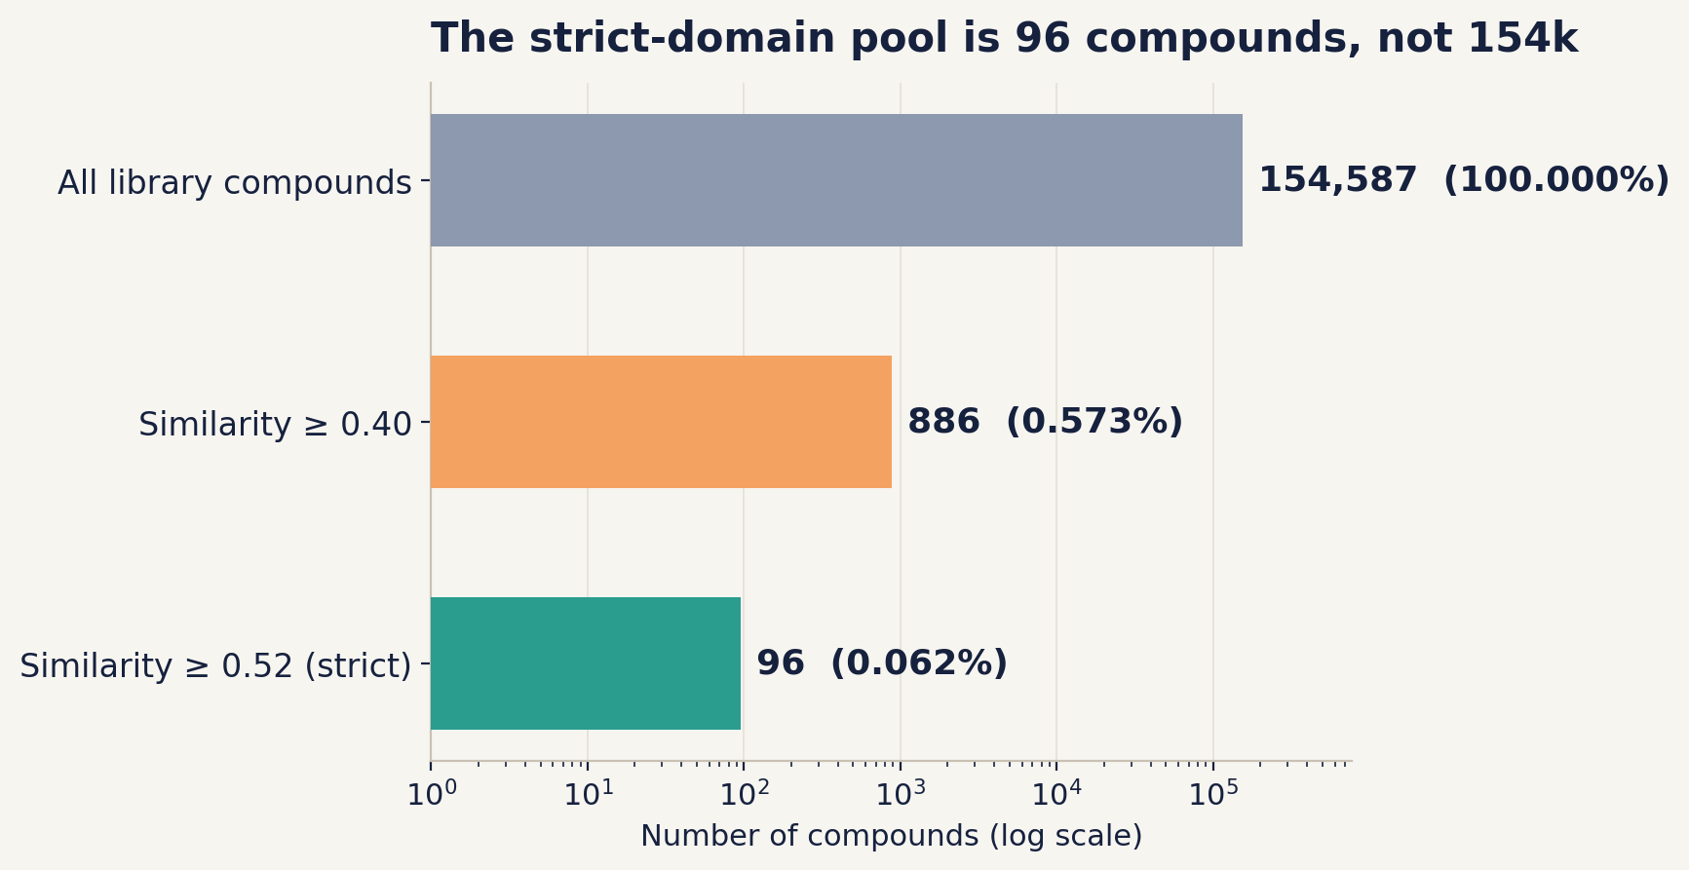
THE REAL SEARCH SPACE
The strict-domain pool is only 96 compounds
The library is not a 154k-choice buffet. Strict applicability-domain filtering leaves almost nothing to rank.
• 154,587 total library compounds
• 886 pass similarity 0.40 (0.57%)
• 96 pass strict 0.52 (0.062%)
• 0 of the top 100 pass 0.40
• 0 of the top 100 pass 0.52
If active support and model agreement are also required, the pool may be empty. An empty shortlist is a valid scientific result.
MDM2 pipeline review · 645 training compounds / 154,587 screening compounds · data: 2026-10-26
4/10
Notes:
This is the most important practical consequence. Strict AD does not produce a 12-compound shortlist from 154k candidates; it produces a pool of 96. If that pool has no active-supported, model-agreeing compounds, the honest answer is 'no reliable hits in this library'.

Slide 5
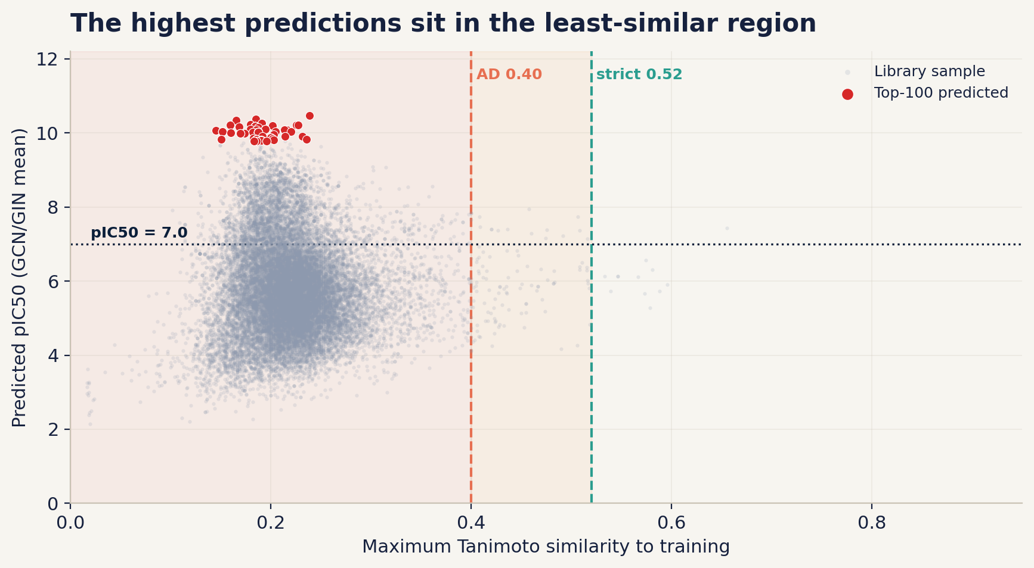
THE SMOKING GUN
Top predictions are the least similar compounds
Predicted pIC50 versus maximum similarity to training. The red points are the top 100 by prediction.
Top-100 signal
Mean similarity 0.186
Library median 0.217
All 100 outside AD 0.40
What this means
Its most extreme predictions occur exactly where evidence is weakest. This is extrapolation, not discovery.
Selection bias
Choosing the maximum of 154k noisy predictions enriches for over-predictions. This is the winner's curse.
MDM2 pipeline review · 645 training compounds / 154,587 screening compounds · data: 2026-10-26
5/10
Notes:
Top-100 mean maxT is 0.186, median 0.186, max 0.239. Library median is 0.217. So the top predictions are not just outside the domain; they are slightly farther out than a random library compound. The model is not finding hidden analogs; it is selecting the extrapolation tail.

Slide 6
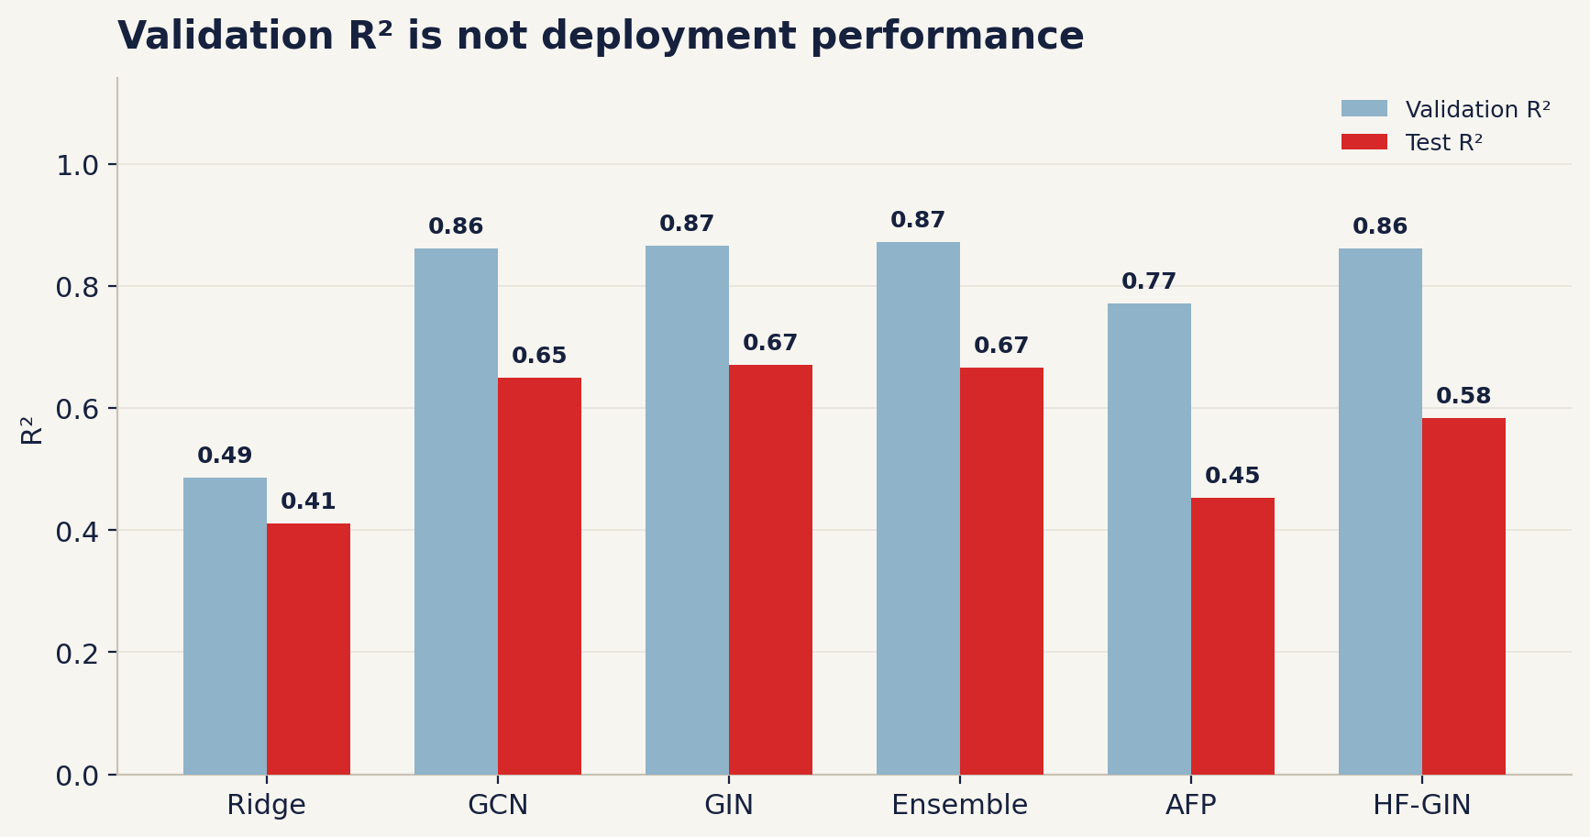
WHY THE NUMBERS LOOKED GOOD
Validation looked good because it was analog-rich
The test is scaffold-disjoint — good — but 97.7% of test compounds still pass the 0.40 similarity cut.
• 42 of 52 validation compounds share a scaffold with training.
• 30 scaffolds are shared between train and validation.
• Train–test and validation–test scaffold overlap is zero.
• Val R² ≈ 0.87; test R² ≈ 0.65.
• The test is cleaner than validation, but it is not the library.
Model selection, early stopping, and calibration were all chosen on the analog-rich validation set.
MDM2 pipeline review · 645 training compounds / 154,587 screening compounds · data: 2026-10-26
6/10
Notes:
The test set is genuinely scaffold-disjoint, so it is not cheating. But scaffold-disjoint does not mean out-of-domain: 97.7% of test compounds still have a training neighbor at Tanimoto >= 0.40. The library does not. That is why test R² 0.65 does not transfer to a 0.22-similarity library.

Slide 7
THE CAUSAL CHAIN
One mismatch, amplified by one selection rule
645 analogs
Analog validation
Select + calibrate
154k library
Top-100
small, biased chemical neighborhood
42/52 val share a train scaffold
choose the best on analogs
99.4% outside AD 0.40
all outside AD; mean 0.186
Two red links: the validation does not represent the library, and the shortlist selects the extrapolation tail.
Code-level amplifiers (not the root cause)
Active evidence
NNLS label
Tier mismatch
Stale cache
all 645 actives used, including test; 52 test actives self-match
‘NNLS ensemble’ row is actually the simple mean
tier uses 0.40 while the shortlist uses 0.52
154,587 rows vs 154,647 canonical; final shortlist missing
MDM2 pipeline review · 645 training compounds / 154,587 screening compounds · data: 2026-10-26
7/10
Notes:
The root cause is the top chain, not the bottom row. The code bugs are real and should be fixed, but even a perfect NNLS label and perfect active evidence would not make a 0.186-similarity compound reliably predictable. The root is the mismatch between the validation/deployment chemistry and the selection rule.

Slide 8
THE PROPER WAY
Train for the chemistry you will actually screen
A protocol that matches the deployment question, not a random benchmark.
1
Define the domain
2
Split by scaffold
3
Nested CV
4
Freeze test
Is the goal analog optimization or diverse-library discovery? They need different data and metrics.
GroupShuffleSplit / GroupKFold by Murcko scaffold. Never let analogs leak into validation.
Select and calibrate inside the training folds. Keep the test set frozen.
Compute test predictions once, at the end. No repeated peeking.
5
Train-only evidence
6
Report uncertainty
7
Prospective assay
Active support and AD reference must use training data for held-out evaluation.
AD coverage, calibration slope, prediction intervals, enrichment with bootstrap CIs.
A computational shortlist is a hypothesis. Only a wet-lab assay makes it a hit.
If the goal is a diverse library: use a classifier for enrichment + AD, then assay. Do not rank pIC50 outside the domain.
A lower, honest score is better than a high score that does not transfer.
MDM2 pipeline review · 645 training compounds / 154,587 screening compounds · data: 2026-10-26
8/10
Notes:
The key change is not a new model. It is a new evaluation contract: split by scaffold, nest all selection, freeze the test, use train-only evidence, and report AD coverage. If the deployment domain is a diverse library, a pIC50 regressor is the wrong primary tool; a classifier plus AD plus assay is more honest.

Slide 9
WHAT I WOULD FIX FIRST
P0 is not a new model. P0 is an honest evaluation.
P0 — before any more claims
P1 — robustness
• Scaffold-grouped validation
• Train-only active evidence
• Freeze test predictions
• Fix/relabel NNLS result
• Align tier with 0.52
• Rebuild cache with content hashes
• Rerun the final pipeline
• Deterministic seeds / generators
• Parent + salt + stereoisomer collapse
• Explicit model availability
• Nested CV for every compared model
• Bootstrap CIs for enrichment
• Per-compound uncertainty
P2 — engineering
Expected result
• Split the 2,423-line script into modules
• Add smoke tests and a pinned environment
• One config source + schema version
• Pin data by SHA256, not ‘main’
• Remove silent exception swallowing
Lower validation/test numbers.
A smaller — possibly empty — shortlist.
That is success, not failure: it tells you what the data can support.
Do not start by tuning the model. Start by making the evaluation match the screening question.
MDM2 pipeline review · 645 training compounds / 154,587 screening compounds · data: 2026-10-26
9/10
Notes:
P0 is about truth, not performance. If the scaffold-grouped validation drops R² to 0.3, that is the honest number for new chemotypes. If the strict shortlist is empty, that is a finding: the library does not contain reliable analogs. P1/P2 make the result reproducible and maintainable.

Slide 10
BOTTOM LINE
A model is not a microscope.
It cannot see chemistry it was never trained on.
Your pipeline is a potentially useful analog-ranking tool, once validation is fixed. It is not yet a discovery engine for a diverse library.
The correct answer may be: “No reliable hits in this library.”
Fix the validation contract first. Then the model has a chance to be believed.
MDM2 pipeline review · 645 training compounds / 154,587 screening compounds · data: 2026-10-26
10/10
Notes:
Close with the distinction between a ranking tool and a discovery engine. The current shortlist is a hypothesis generator, not evidence. The most valuable next step is an honest, scaffold-grouped evaluation and a prospective assay, not a more complex model.

