Slide 1
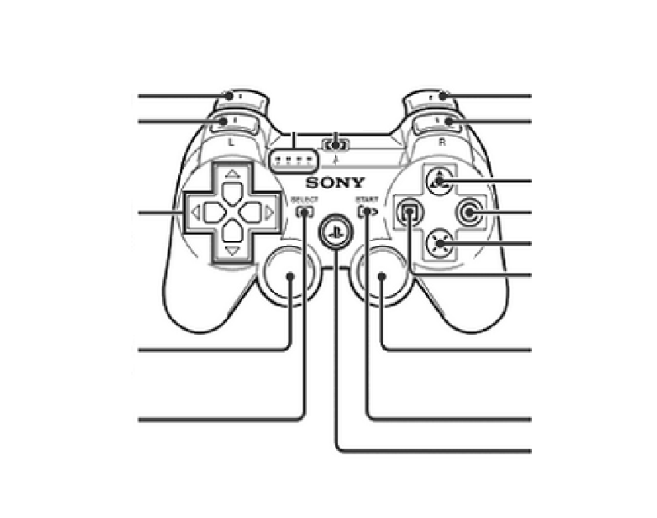
Track
Fire
(Super) Shift
Arm
Retract winch
Up: Extend lift
Down: Retract lift
Extend winch
Move
Shooter Angle

