Slide 1

“ NutriScan: Explainable ML-Based Food-Label Analysis”
Guided By :
Dr. Vandan Tewari
Ms. Teena Dubey
Submitted By :
0801CS253D03 –Divy Arora 0801CS253D10 – Sudhanshu Suryawanshi 0801CS253D07 – Pawan Mewada 0801CS253D09 – Samiya Akhtar
0801CS241127 – Santosh
Computer Engineering Department
SHRI G.S.INSTITUTE OF TECHNOLOGY & SCIENCE, INDORE
2026 – 2027

Slide 2


Barcode Scanning
Personalized Health
Health Analytics
NUTRISCAN.AI
PERSONALIZED PRODUCT HEALTH SCORING USING MACHINE LEARNING
Presented By:
Guide/Supervisor:
Dr. Vandan Tewari
Ms. Teena Dubey
Divy Arora (0801CS253D03)
Sudhanshu Suryawanshi (0801CS253D10)
Pawan Mewada (0801CS253D07)
Samiya Akhtar (0801CS253D09)
Santosh (0801CS241127)

Slide 3
01
BACKGROUND & MOTIVATION
Bardcode
  Consumers often find it difficult to understand nutrition labels and ingredient lists.
  Products with similar appearances can have significantly different nutritional values.
  Existing health scores are generally generic and may not consider individual user requirements.
  Users need a simple way to determine: "Is this product suitable for me?"
Heath
Analysis
PRODUCT → BARCODE → NUTRITION/INGREDIENTS → AI ANALYSIS → SIMPLE HEALTH SCORE

Slide 4
02
Health Score
Barcode
Personalized
PROPOSED IDEA & SIGNIFICANCE
01
Product: Chocolate Cereal
A MOBILE APPLICATION THAT ALLOWS A USER TO
02
Score: 62/100
  Scan a product barcode or ingredient list.
  Retrieve product information
  Provide basic user preferences/profile
  Analyze nutritional and ingredient information
  Use an ML model to generate a Health Score
  Ask questions about the product using an AI assistant
  Receive understandable recommendations
03
Analysis: High sugar, moderate calories, good fiber
Recommendation: Suitable occasionally; not ideal as a daily breakfast.

Slide 5
Needs and Impact
Needs
Nutrition labels are difficult for many users to interpret.
Comparing nutritional values across products is time-consuming.
Important nutritional factors such as sugar, sodium and saturated fat can be overlooked.
OCR-extracted label information needs cleaning and standardisation before analysis.
Users need a simple way to understand the nutritional quality of a packaged product.
Impact:
Makes nutrition information easier for normal users to understand.
Reduces the effort required to manually compare packaged products.
Provides a consistent ML-based nutritional-health assessment.
Highlights the major nutritional factors influencing the result.
Improves transparency by explaining the model's output in simple language.
Workflow
NutriScan
03
Health Score

Slide 6

Health Score
NutriScan
Personalized
PROBLEM STATEMENT
CONSUMERS LACK A SIMPLE AND PERSONALIZED MECHANISM TO EVALUATE THE HEALTH SUITABILITY OF PACKAGED PRODUCTS FROM THEIR NUTRITIONAL AND INGREDIENT INFORMATION.
Existing Problems
  Nutrition labels are difficult for many users to interpret.
  Generic health ratings don't consider individual preferences.
  Important ingredients may be overlooked.
  Comparing multiple products manually is time-consuming.
  Users often don't know why a product is considered healthy or unhealthy.
04
OUR SOLUTION
Barcode + ML + Personalization

Slide 7
05
Develop barcode scanning and product information retrieval.
Preprocess nutritional and ingredient data for analysis.
01
02
Develop an ML-based personalized health scoring system.
Provide AI-powered explanations, Q&A, and healthier recommendations.
03
04
Project.
OBJECTIVE
Studio Shodwe
WHY WE NEED NUTRISCAN ?

Slide 8
LITERATURE REVIEW
WHAT ALREADY EXISTS AND WHAT ARE WE ADDING?
Existing Application | What It Offers | Limitation / Our Opportunity
Yuka | Barcode scanning, product health score, ingredient analysis | Mainly provides a generalized score; limited user-specific personalization
Open Food Facts | Barcode-based product database, nutrition & ingredients | Primarily an information/database platform, not an ML-based personalized assessment
Fooducate | Product scanning, nutrition grades, dietary information | Focuses mainly on predefined grading and nutritional guidance
NUTRI SCAN
HEALTH SCORE
06

Slide 9
07
Barcode-Based Product Identification — Scan a product barcode to quickly identify and retrieve relevant product information.
Personalized Health Assessment — Consider user-specific preferences and requirements while evaluating the product.
A
D
Nutritional & Ingredient Analysis — Analyze nutritional values and ingredients to determine factors affecting the product's health score.
A VISUAL ODYSSEY
Age-Based Recommendations — Provide product suitability and recommendations based on the user's age group and nutritional requirements.
B
E
MAPPING OUR THOUGHTS
C
ML-Based Health Scoring — Use a machine learning model to generate a health score based on product characteristics.
F
Healthier Recommendations — Suggest suitable healthier alternatives based on product analysis and user preferences.
Health Score
NutriScan
Personalized

Slide 10
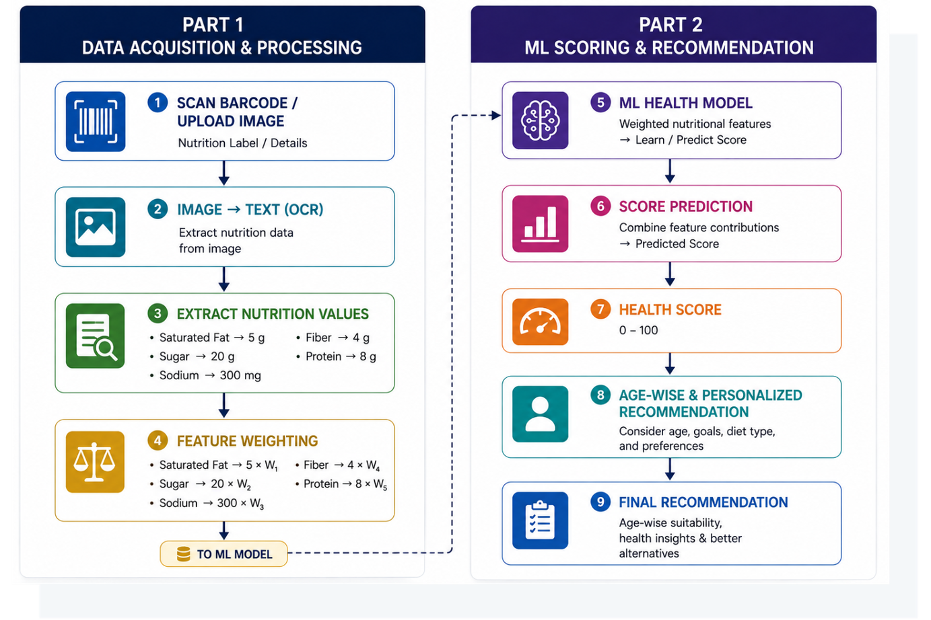
WORKFLOW
System Methodology/ Architecture
Workflow
NutriScan
08
Health Score

Slide 11
09
Health Score
ML
Score Prediction
ML METHEDOLOGY
ML METHEDOLOGY
HEALTH-FACTOR MAPPING
QUANTITY CONTRIBUTION
Map each extracted nutritional/ingredient value to its corresponding health score from the ML dataset.
Multiply the mapped health factor by the quantity present in the product to calculate its individual contribution.
FEATURE AGGREGATION
SCORE PREDICTION
Combine the contributions of all nutritional and ingredient factors to form the input features for the ML model.
The ML model analyzes the combined features and predicts the final Health Score (0–100).

Slide 12
PROJECT WORK PLAN
Schedule
Workflow
PHASE – 1
Research & Data Preparation
Literature review
Dataset collection
Data cleaning
Define nutritional features
Finalise ML problem
PHASE – 2
Model & Input Development
Barcode module
OCR implementation
Data preprocessing
Feature engineering
Random Forest training
NutriScan
PHASE – 3
Evaluation & Integration
Model Evaluation
Accuracy, Precision, Recall & F1-score
Confusion matrix
Health-score generation
PHASE – 4
Testing and finalisation
End-to-end testing
Error correction
Performance refinement
Documentation
10
Health Score

Slide 13
Recommendation
NutriScan
Outcomes
11
1. Working Barcode Scanner
2. Product Information System
3. ML Health Scoring Model
4. Personalized Evaluation
5. AI Product Assistant
6. Recommendation System
DELIVERABLES
EXPECTED OUTCOMES

Slide 14
THANK YOU
WRAPPING UP AND PARTING THOUGHTS

