Slide 1



Slide 2
FAKE NEWS DECTECTED BY APP
BY: SURBHIKAUSHAL SHIVANGI RAJ NEHAL KASHYAP DC ANJANA TAMIZARASI S

Slide 3
ABOUT US
Our app helps to detect if the news is fake or original by checking its credibility with reliable sources. This app creates a safe space for its users and has the potential to be nearly foolproof. Be it whatever field you follow- Bollywood, sports or the news ; we aspire to bring you nothing but the best.

Slide 4
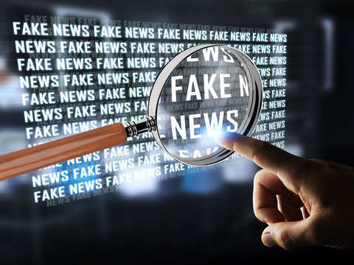
PREVENTATIVE MEASURES
Verify Information: Check the credibility of sources before sharing or believing information. Look for corroboration from multiple reputable sources.
Check the Source: Verify if the news comes from a trustworthy and established news organization.
Look for Evidence: Seek out evidence and fact-checking reports that support or refute the information . Be Skeptical of Sensationalism: Be cautious of news that evokes a strong emotional reaction or seems too good (or bad) to be true.
Educate Yourself: Understand common signs of fake news and misinformation, such as poorly written articles, exaggerated headlines, or lack of sources.

Slide 5
DEMERITS OF FAKE NEWS
Questions like: “Was there voter fraud during the 2020 U.S. elections?” or “Is climate change a hoax?” can be fact-checked by analyzing available data. These questions can be answered with true or false, but there is potential for misinformation surrounding questions like these.
Misinformation and disinformation — or fake news — can have damaging effects on a large number of people in a short time. Although the notion of fake news has existed well before technological advances, social media have exacerbated the problem.

Slide 6
SOLUTIONS
AWARENESS AND MEDIA LITERACY WILL BE RAISED AT CONSUMER LEVEL WITH AN EFFECT ON DATA PROTECTION
EFFECTIVE FAKENEWS DETECTION WILL REDUCE DEFAMATION OF INDIVIDUALS
MORE TRANSPARENCY AND LESSER SPREADING OF HATRED BY DIFFERENT RIOTS IGNITING GROUP

Slide 7
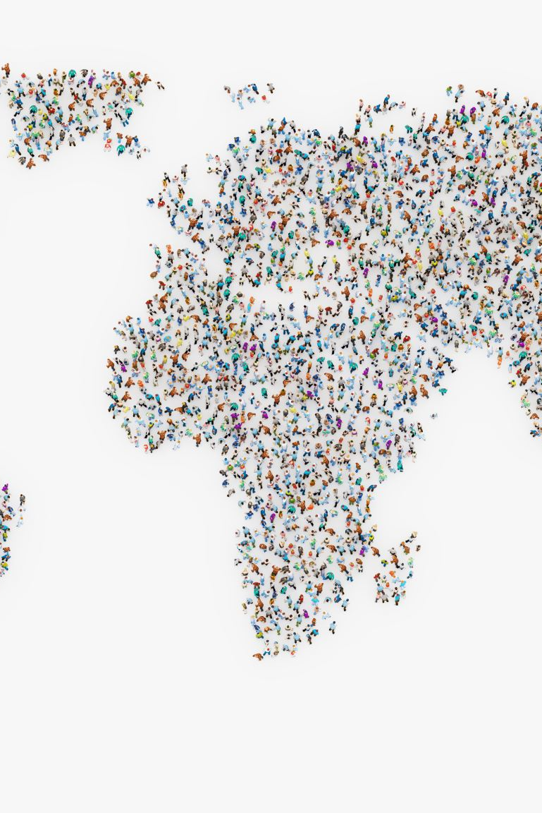
CONSEQUENCES OF FAKE NEWS
Real world violence - There have been numerous instances where fake news has directly incited violence. For example, false rumours about certain community or individuals have led to mob violence and other forms of aggression. Fake news can play a role in radicalizing individuals by feeding them false or exaggerated information that supports extremist idealogies.
Impact on businesses and employment - Small businesses can suffer immensely from fake news, such a false reviews or fabricated scandals which can drive away customers and tarnish their reputation. In extreme cases fake news can lead to job losses.

Slide 8


VIRAL FAKE NEWS
Are microwaves hazardous for health? A WhatsApp forward claiming that the Japanese government was doing away with microwaves due to its hazardous effect went viral on the chat platform. The lengthy forward titled ‘End of the Microwave industry’ further claims that the decision was backed by a study from Hiroshima University, which said that microwaves cause greater harm than atomic bombs. The same has also been widely shared on other social media platforms like Facebook and Twitter. A fact check by Newschecker has found this claim to be, no surprises- false.
People love freebies and cashing-in on this, a viral post claiming the TATA Group is celebrating its 150th anniversary, with a link to “participate in the event to win a car” was widely shared on WhatsApp messenger. Newschecker received the same claim on our WhatsApp tip line and also found similar posts widely shared on Facebook and Twitter. But a fact check revealed that the claim was fabricated and that no such ‘celebration’ was put out by the organisation.

Slide 9
THANK YOU

