Slide 1

Scripting Language
A script or scripting language is a computer language that does not need the compilation step
interpreted one by one at runtime.
script is written and where instructions for a run-time environment are written
In contrast to programming languages that are compiled first before running,
scripting languages do not compile the file and execute the file without being compiled.

Slide 2
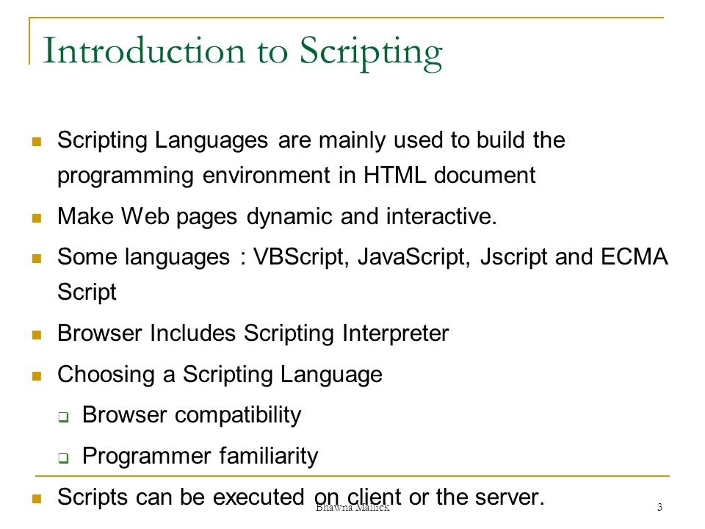

Slide 3
Characteristics of Scripting Language[ key concepts ]
It is open-source, which means a user can have full control to view and edit it.
It is easy to learn and work with.
Comparatively faster to develop than an actual program.
It has a limited number of data structures which makes it easy to write and edit.
The language is beneficial to bring interactivity in web pages.
It helps in creating new applications in web browsers.
It is used to create plug-ins and extensions.

Slide 4
Types of Scripting Languages
Server-Side Scripting Languages and Client-Side Scripting Languages
Python, PHP, and Perl are examples of server-side scripting languages,
JavaScript is the greatest example of a client-side scripting language.
ASP.NET, Node. Js. Java, Ruby
.

Slide 5

Advantages of Scripting Languages
01
02
03
04
Easy Learning
Interactivity
Functionality
Fast Editing
07
08
05
06
Port b/w O/s
No Compilation
Open Source
Much faster
09
10
11
Modular Approach
Dynamic Web Pages
Debugging is Easier

Slide 6
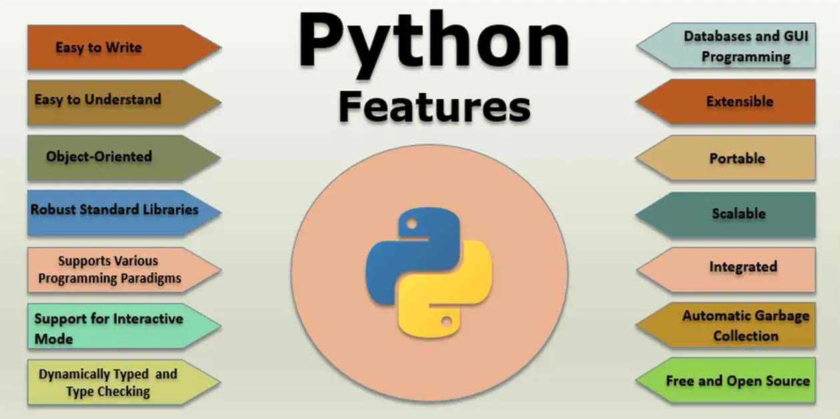

Slide 7
What are values & Types in Python?
A value is one of the basic things a program works with, like a letter or a number.
Computer programs operate on data. A single piece of data can be called a datum, but we will use the related term, value.
Values are grouped into different data types
The assignment operator, denoted by the “=” symbol, is the operator that is used to assign values to variables in Python.

Slide 8
Returning values using function in python
def name():
return "John","Armin"
# print the tuple with the returned values
print(name())
# get the individual items
name_1, name_2 = name()
print(name_1, name_2)

Slide 9
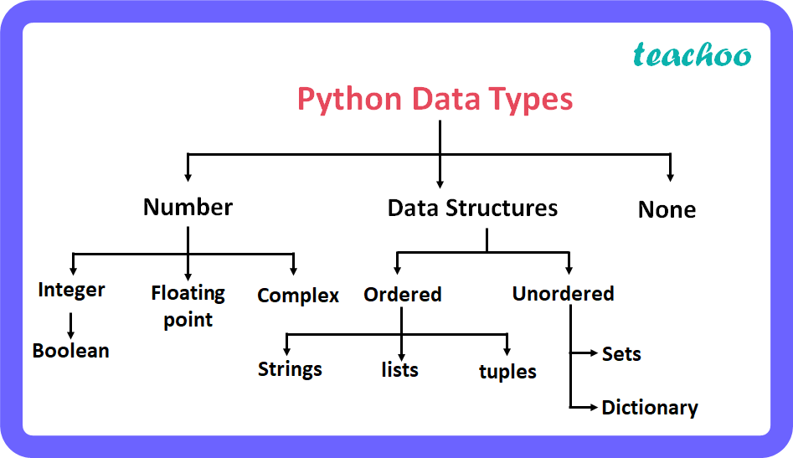
DT-PYTHON

Slide 10
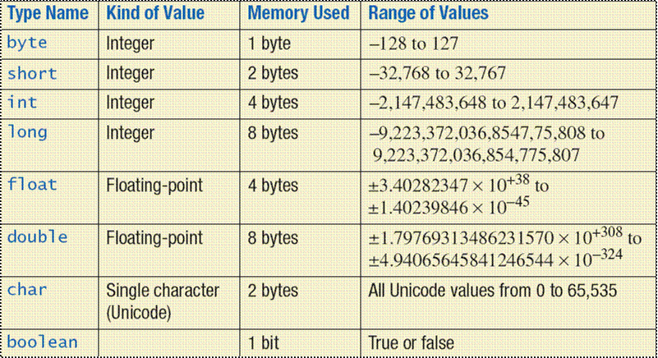

Slide 11
Returning values using Dictonary in python
def name():
n1 = "John"
n2 = "Armin"
return {1:n1, 2:n2}
names = name()
print(names)

Slide 12
Explain various storage and control statements available in Python.
Improper memory management leads to slowness on the application and the server-side components.
In Python, memory is managed by the Python manager which determines where to put the application data in the memory.
Python Memory Allocation
Memory allocation is an essential part of the memory management for a developer.
This process basically allots free space in the computer's virtual memory, and there are two types of virtual memory works while executing programs.
Static Memory Allocation
Dynamic Memory Allocation

Slide 13
Static Memory Allocation
Static memory allocation happens at the compile time. For example - In C/C++, we declare a static array with the fixed sizes. Memory is allocated at the time of compilation. However, we cannot use the memory again in the further program.
static int a=10;

Slide 14
Stack Allocation
The Stack data structure is used to store the static memory. It is only needed inside the particular function or method call. The function is added in program's call stack whenever we call it. Variable assignment inside the function is temporarily stored in the function call stack; the function returns the value, and the call stack moves to the text task. The compiler handles all these processes,

Slide 15
Dynamic Memory Allocation
Unlike static memory allocation, Dynamic memory allocates the memory at the runtime to the program.
Memory is allocated to the objects at the run time. We use the Heap for implement dynamic memory management. We can use the memory throughout the program.

Slide 16
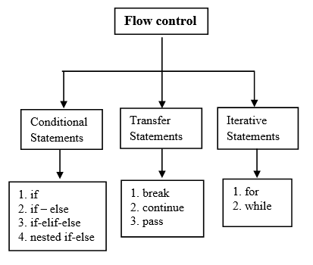

Slide 17
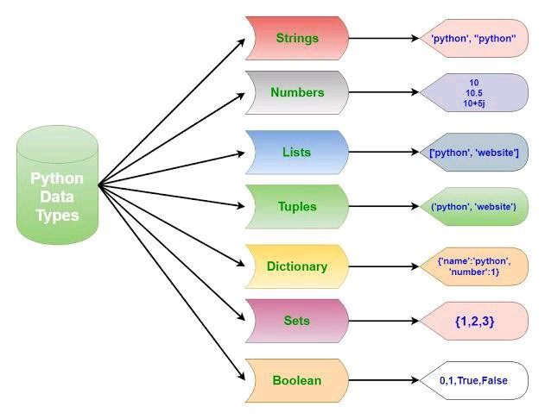

Slide 18
What is data abstraction
Abstraction in python is defined as a process of handling complexity by hiding unnecessary information from the user.
an abstraction is used to hide the irrelevant data/class in order to reduce the complexity. It also enhances the application efficiency.
Abstraction is used to hide the internal functionality of the function from the users. The users only interact with the basic implementation of the function, but inner working is hidden. User is familiar with that "what function does" but they don't know "how it does."
In Python, abstraction can be achieved by using abstract classes and interfaces.

Slide 19
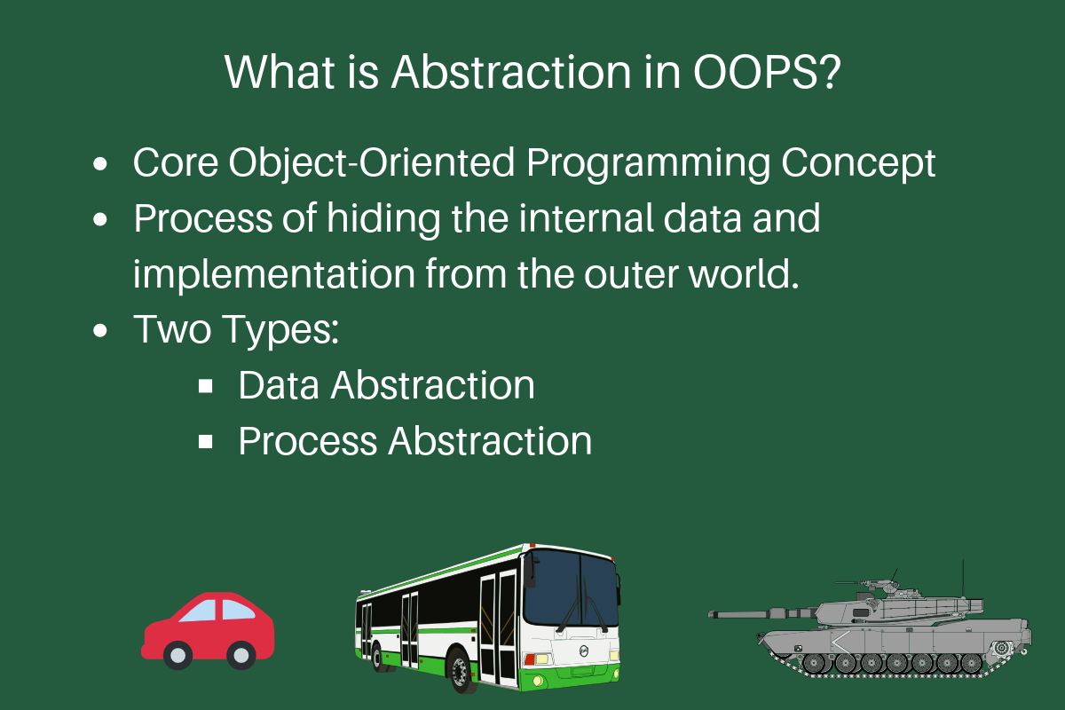

Slide 20
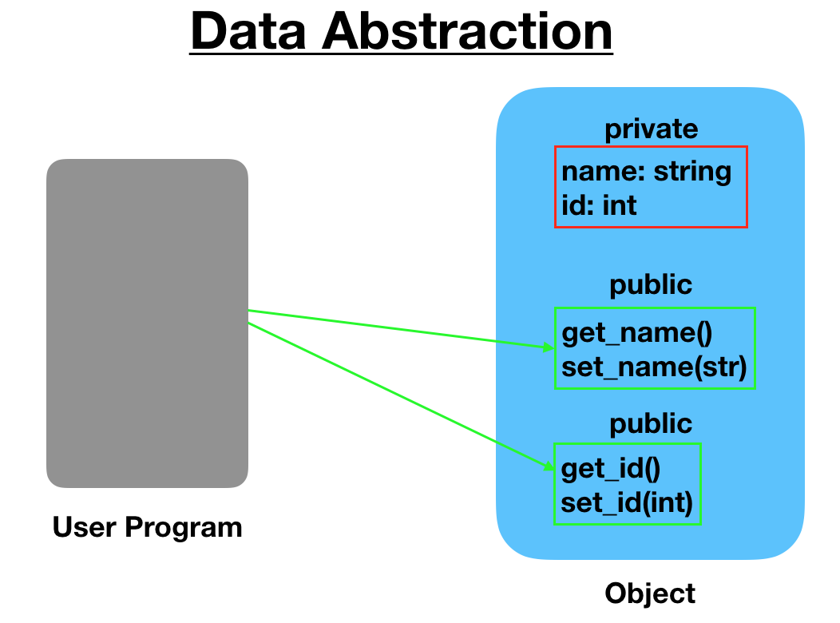

Slide 21
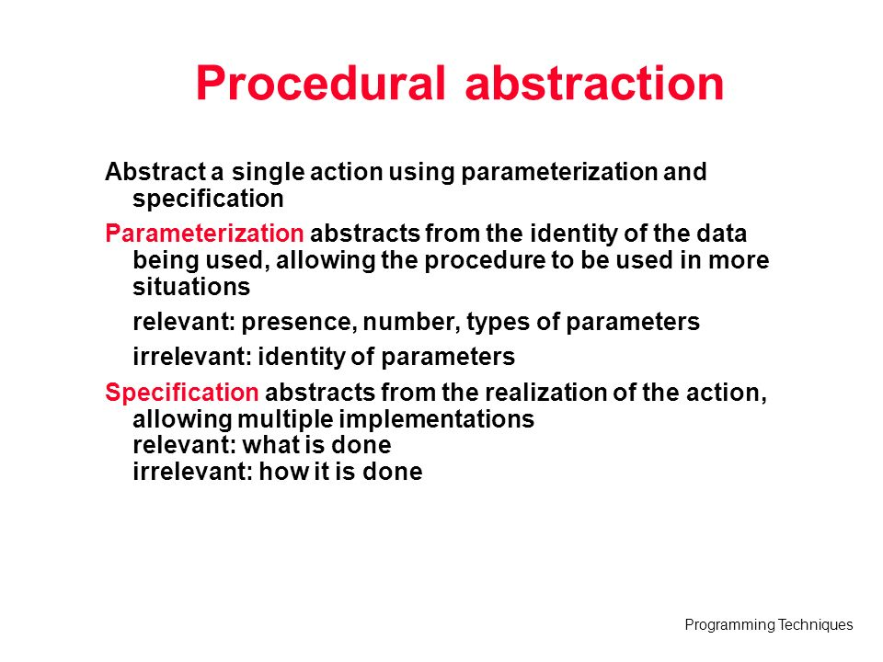

Slide 22
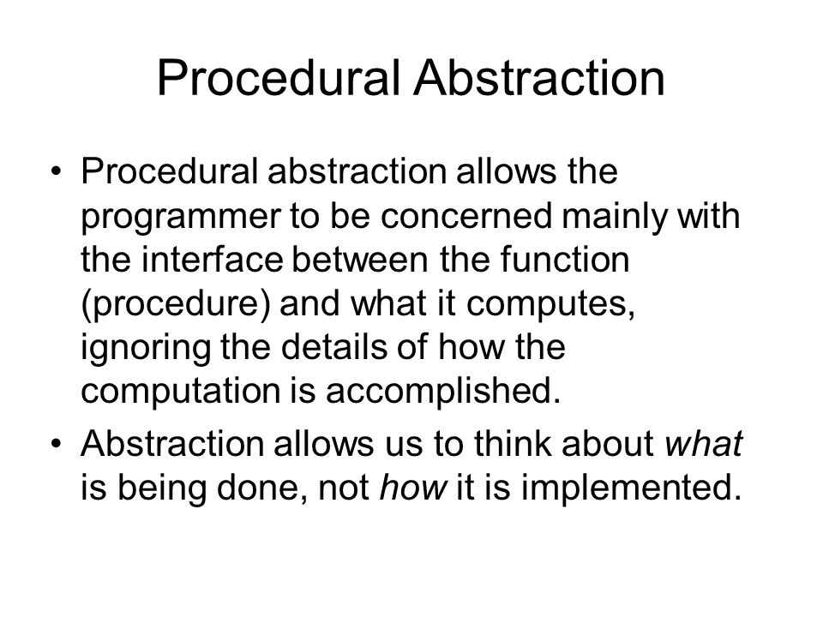

Slide 23
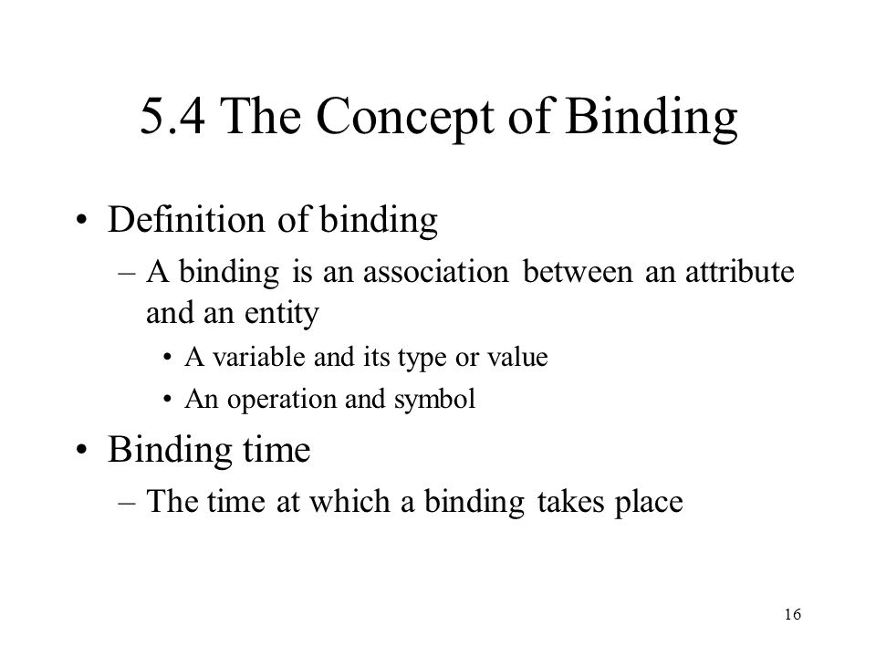

Slide 24
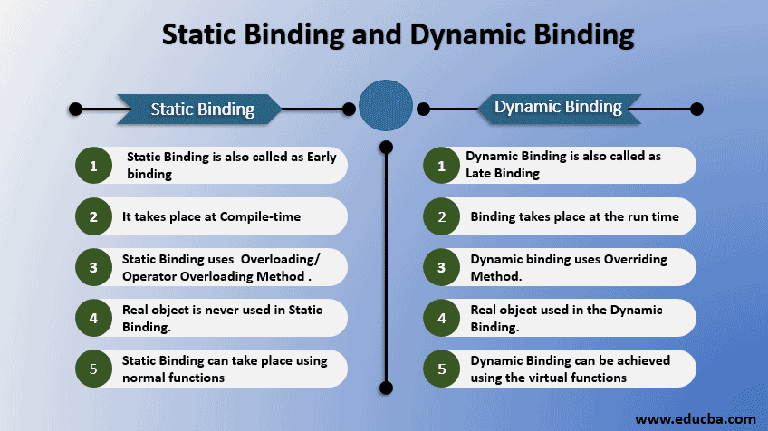

Slide 25
Scope in Python
A variable is only available from inside the region it is created. This is called scope.
variable created inside a function belongs to the local scope of that function, and can only be used inside that function.
def myfunc(): x = 300 print(x) myfunc()

Slide 26
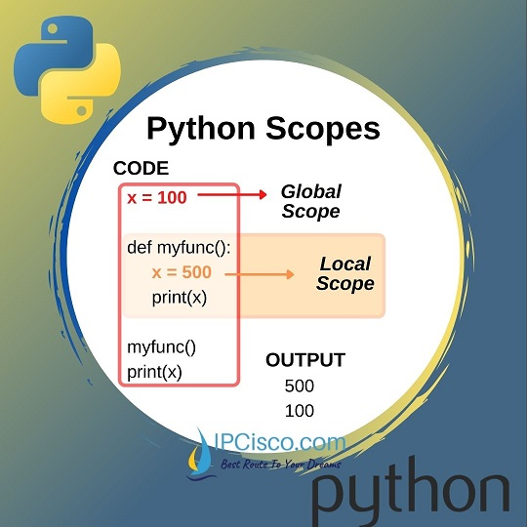

Slide 27
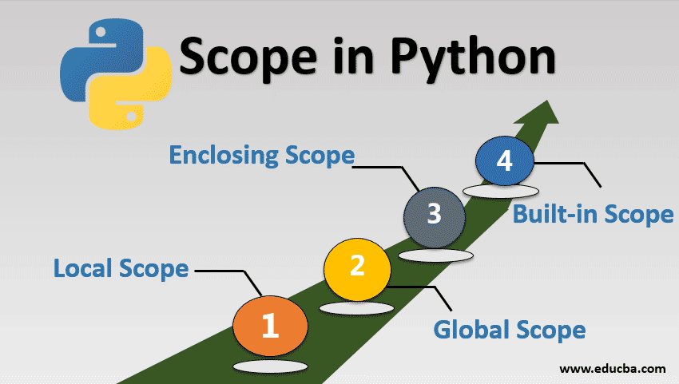

Slide 28
Function Inside Function
The local variable can be accessed from a function within the function:
def myfunc(): x = 300 def myinnerfunc(): print(x) myinnerfunc() myfunc()

Slide 29
Global Scope
A variable created outside of a function is global and can be used by anyone:
x = 300 def myfunc(): print(x) myfunc() print(x)

Slide 30
Enclosing Scope in Python
>>> def red():
a=1
def blue():
b=2
print(a)
print(b)
blue()
print(a)
>>> red()

Slide 31
Built-in Scope
>>> a=1
>>> def counter():
a=2 print(a)
>>> counter()

Slide 32
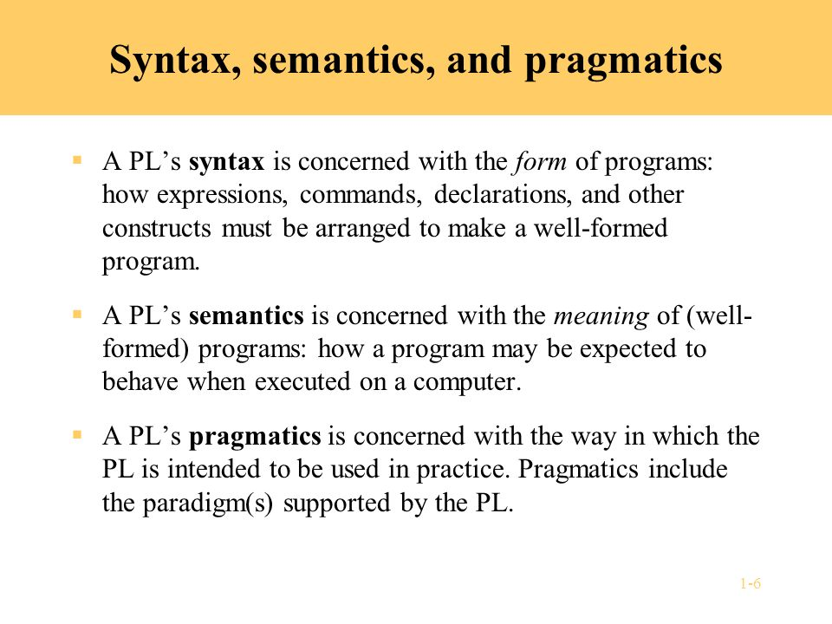

Slide 33
Pragmatics is the third general area of language description, referring to practical aspects of how constructs and features of a language may be used to achieve various objectives.
Consider, for example, the syntax, semantics and pragmatics of an assignment statement.

Slide 34
What does separate compilation mean?
Split the program into multiple separate source files, each of which can be compiled independently.
Store the various parts of the program in separate files and allow programs to be written in logical parts, each of which can be compiled independently.
Separate compilation allows programs to be compiled and tested one class at a time, even built into libraries for later use.

Slide 35
Why is separate compilation useful?
Separate compilation can bring several benefits to a module system such as allowing modules to be pre-compiled and then linked with different programs on the same system.
which can result in shorter compilation times for repeated compilations of a program.

Slide 36
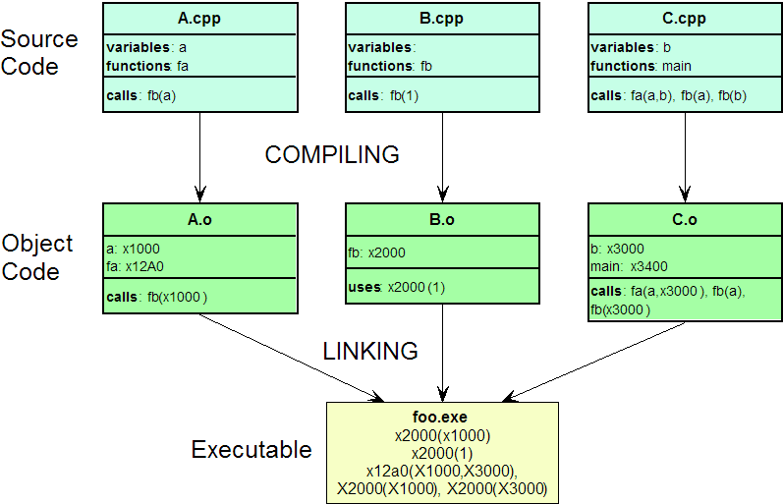

Slide 37
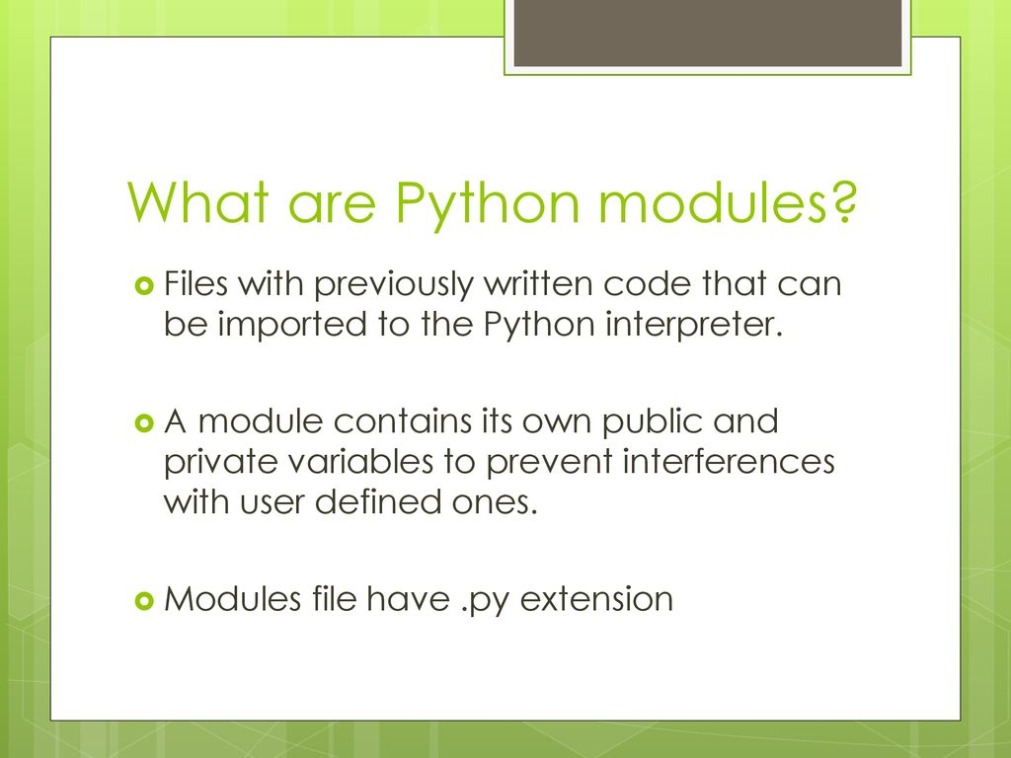

Slide 38
What is a module library?
A module is basically a single purpose library. A library contains many modules (a module is usually packaged as a single . jar file).
A module is a collection of code or functions that uses the . py extension.
A Python library is a set of related modules or packages bundled together.

Slide 39
What is a module library?
Modules are used primarily to group object definitions together that have a common business purpose or use.
For example a module might contain all the data types and routines related to inventory management.
A module allows you to logically organize your Python code. Grouping related code into a module makes the code easier to understand and use.
A module is a Python object with arbitrarily named attributes that you can bind and reference. Simply, a module is a file consisting of Python code.

Slide 40
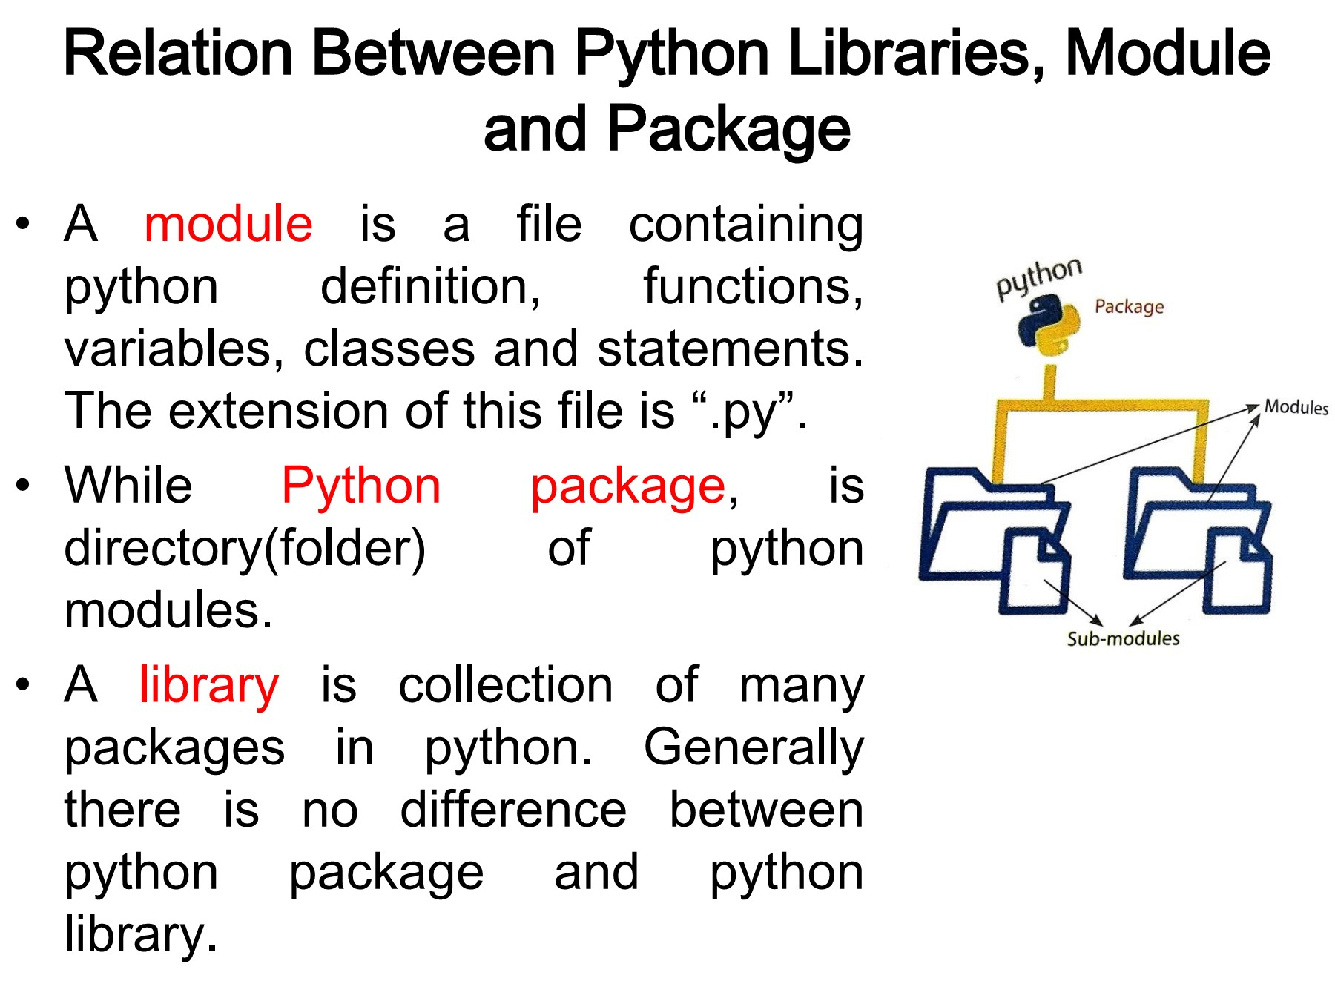

Slide 41
